Slide 1

Mobile and Wireless Network
IoT Project
Secured thermal monitoring room concept

Slide 2

Mobile and Wireless Network
ESP32 Project
AGENDA
Introduction and concept
Data flow and STRIDE threat detection
Security mitigation
Discussion and conclusion

Slide 3
Mobile and Wireless Network
ESP32 Project
Introduction and concept

Slide 4
Mobile and Wireless Network
ESP32 Project
Data flow and STRIDE threats detection

Slide 5
Mobile and Wireless Network
ESP32 Project
SPOOFING
TAMPERING
REPUDATION
INFO DISCLOSURE
DENIALS OF SERVICE
ELEVATION OF PRIVILEGE
Trust Boundary
Computer
STRIDE Thread Model
LVL 1 DIAGRAM FLOW
MQTT Broker
Publisher
ESP32
Suscriber
ESP32
SPOOFING
TAMPERING
REPUDATION
INFO DISCLOSURE
DENIALS OF SERVICE
ELEVATION OF PRIVILEGE
SPOOFING
TAMPERING
REPUDATION
INFO DISCLOSURE
DENIALS OF SERVICE
ELEVATION OF PRIVILEGE
SPOOFING
TAMPERING
REPUDATION
INFO DISCLOSURE
DENIALS OF SERVICE
ELEVATION OF PRIVILEGE

Slide 6
Mobile and Wireless Network
ESP32 Project
SPOOFING
TAMPERING
REPUDATION
INFO DISCLOSURE
DENIALS OF SERVICE
ELEVATION OF PRIVILEGE
Trust Boundary
Computer
STRIDE Thread Model
LVL 1 DIAGRAM FLOW
MQTT Broker
Publisher
ESP32
Suscriber
ESP32
SPOOFING
TAMPERING
REPUDATION
INFO DISCLOSURE
DENIALS OF SERVICE
ELEVATION OF PRIVILEGE
SPOOFING
TAMPERING
REPUDATION
INFO DISCLOSURE
DENIALS OF SERVICE
ELEVATION OF PRIVILEGE
SPOOFING
TAMPERING
REPUDATION
INFO DISCLOSURE
DENIALS OF SERVICE
ELEVATION OF PRIVILEGE

Slide 7

Mobile and Wireless Network
ESP32 Project
SPOOFING
TAMPERING
REPUDATION
INFO DISCLOSURE
DENIALS OF SERVICE
ELEVATION OF PRIVILEGE
STRIDE Thread Model
Repudiation
Trust Boundary
Computer
Denials of Service
Denials of Service
MQTT Broker
Tampering
Tampering
Publisher
ESP32
Subscriber
ESP32
Elevation of
Privilege
NETWORK
Elevation of
Privilege
NETWORK
Denials of Service
Denials of Service
Repudiation
Repudiation
Info Disclosure
Spoofing
Info Disclosure
Spoofing
Tampering
Tampering
Notes:
Denials of service : Publisher – storage capacity modification / Subscriber – Data flooding / Network – Data flooding
Elevation of Privilege : Access to the plain text data through Firmware access – Flash
Tampering : ESP32 – Flash memory modification / Network – MQTT package modification
Info disclosure : listening
Spoofing : Faking User identity
Repudation : Alter Log files – impossible to identify who sent data or if data has been sent

Slide 8
Mobile and Wireless Network
ESP32 Project
SPOOFING
TAMPERING
REPUDATION
INFO DISCLOSURE
DENIALS OF SERVICE
ELEVATION OF PRIVILEGE
Trust Boundary
Computer
Trust Boundary
Computer
MQTT Broker
Data Visualization Server
Publisher
ESP32
Subscriber
ESP32
SPOOFING
TAMPERING
REPUDATION
INFO DISCLOSURE
DENIALS OF SERVICE
ELEVATION OF PRIVILEGE
SPOOFING
TAMPERING
REPUDATION
INFO DISCLOSURE
DENIALS OF SERVICE
ELEVATION OF PRIVILEGE
SPOOFING
TAMPERING
REPUDATION
INFO DISCLOSURE
DENIALS OF SERVICE
ELEVATION OF PRIVILEGE

Slide 9
Mobile and Wireless Network
ESP32 Project
SPOOFING
TAMPERING
REPUDATION
INFO DISCLOSURE
DENIALS OF SERVICE
ELEVATION OF PRIVILEGE
Trust Boundary
Computer
Security Mitigation
MQTT Broker
Publisher
ESP32

Slide 10
Mobile and Wireless Network
ESP32 Project
SPOOFING
TAMPERING
REPUDATION
INFO DISCLOSURE
DENIALS OF SERVICE
ELEVATION OF PRIVILEGE
Trust Boundary
Computer
Rate Limit
Security Mitigation
MQTT Broker
KEY PLAIN,
LOG
Flash
KEY PLAIN
OS
Publisher
ESP32
Saved in log file
Flash
Key Plain
Mess = Enc [Payload, Key Plain]
Sign = Hashed [Mess, Key Plain]
Key Plain
Ram
Subscriber ESP32
Notes:
PBKDF2 – High iteration algorithm
Public Code, Shared Key saved in Encrypted flash
Morse code to enter by push button – Debounce code needed
Hashed message for Denial of Service check (ensure no flooding by wrong devices) + Repudation control - saved in log file
Encrypt Flash + Rate limit to avoid DOS
If Subscriber found too many failed hashed message verification -> Quiet mode – does not listen to the broker.
Port Knocking for sniffing !!

Slide 11
Mobile and Wireless Network
ESP32 Project
SPOOFING
TAMPERING
REPUDATION
INFO DISCLOSURE
DENIALS OF SERVICE
ELEVATION OF PRIVILEGE
Trust Boundary
Computer
STRIDE Thread Model
LVL 1 DIAGRAM FLOW
MQTT Broker
Publisher
ESP32
Suscriber
ESP32
SPOOFING
TAMPERING
REPUDATION
INFO DISCLOSURE
DENIALS OF SERVICE
ELEVATION OF PRIVILEGE
SPOOFING
TAMPERING
REPUDATION
INFO DISCLOSURE
DENIALS OF SERVICE
ELEVATION OF PRIVILEGE
SPOOFING
TAMPERING
REPUDATION
INFO DISCLOSURE
DENIALS OF SERVICE
ELEVATION OF PRIVILEGE

Slide 12
Mobile and Wireless Network
ESP32 Project
SPOOFING
TAMPERING
REPUDATION
INFO DISCLOSURE
DENIALS OF SERVICE
ELEVATION OF PRIVILEGE
Trust Boundary
Computer
Rate Limit
Security Mitigation
MQTT Broker
KEY PLAIN,
LOG
Flash
KEY PLAIN
OS
Publisher
ESP32
MORSE
Saved in log file
Flash
Key Plain
Mess = Enc [Payload, Key Plain]
Sign = Hashed [Mess, Key Plain]
Key Plain
Ram
Subscriber ESP32
Notes:
PBKDF2 – High iteration algorithm
Public Code, Shared Key saved in Encrypted flash
Morse code to enter by push button – Debounce code needed
Hashed message for Denial of Service check (ensure no flooding by wrong devices) + Repudation control - saved in log file
Encrypt Flash + Rate limit to avoid DOS
If Subscriber found too many failed hashed message verification -> Quiet mode – does not listen to the broker.
Port Knocking for sniffing !!

Slide 13
Mobile and Wireless Network
ESP32 Project
SPOOFING
TAMPERING
REPUDATION
INFO DISCLOSURE
DENIALS OF SERVICE
ELEVATION OF PRIVILEGE
Trust Boundary
Computer
Security Mitigation - Features
Rate Limit
Flash
KEY ENC,
PUBLIC CODE
MQTT Broker
KEY ENC,
LOG
OS
Publisher
ESP32
MORSE
Saved in log file
PBKDF2 [Morse, Pub. Code]
Key User
AES[Key Plain, Key user]
Mess = Enc [Payload, Key Plain]
Sign = Hashed [Mess, Key Plain]
Flash
Dec [Key user, Key enc]
Ram
Subscriber ESP32
Quiet Mode implementation
Notes:
PBKDF2 – High iteration algorithm
Public Code, Shared Key saved in Encrypted flash
Morse code to enter by push button – Debounce code needed
Hashed message for Denial of Service check (ensure no flooding by wrong devices) + Repudation control - saved in log file
Encrypt Flash + Rate limit to avoid DOS
If Subscriber found too many failed hashed message verification -> Quiet mode – does not listen to the broker.
Port Knocking for sniffing !!

Slide 14
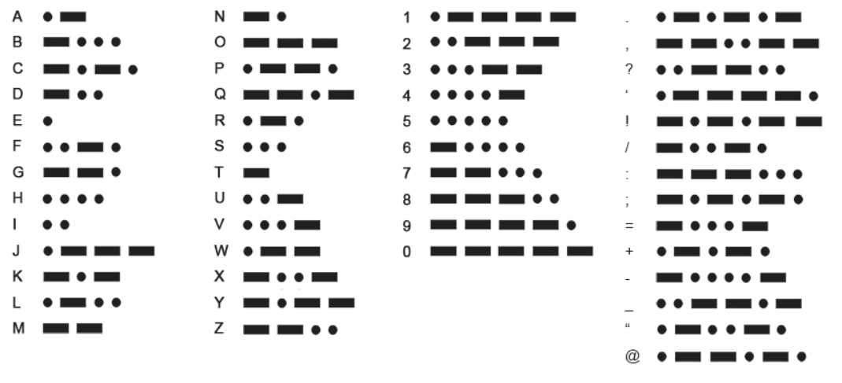
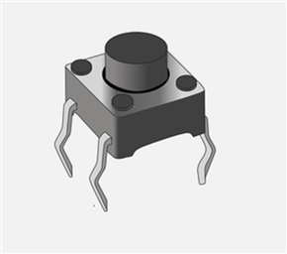
MORSE TABLE
PBKDF2 [Morse, “Salt”]
Key User
AES[Key Plain, Key user]
Flash

Slide 15
Mobile and Wireless Network
ESP32 Project
SPOOFING
TAMPERING
REPUDATION
INFO DISCLOSURE
DENIALS OF SERVICE
ELEVATION OF PRIVILEGE
Additional Features
Dashboard with decrypted message
Attack detection and display on dashboard

Slide 16
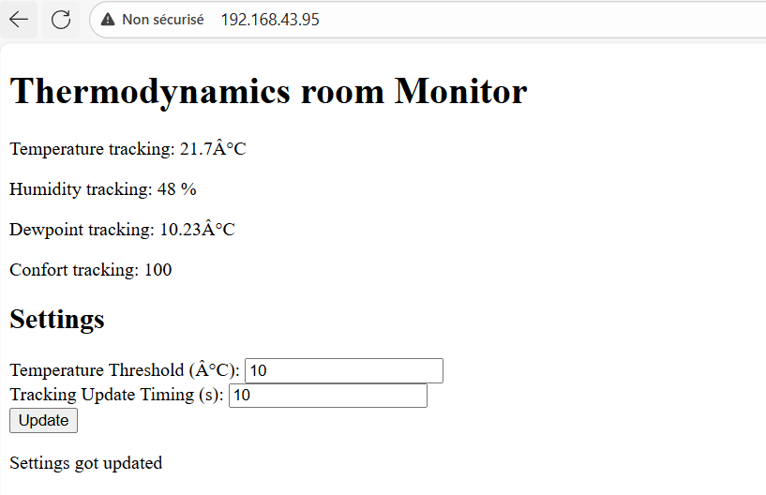
Mobile and Wireless Network
ESP32 Project
WebServer

