Slide 1


SEE Benchmark A Benchmark for VLM-Generated Screen Descriptions for Visually Impaired Users
Cédrick Makhlouf
July 2025

Slide 2
Context
Visually impaired individuals rely on desktop devices for critical tasks:
Taxes
Government services
Office work
Etc.
Rely on screen readers

Slide 3
Context – Screen Readers
Detect underlying structure
Users navigate using keyboard (virtual cursor)
Element-by-element
Metadata relayed vocally
Metadata:
Class (button, input field, etc.)
Labels (“Email Address”)
Descriptions
Metadata is developer-defined

Slide 4
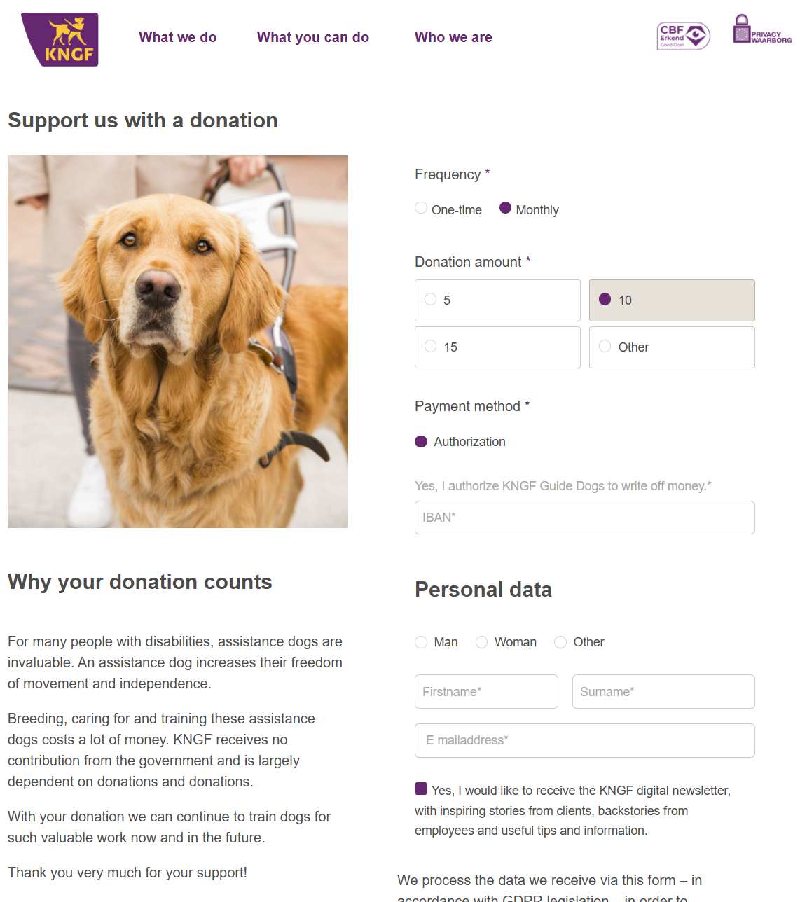

Slide 5
KNGF
Dutch non-profit
Provides guide dogs for visually impaired people
Donation form screen
Already aimed at visually impaired

Slide 7
https://formulieren.geleidehond.nl/form-58970/steun-met-een-donatie
Help us with a donation.
Main region.

Slide 8
https://formulieren.geleidehond.nl/form-58970/steun-met-een-donatie
Help us with a donation.
Main region.
Unlabelled image.

Slide 9
https://formulieren.geleidehond.nl/form-58970/steun-met-een-donatie
Help us with a donation.
Main region.
Unlabelled image.
Link. What we do.

Slide 10
https://formulieren.geleidehond.nl/form-58970/steun-met-een-donatie
Help us with a donation.
Main region.
Unlabelled image.
Link. What we do.
Link. What you can do.

Slide 11
https://formulieren.geleidehond.nl/form-58970/steun-met-een-donatie
Help us with a donation.
Main region.
Unlabelled image.
Link. What we do.
Link. What you can do.
Link. Who we are.

Slide 12
https://formulieren.geleidehond.nl/form-58970/steun-met-een-donatie
Help us with a donation.
Main region.
Unlabelled image.
Link. What we do.
Link. What you can do.
Link. Who we are.
CBF recognised charity. Image.

Slide 13
https://formulieren.geleidehond.nl/form-58970/steun-met-een-donatie
Help us with a donation.
Main region.
Unlabelled image.
Link. What we do.
Link. What you can do.
Link. Who we are.
CBF recognised charity. Image.
Privacy guarantee. Image.

Slide 14
https://formulieren.geleidehond.nl/form-58970/steun-met-een-donatie
Help us with a donation.
Main region.
Unlabelled image.
Link. What we do.
Link. What you can do.
Link. Who we are.
CBF recognised charity. Image.
Privacy guarantee. Image.
Heading level 2. Support us with a donation.

Slide 15
https://formulieren.geleidehond.nl/form-58970/steun-met-een-donatie
Help us with a donation.
Main region.
Unlabelled image.
Link. What we do.
Link. What you can do.
Link. Who we are.
CBF recognised charity. Image.
Privacy guarantee. Image.
Heading level 2. Support us with a donation.
Heading level 2. Why your donation counts.

Slide 16
https://formulieren.geleidehond.nl/form-58970/steun-met-een-donatie
Help us with a donation.
Main region.
Unlabelled image.
Link. What we do.
Link. What you can do.
Link. Who we are.
CBF recognised charity. Image.
Privacy guarantee. Image.
Heading level 2. Support us with a donation.
Heading level 2. Why your donation counts.
For many people with a disability, assistance dogs are invaluable. An assistance dog increases their freedom of movement and independence. Breeding, caring for and training these dogs costs a lot of money. KNGF receives no government funding and is largely dependent on gifts and donations. With your donation, we can continue to train dogs for this valuable work now and in the future. Thank you very much for your support!

Slide 17
https://formulieren.geleidehond.nl/form-58970/steun-met-een-donatie
Help us with a donation.
Main region.
Unlabelled image.
Link. What we do.
Link. What you can do.
Link. Who we are.
CBF recognised charity. Image.
Privacy guarantee. Image.
Heading level 2. Support us with a donation.
Heading level 2. Why your donation counts.
For many people with a disability, assistance dogs are invaluable. An assistance dog increases their freedom of movement and independence. Breeding, caring for and training these dogs costs a lot of money. KNGF receives no government funding and is largely dependent on gifts and donations. With your donation, we can continue to train dogs for this valuable work now and in the future. Thank you very much for your support!
Frequency asterisk.
One-time. Radio button not selected.
One-time.

Slide 18
https://formulieren.geleidehond.nl/form-58970/steun-met-een-donatie
Help us with a donation.
Main region.
Unlabelled image.
Link. What we do.
Link. What you can do.
Link. Who we are.
CBF recognised charity. Image.
Privacy guarantee. Image.
Heading level 2. Support us with a donation.
Heading level 2. Why your donation counts.
For many people with a disability, assistance dogs are invaluable. An assistance dog increases their freedom of movement and independence. Breeding, caring for and training these dogs costs a lot of money. KNGF receives no government funding and is largely dependent on gifts and donations. With your donation, we can continue to train dogs for this valuable work now and in the future. Thank you very much for your support!
Frequency asterisk.
One-time. Radio button not selected.
One-time.
Monthly. Radio button selected.
…

Slide 19
https://formulieren.geleidehond.nl/form-58970/steun-met-een-donatie
**The list of elements spoken by the screen reader:**
Help us with a donation.
Main region.
Unlabelled image.
Link. What we do.
Link. What you can do.
Link. Who we are.
CBF recognised charity. Image.
Privacy guarantee. Image.
Heading level 2. Support us with a donation.
Heading level 2. Why your donation matters.
For many people with a disability, assistance dogs are invaluable. An assistance dog increases their freedom of movement and independence. Breeding, caring for and training these dogs costs a lot of money. KNGF receives no government funding and is largely dependent on gifts and donations. With your donation, we can continue to train dogs for this valuable work now and in the future. Thank you very much for your support!
Frequency asterisk.
One-time. Radio button not selected.
One-time.
Monthly. Radio button selected.
Monthly.
Donation amount asterisk.
5\. Radio button not selected.
5\.
10\. Radio button selected.
10\.
15\. Radio button not selected.
15\.
Other. Radio button not selected.
Other.
Payment method asterisk.
Direct debit. Radio button selected.
Direct debit.
Yes, I authorise KNGF Guide Dogs to withdraw money.
IBAN asterisk.
IBAN asterisk. Input field.
Heading level 5. Personal details.
Male asterisk. Radio button selected.
Male.
Female asterisk. Radio button not selected.
Female.
Other asterisk. Radio button not selected.
Other.
First name asterisk.
First name asterisk. Input field.
Last name asterisk.
Last name asterisk. Input field.
Email address asterisk.
Email address asterisk. Input field popup.
Yes, I would like to receive the KNGF digital newsletter, with inspiring client stories, background stories from staff, and useful tips and information. Checkbox selected.
Yes, I would like to receive the KNGF digital newsletter, with inspiring client stories, background stories from staff, and useful tips and information.
The data we receive through this form is processed—in accordance with GDPR legislation—to handle your request. By submitting this form, you agree to the privacy statement. Want to know more? Click here. Checkbox not selected.
The data we receive through this form is processed—in accordance with GDPR legislation—to handle your request. By submitting this form, you agree to the privacy statement. Want to know more? Link. Click here.
Donate.
End of main region.

Slide 20
https://formulieren.geleidehond.nl/form-58970/steun-met-een-donatie
**The list of elements spoken by the screen reader:**
Help us with a donation.
Main region.
Unlabelled image.
Link. What we do.
Link. What you can do.
Link. Who we are.
CBF recognised charity. Image.
Privacy guarantee. Image.
Heading level 2. Support us with a donation.
Heading level 2. Why your donation matters.
For many people with a disability, assistance dogs are invaluable. An assistance dog increases their freedom of movement and independence. Breeding, caring for and training these dogs costs a lot of money. KNGF receives no government funding and is largely dependent on gifts and donations. With your donation, we can continue to train dogs for this valuable work now and in the future. Thank you very much for your support!
Frequency asterisk.
One-time. Radio button not selected.
One-time.
Monthly. Radio button selected.
Monthly.
Donation amount asterisk.
5\. Radio button not selected.
5\.
10\. Radio button selected.
10\.
15\. Radio button not selected.
15\.
Other. Radio button not selected.
Other.
Payment method asterisk.
Direct debit. Radio button selected.
Direct debit.
Yes, I authorise KNGF Guide Dogs to withdraw money.
IBAN asterisk.
IBAN asterisk. Input field.
Heading level 5. Personal details.
Male asterisk. Radio button selected.
Male.
Female asterisk. Radio button not selected.
Female.
Other asterisk. Radio button not selected.
Other.
First name asterisk.
First name asterisk. Input field.
Last name asterisk.
Last name asterisk. Input field.
Email address asterisk.
Email address asterisk. Input field popup.
Yes, I would like to receive the KNGF digital newsletter, with inspiring client stories, background stories from staff, and useful tips and information. Checkbox selected.
Yes, I would like to receive the KNGF digital newsletter, with inspiring client stories, background stories from staff, and useful tips and information.
The data we receive through this form is processed—in accordance with GDPR legislation—to handle your request. By submitting this form, you agree to the privacy statement. Want to know more? Click here. Checkbox not selected.
The data we receive through this form is processed—in accordance with GDPR legislation—to handle your request. By submitting this form, you agree to the privacy statement. Want to know more? Link. Click here.
Donate.
End of main region.

Slide 21
https://formulieren.geleidehond.nl/form-58970/steun-met-een-donatie
**The list of elements spoken by the screen reader:**
Help us with a donation.
Main region.
Unlabelled image.
Link. What we do.
Link. What you can do.
Link. Who we are.
CBF recognised charity. Image.
Privacy guarantee. Image.
Heading level 2. Support us with a donation.
Heading level 2. Why your donation matters.
For many people with a disability, assistance dogs are invaluable. An assistance dog increases their freedom of movement and independence. Breeding, caring for and training these dogs costs a lot of money. KNGF receives no government funding and is largely dependent on gifts and donations. With your donation, we can continue to train dogs for this valuable work now and in the future. Thank you very much for your support!
Frequency asterisk.
One-time. Radio button not selected.
One-time.
Monthly. Radio button selected.
Monthly.
Donation amount asterisk.
5\. Radio button not selected.
5\.
10\. Radio button selected.
10\.
15\. Radio button not selected.
15\.
Other. Radio button not selected.
Other.
Payment method asterisk.
Direct debit. Radio button selected.
Direct debit.
Yes, I authorise KNGF Guide Dogs to withdraw money.
IBAN asterisk.
IBAN asterisk. Input field.
Heading level 5. Personal details.
Male asterisk. Radio button selected.
Male.
Female asterisk. Radio button not selected.
Female.
Other asterisk. Radio button not selected.
Other.
First name asterisk.
First name asterisk. Input field.
Last name asterisk.
Last name asterisk. Input field.
Email address asterisk.
Email address asterisk. Input field popup.
Yes, I would like to receive the KNGF digital newsletter, with inspiring client stories, background stories from staff, and useful tips and information. Checkbox selected.
Yes, I would like to receive the KNGF digital newsletter, with inspiring client stories, background stories from staff, and useful tips and information.
The data we receive through this form is processed—in accordance with GDPR legislation—to handle your request. By submitting this form, you agree to the privacy statement. Want to know more? Click here. Checkbox not selected.
The data we receive through this form is processed—in accordance with GDPR legislation—to handle your request. By submitting this form, you agree to the privacy statement. Want to know more? Link. Click here.
Donate.
End of main region.
~10 minutes of listening

Slide 22
Problem
Top-down (sighted) vs Bottom-up (screen reader)
Top-down:
Summary-first, focus later
Bottom-up
Elements first, slowly construct screen piece by piece
Requires high amount of mental effort

Slide 23
Proposed solution
Large vision language model (VLM)

Slide 24
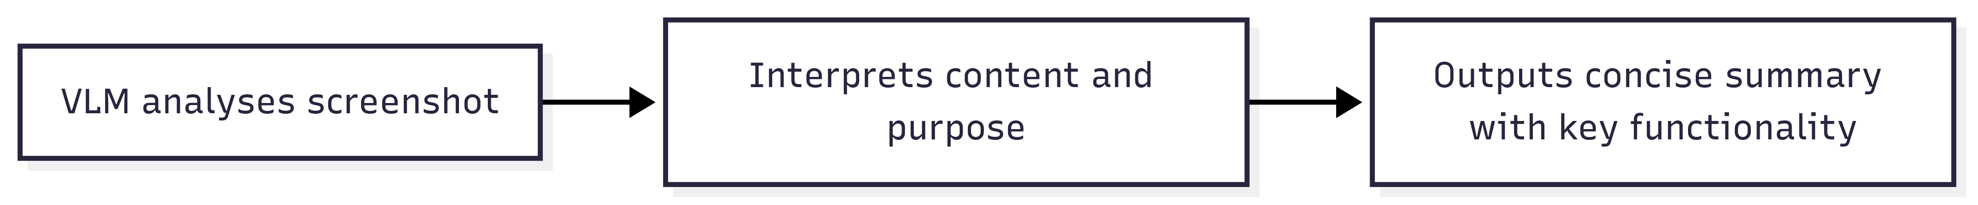
Proposed solution
Large vision language model (VLM)

Slide 25
Proposed solution
Large vision language model (VLM)

Slide 26
Proposed solution
Large vision language model (VLM)

Slide 27
Proposed solution
Large vision language model (VLM)
“As if someone looks over your shoulder and describes your screen to you”
Mimics top-down paradigm
Enables summary-first, focus later
Reducing cognitive overload

Slide 28
VLM Screen Describer
Consists of 2 parts:
Model
Prompt
Notes:
test

Slide 29
VLM Screen Describer
Consists of 2 parts:
Model
Prompt
Model:
Raw visual and linguistic capabilities
OCR, reasoning, etc.
Notes:
test

Slide 30
VLM Screen Describer
Consists of 2 parts:
Model
Prompt
Model:
Raw visual and linguistic capabilities
OCR, reasoning, etc.
Prompt:
Instructs model
What should be described? (content, functionality, purpose, etc.)
What should be left out? (decorative clutter, etc.)
Notes:
test

Slide 31
VLM Screen Describer
Consists of 2 parts:
Model
Prompt
Model:
Raw visual and linguistic capabilities
OCR, reasoning, etc.
Prompt:
Instructs model
What should be described? (content, functionality, purpose, etc.)
What should be left out? (decorative clutter, etc.)
No way to evaluate performance!
Notes:
test

Slide 32
SEE Benchmark
Screen Explanation Evaluation (SEE)
Notes:
test

Slide 33
SEE Benchmark
Screen Explanation Evaluation (SEE)
“Create a test that scores how well a given VLM describes screens”
Notes:
test

Slide 34
SEE Benchmark
Screen Explanation Evaluation (SEE)
“Create a test that scores how well a given VLM describes screens”
Consists of 2 parts:
Annotation dataset
Evaluation system
Notes:
test

Slide 35
SEE Benchmark – Dataset
Consists of:
100 screenshots
Human-written reference descriptions (Dutch)
Must-include elements
Prioritizes essential elements
Notes:
test

Slide 36
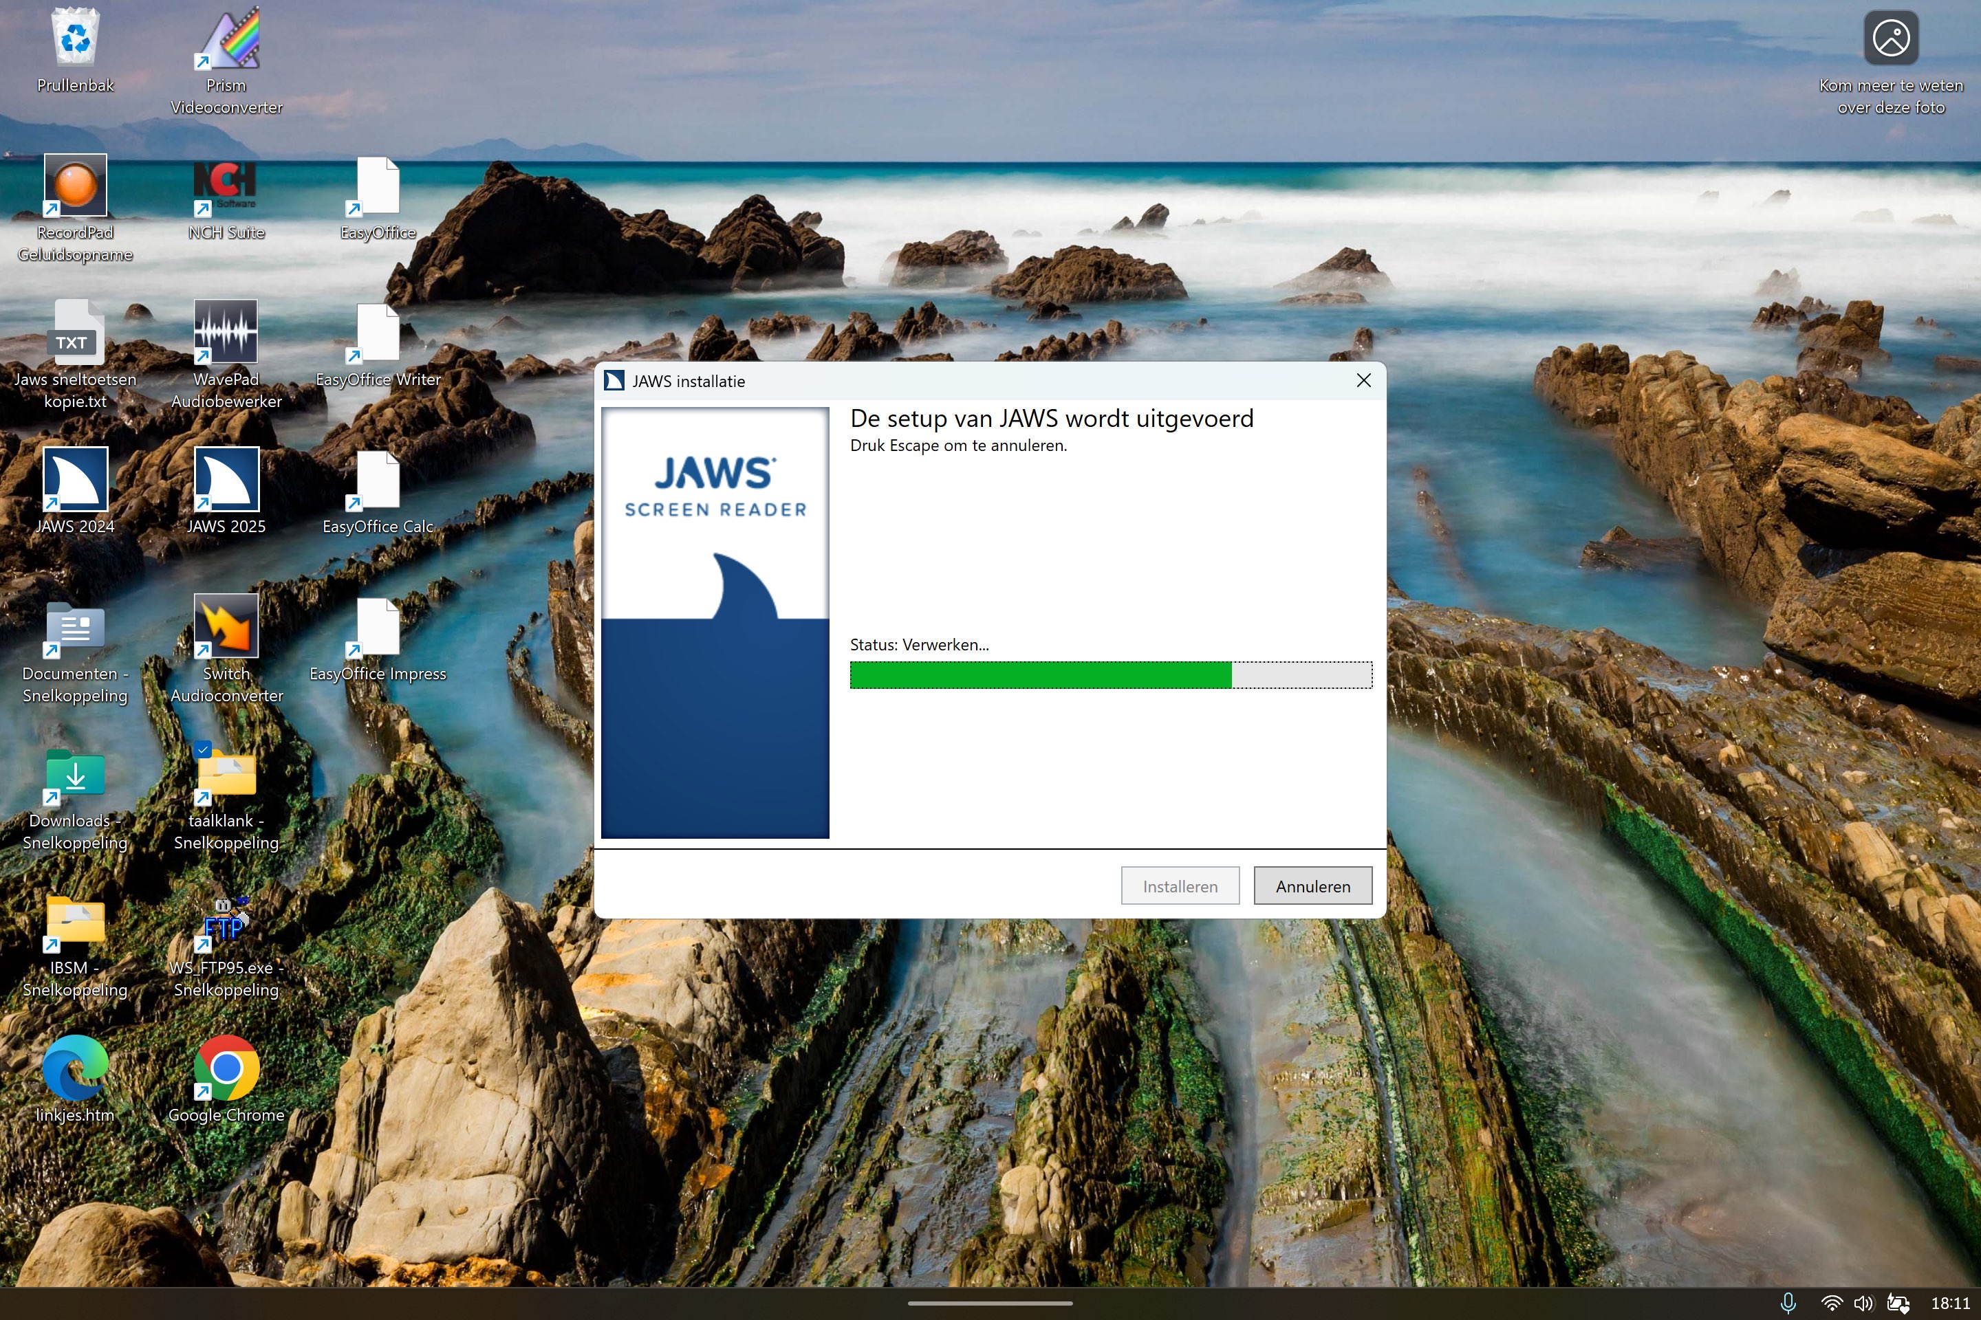
SEE Benchmark – Dataset
Reference description “A JAWS installation window is visible. The setup is currently in progress and nearly complete. The installation status is "processing", and pressing Escape allows the user to cancel the installation.”
Must-include:
JAWS installation screen
Installation nearly complete
Message that Escape can be used to cancel
Progress bar for installation
Notes:
test

Slide 37
SEE Benchmark – Evaluation
A tuned LLM-as-a-Judge (G-Eval)
Checks reference coverage
Does the model output capture the meaning of the reference description?
Notes:
test

Slide 38
SEE Benchmark – Evaluation
A tuned LLM-as-a-Judge (G-Eval)
Checks reference coverage
Does the model output capture the meaning of the reference description?
Checks must-include coverage
Are all critical elements mentioned explicitly in the model output?
Notes:
test

Slide 39
SEE Benchmark – Evaluation
A tuned LLM-as-a-Judge (G-Eval)
Checks reference coverage
Does the model output capture the meaning of the reference description?
Checks must-include coverage
Are all critical elements mentioned explicitly in the model output?
Allows rubric-based scoring (0-10)
Based on tuned evaluation steps
Provides feedback on improvements
Notes:
test

Slide 40
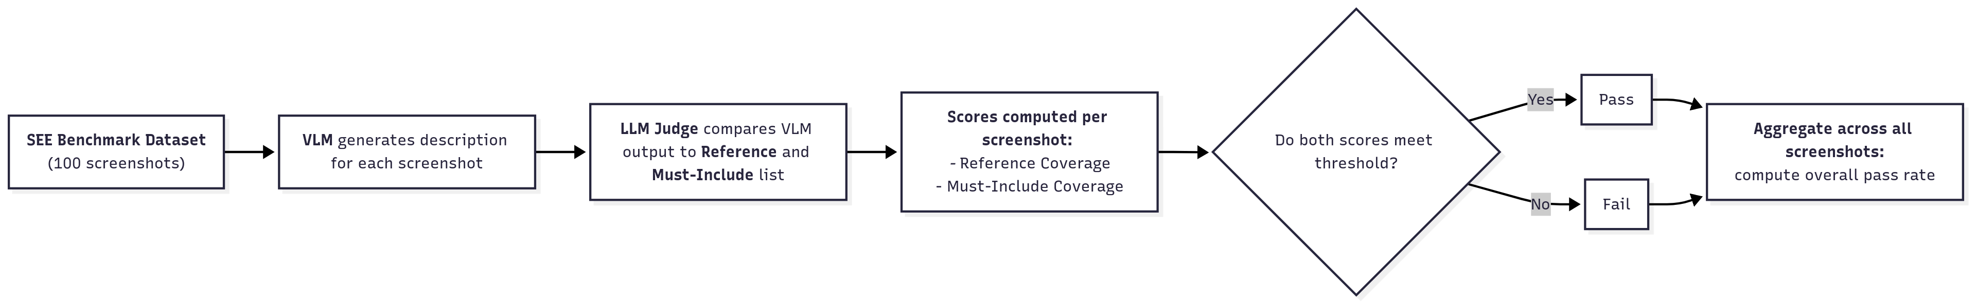
SEE Benchmark – Evaluation
A tuned LLM-as-a-Judge (G-Eval)
Checks reference coverage
Checks must-include coverage
Allows rubric-based scoring (0-10)
Based on tuned evaluation steps
Notes:
test

Slide 41
Implementation – VLM Screen Describer
Model selection phase
Prompt tuning phase
Notes:
test

Slide 42
Implementation – VLM Screen Describer
Model selection phase
Compare 8 models
4 instantly visibly unfit (small models)
2 proved unfit after a simple zero-shot prompt (large)
Remaining 2 were tested on 6 prompts
Prompt tuning phase
Notes:
test

Slide 43
Implementation – VLM Screen Describer
Model selection phase
Compare 8 models
4 instantly visibly unfit (≤ 11B)
2 proved unfit after zero-shot (≤ 90B)
Remaining 2 were tested on 6 prompts
Best: LLaMa 4 Maverick (17B x 128E)
Prompt tuning phase
Best model
Notes:
test

Slide 44
Implementation – VLM Screen Describer
Model selection phase
Compare 8 models
4 instantly visibly unfit (≤ 11B)
2 proved unfit after zero-shot (≤ 90B)
Remaining 2 were tested on 6 prompts
Best: LLaMa 4 Maverick (17B x 128E)
Prompt tuning phase
Best model
6 Iterations of refinement based on Judge feedback
Notes:
test

Slide 45
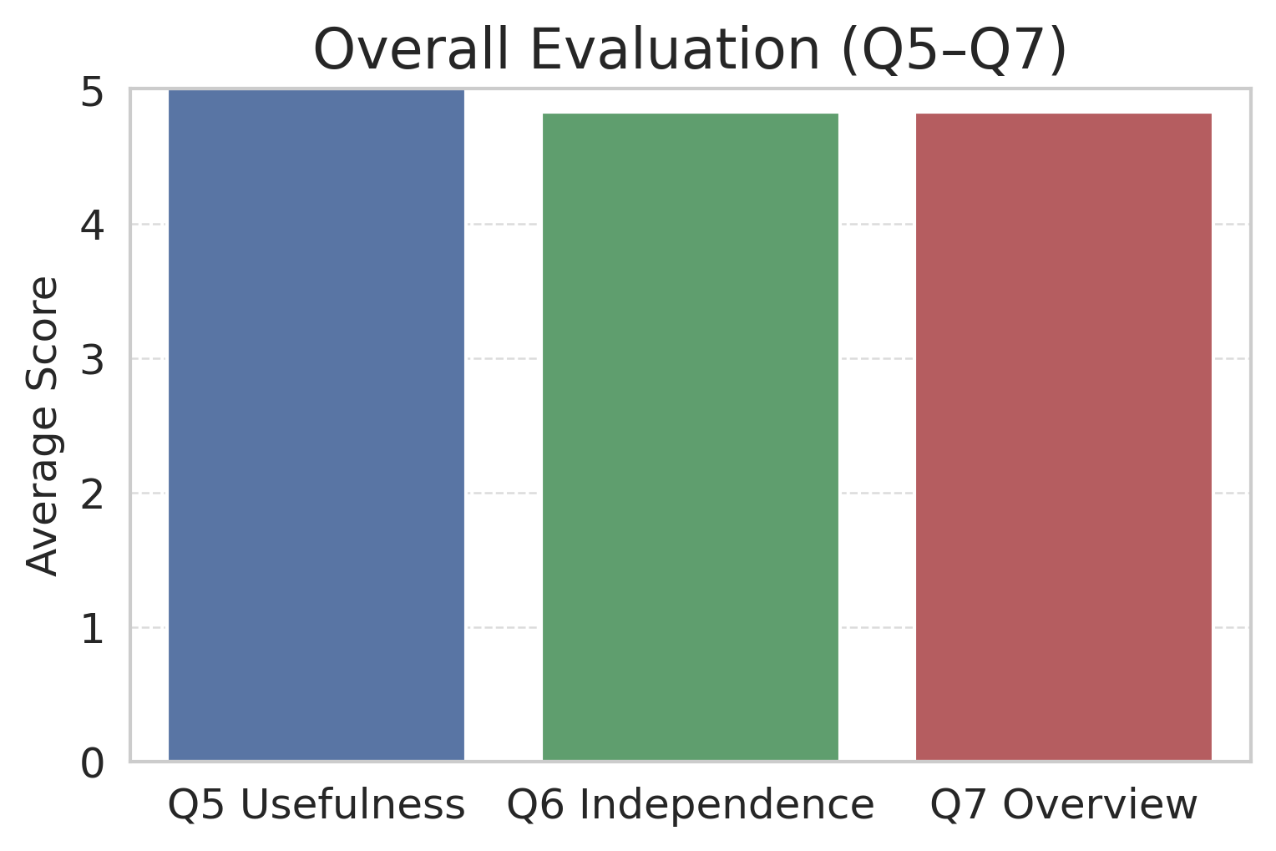
Result – VLM Screen Describer
SEE Scores:
37% Overall Pass
40% Reference pass
87% Must-Include pass
User study
Usefulness in daily work: 5.0/5.0
Increased independence: 4.83/5.0
Improved overview vs screen reader: 4.83/5.0
Notes:
test

Slide 46
Result – VLM Screen Describer
Notes:
test

Slide 47
https://formulieren.geleidehond.nl/form-58970/steun-met-een-donatie
**The list of elements spoken by the screen reader:**
Help us with a donation.
Main region.
Unlabelled image.
Link. What we do.
Link. What you can do.
Link. Who we are.
CBF recognised charity. Image.
Privacy guarantee. Image.
Heading level 2. Support us with a donation.
Heading level 2. Why your donation matters.
For many people with a disability, assistance dogs are invaluable. An assistance dog increases their freedom of movement and independence. Breeding, caring for and training these dogs costs a lot of money. KNGF receives no government funding and is largely dependent on gifts and donations. With your donation, we can continue to train dogs for this valuable work now and in the future. Thank you very much for your support!
Frequency asterisk.
One-time. Radio button not selected.
One-time.
Monthly. Radio button selected.
Monthly.
Donation amount asterisk.
5\. Radio button not selected.
5\.
10\. Radio button selected.
10\.
15\. Radio button not selected.
15\.
Other. Radio button not selected.
Other.
Payment method asterisk.
Direct debit. Radio button selected.
Direct debit.
Yes, I authorise KNGF Guide Dogs to withdraw money.
IBAN asterisk.
IBAN asterisk. Input field.
Heading level 5. Personal details.
Male asterisk. Radio button selected.
Male.
Female asterisk. Radio button not selected.
Female.
Other asterisk. Radio button not selected.
Other.
First name asterisk.
First name asterisk. Input field.
Last name asterisk.
Last name asterisk. Input field.
Email address asterisk.
Email address asterisk. Input field popup.
Yes, I would like to receive the KNGF digital newsletter, with inspiring client stories, background stories from staff, and useful tips and information. Checkbox selected.
Yes, I would like to receive the KNGF digital newsletter, with inspiring client stories, background stories from staff, and useful tips and information.
The data we receive through this form is processed—in accordance with GDPR legislation—to handle your request. By submitting this form, you agree to the privacy statement. Want to know more? Click here. Checkbox not selected.
The data we receive through this form is processed—in accordance with GDPR legislation—to handle your request. By submitting this form, you agree to the privacy statement. Want to know more? Link. Click here.
Donate.
End of main region.

Slide 48
This is a donation form from KNGF. The purpose of the page is to enable visitors to make a donation. At the top of the page is the KNGF Guide Dogs logo and a navigation menu with the options "What we do", "What you can do", and "Who we are".
The form requests various details:
The user can choose between a one-time or monthly donation under the heading "Frequency".
Then, the "Donation amount" can be selected: 5, 10, 15 euros, or another amount.
Under "Payment method", the user can choose between direct debit or IBAN.
In the "Personal details" section, gender, first name, last name, and email address are requested.
There is also an option to sign up for a digital newsletter.
Under the heading "Why your donation matters" there is an explanation about the importance of donations for the work of KNGF.

Slide 49
This is a donation form from KNGF. The purpose of the page is to enable visitors to make a donation. At the top of the page is the KNGF Guide Dogs logo and a navigation menu with the options "What we do", "What you can do", and "Who we are".
The form requests various details:
The user can choose between a one-time or monthly donation under the heading "Frequency".
Then, the "Donation amount" can be selected: 5, 10, 15 euros, or another amount.
Under "Payment method", the user can choose between direct debit or IBAN.
In the "Personal details" section, gender, first name, last name, and email address are requested.
There is also an option to sign up for a digital newsletter.
Under the heading "Why your donation matters" there is an explanation about the importance of donations for the work of KNGF.
~70% length decrease

Slide 50
Result – VLM Screen Describer
Model Output:
This is a donation form from KNGF Guide Dogs. The purpose of the page is to enable visitors to make a donation. At the top of the page is the KNGF Guide Dogs logo and a navigation menu with the options "What we do", "What you can do", and "Who we are".
The form requests various details:
The user can choose between a one-time or monthly donation under the heading "Frequency".
Then, the "Donation amount" can be selected: 5, 10, 15 euros, or another amount.
Under "Payment method", the user can choose between direct debit or IBAN.
In the "Personal details" section, gender, first name, last name, and email address are requested.
There is also an option to sign up for a digital newsletter.
Under the heading "Why your donation matters" there is an explanation about the importance of donations for the work of KNGF.
Notes:
test

Slide 51
Conclusion
SEE Benchmark:
Allows creation/comparison VLM screen describers
Enables highly useful real-world screen descriptions
Notes:
test

