Slide 1
Modeling a Soft Modular Adaptive Robotic Technology (SMART) Arm
MAE263F Project Proposal
Che Jin Goh and Agathiya Tharun

Slide 2
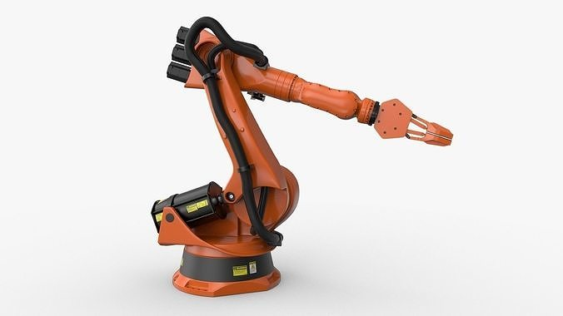
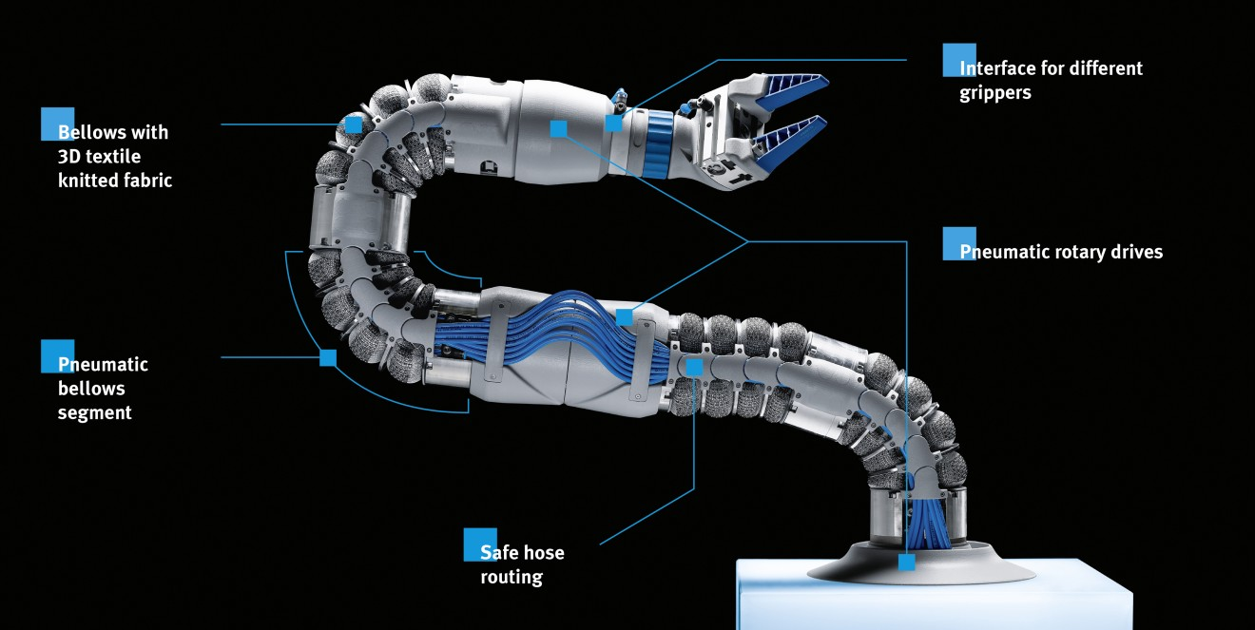
Background
Rigid Robotic Arms
Fixed joints locations and stiffness
Rigid structures
Limiting adaptability
Limited workspace
Safety hazard during human-robot collaboration
Soft Robotic Arms
Flexible materials
Dynamic structures enhance versatility
Dynamic joint locations
Increased safety in unpredictable environments
Increased adaptability, functionality, and workspace
KUKA robotic arm
Bionic SoftArm
Notes:
Soft robotic arms are designed to overcome the limitations of conventional rigid robotic systems. Traditional robots are restricted by their fixed joints and rigid structures, which limit their ability to adapt to unpredictable environments. This restricts their reachable workspace, adaptability, and potential for safe collaboration with humans.
Soft robotic arms on the other hand, use flexible materials and dynamically adjustable structures to enhance movement capabilities. These robots can modify their joint locations and lengths, expanding their reach and allowing for safe interactions in uncertain environments. However, there are still some challenges such as limited degrees of freedom, scalability issues due to bulky actuators, which hinder their potential for performing complex tasks. Our proposed research aims to address these challenges by modeling and optimizing the behavior of soft robotic arms.

Slide 3
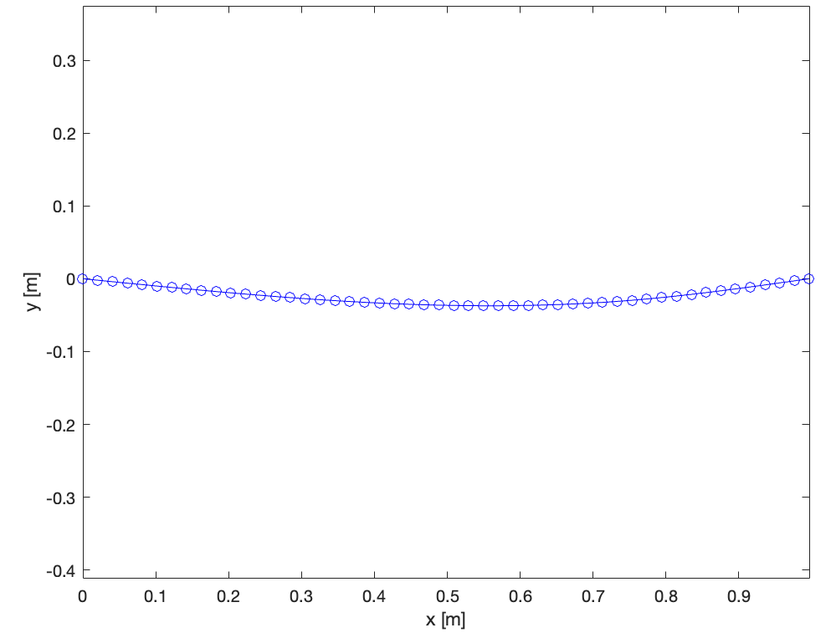
Simulation
Objective: Maximize workspace, adaptability, and configuration potential
Simulation Framework Architecture: Dynamic beam bending problem
Variable Stiffness Implementation: Each node has an adjustable stiffness and location
Actuation Mechanism: Simulate forces at each module/link (edge)
Notes:
Research Focus
Model and optimize the behavior of soft robotic arms to expand their functional capabilities and real-world applications.
Simulation Framework Design
The problem is approached as a beam bending problem, treating the soft robotic arm as a series of nodes that can bend and adjust.
The first node is fixed, representing the base of the robotic arm, while N nodes are placed along the length to allow flexible movement.
Objective
Enable the arm to reach complex positions, such as areas close to its base, which are challenging for traditional rigid robotic arms.
Variable Stiffness Implementation
Each node has adjustable stiffness, allowing controlled bending at different sections of the arm.
Variable stiffness provides adaptability for navigating complex environments.
By selectively stiffening specific nodes, targeted bending is achieved to reach desired positions.
Actuation Mechanism
Once stiffness is adjusted, forces are applied to move the arm towards a specific direction.
The combination of stiffness control and actuation allows precise movement and configuration for different tasks.
Accounts for weight

Slide 4
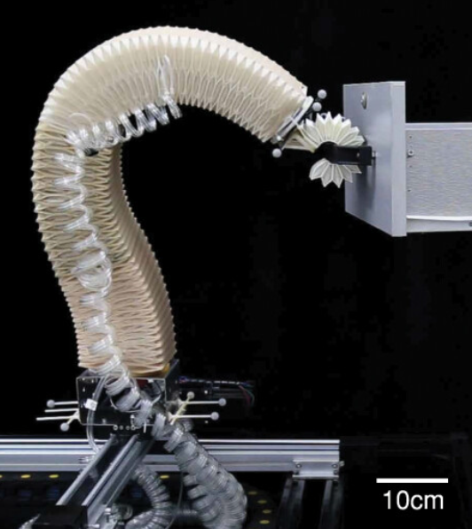
Hypothetical Physical Representation
Pneumatic, hydraulic, dielectric elastomer, shape memory alloy/polymer, and fibrous actuation
Dynamic link length
Joint location
Variable joint stiffness
Second Moment of Area
Node count
Notes:
NOTES: Actuation means change in natural curvature, not usually simulated by applying an external force Mention boundary conditions

Slide 5
References
Hajiesmaili, E., & Clarke, D. R. (2021). Dielectric elastomer actuators. Retrieved from https://pubs.aip.org/aip/jap/article/129/15/151102/1025587/Dielectric-elastomer-actuators
(N.d.). Retrieved from https://ieeexplore.ieee.org/stamp/stamp.jsp?tp=&arnumber=8722799
Jiang, H., Wang, Z., Jin, Y., Chen, X., Li, P., Gan, Y., … Chen, X. (2021). The International Journal of Robotics Research, 40(1), 411–434. doi:10.1177/0278364920979367
Liow, L., & Howard, D. (2024). Frontiers for Young Minds, 12. doi:10.3389/frym.2024.1341887
Scalet, G. (2020). Two-Way and Multiple-Way Shape Memory Polymers for Soft Robotics: An Overview. Retrieved from https://www.mdpi.com/2076-0825/9/1/10

