Slide 1

GEGONU
FINAL PROJECT IN
INFORMATION MANAGEMENT 1
Website
Overview
Objectives
Features
User’s Guide
Signup as a User
Registration
Repository
Documentations
MANAGEMENT
SYSTEM
Leader:
Chris Vincent
Gesulga
Member(s): Melanie Nunez
Michael Gonato

Slide 2

OVERVIEW:
Welcome to GEGONU, the premier destination for bespoke events tailored to your preferences. Whether you're seeking entertainment, networking opportunities, or indulging in luxury experiences, GEGONU is your one-stop platform. Our mission is to bring your event dreams to life, offering a diverse array of experiences designed to captivate and delight.
And now, prepare to be dazzled by our latest announcement: an exclusive raffle draw game that promises to elevate your excitement to new heights. Featuring a lineup of luxurious prizes that redefine opulence, this event is not to be missed. Stay tuned for details on how to participate and secure your chance to win big with GEGONU.
INFORMATION MANAGEMENT 1
GEGONU
Website

Slide 3
OBJECTIVES:
Personalized Experiences: Tailor events to individual preferences.
Diverse Events: Offer a wide range of experiences for all interests.
Engagement: Foster a lively community and active participation.
User Experience: Provide a seamless journey from discovery to post-event.
Excitement: Generate anticipation through innovative offerings like raffle draws.
Partnerships: Collaborate with brands for enhanced experiences.
Transparency: Ensure clear communication and trust with users.
Continuous Improvement: Use data to refine and innovate.
INFORMATION MANAGEMENT 1
GEGONU
Website

Slide 4
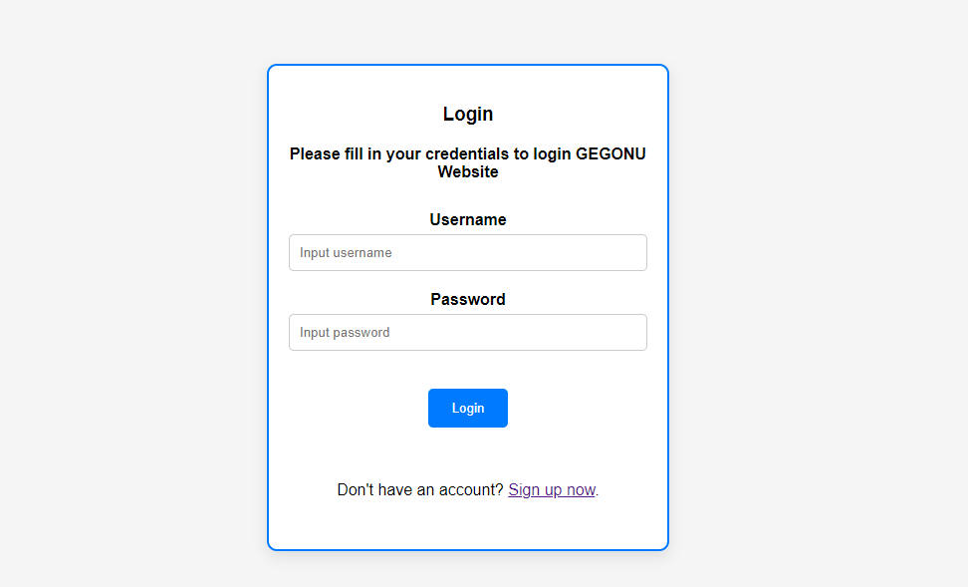
INFORMATION MANAGEMENT 1
GEGONU
Website
User’s Guide
Step 1: Logging In
Log-in Session/
Signup
Open the GEGONU application on your PC.
Enter your username and password in the designated fields.
Click on the "Login" button to access the system.
The same login form for admin but different role.

Slide 5
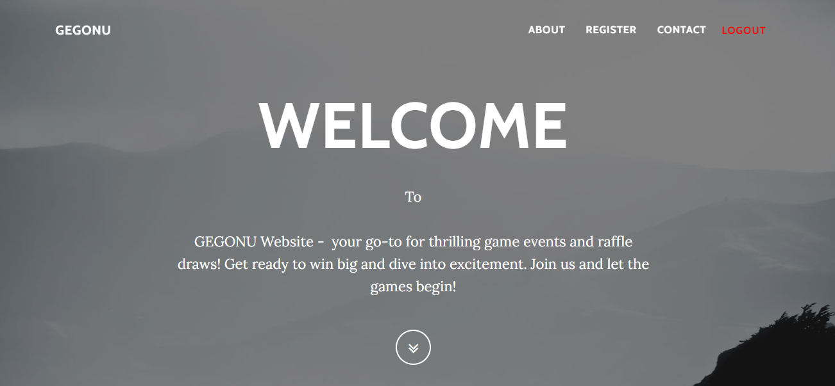
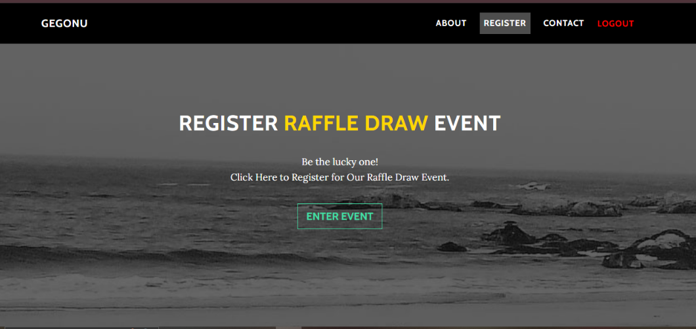
INFORMATION MANAGEMENT 1
GEGONU
Website
Step 2: Accessing the HOME Interface
User’s Guide
Here you can view the features of the webpage including the Posted Event(s) which is the RaffleDraw Event
Home Interface
Step 3: Entering the Posted Available Event
Scroll down to reach the event’s destination.
By clicking ENTER to the posted event, the Register Form and the Registered data appears

Slide 6
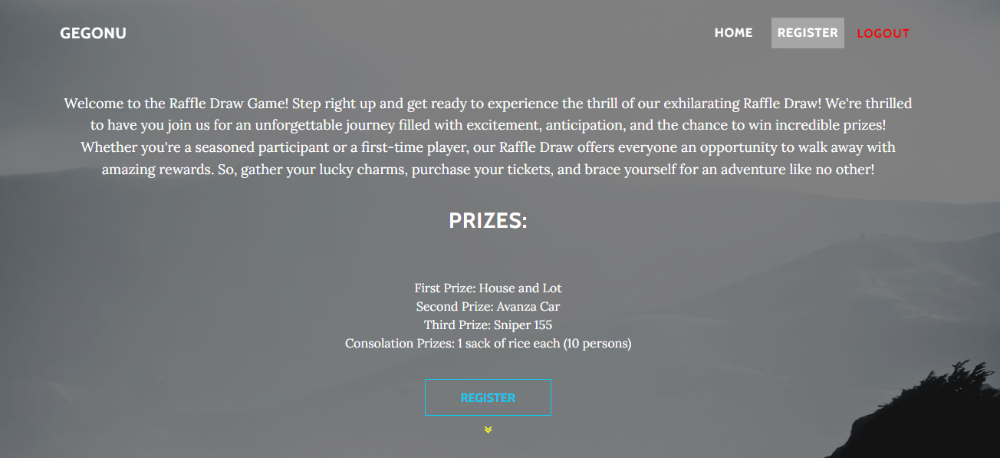
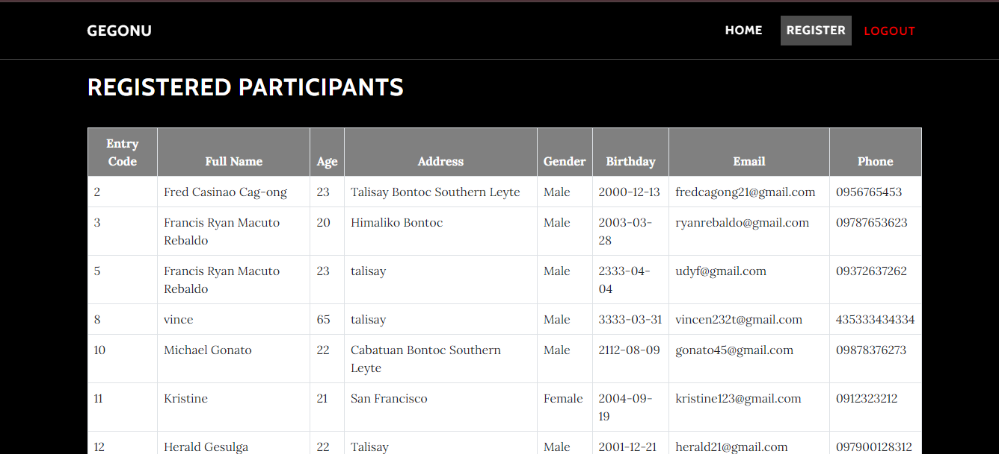
INFORMATION MANAGEMENT 1
GEGONU
Website
Step 4: Event’s Interface
User’s Guide
Here you can view a simple interface where register
button appears and the registered datas below
Home Interface
Step 5: Register as participants
Register your required details and save.
The Admin access can only modify the participant’s data and spin the wheel to choose the lucky one.

Slide 7
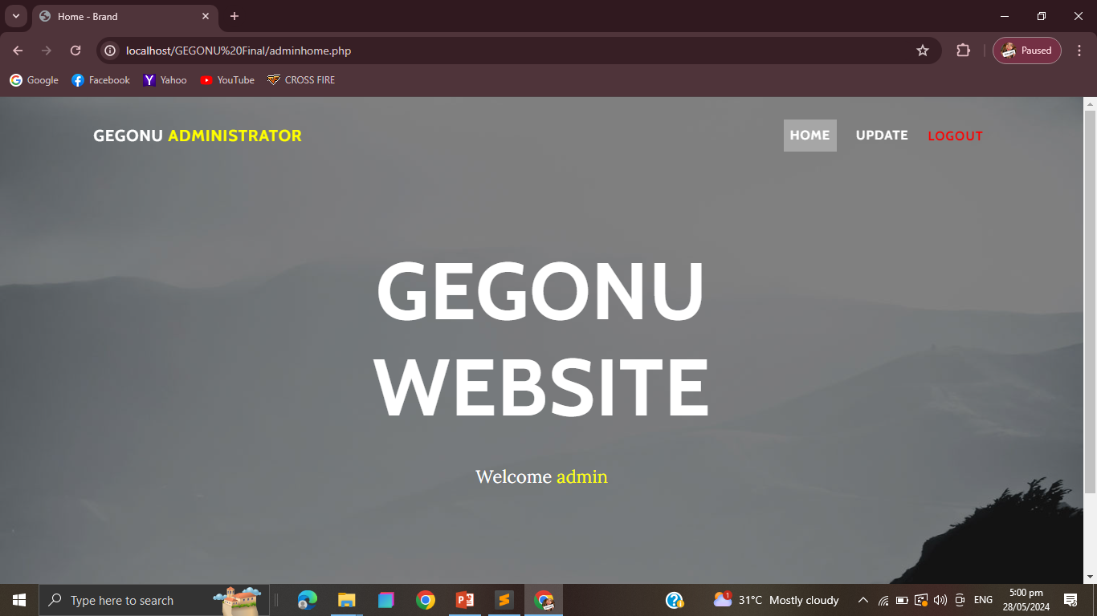
INFORMATION MANAGEMENT 1
GEGONU
Website
Administrator: Admin Access
User’s Guide
Admin access require a special admin account.
Home Interface
Step 1: Admin’s Interface
A simple home interface of an admin access
The Admin access can only modify the participant’s data and spin the wheel to choose the lucky one.

Slide 8
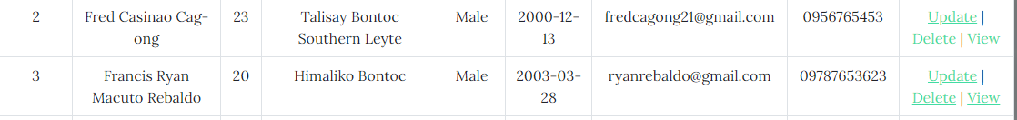
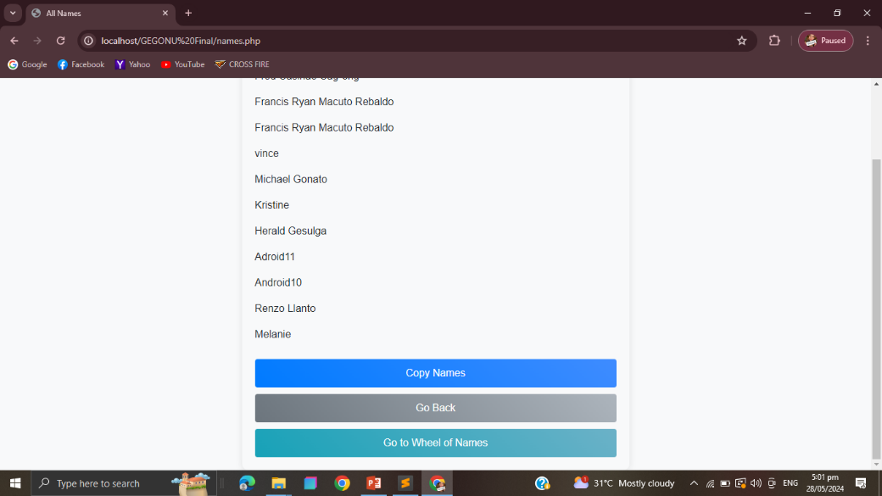
INFORMATION MANAGEMENT 1
GEGONU
Website
Administrator: Admin Access
User’s Guide
Admin access require a special admin account.
Home Interface
Step 5: Admin’s Interface
A simple home interface of an admin access
The Admin access can only modify the participant’s data and spin the wheel to choose the lucky one.

Slide 9
Repository
INFORMATION MANAGEMENT 1
GitHub link here!
(not available for now,
account has been
temporarily block from
Multiple login attempts)
GEGONU
System

Slide 10
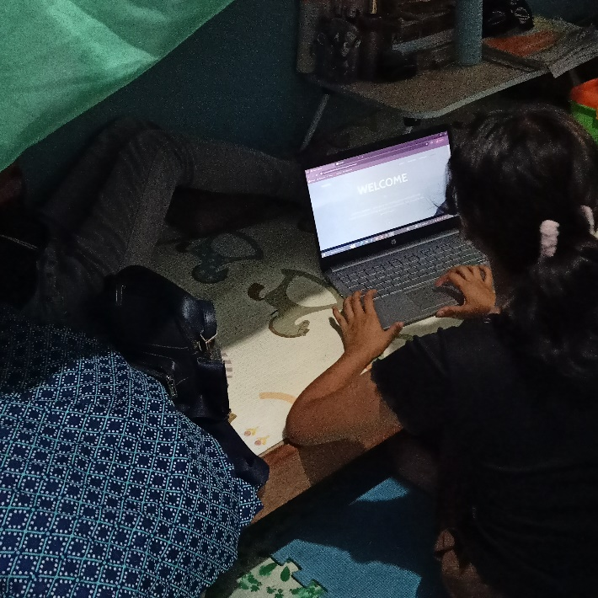
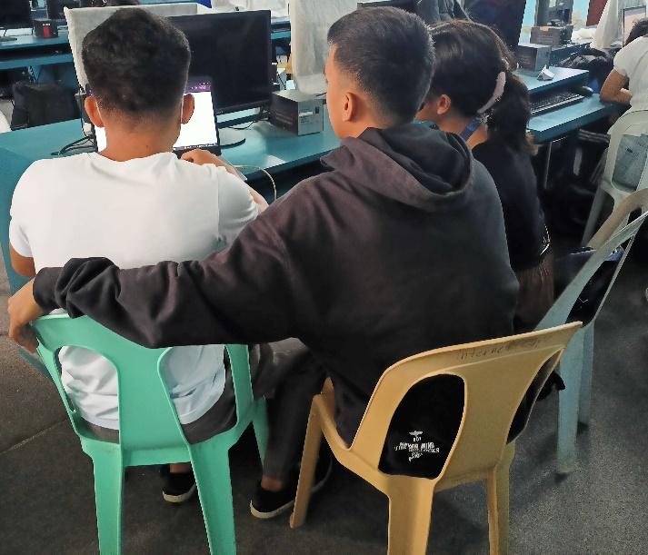
DOCUMENTATIONS
GEGONU
INFORMATION MANAGEMENT 1
System

