Slide 1
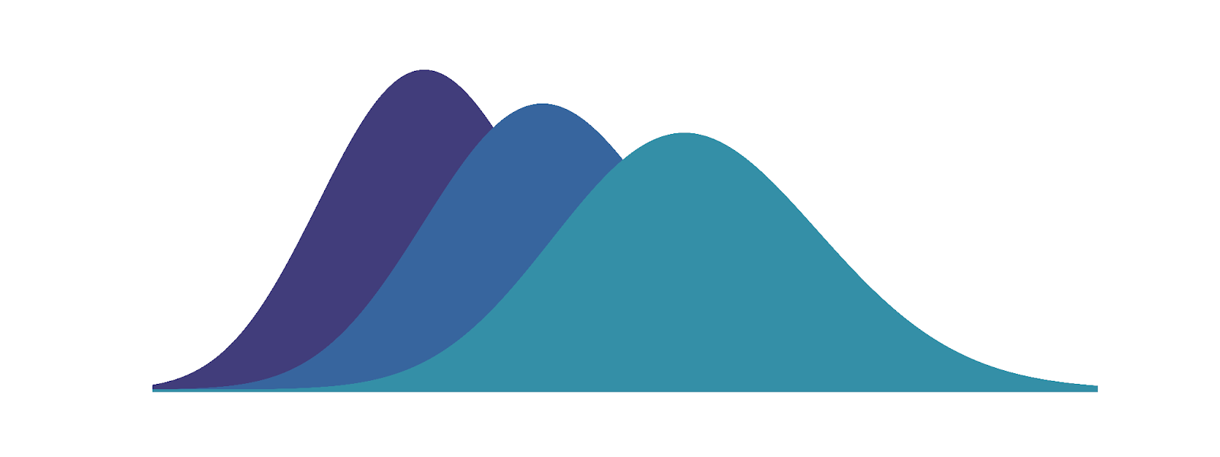
Welcome
1
Poisson Distribution
Fisheries for the Future
Pat Wichitwechkarn | Bethan Moncur | Jack Foster | Garry Clawson

Slide 2
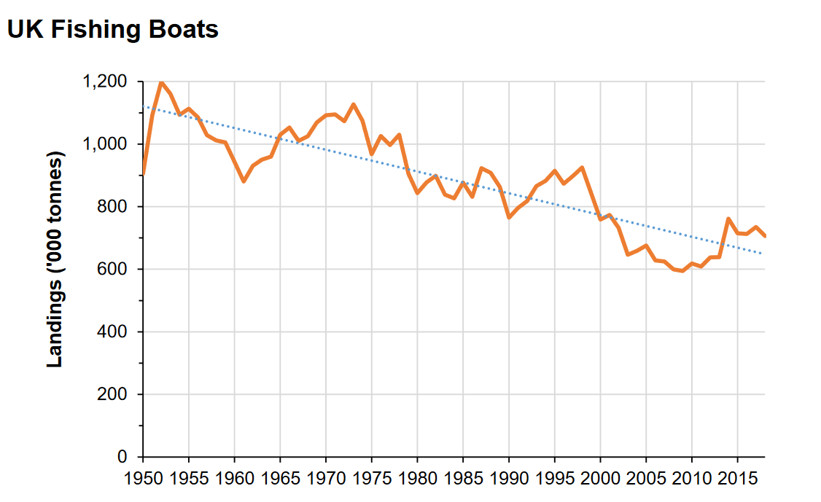
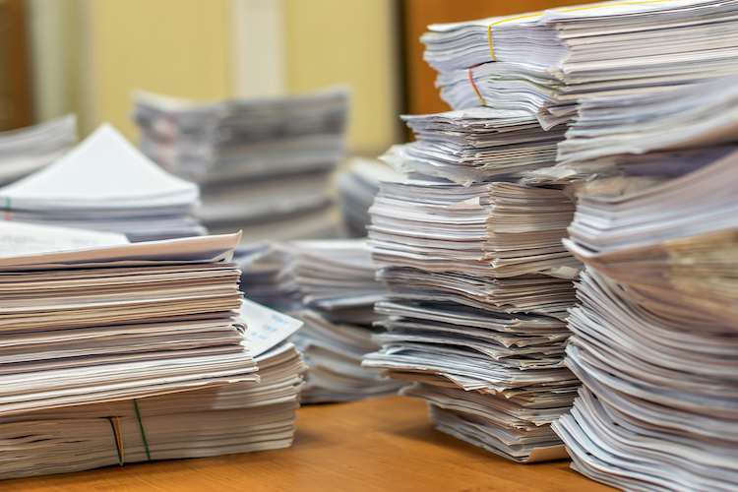
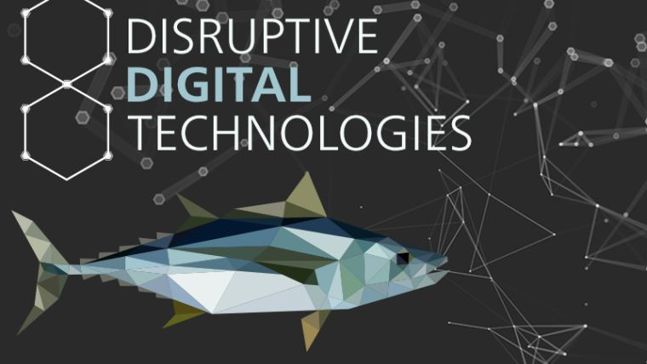
Problem
2
Increasing burden on fishers
Disjointed technology adoption
Declining landings since 1950
Pat Wichitwechkarn | Bethan Moncur | Jack Foster | Garry Clawson
Notes:
- UK fishing is a declining industry with UK fishers landings (in tonnes) has almost halving in landings since 1950 with UK boats landing only 29% of UK EEZ fish
- Increasing burden of work such as form completion for less than 10m boats causing productivity as well as distrust
- Disjointed technology adoption with large scale fishers leading adoption and small fishers

Slide 3
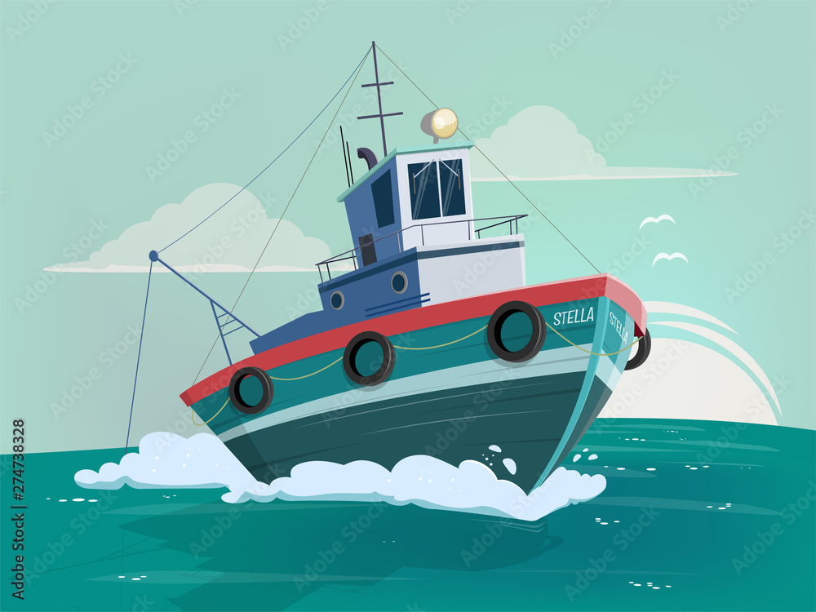
Current State
3
Traditional revenue streams are limited:
Quotas
Fish
Pat Wichitwechkarn | Bethan Moncur | Jack Foster | Garry Clawson
Notes:
- fish sales are down year on year with £831M landed which is a slight increase form previous years landings but a 16% reduction in value. Source: https://www.gov.uk/government/news/fishing-industry-in-2020-statistics-published
- Quata's are continually a point of friction with many fishers noting unfair allocation with small boats getting only 6% of the overall quota. Source: https://www.marinet.org.uk/who-owns-the-uk-fishing-industry-and-its-fishing-quotas.html

Slide 4
Opportunities
4
Technologies enable new revenue:
Adopting adjacent technologies
Sustainability and eco-certification
Real time auction models
Direct B2B and B2C
Data driven decision making
Pat Wichitwechkarn | Bethan Moncur | Jack Foster | Garry Clawson
Notes:
- Technologies have the potential to reduce overall costs by adopting current adjacent technoolgies for instance used in the agricultural sector as well as posistiing itself to be in the middle of the where new technological trends (such as IoT) will be useful in 5-10 years
- technolgy allows for real time auction processes to be had so a fisher can be confident in their revenues
- leverage data from increasing use of automated technologies to degitise the supply chain with the 'digital fish' at the centre driving value towards the fisher
- drive eco certification and CEFAS credentilas to move fishers up the value chain by driving demand for high quality fish from accredited local sources. Such as the MSC blue label (marine stewardship council)
-

Slide 5
Strategy
Pat Wichitwechkarn | Bethan Moncur | Jack Foster | Garry Clawson
Notes:
- phases 1
- phase 2
- phase 3

Slide 6





Transition Timeline
5
Finding software and catching hardware​
Phase 1
Phase 2
Phase 3
Time
Onboarding
Major fisher support
Data critical point
Pat Wichitwechkarn | Bethan Moncur | Jack Foster | Garry Clawson
Notes:
- phases 1
- phase 2
- phase 3

Slide 7
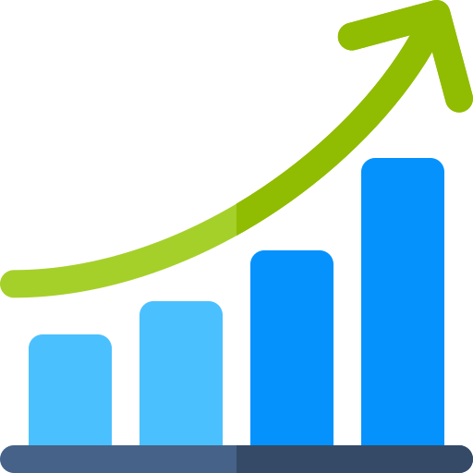




Strategy (1/2)
6
Finding software and catching hardware​
Phase 1
Phase 2: once adoption is high
Encourage adoption of digital technologies
B2C fish ordering
Automate non-value-added tasks
Self-certification and blockchain integration
3rd-party eco-certification
Price setting using automated markets
Pat Wichitwechkarn | Bethan Moncur | Jack Foster | Garry Clawson
Notes:
Phase 1: sorting software free of charge, finding software and catching hardware subscription service. Revenue from extra margins from eco-certification. Main objective is to encourage digitalisation in the fishing industry
Phase 2: B2C ordering, self certification, price setting using automated markets
- current technology now allows the automation of filling out forms lower cost for fishers. Encouraging adoption in the current fishing industry
- first phase - potential revenues from eco certification can increase revenue while also support adoption of data driven services in the future
- second phases – broader revenue streams are provided through direct to consumer fish ordering and predictive analytics for catching
- third phase – by self certifying and price setting using automated markets fishers can improve their confidence and margin levels
- fourth phase – using enhanced real time auction systems we can begin to self manage sustainability
- fifth phases – accumulate high quality data will move the ecosystem away from precautionary approach

Slide 8
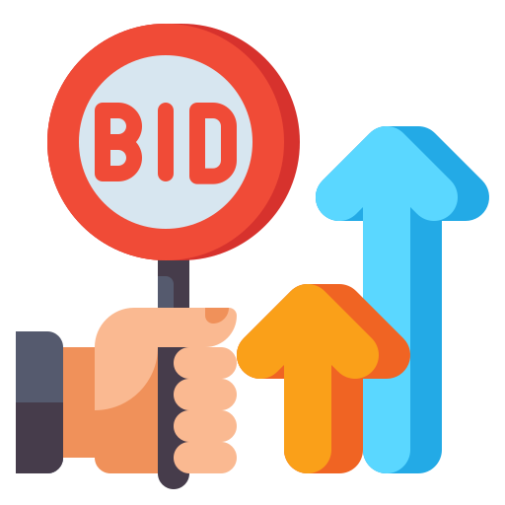




Strategy (2/2)
7
Finding software and catching hardware​
Phase 3: once adoption is high and data is abundant
Generating value from data
Predictive analytics for fishers
Data for retailers
Data for
researchers and policy makers
Enhanced real time auction systems
Capturing value from bigger margins
Additional value streams
Pat Wichitwechkarn | Bethan Moncur | Jack Foster | Garry Clawson
Notes:
Phase 3: utilising data for predictive analytics
Phase 4: enhanced real time auction systems to increase margins and simplify supply chain
Phase 5: Accumulate high quality data to move the ecosystem away from the default precautionary approach – generate environmental value
- current technology now allows the automation of filling out forms lower cost for fishers. Encouraging adoption in the current fishing industry
- first phase - potential revenues from eco certification can increase revenue while also support adoption of data driven services in the future
- second phases – broader revenue streams are provided through direct to consumer fish ordering and predictive analytics for catching
- third phase – by self certifying and price setting using automated markets fishers can improve their confidence and margin levels
- fourth phase – using enhanced real time auction systems we can begin to self manage sustainability
- fifth phases – accumulate high quality data will move the ecosystem away from precautionary approach

Slide 9
Initial Revenue Streams
Pat Wichitwechkarn | Bethan Moncur | Jack Foster | Garry Clawson
Notes:
- phases 1
- phase 2
- phase 3

Slide 10
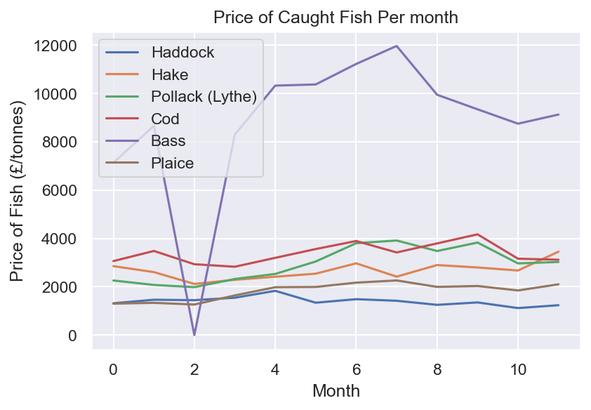
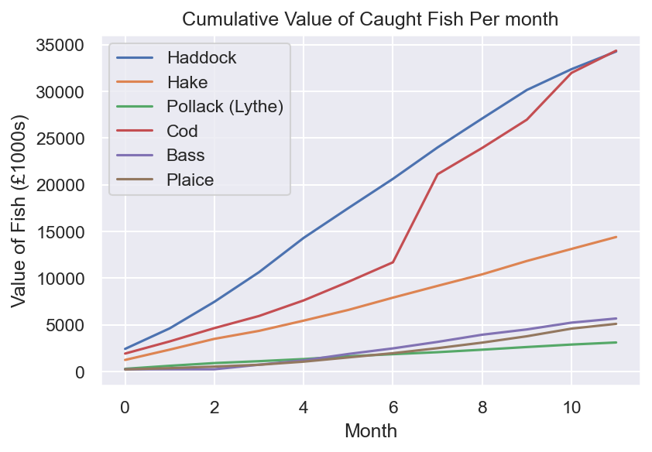
Fish Insights and Selection
8
Initial focus on luxury/high-end fish -> sea bass
Will also touch on potential gains from Haddock/Cod as these are highest value fish
Pat Wichitwechkarn | Bethan Moncur | Jack Foster | Garry Clawson

Slide 11
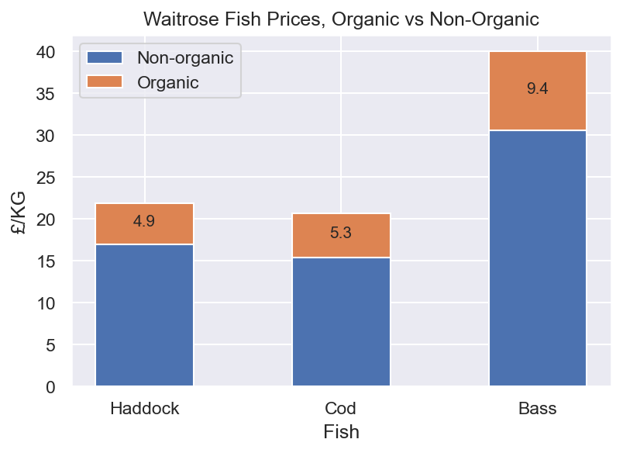
Eco-certification Graphs
9
Fish | Potential Annual Gain
Haddock | £9,995,772
Cod | £10,615,366
Sea Bass | £1,944,181
Pat Wichitwechkarn | Bethan Moncur | Jack Foster | Garry Clawson

Slide 12
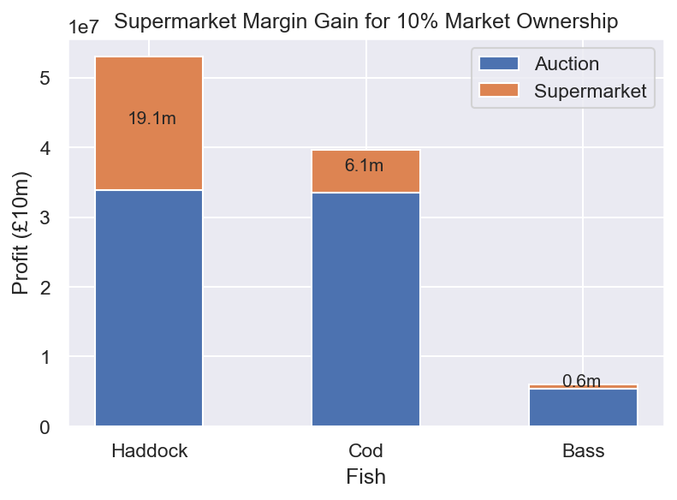
Retail Margins
10
Fish | At 10% of quantity
Haddock | £19.1m
Cod | £6.1m
Sea Bass | £0.6m
Pat Wichitwechkarn | Bethan Moncur | Jack Foster | Garry Clawson

Slide 13
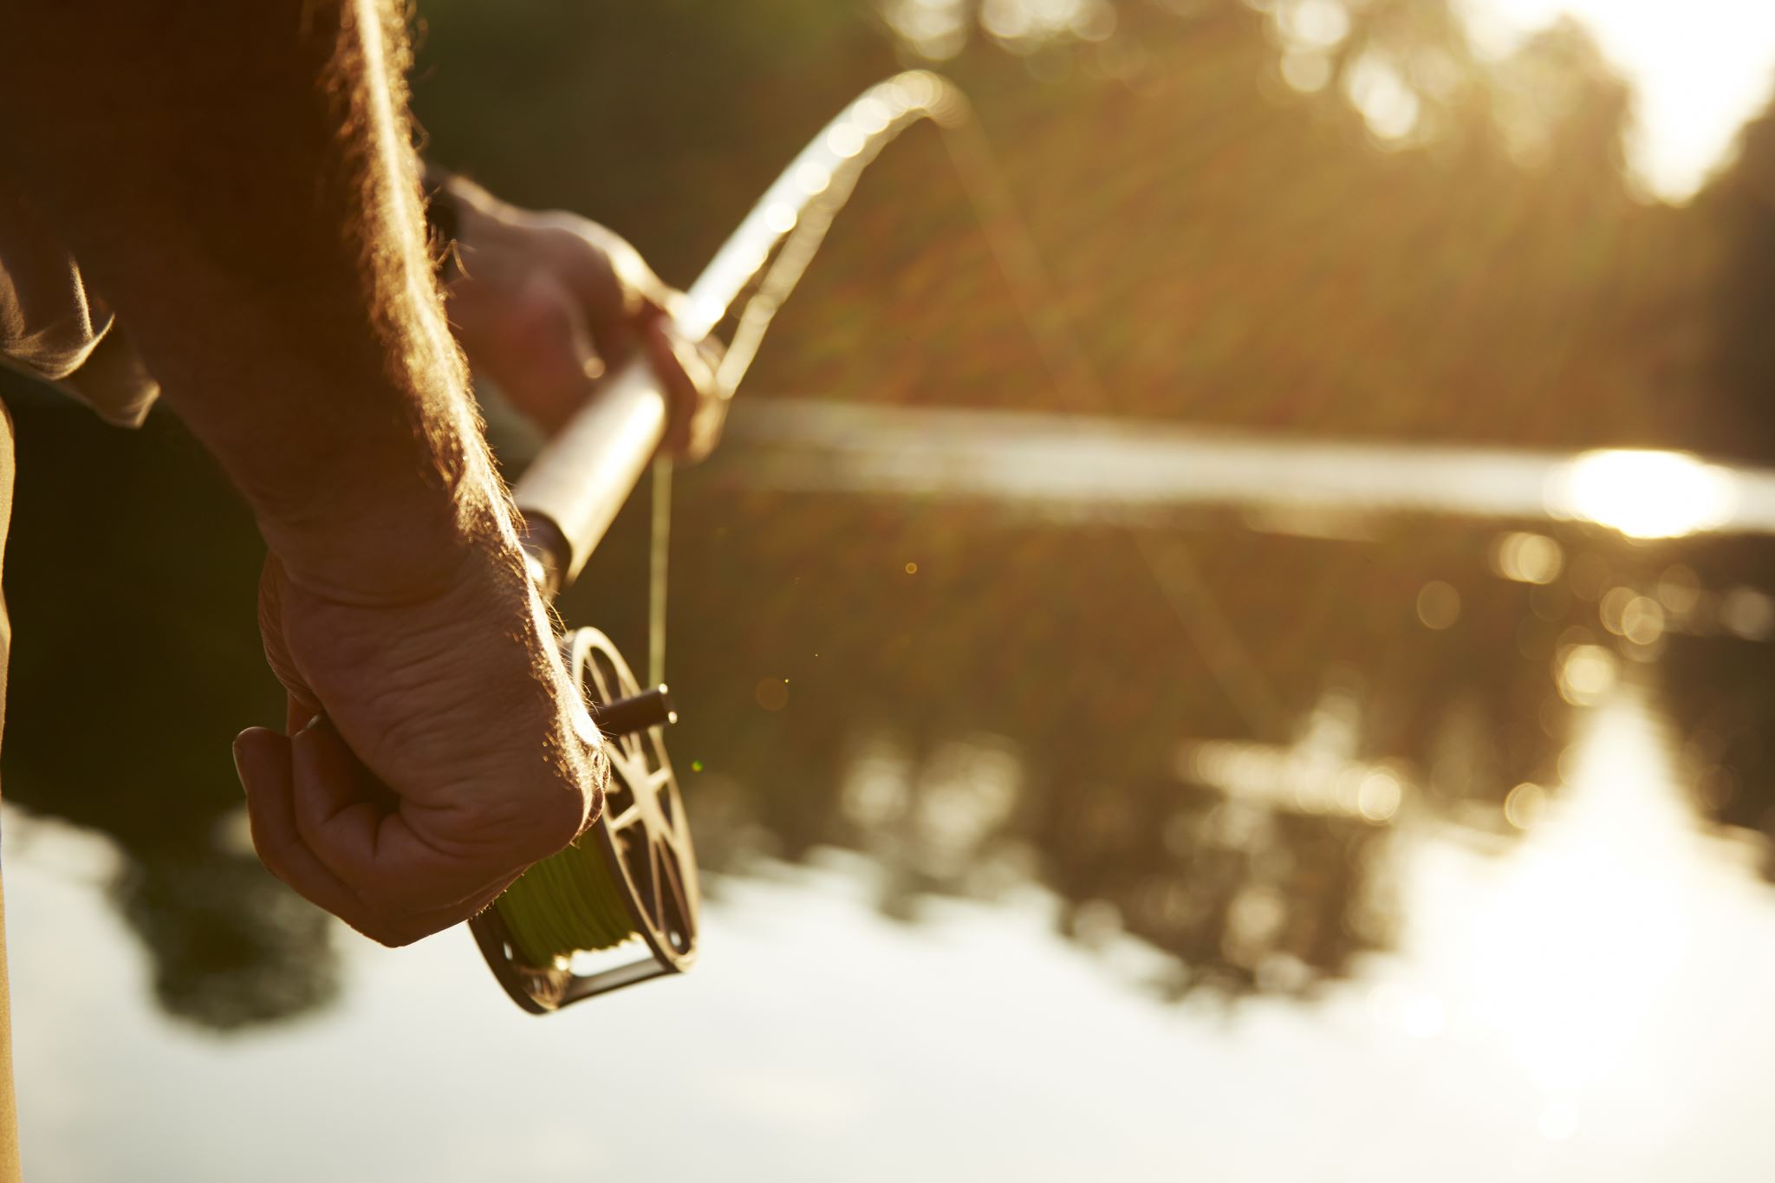
Cost reductions: RodBot
11
Average UK fisher salary is ~£20,000 [1]
~4600 small vessels registered in the UK in 2019 [2]
If we replace 1 retiring fisher per boat, we could save ~£92m/yr
[1] uk.talent.com/salary?job=fisherman
[2] UK sea fisheries statistics 2019 marine management organisation
Pat Wichitwechkarn | Bethan Moncur | Jack Foster | Garry Clawson

Slide 14
Operations Model
Pat Wichitwechkarn | Bethan Moncur | Jack Foster | Garry Clawson
Notes:
- phases 1
- phase 2
- phase 3

Slide 15
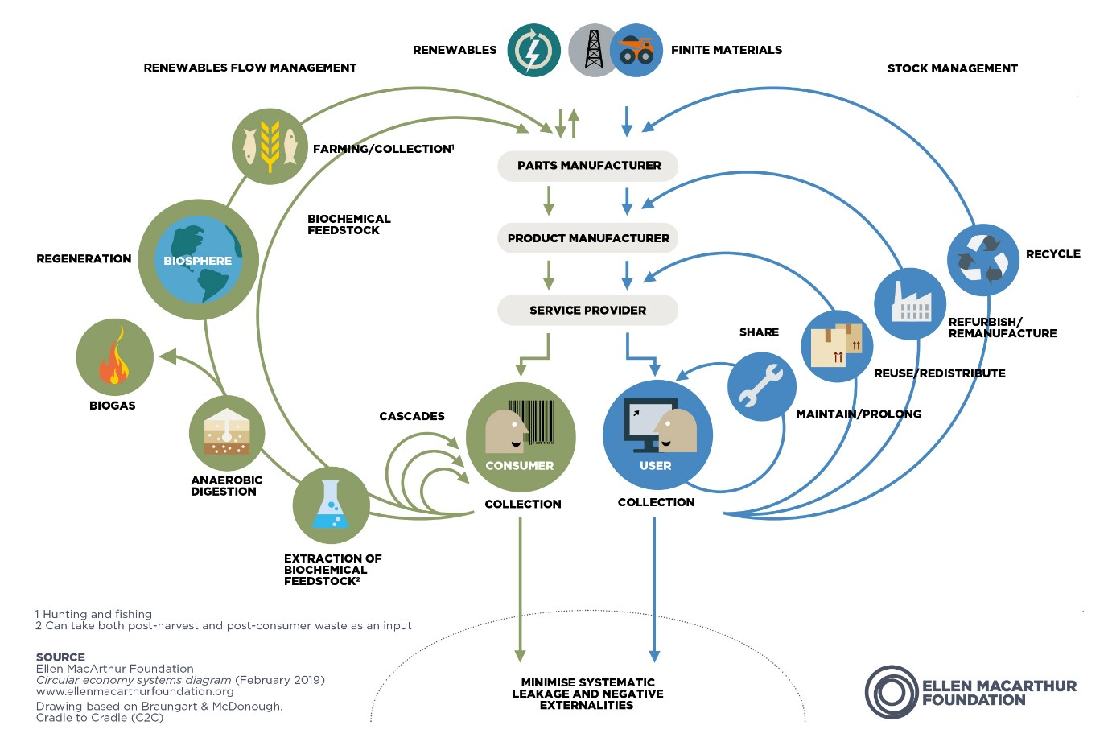


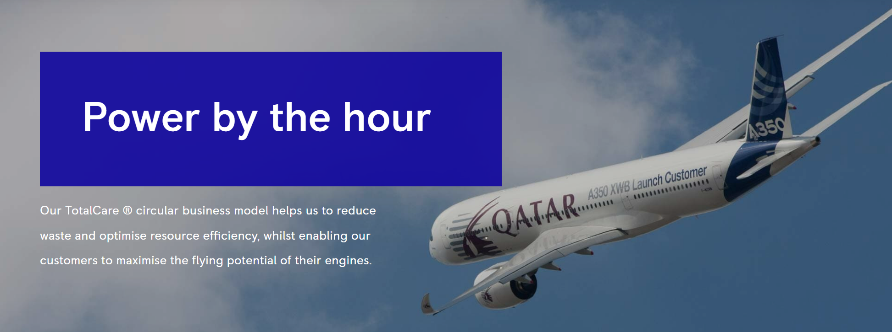
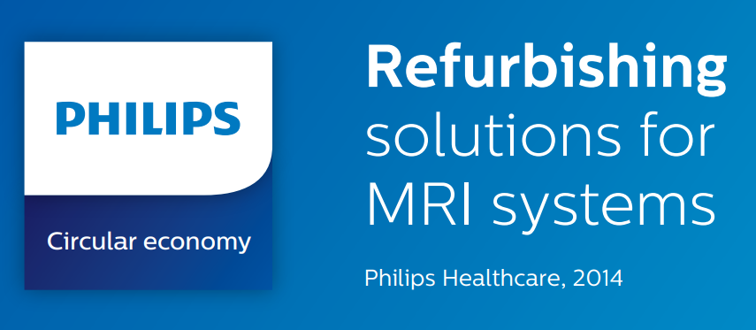



Fishing as a service
12
Extend lifecycle of physical assets
Longevity of revenue
Strong customer relationships &
Reduction in high barrier costs
Pat Wichitwechkarn | Bethan Moncur | Jack Foster | Garry Clawson
Notes:
Capturing economic, environmental and societal value for stakeholders
Circular economy: moves from a linear economy to one that is restorative or regenerative by design – rewards conservation and restoration. Allow sustainable consumption of biological resources (fish) whilst eliminating losses in technological cycles by retaining ownership of technology. This enables sharing of technology (for example shifting between fishers for different species seasons) as well as prolonged life of the technological components through managing repair, remanufacture and eventually recycling of components.

Slide 16

Summary
13
Transition to automation requires intermediate steps
Service-based business model to drive adoption of new technologies
Leverage data to generate value for all stakeholders
Pat Wichitwechkarn | Bethan Moncur | Jack Foster | Garry Clawson

Slide 17
Thank you for your time
Any questions?
Poisson Distribution
Pat Wichitwechkarn | Bethan Moncur | Jack Foster | Garry Clawson
Notes:
- phases 1
- phase 2
- phase 3

Slide 18
Appendix – More Ideas
Improved traceability through real time data capture
Improved auctioning – real time of fish as well as real time quota
Leveraging data from automation such as AI for real species management
Service model allows for more flexibility amongst small fishers
Pat Wichitwechkarn | Bethan Moncur | Jack Foster | Garry Clawson
Notes:
- UK fishing is a declining industry with UK fishers landings (in tonnes) has almost halving in landings since 1950 with UK boats landing only 29% of UK EEZ fish
-

