Slide 1
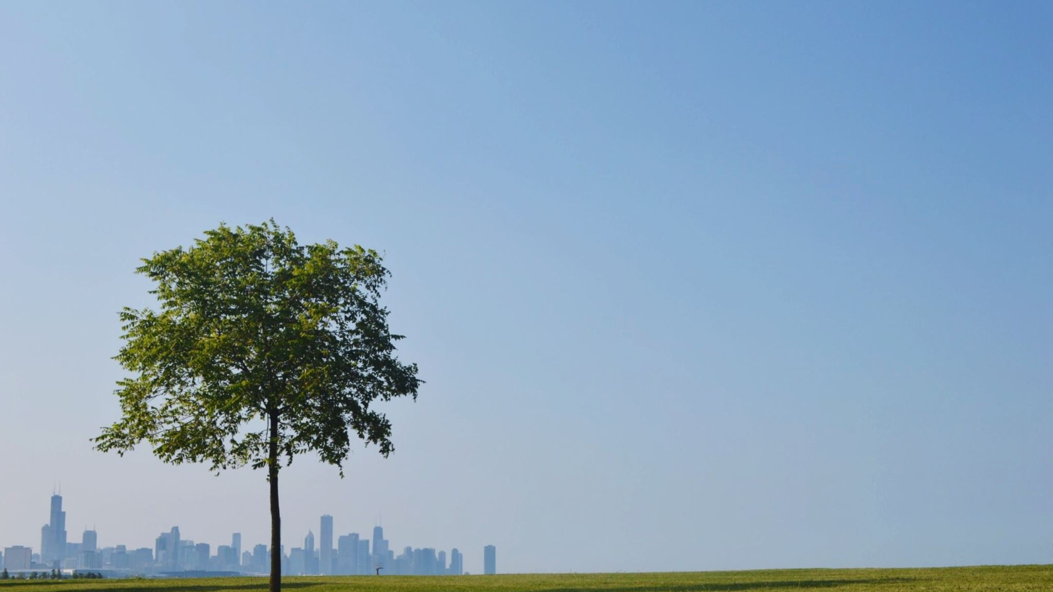
Are greener cities happier?
An exploration of urban greenness & life satisfaction in European cities
Robert Rommel • WBS Codin School • October 2026
Notes:
Hello and welcome to my project!
As you can probably see, my topic is „Are Greener Cities Happier?“
It‘s a little exploration of urban greenes & life satisfaction in European cities

Slide 2

Can a city affect how satisfied the residents feel?
Modern city life can feel fast-paced and demanding, surrounded by screens, concrete, and constant activity and noise.
In a dense urban environment, it can sometimes feel as though there is little room to breathe.
Notes:
First of on how I got to this topic:
For me, especially during university and school, days were quite repetetive with the same ways and paths from and to school/uni
Since it was right in the city center, it was just roads, cars and mostly colorless blocks surrounding me.

Slide 3

Green infrastructure as an escape
Parks, gardens and other urban green spaces offer opportunities to walk, relax, connect with others, and step away from the pace of city life.
Notes:
At some point on my way home, or just general ways through the city I started to take detours through nearby parks or more green and colourful areas.
It was a way to walk, relax and get away from the busy pace of city life

Slide 4

Are greener cities actually happier?
Notes:
And this goes back to my main question:
ARE GREENER CITIES ACTUALLY HAPPIER?

Slide 5
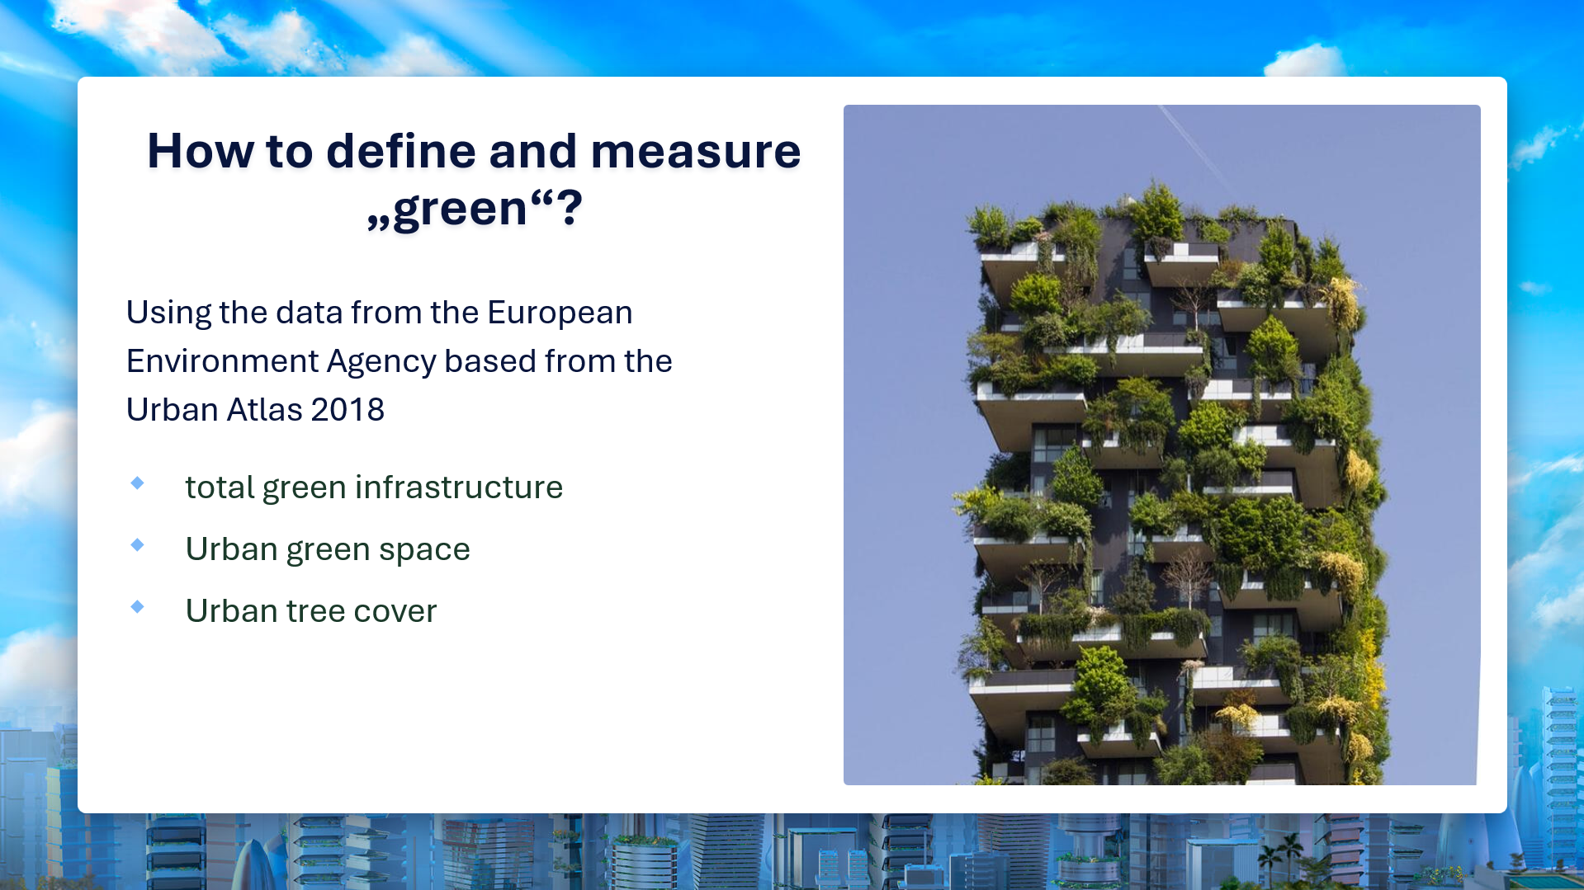
Notes:
To answer this, I‘d need a way to define and know how to measure „green“ for a city
For this I used the Europoean Environment Agency‘s dataset which is based on the Urban Atlas, 2018.
While I took all three points, Urban Green Space, Urban Tree Cover, my main focus was on „total green infrastructure“, since that‘s the closet and broadest one fitting my question

Slide 6
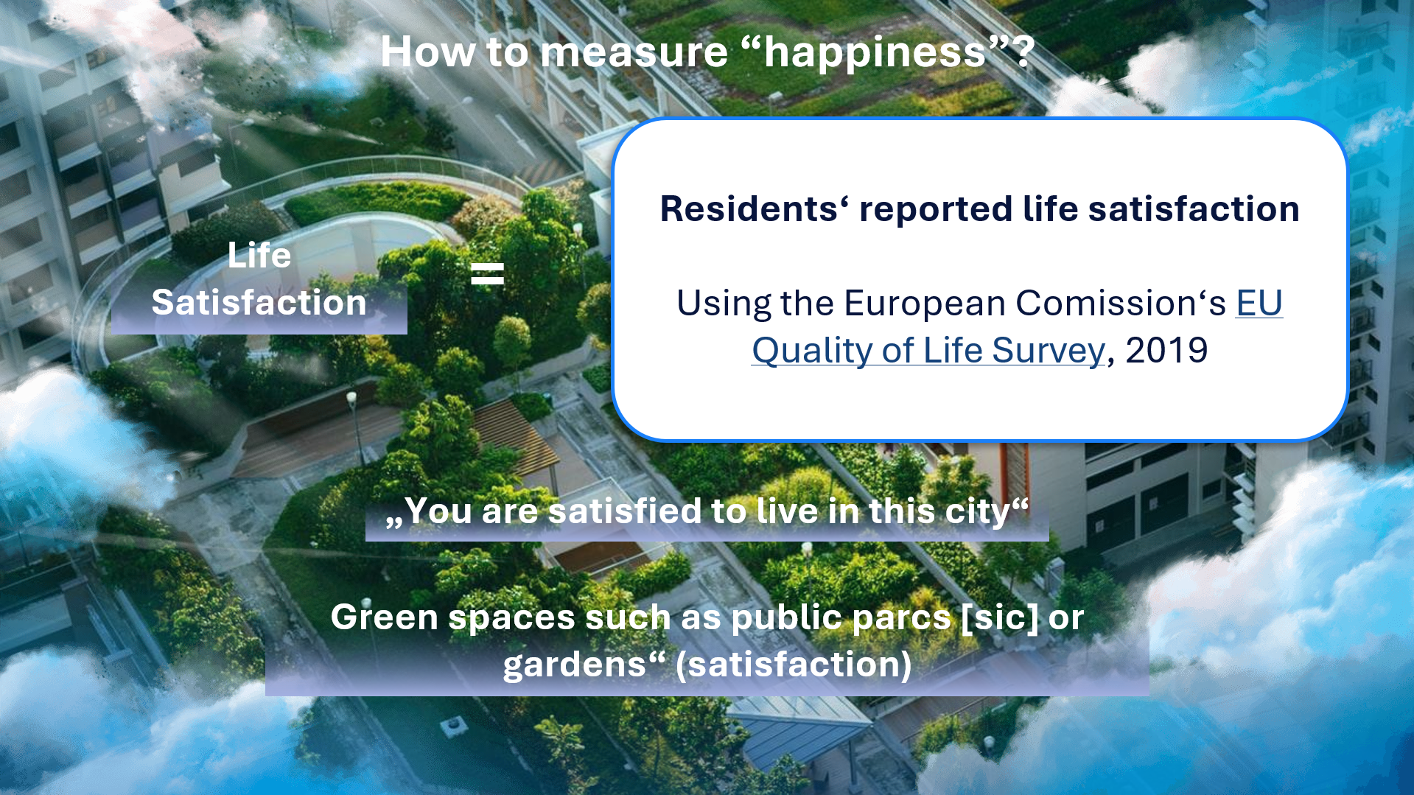
Notes:
The same goes for measuring happiness:
I looked at LIFE SATISFACTION:
For this I used data from the European‘s Comission‘s Quality of Life Survey, 2019
Using these two survey questions for my analysis
„YOU ARE SATISFIED TO LIVE IN THIS CITY“
„GREEN SPACES SUCH AS PUBLIC PARCS OR GARDENS“ (Satisfaction)

Slide 7
How to compare different European cities
The Data
Matching the available datasets left me with 29 capitals that could be compared.
Perspective
“Quality of life is higher in small and medium-sized cities…”
— Quality of Life in European Cities survey
Notes:
From the datasets I get 29 overlapping citites, which are all capitals
Since the survey speaks of the quality of life being higher in small and medium-sized cities, capitals are ideal candidates to compare, since they‘re usually bigger

Slide 8
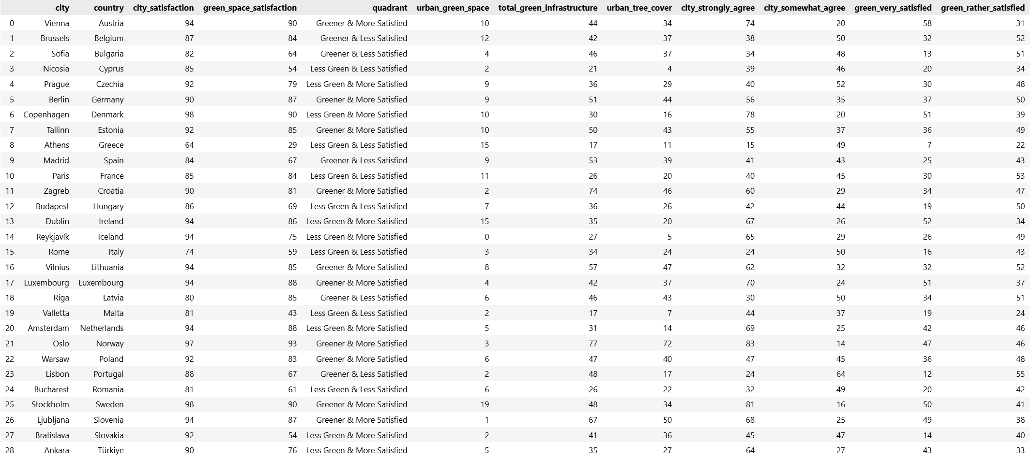
The data
Notes:
Here we can see the data I end up working with for my analysis
I summarized both positive values from the survey for city and green space satisfaction into
CITY SATISFACTION
GREEN SPACE SATISFACTION

Slide 9
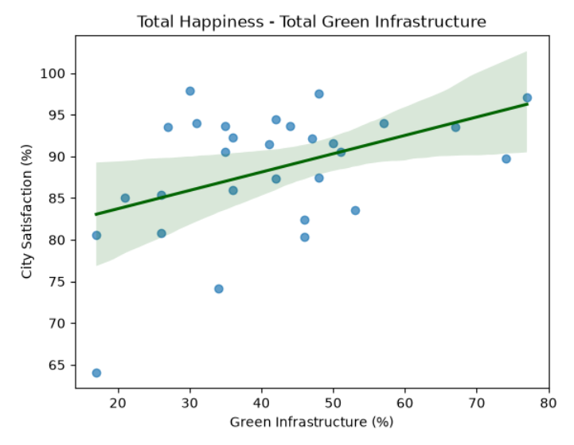
First analysis
Correlation between
Total city satisfaction / very happy
To:
total green infrastructure
Urban green space
Urban tree cover
Notes:
Before I started a deep dive I first did a first analysis where I looked at the correlation between total city satisfaction / people that are very happy in the city to
Total Green Infrastructure
Urban Green Space
Urban Tree Cover,
Though here again, only using the first one.
The graph shows the cities scattered around, but over all it hints to an upward trend

Slide 10
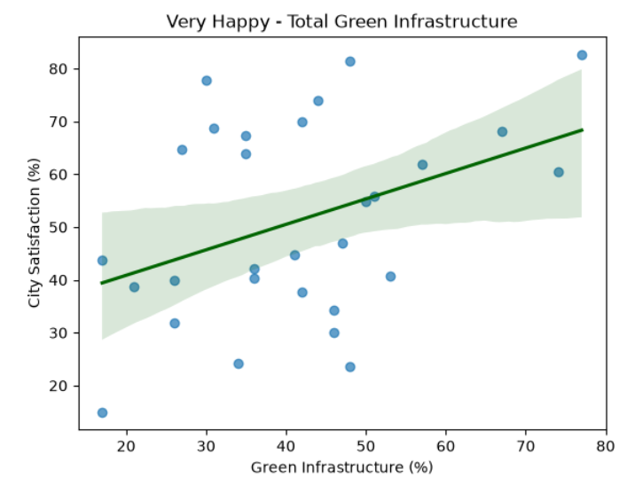
Very happy and total city satisfaction show a similar trend
Notes:
Here is the graph with the very happy people, it shows a similar upwards trend like with the total satisfaction

Slide 11
Key findings
The relationship
Green infrastructure and city satisfaction appear to move in a positive direction in the analyzed sample
The differences
Cities vary in both greenery and satisfaction
=> green infrastructure is only one part of it
The limitation
This comparison of 29 capitals cannot establish causation or represent every European city
Notes:
My key take aways are:
The relationship
Green infrastructure and city satisfaction appear to move in a postive direction in my analyzed samples
The differences
Each city is still very different to the other in greenery and satisfaction
green infrastructure alone is only part of it
The Limitations
The comparision is only of 29 capitals and it cannot establish causation or represent every European city

Slide 12
Further analysis in Tableau
Notes:
For the rest let‘s move to Tableau

