Slide 1
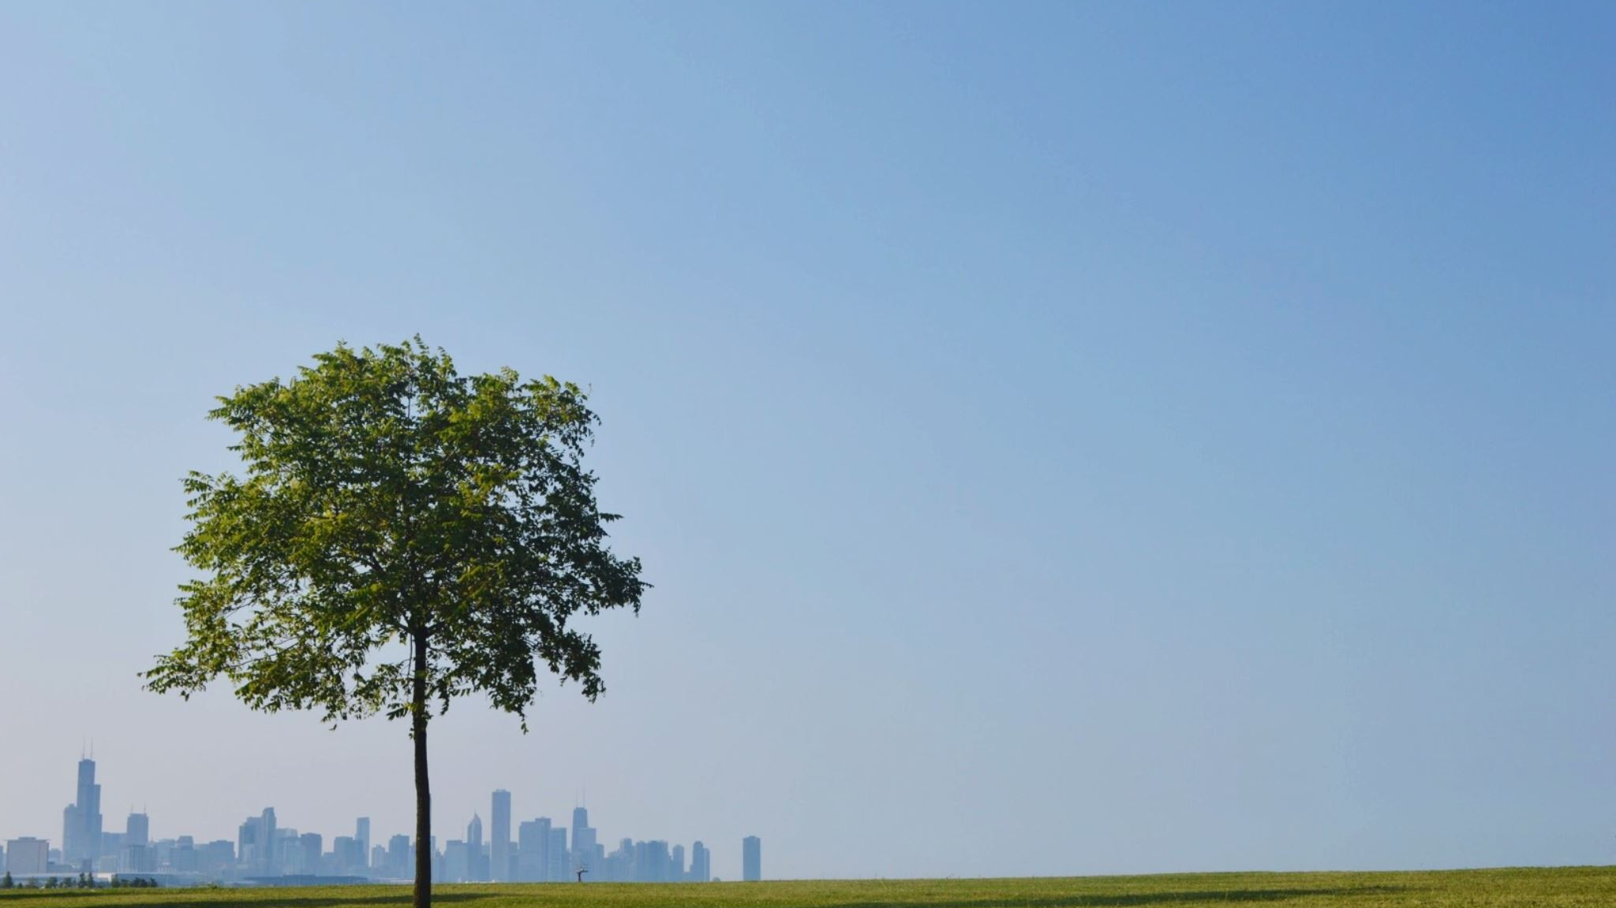
Are greener cities happier?
An exploration of urban greenness & life satisfaction in European cities

Slide 2
Can a city affect how satisfied the residents feel?
Modern city life can feel fast-paced and stressful, dominated by screens and concrete.
However, parks and green spaces offer opportunities to walk, relax and socialise, which can potentially improve residents’ well-being and satisfaction
do greener cities have more satisfied residents?

Slide 3
How to define and measure „green“
Green Space
Share of city area classified as green urban space
Access
How much green area can residents reach on foot
Trees
Urban tree cover where available
Primary measure: share of city area covered by green urban space
Access and tree cover provide additional context where data is available.

Slide 4
How to measure „happiness“?
Residents‘ reported life satisfaction
Using for example the EU Quality of Life Survey
=
Life
Satisfaction
Better access to green spaces
=
Greater statisfaction
Wellbeing
&
Healthy Cities

Slide 5
Where the data comes from
Quality of Life in European Cities
European Comission
Urban Atlas
EEA / Copernicus
European city air quality
EEA
City statistics
Eurostat

Slide 6
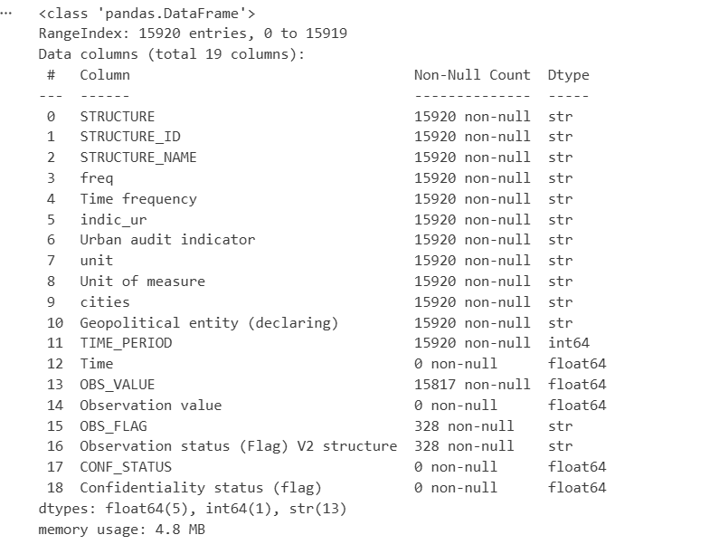
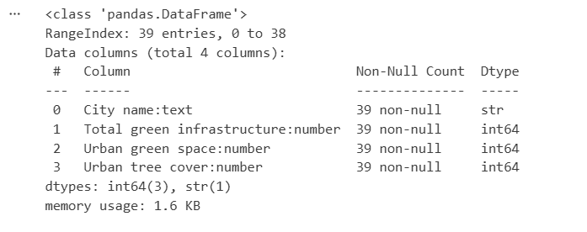
Data Journey
Survey Data
Green Space Coverage
Adjustments: Column names, dropping unrelevant & not needed columns, data types, fixing city names, adding countries, keeping the data within shortest time span, seperating relevant surveys

Slide 7
Additional Surveys
Satisfied to live in this city
Satisfied with the green spaces
If it‘s a healthy city to live in
Satisfied with the air quality

Slide 8
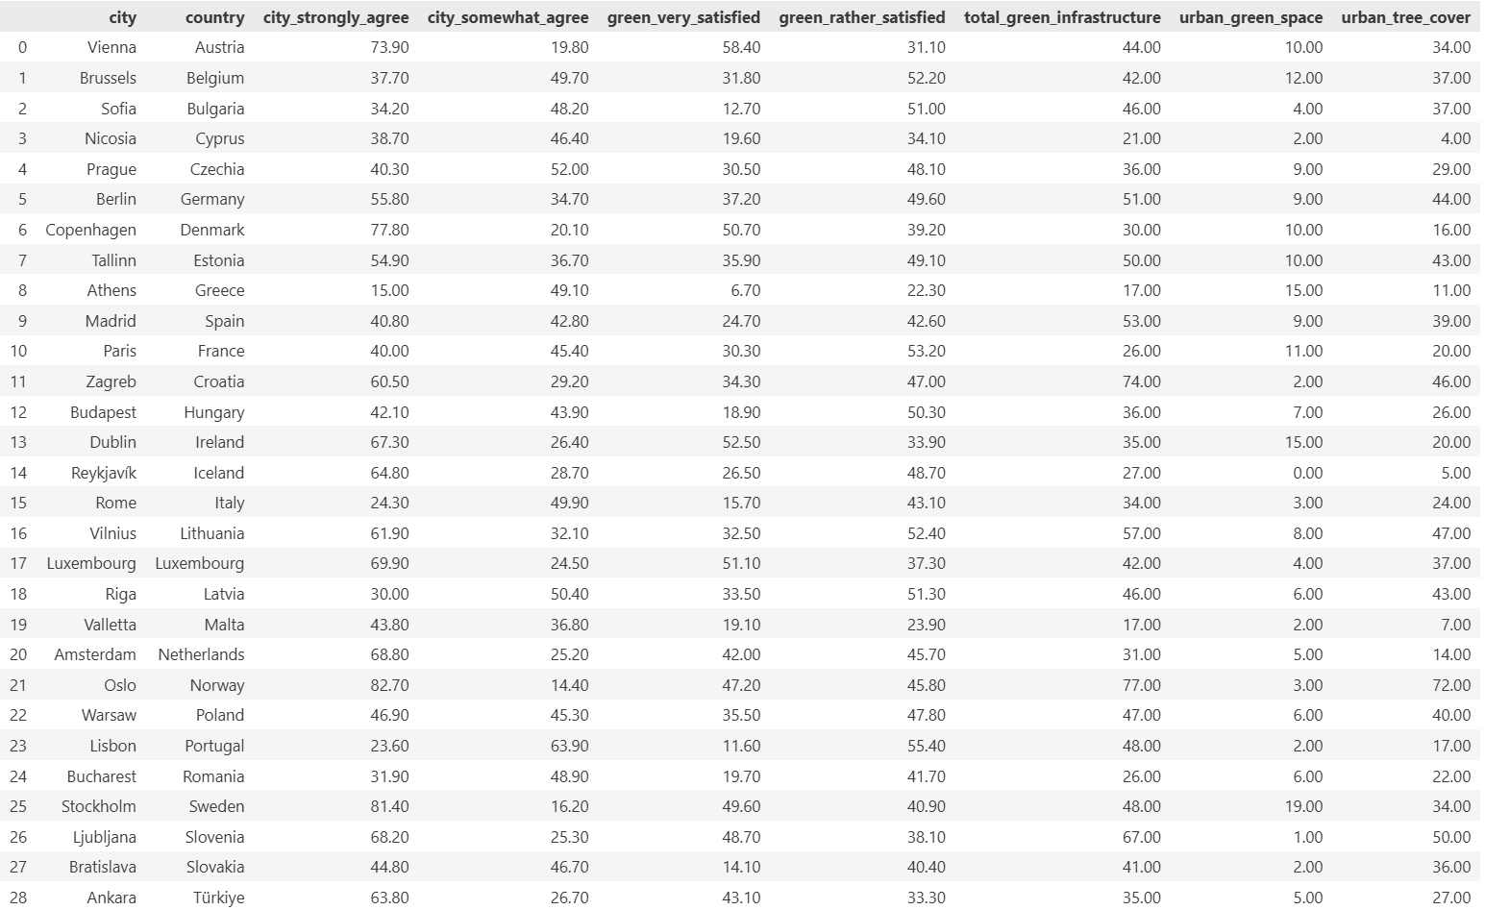
Creating a master sheet
Matching cities, countries, satisfaction to live in city and with green spaces, green space coverage

Slide 9
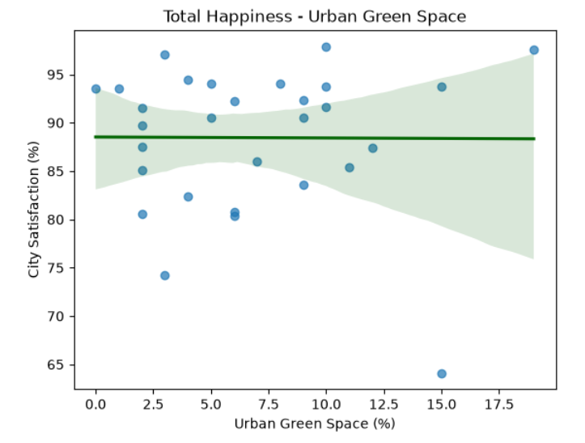
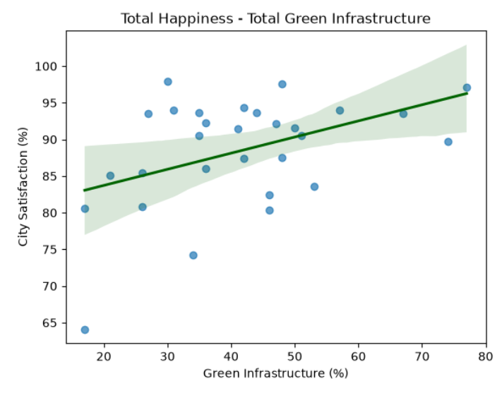
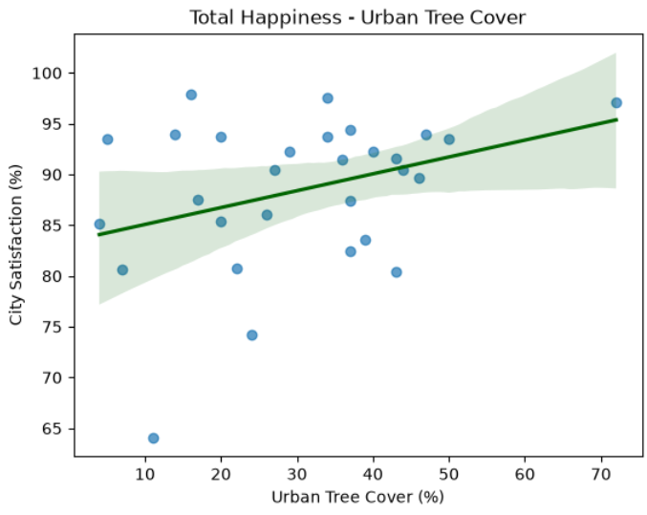
Correlation Analysis

Slide 10
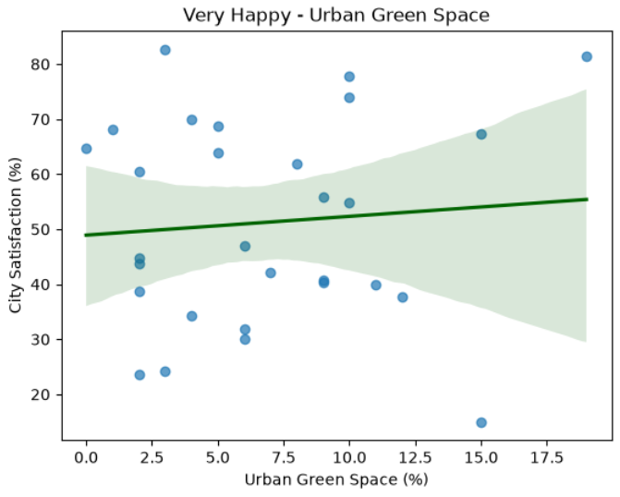
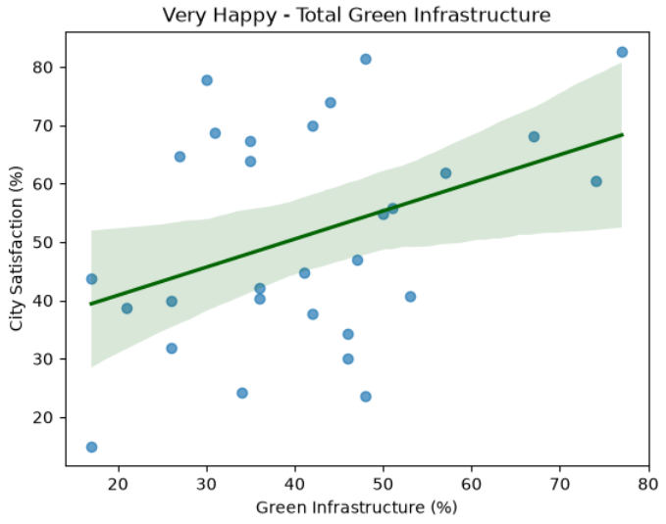
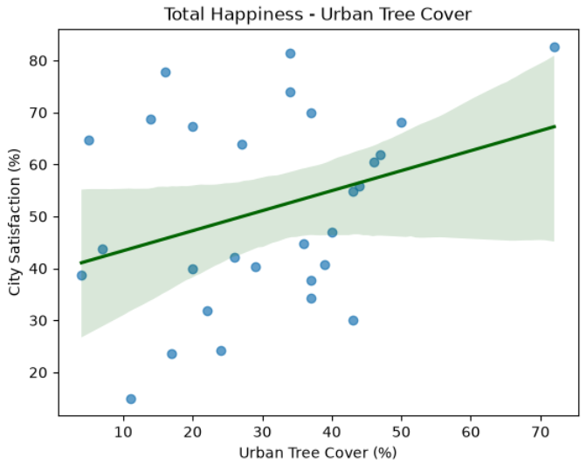
Correlation Analysis

Slide 11
How will the question be answered?
Correlation is not causation
A greener city can be more satisfied without greenery being the reason
Green not equal to access
A city can have lots of green area that is not reachable or usable by residents
City context matter
Income, housing, mobility, climate and other differences shape life satisfaction
Goal: Find a clear pattern without claiming that green causes happiness

Slide 12
How will the question be answered?
Match citites
Find cities in the datasets
Compare
Relate green-space share to reported life satisfaction
Visualise
Strong focus on the visualisation of the data

Slide 13
Work approach
Find & Clean the data
Match the data to the cities, keeping only cities that can be comapred reliably
Analyse and test the the correlation; flag outliers
Visualize the data

