Slide 1
Eniac’s Discount Strategy

Slide 2
Eniac’s Discount Strategy
Are discounts beneficial?

Slide 3
Eniac’s Discount Strategy
Are discounts beneficial?
Marketing Team: discounts ⇒ attract customers
Board: aggressive discounting ⇒
- hurt revenue
- weaken Eniac’s position as a quality‑focused brand

Slide 4

Eniac’s Discount Strategy
Are discounts beneficial?
Yes!
Notes:
Ciba

Slide 5
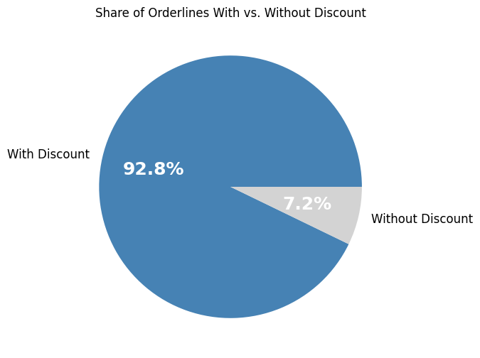
Most sold products are discounted
Notes:
Ciba

Slide 6
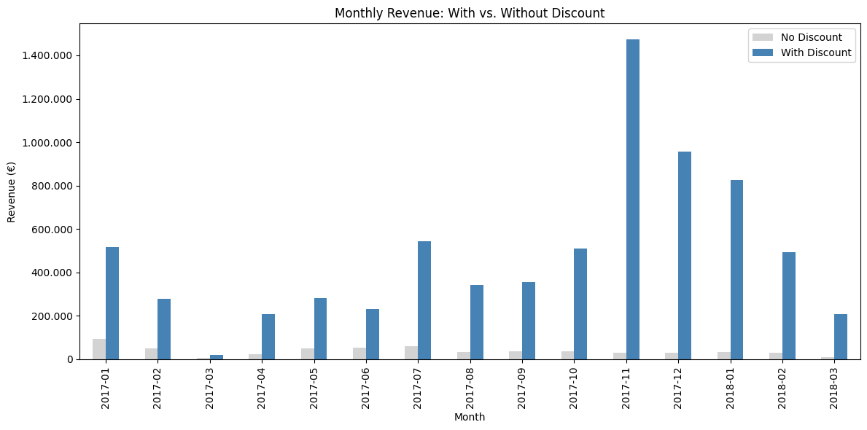
Most of the revenue comes from discounted products
Notes:
Ciba

Slide 7
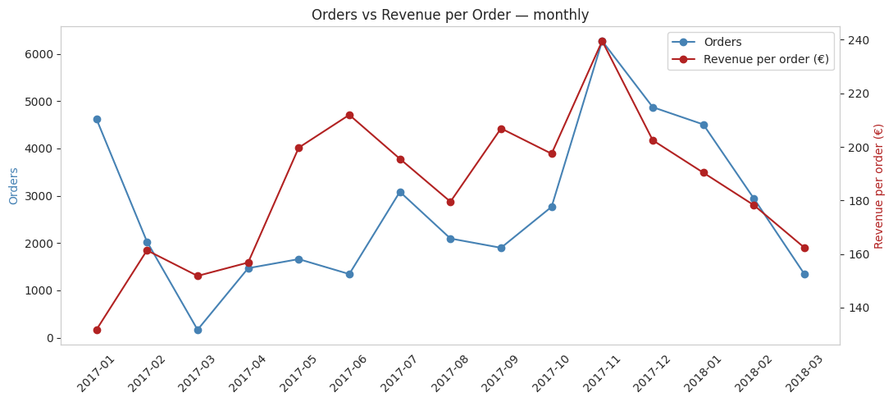
No decrease in revenue and increase in orders
Notes:
Javier

Slide 8
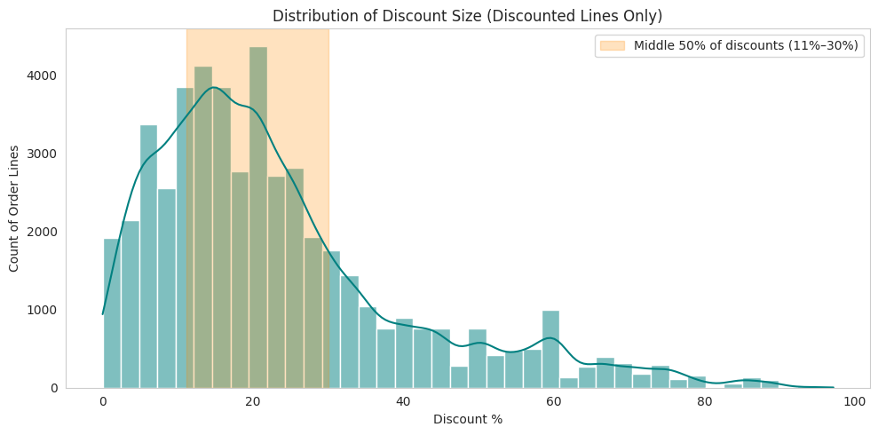
Discounts are moderate
Notes:
Javier

Slide 9
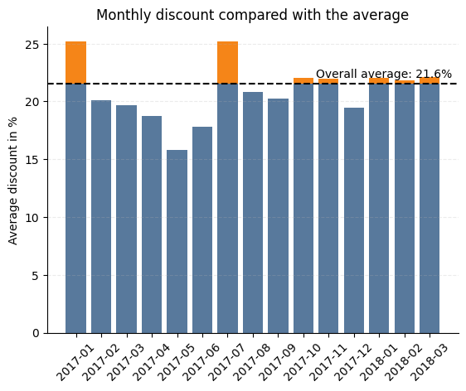
Discounts are moderate
Notes:
Robert

Slide 10
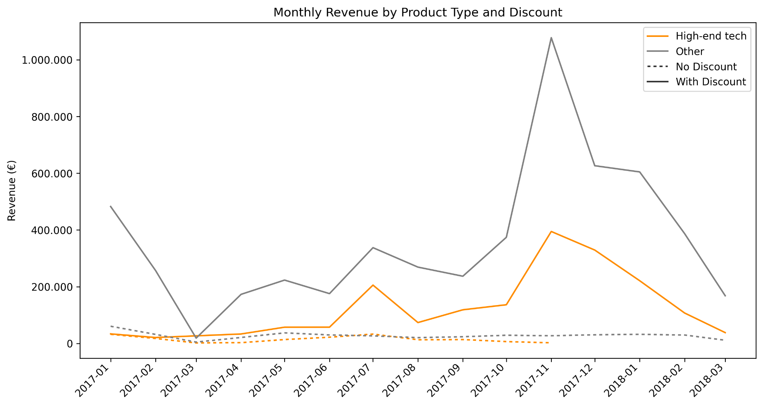
High-end tech:
More revenue when discounted, but not much revenue altogether.
High-end tech:
Desktops
Laptops
Smartphones
iPads
iPods
Notes:
Tatiana
Since Eniac’s main focus is on premium, high end tech, we decided to separate out this category and see if it behaves similarly to the rest of our products
On this graph, the high-end tech is represented by the orange line, as opposed to the other products in gray.
What we observe here is that high-end tech generates more revenue when discounted - the solid line WITH discount is much higher than the dotted line with NO discount This is similar between the high end tech and other products
What is different though is that the high-end tech does not generate as much revenue as the other products, so high-end tech is not our core category at the moment.
The final thing that we can see here is that there is a peak in revenue around the end of year for both product types, and if we zoom in on this seasonality…

Slide 11
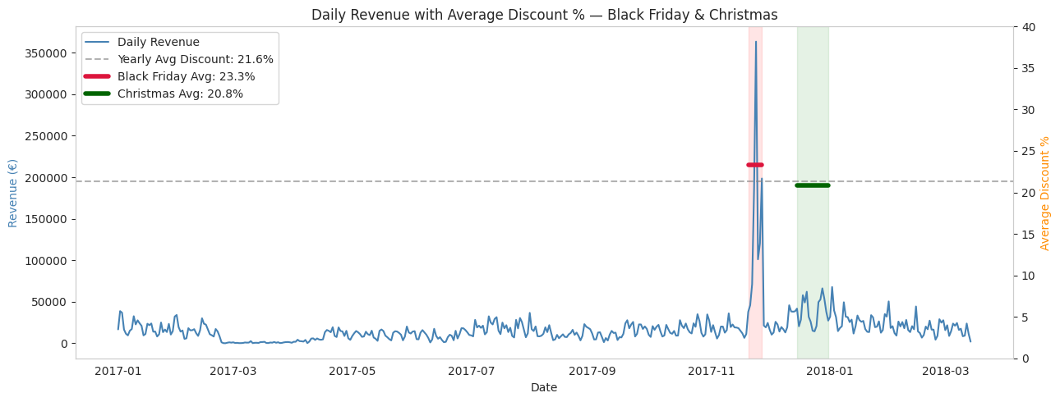
Customers buy seasonally but not because of discounts!
Notes:
Tatiana
… we will see that the peaks are on Black Friday and around Christmas, the 2 highlighted time periods here And - during these peak times the discounts are still quite moderate - look at the two bold lines. The discounts remain around 20%, not much different from the average discount throughout the year. So our customers do buy seasonally but this is not because of aggressive discounts!

Slide 12
Sum up
Action points: - Keep discounts around 20% - To place ourselves in the quality segment, increase sales of high-end tech
Data improvements for future analyses: - Missing data - Customer data - Human-readable product categories
Notes:
Robert

Slide 13


