Slide 1


MOXA Interview
John Dall’olio

Slide 2

AGENDA
CNA: Responsibilities of a CVE Numbering Authority
Actions and Recommendations for PSIRT handling with conditions:
a. Discovery of a serious Zero-Day vulnerability
b. R&D cannot fix the issue within the required time frame.
Questions?

Slide 3
CNA - CVE Numbering Authority
CNAs are authorized to issue CVE IDs and manage CVEs that is within a clearly defined scope, following predetermined rules dictated by the program Root CNA, in order maintain a coordinated vulnerability tracking system.
Ref: CNA
Notes:
https://www.cve.org/PartnerInformation/ListofPartners/partner/Moxa

Slide 4
Handling a Zero-Day Vulnerability
Scenario:
A serious zero-day vulnerability has been discovered by the engineering departement
The R&D are unable to resovle the issue in the required time frame
What are actions would you take?

Slide 5
Steps 1 - 8
1. Vulnerability Qualification
2. Verify Severity
3. Advise Internal Stakeholders
4. Reproduce the vulnerability
5. Remediate – Create a temporary workaround(s)*
6. Disclosure
8. Post-Mortem
7. Continue with Remediation
Notes:
Depends largely on the PSIRT maturity level. From the perspective that PSIRT just found out about the issue * likely starting point

Slide 6
Vulnerability Qualification
Verify a vulnerability exists and is not a matter of poor security hygiene. For example, is this vulnerability or an issue related to user not employing multi-factor authentication?
As a CVE Naming Authority (CNA), Microsoft follows the MITRE.org definition of a security vulnerability which defines a security vulnerability as “a weakness in the computational logic (e.g., code) found in software and hardware components that, when exploited, results in a negative impact to confidentiality, integrity, OR availability.
Check that the vulnerability reaches the vulnerability level on the ‘Bug Bar’: https://www.microsoft.com/en-us/msrc/sdlbugbar#:~:text=This%20bug%20bar%20describes%20different,fulfill%20requests%20from%20client%20processes
Notes:
Check that the vulnerability reaches the vulnerability level on the ‘Bug Bar’:
Correlate with Threat Intelligence

Slide 7
Verify Severity
Category Type | Examples
Date and Time | 01/01/01 20:00
Root Cause / CWE | Buffer overflow, hardcoded credentials, race condition CWE-787: Out-of-bounds Write
Attack Surface | Web UI, network service, API, local CLI
Impact Type | Confidentiality, Integrity, Availability, Safety
Exploitability Level | Remote/Local, Privileged/Unprivileged
CVSS Score Range | Critical (9.0–10), High (7.0–8.9), etc.
Product(s)/Component | Affected module, firmware version, library
Threat Context | Zero- Day; Used in the wild (e.g., “Attacked” in CVSS); or Proof-of-Concept exists
Calculate the CVSS score: Calculator
Define Categories and Criteria:
Notes:
Advantages of 2 – metrics that will dictate weakness in dev related to cybersecurity, training requirements, trends in vulnerability discovery, future reference, time to fix data. Are there other impacted products / third party software, clients impacted. Verfiy this is a serious issue.

Slide 8
Advise Internal Stakeholders
Who:
Executives
Engineering
R&D – communication should be ongoing
About:
Situation
Actions taken
Future course of action
Notes:
This is an optional step depending on SOPS

Slide 9
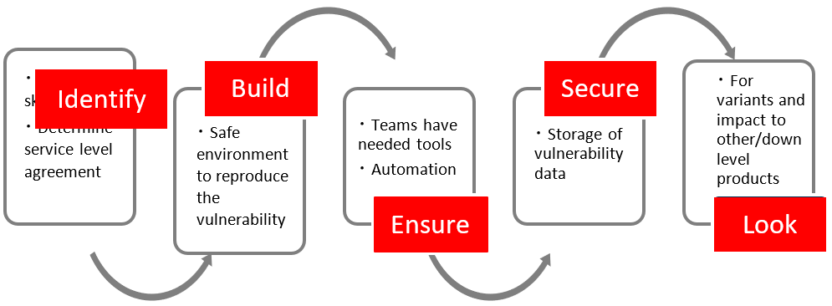
Reproduction
Reproduce the vulnerability
Notes:
Recreate the vulnerability in a safe environment.
- For the Customers/engineering so the can complete risk analysis in their own environment. - Reproducing it is important for disclusoer

Slide 10
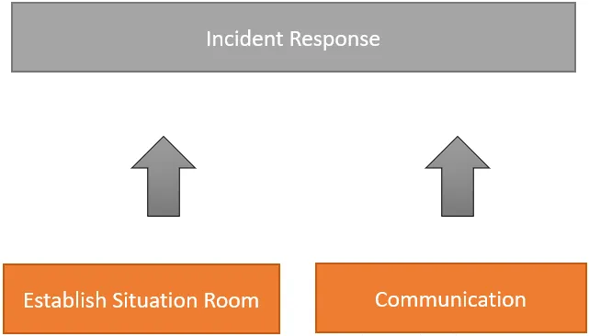
Remediate / Temporary Workaround
Establish a situation room:
SME: Devs, Engineers
Legal, Communication, PR, and other relevant parties
Create temporary workarounds solutions for the issue if remediation not possible and validate workaround.
How Vulnerability impacts all supported products
How will remedy be delivered
When it will be delivered
Notes:
Metrics to consider # CWE, invovled third party components, on-time remediation, # of incidents
Legal considerations, how to handle unplanned public disclosure, how will this impact product development

Slide 11

Disclosure
Common Security Advisory Framework
https://docs.oasis-open.org/csaf/csaf/v2.0/os/csaf-v2.0-os.md
Advise Stakeholders of the issue, temporary workaround, expected timeline, contact information for technical support
Stakeholders include, sales, legal, engineering, support, executives, …
Update internal wiki support documents of temporary workaround, expected delivery time and delivery method
May not disclose publicly until fix has been created*
Notes:
Customers may have issues implementing the workaround, ensure contact information is available for help, update wiki
Do not disclose publicly
– public notices increase attention has a boost threat activity. Notifying the public about a serious vulnerability for which there is no fix dramatically increases the odds of exploit.
CNA requires a fix to publish a CVE – verify
May cause permanent damage business and reputation damage through FUD – fear uncertainty and doubt. If we do disclose: CVE ID
Affected products
Interim mitigations
Estimated fix timeline

Slide 12
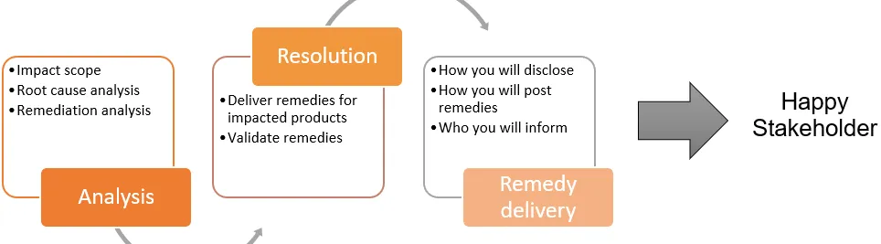
Continue with Remediation
Important Points
Risk Management in the case of no solution:
Notify and document.
How will risk be managed?
Which stakeholders accept risk?
Notes:
Ultimately we want to: Confirm Internal coordination – and workaround
Stakeholder communication
Issue Fix
Communicate and Publish

Slide 13
Disclose FIX
Common Security Advisory Framework
https://docs.oasis-open.org/csaf/csaf/v2.0/os/csaf-v2.0-os.md
Communicate with upstream, downstream vendors, researchers etc.
Gather metrics

Slide 14

Post-Mortem
Conduct a post-mortem of the event and consider:
Time to fix
Bottle necks –> training opportunities
Areas where communication was slow
Areas where communication failed
Neccesary information / supporting documents not available
Parties that need to be added to the emergency incident response team
Identify outdated tools / processes
Methods / tools that would improve the process
Ineffective training areas methods that need to be improved upon
Highlights -> transferable processes across departments
Areas communication succeeded and why
New tools or processes that worked
Training that was effective

