Slide 1
MVVM Explained (Ionic)

Slide 2


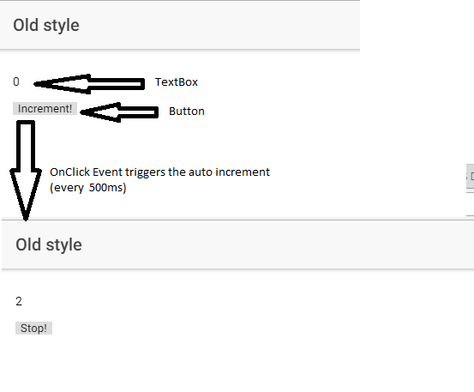

A simple example
A simple page with two UI elements : a Textbox and a Button,
When the button is clicked the value of the textbox is incremented every 500ms,
We may stop the counter any time we desire it,

Slide 3
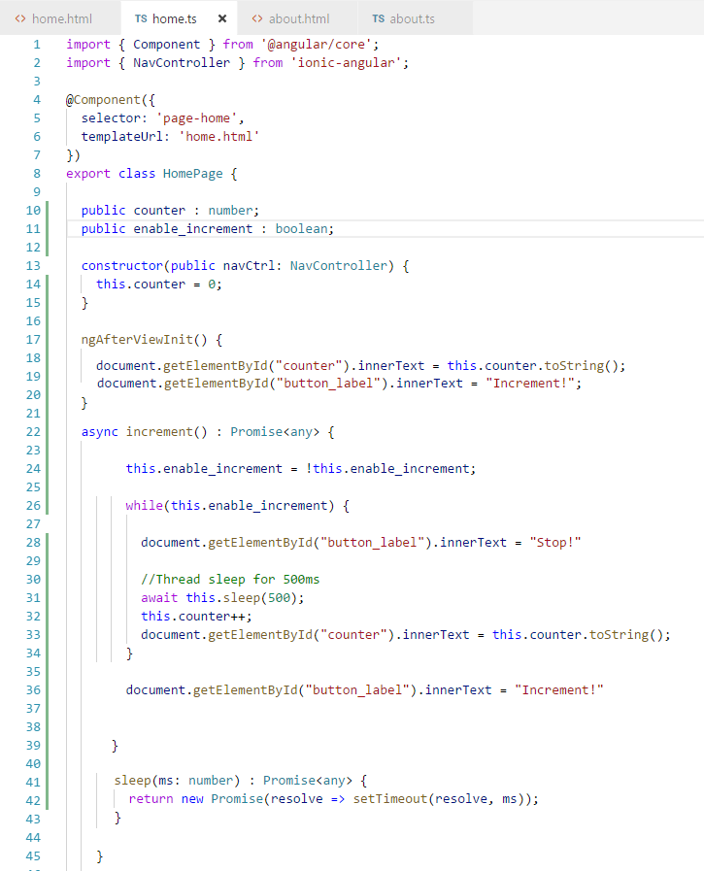
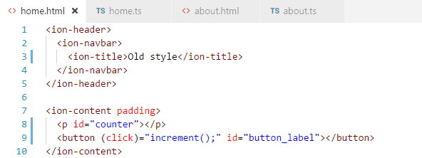
Old style

Slide 4
Old style
View
Code behind
-NB : Dependencies are illustrated via arrows.
-The code behind initializes, references and modifies the view.

Slide 5
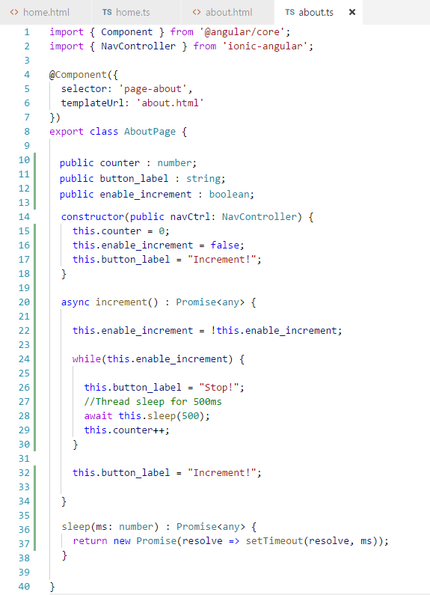
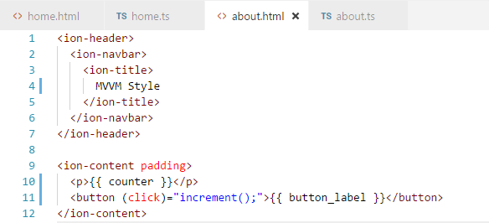
MVVM style

Slide 6
MVVM style
View
ViewModel
-NB : Dependencies are illustrated via arrows.
-The ViewModel is independent of the view.
-The View binds the UI elements to the ViewModel properties, bindings might be in one way mode or two way mode,
-Advantages : We’re able to isolate the ViewModel and unit test it, The ViewModel might be consumed by one or multiple views,

Slide 7
Notes
In order to achieve ‘pure’ MVVM:
The ViewModel should be in a separate class. For pedagogical purposes, these slides re-use the code behind of the view to emulate the behaviour of the ViewModel.
In Web based technologies, separating the ViewModel from the Code Behind is generally not performed.
Bindings allow the Code behind to be void of any code.

