Slide 1
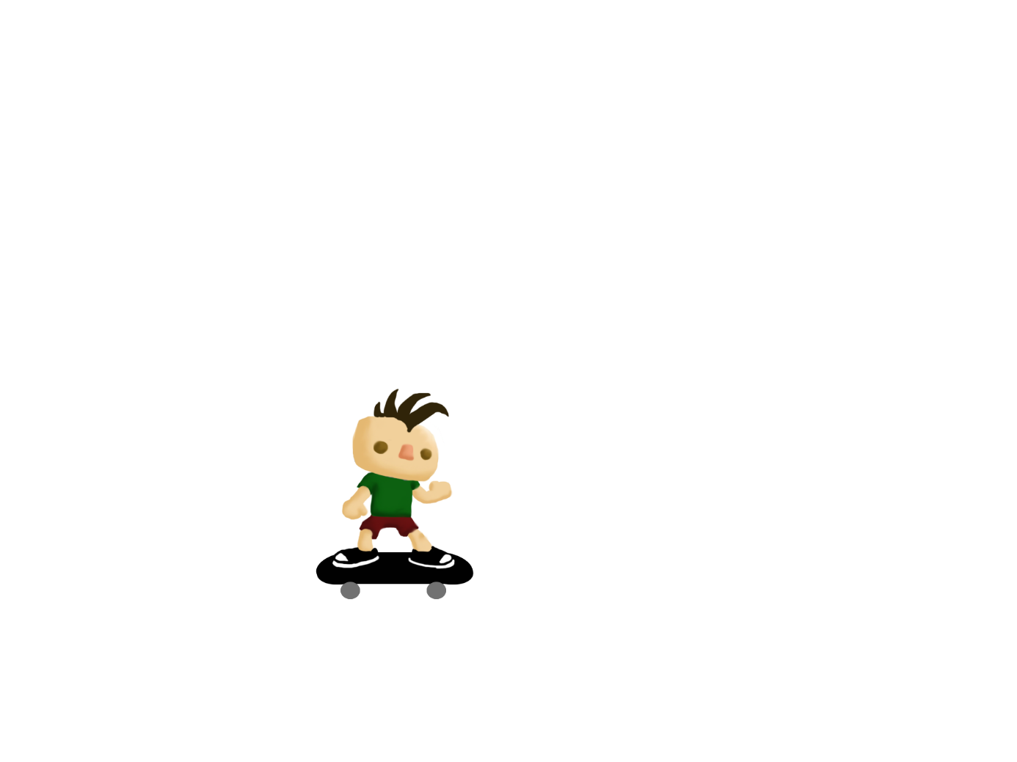
Sk8r Boi

Slide 2

1v1 Multiplayer race

Slide 3


Mechanics

Slide 4
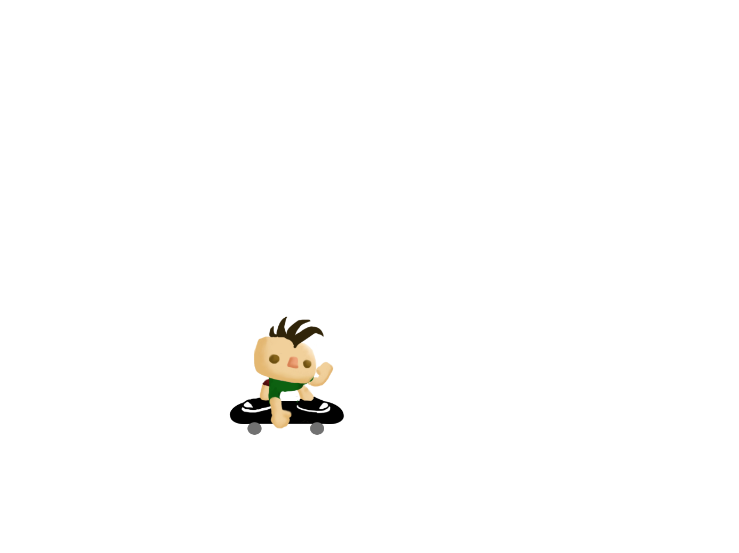
Mechanics

Slide 5
Mechanics

Slide 6
Mechanics
360º = Timed Boost

Slide 7
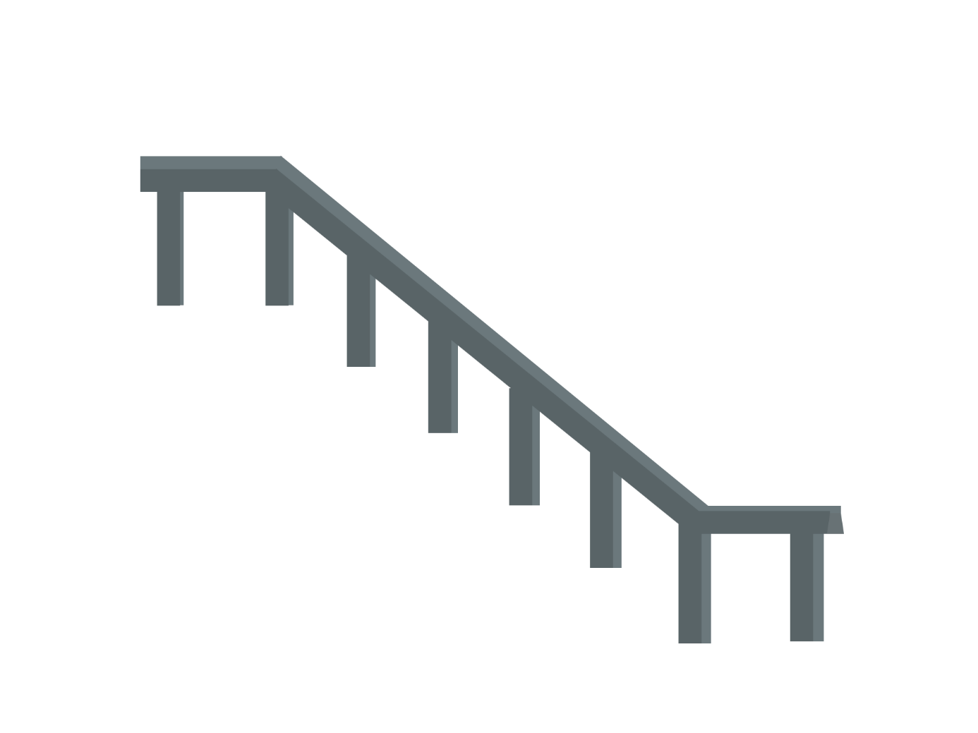
Mechanics
Grind = Boost

Slide 8



Mechanics
Obstacles as
Rubber Banding

Slide 9
Levels
Downtown
Hills
Desert
8 Ball Pool-like
Stages

Slide 10
Levels
Downtown
Predesigned
Segments

Slide 11
Levels
Downtown
Procedurally
Stitched

Slide 12
Levels
Downtown
Same Tier
Many varieties

Slide 13
Monetization
Tier entry fee
Skaters
Grind or Jump tricks
...

Slide 14
Sk8r Boi

