Slide 1
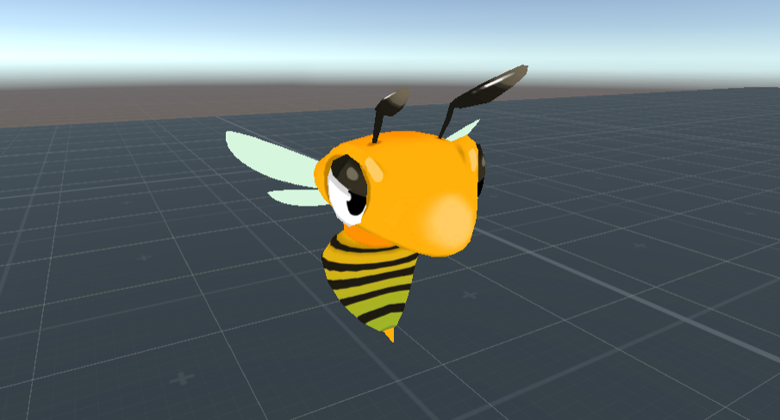
Angry Stingers
Alexander Kalus, Kevin Angermeyer & Jonathan Sasse

Slide 2
Game Concept
Game based in Virtual Reality
Controller: Vive HMD + Controller + Tracker
Player has to defend itself against incoming wasps using a fly swatter and/or anti-insect spray
Play area is a barbecue party that wasps try to invade

Slide 3
Interface

Slide 4
Environment

