Slide 1
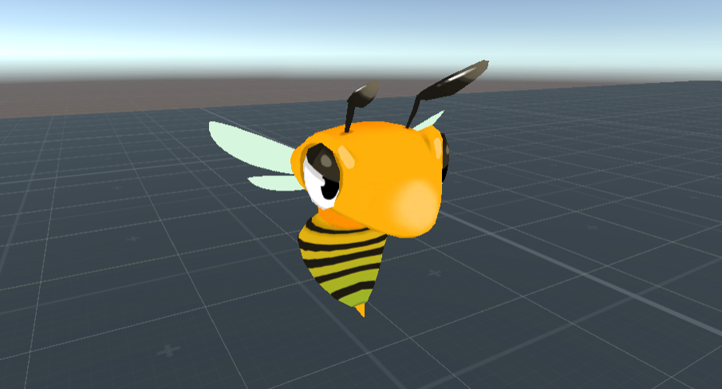
Angry Stingers
Alexander Kalus, Kevin Angermeyer & Jonathan Sasse

Slide 2
Game Concept
VR Game
Player has to defend itself against incoming bees
Controller: Vive HMD, Vive Controller and Vive Tracker

Slide 3

Game Concept
Location: Barbecue Party
Style: Cartoon
Weapon: Fly Swatter(s)
https://www.shutterstock.com/de/image-illustration/barbecue-party-on-backyard-night-scene-1440696809?irgwc=1&utm_medium=Affiliate&utm_campaign=TinEye&utm_source=77643&utm_term=

Slide 4
Game Concept
Difficulty Level increases over time (more bees, more frequent)
Survive as long as you can
Lose life points per hit taken

Slide 5
State
Done
Upcoming
Game Concept
Color concept
Bee logic and animations
Environment
Interface
Vive inclusion

Slide 6
Discussion
Anti-insect spray as off-hand weapon
Several kinds of enemies (mushrooms, rabbits etc.)?

Slide 7
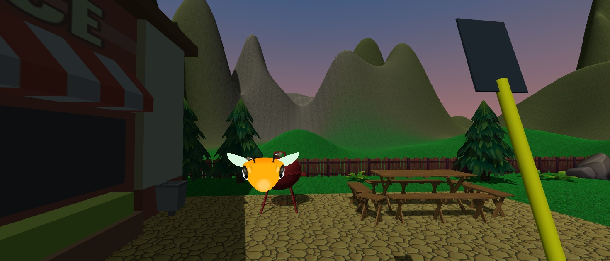
Demo

