Slide 1
Using Artificial Neural Networks to Predict Avatar Movement in VR

Slide 2
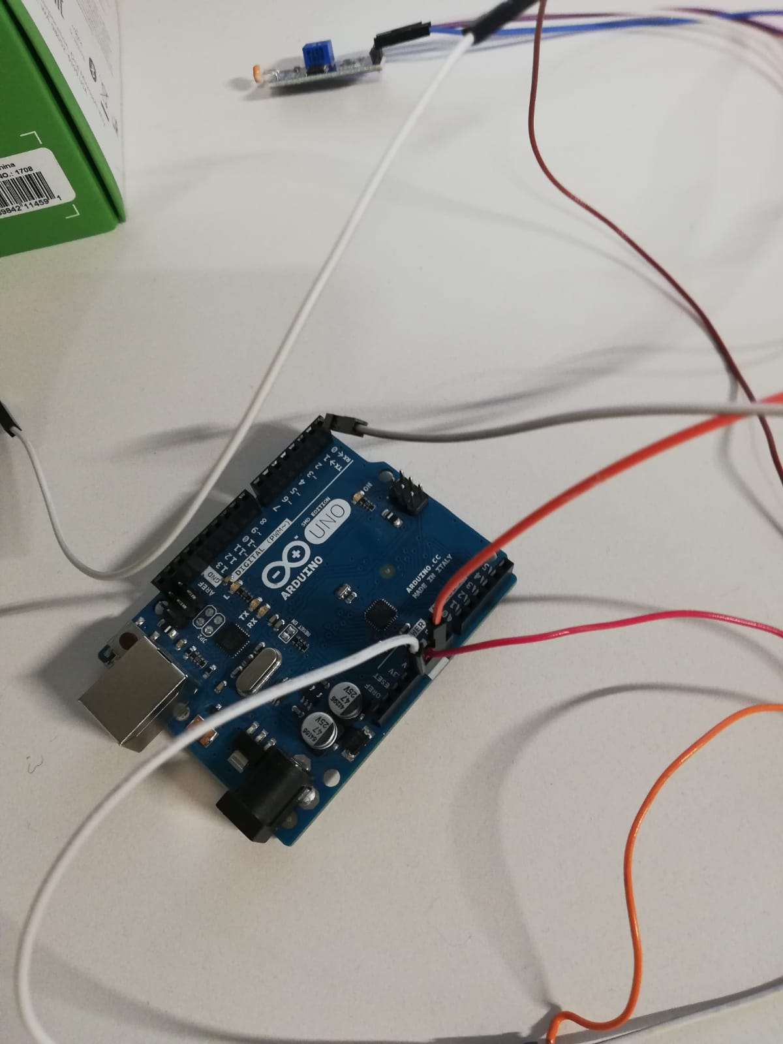
Latency Test Framework

Slide 3
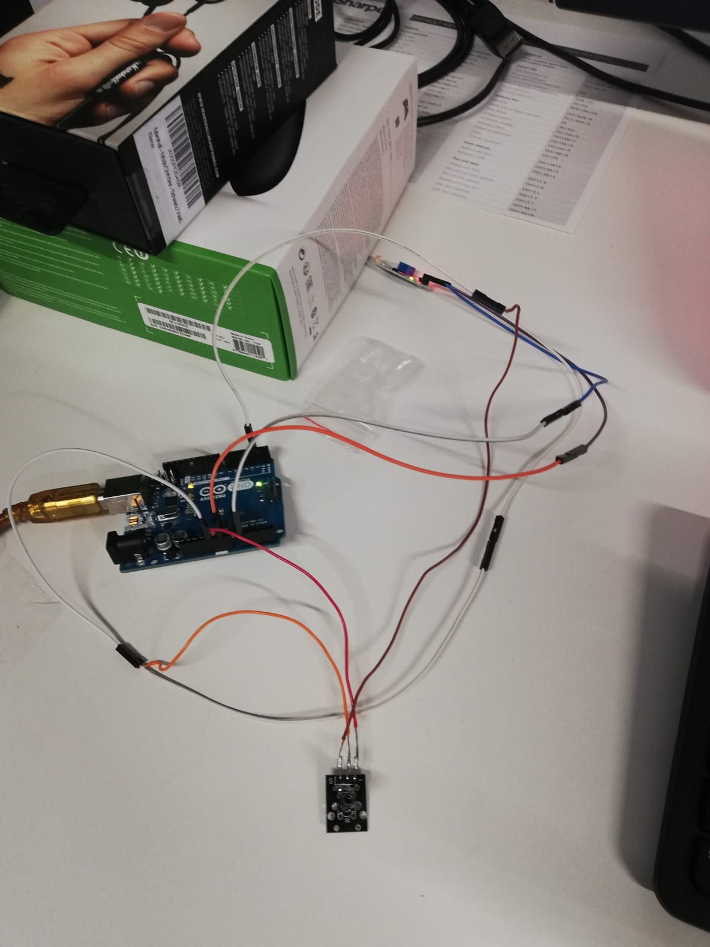
Latency Test Framework

Slide 4
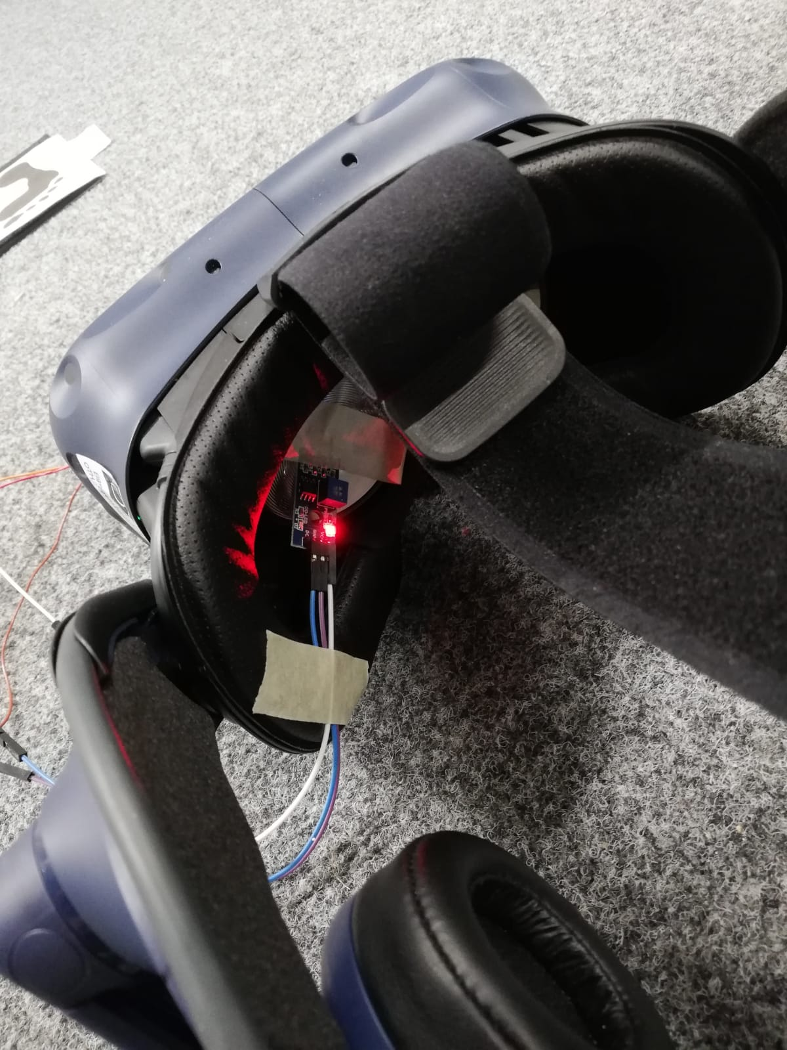
Latency Test Framework

Slide 5
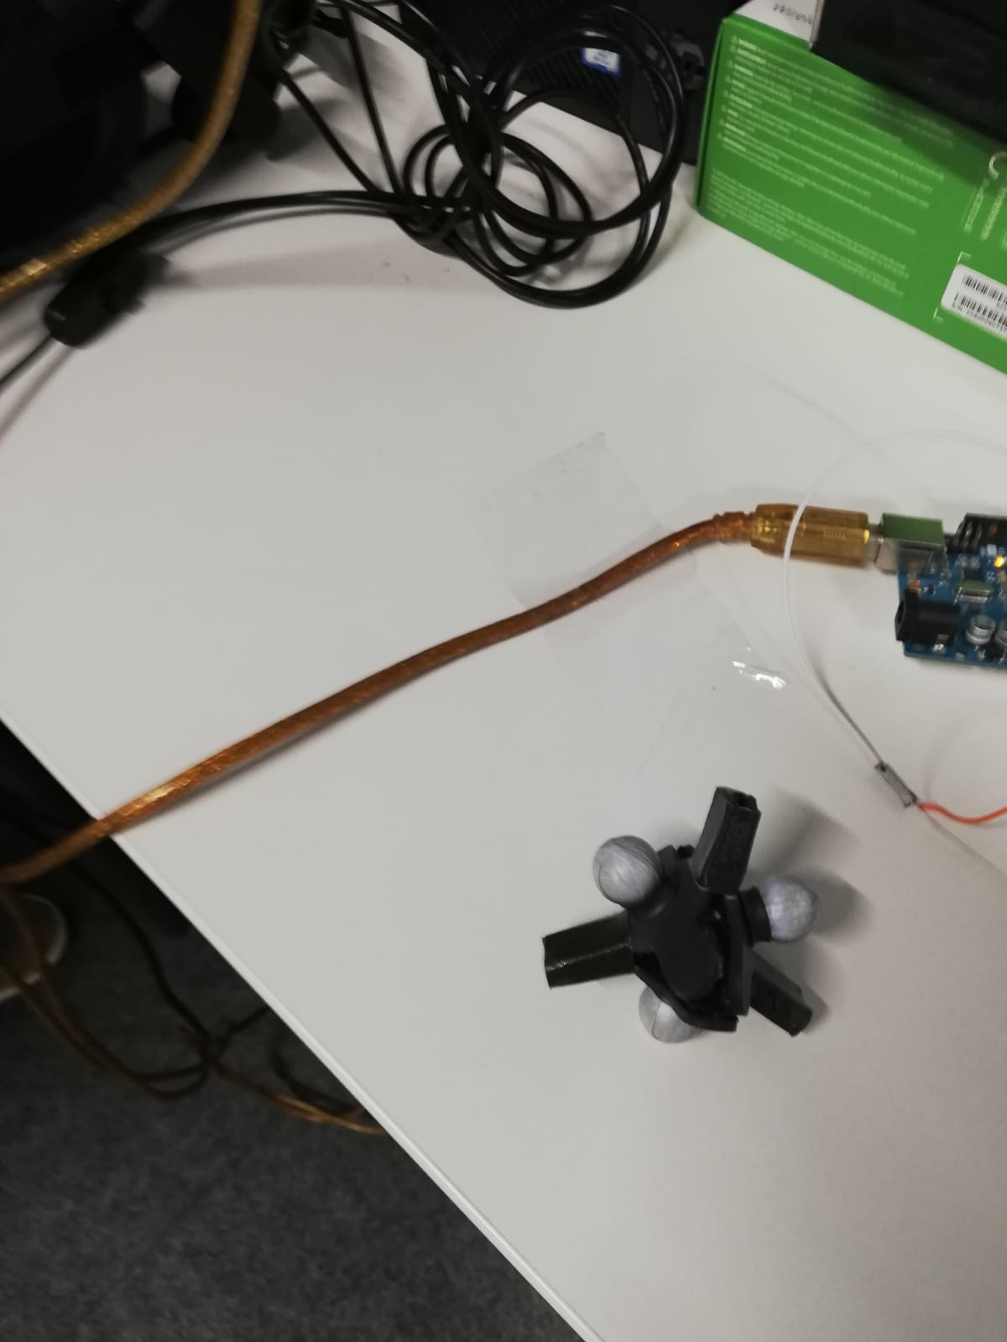
Latency Test Framework

Slide 6
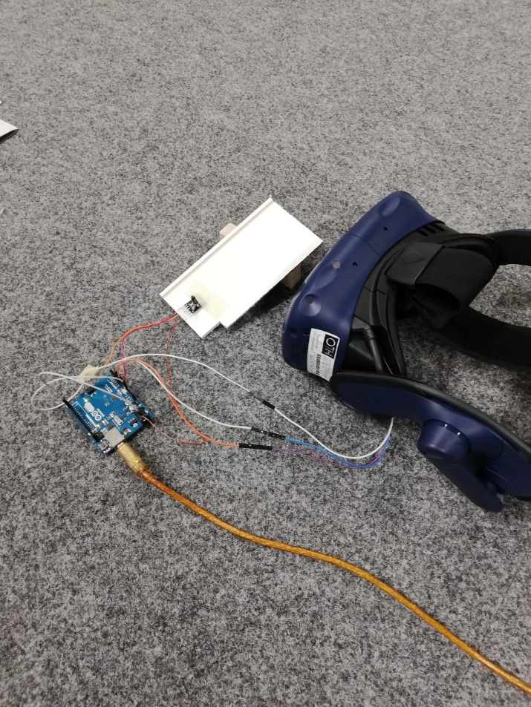
Latency Test Framework

Slide 7
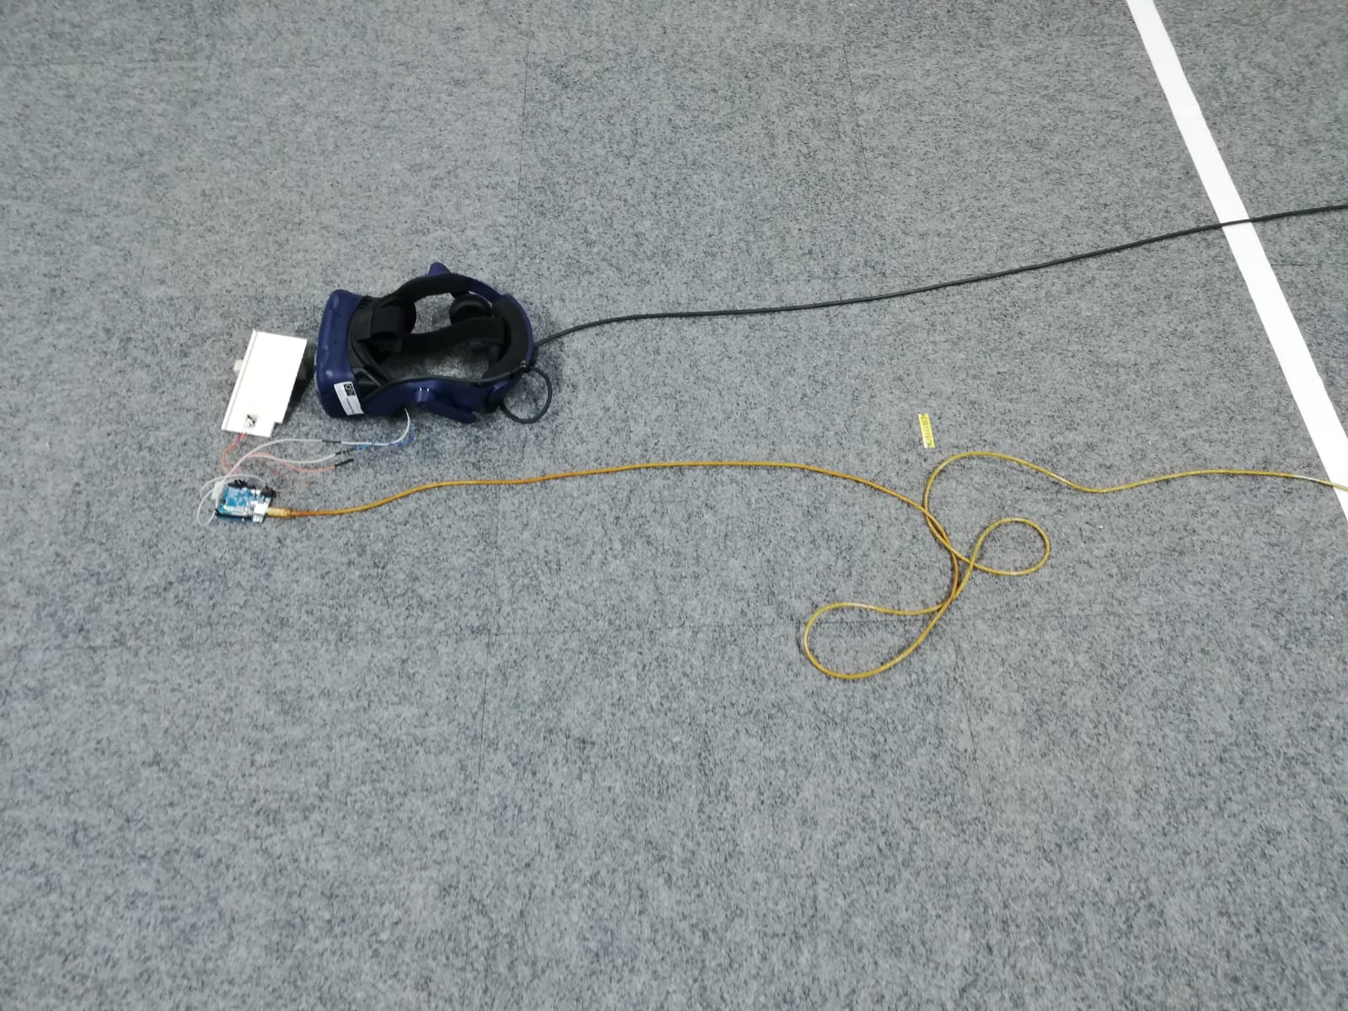
Latency Test Framework

Slide 8
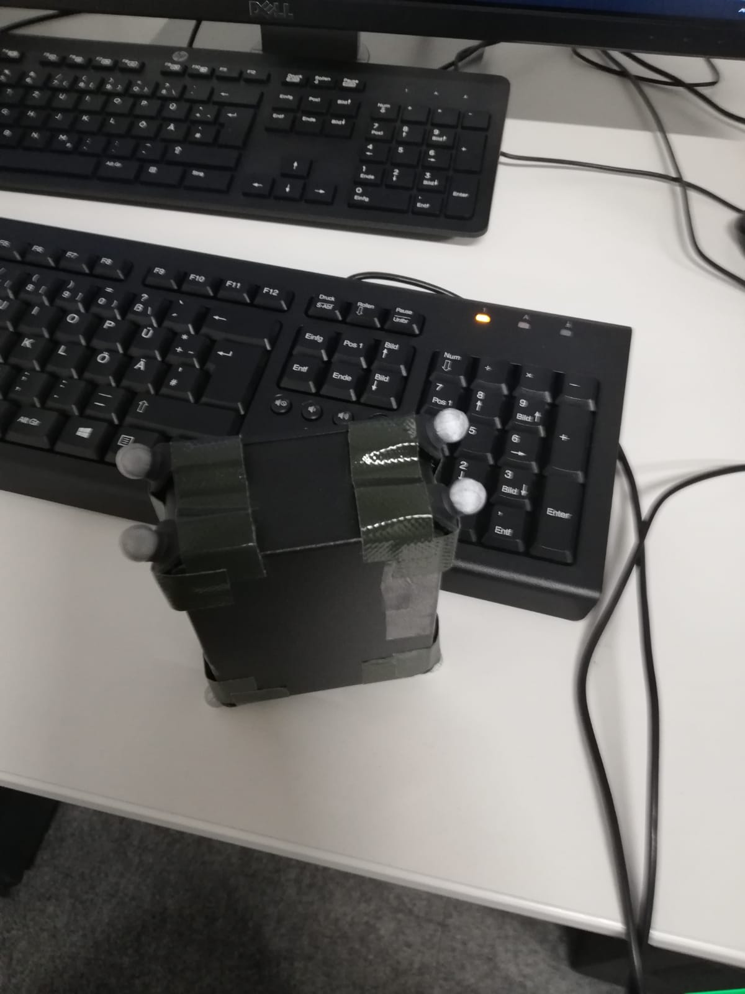
Latency Test Framework

Slide 9
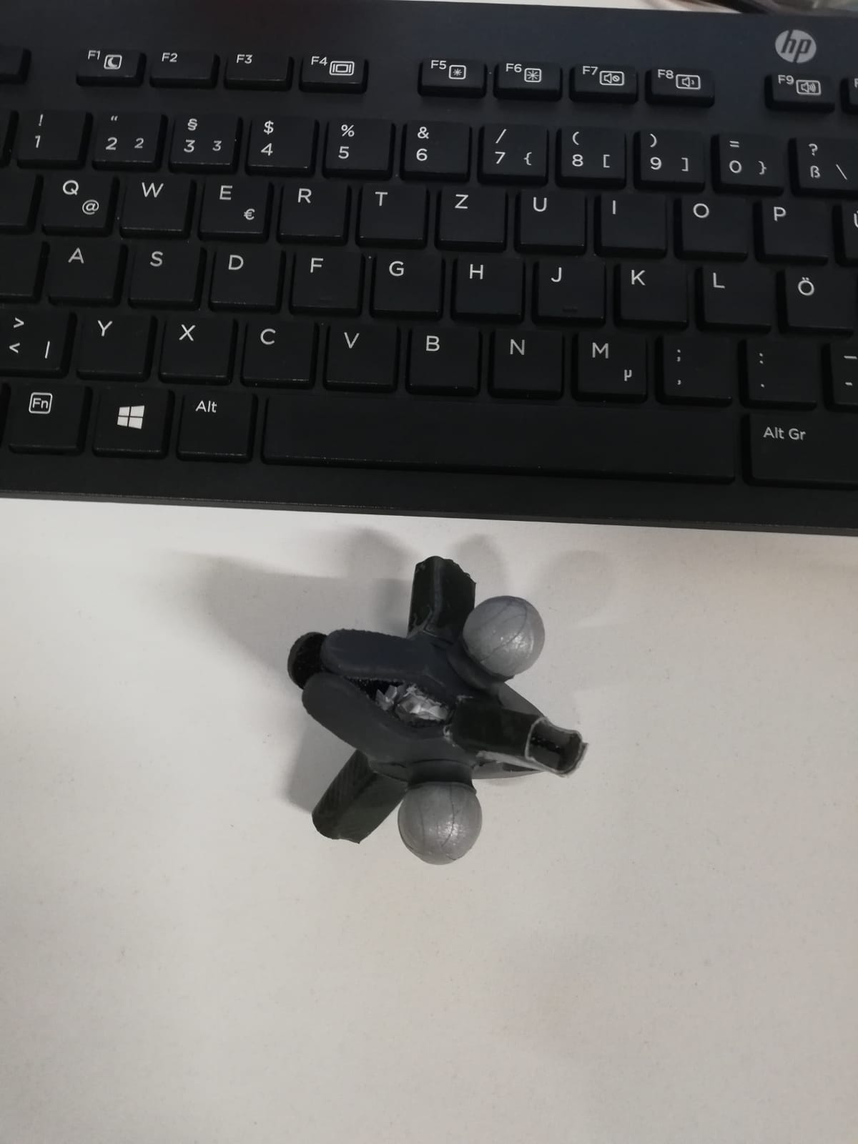
Latency Test Framework

Slide 10
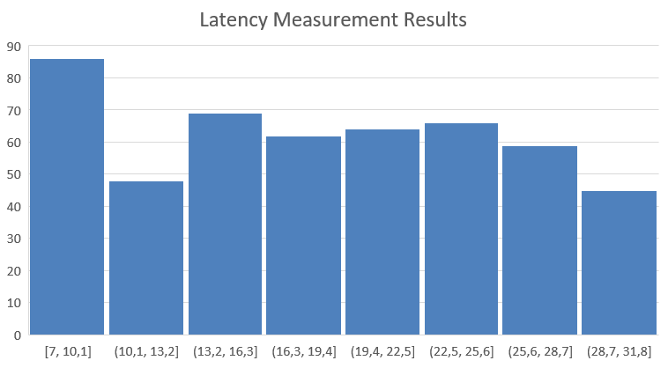
Latency Test Framework

Slide 11
Next Steps
Motion data acquisition framework
Gathering test data for NN training

Slide 12

Vielen Dank für Ihre Aufmerksamkeit!

