Slide 1
Project Plan
Gantt

Slide 2
SCRUM
Weekly meetings/sprints

Slide 3
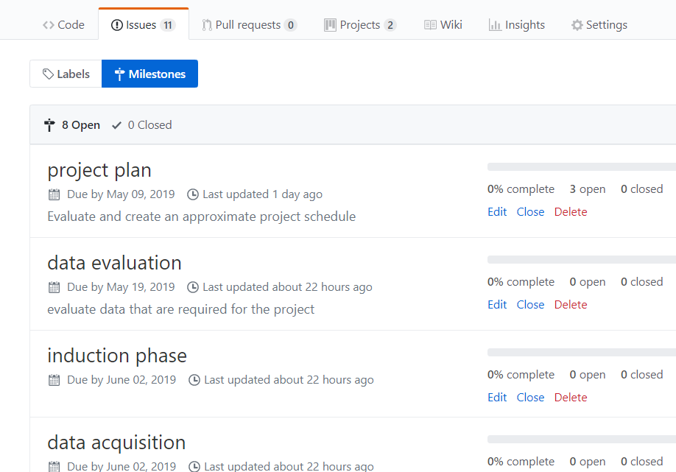
GitHub

Slide 4
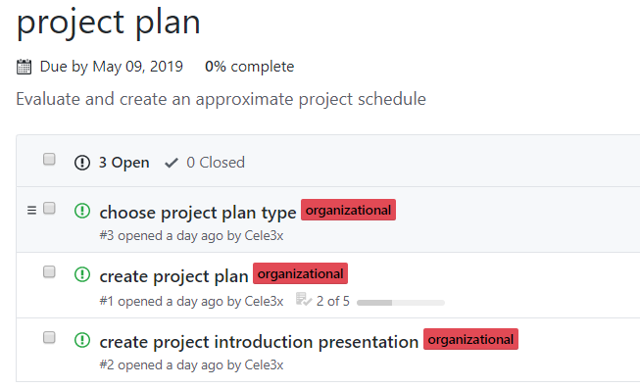
GitHub

Slide 5
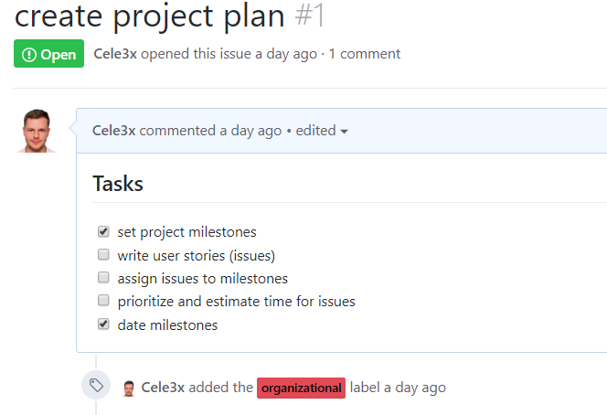
GitHub

Slide 6
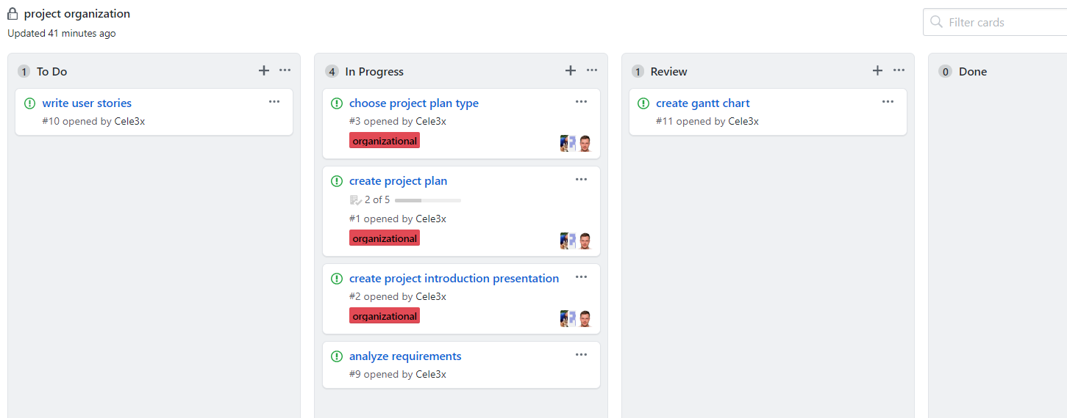
GitHub

