Slide 1
Using Artificial Neural Networks to Predict Avatar Movement in VR

Slide 2
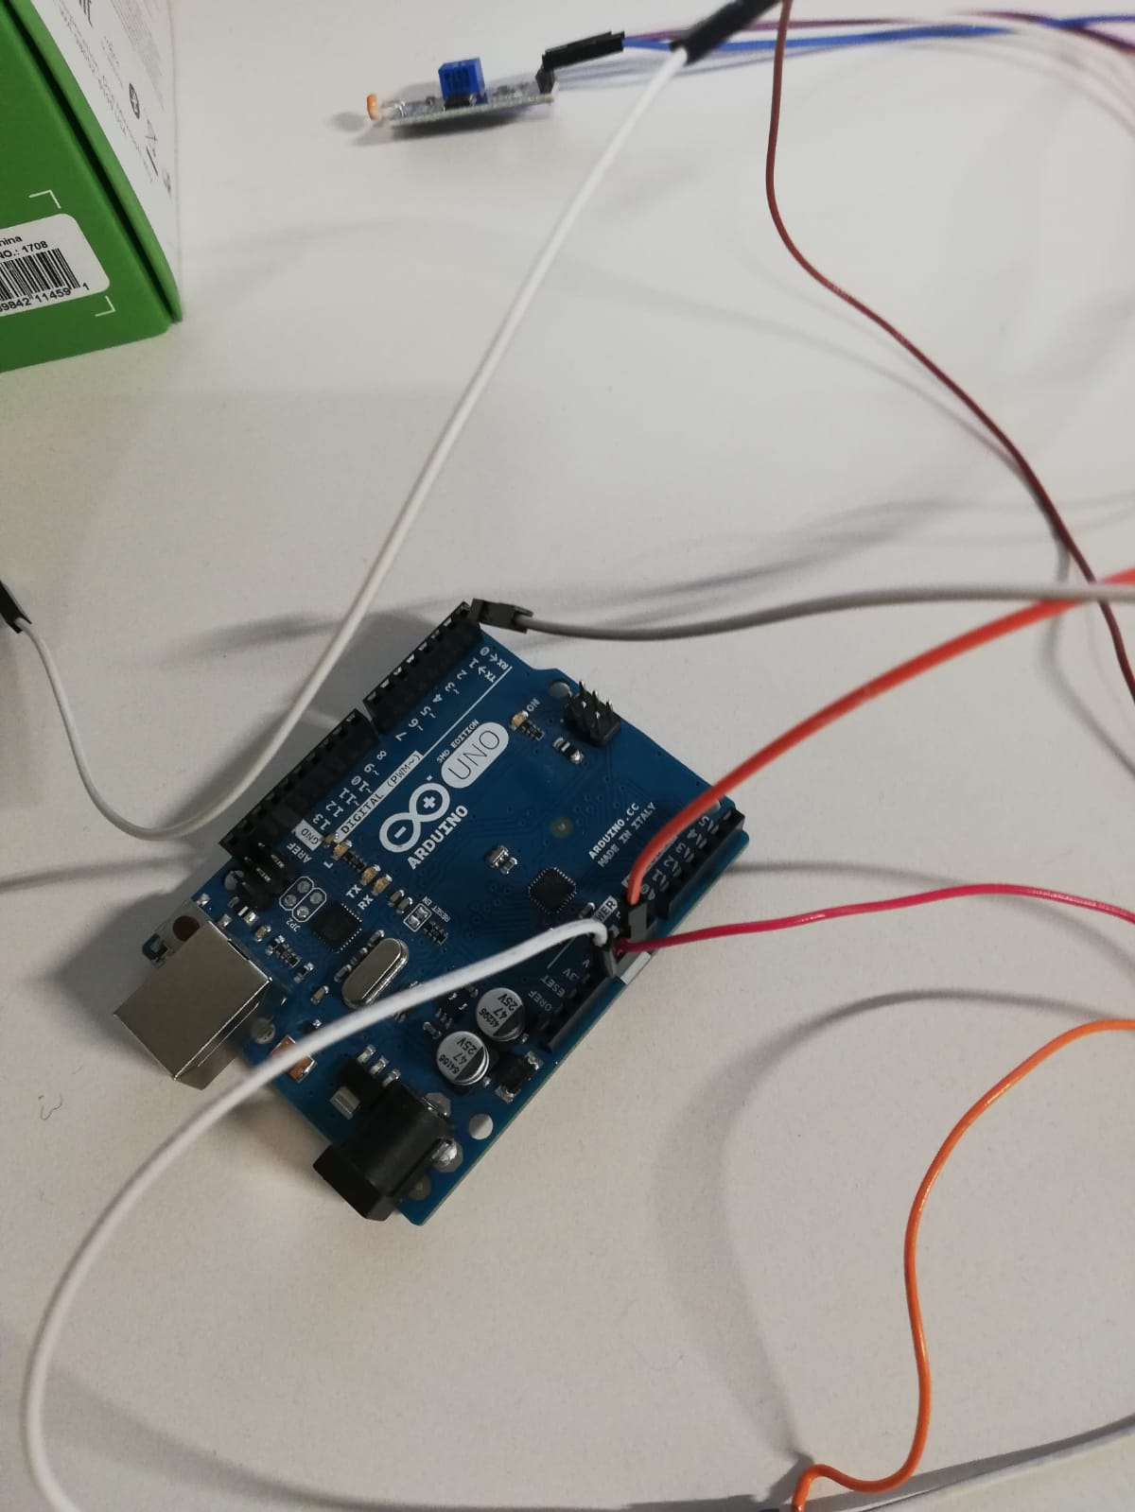
Latency Test Framework

Slide 3
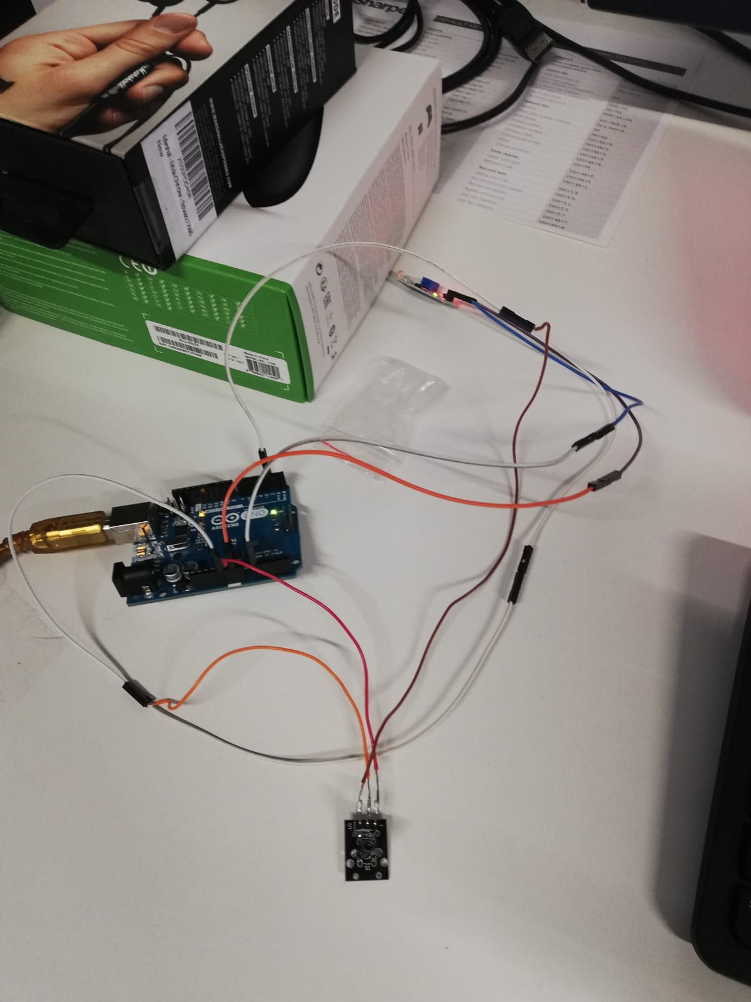
Latency Test Framework

Slide 4
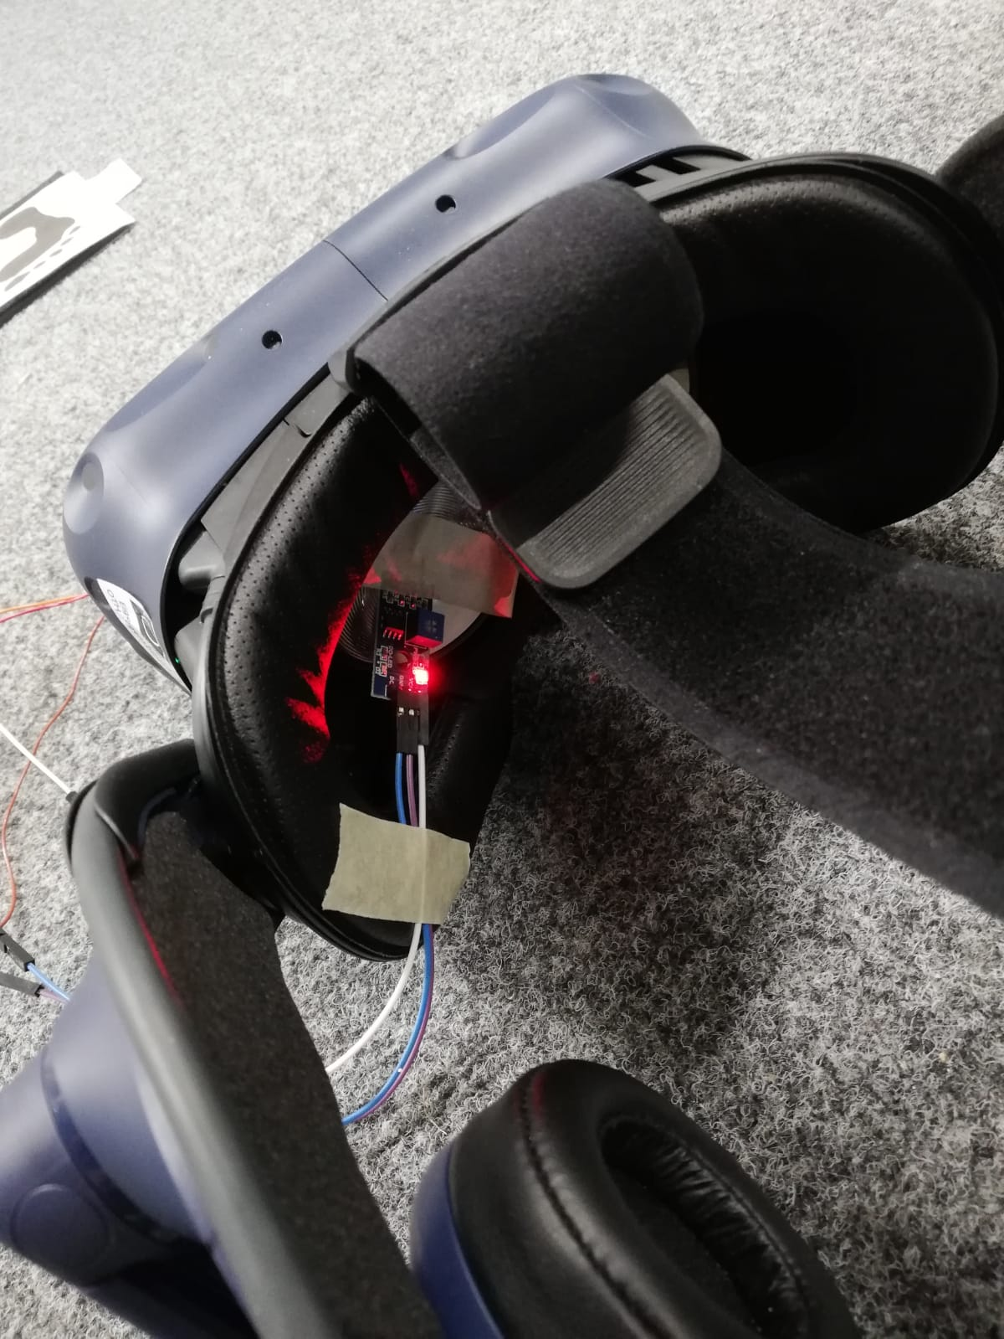
Latency Test Framework

Slide 5
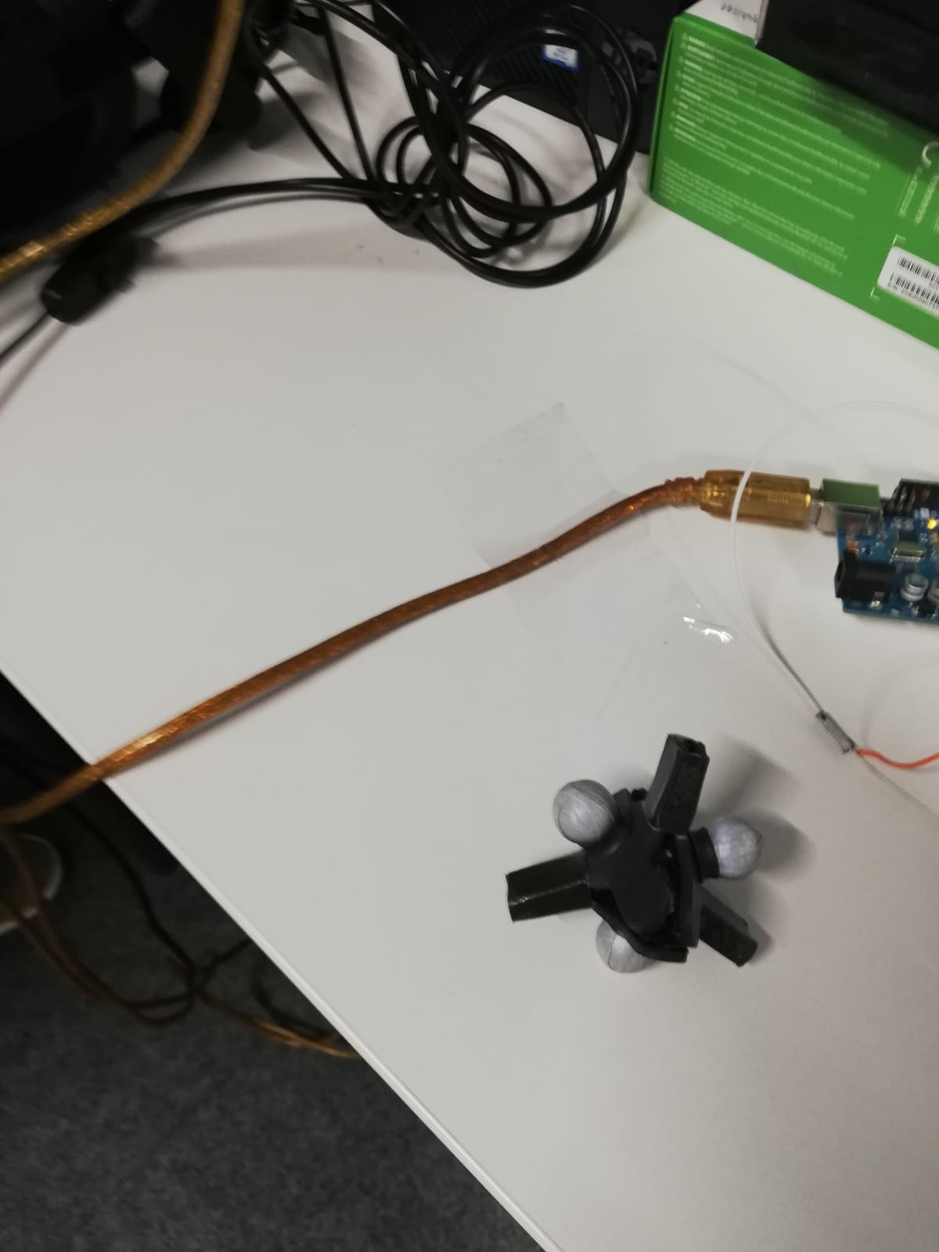
Latency Test Framework

Slide 6
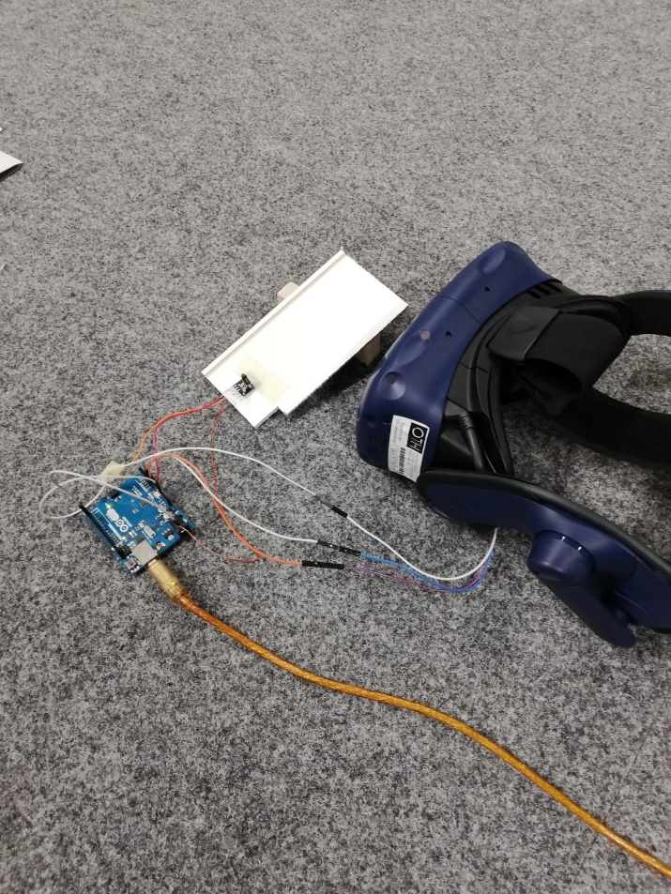
Latency Test Framework

Slide 7
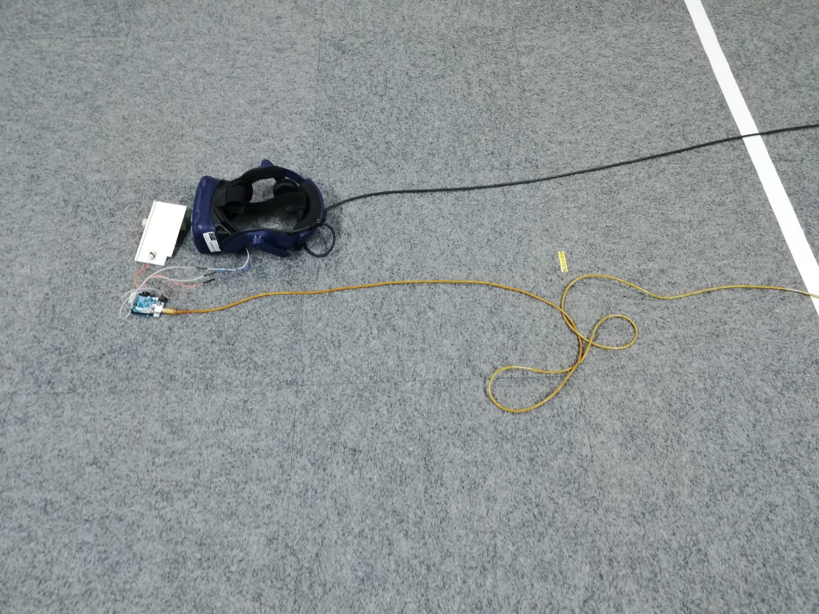
Latency Test Framework

Slide 8
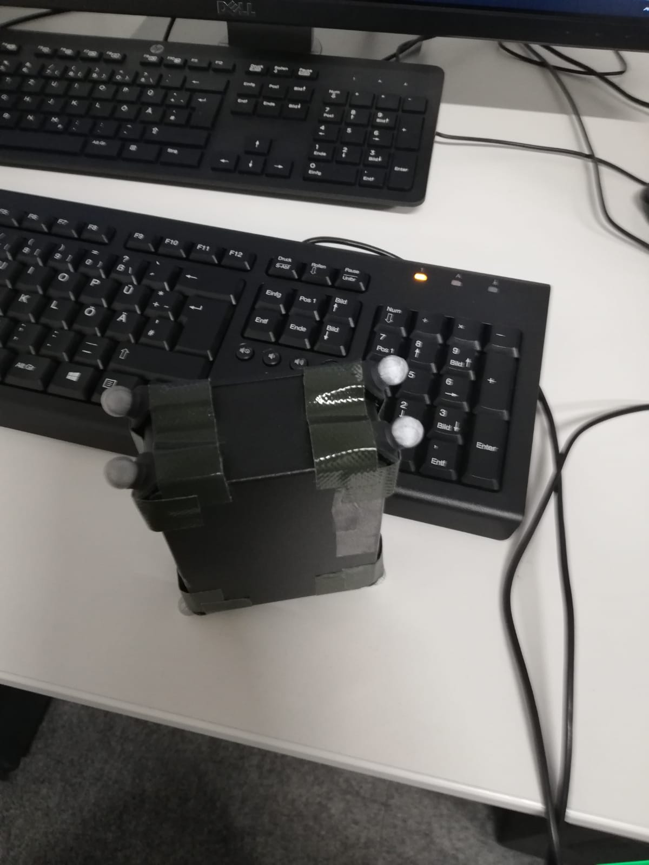
Latency Test Framework

Slide 9
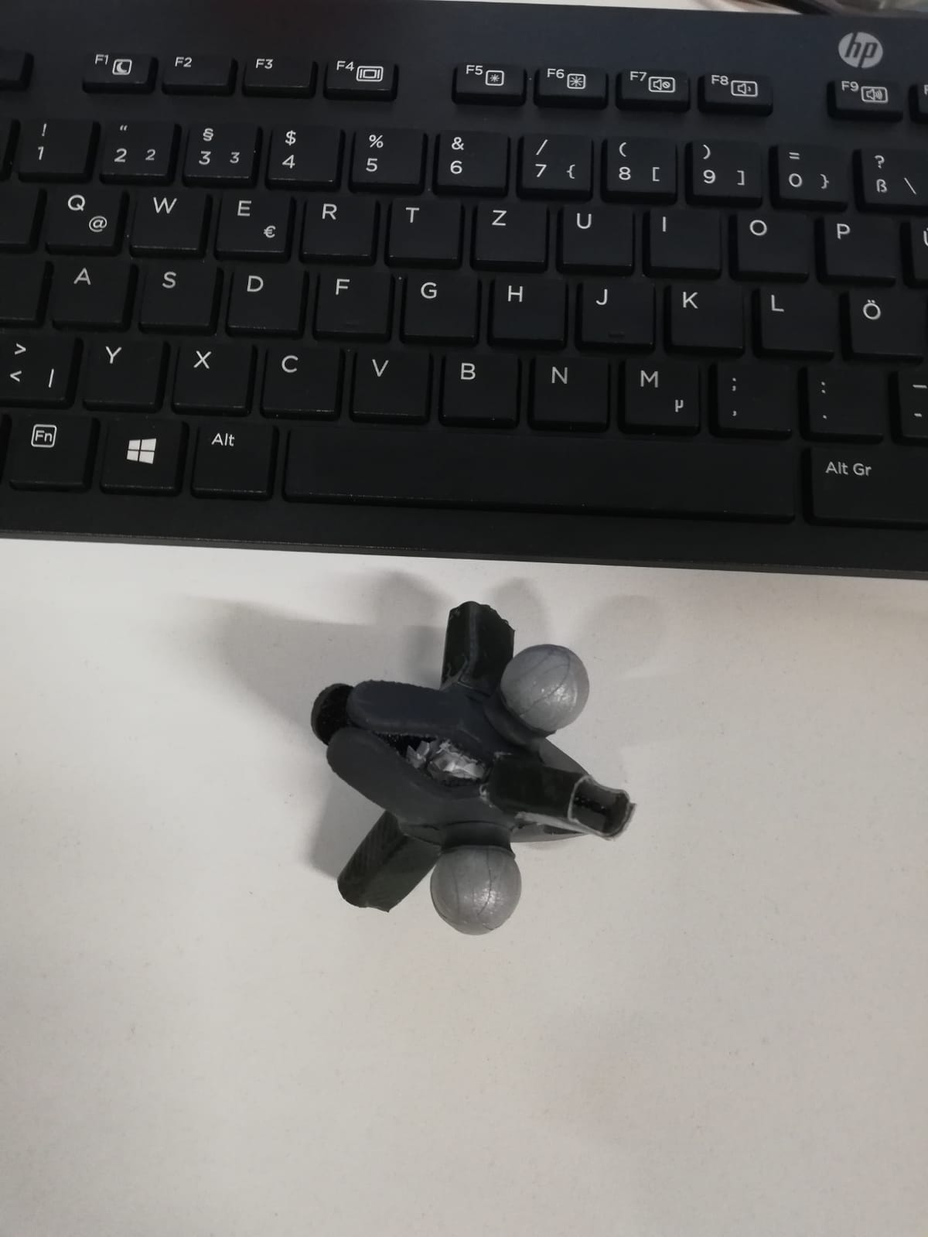
Latency Test Framework

Slide 10
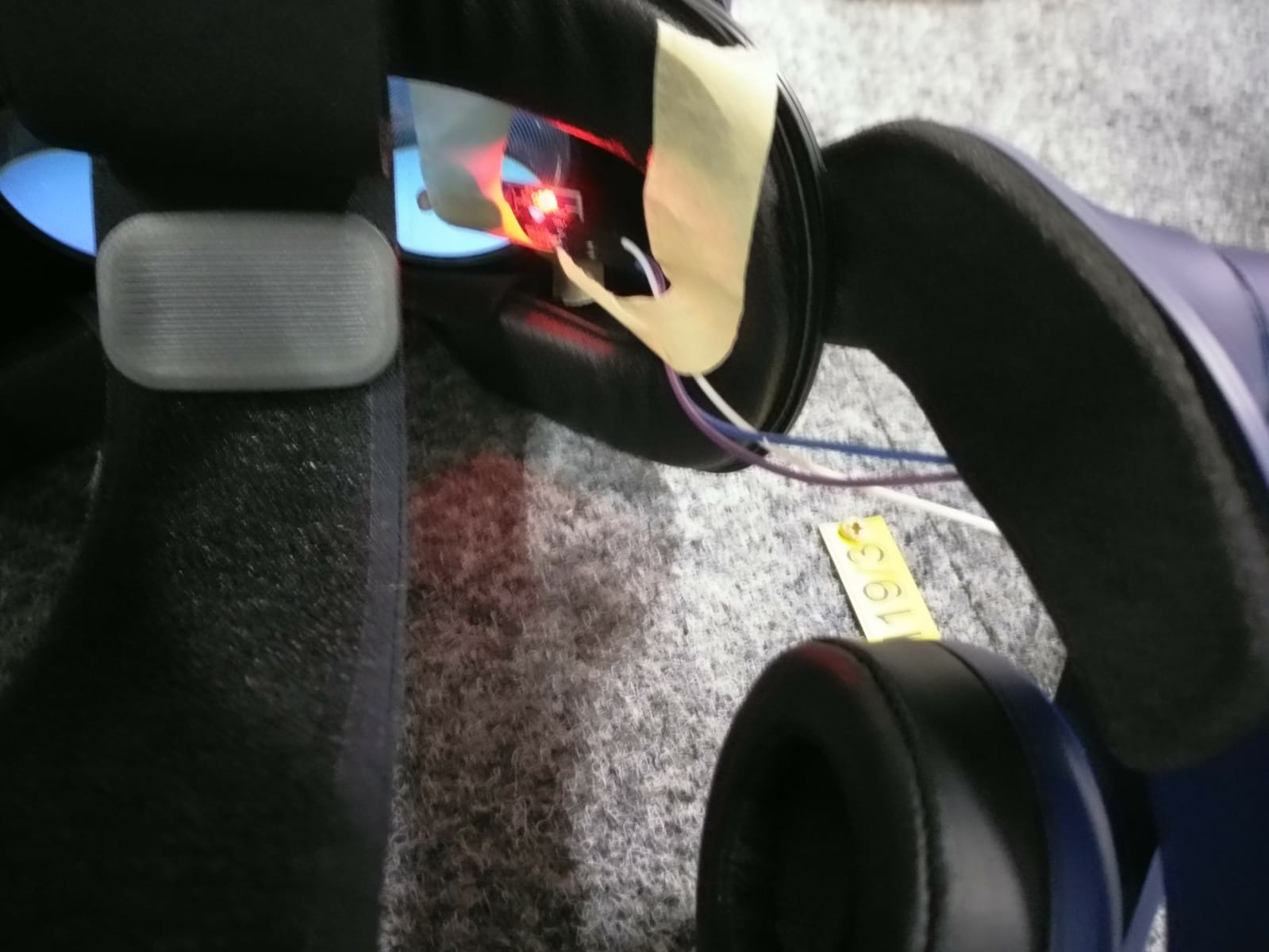
Latency Test Framework

Slide 11
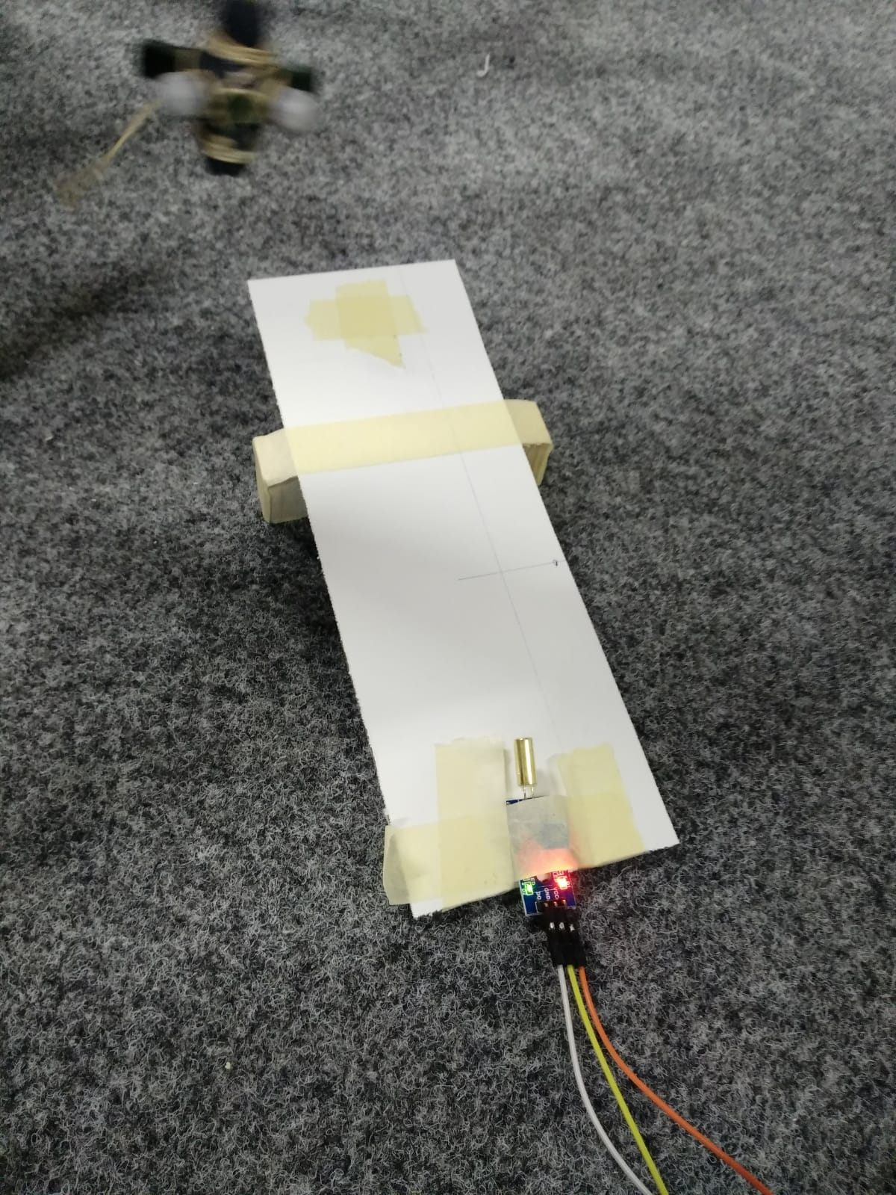
Latency Test Framework

Slide 12
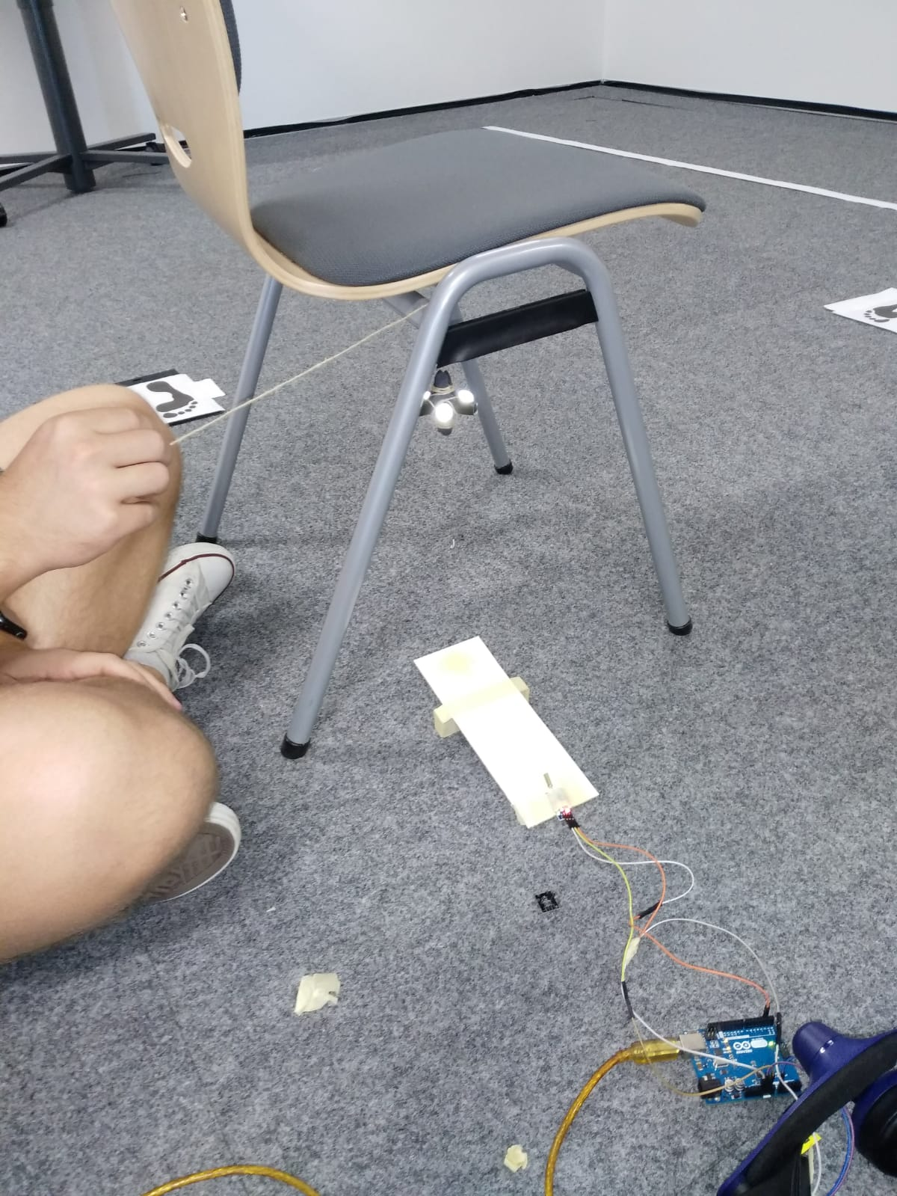
Latency Test Framework

Slide 13
Next Steps
Motion data acquisition framework
Gathering test data for NN training

Slide 14

Vielen Dank für Ihre Aufmerksamkeit!

