Slide 1
Optimizing mouse transfer function using reinforcement learning

Slide 2
Being faster than in Real-Time
Predicting avatar movement in VR
Increase perfomance
Increase immersion of body perception
Tackle latency
Apply prediction to virtual Avater
Recent work shows feasibility of this approach [1]
[1] Huy Viet Le, Valentin Schwind, Philipp Göttlich, and Niels Henze. 2017. PredicTouch: A System to Reduce Touchscreen Latency using Neural Networks and Inertial Measurement Units. In Proceedings of the 2017 ACM International Conference on Interactive Surfaces and Spaces (ISS '17). ACM, New York, NY, USA, 230-239. DOI: https://doi.org/10.1145/3132272.3134138

Slide 3
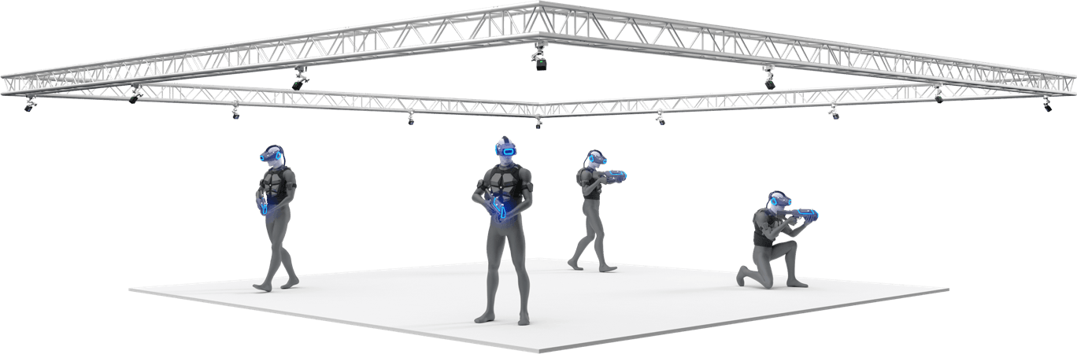
Enviroment
Image source: https://optitrack.com/

Slide 4
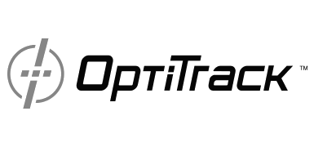

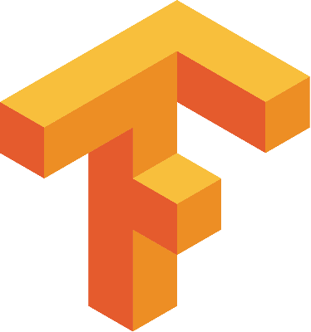
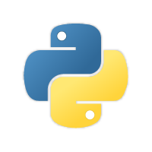
Enviroment
Image source: https://unity.com/
Image source: https://optitrack.com/
Image source: https://tensorflow.org/
Image source: https://python.org/

Slide 5
Problem Statement
OptiTrack
Python-Interface
Unity
Prediction
Research question boils down to:
Is it possible to increase user perfomance/ immersion by prediciting movement using NN?
Quantify it!

