Slide 1
Being faster than in Real-Time

Slide 2
Being faster than in Real-Time
Predicting avatar movement in VR
Increase UX
Increase immersion of body perception
Tackle latency
Apply prediction to virtual Avater
Recent work shows feasibility of this approach [1]
[1] Huy Viet Le, Valentin Schwind, Philipp Göttlich, and Niels Henze. 2017. PredicTouch: A System to Reduce Touchscreen Latency using Neural Networks and Inertial Measurement Units. In Proceedings of the 2017 ACM International Conference on Interactive Surfaces and Spaces (ISS '17). ACM, New York, NY, USA, 230-239. DOI: https://doi.org/10.1145/3132272.3134138

Slide 3
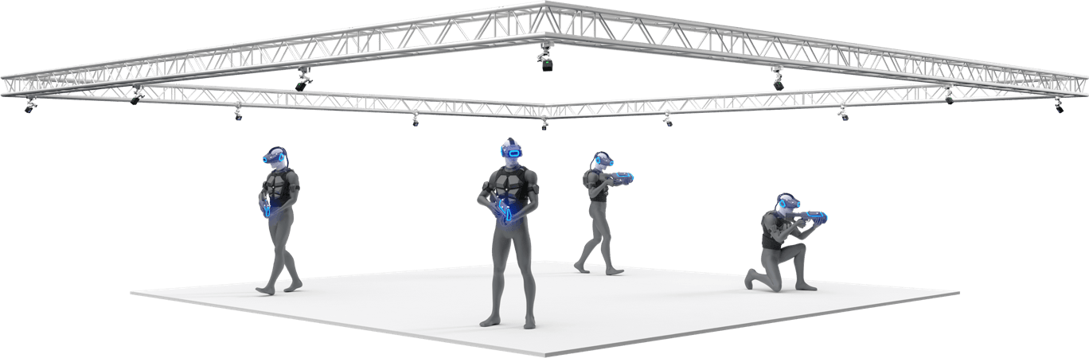
Environment
Image source: https://optitrack.com/

Slide 4


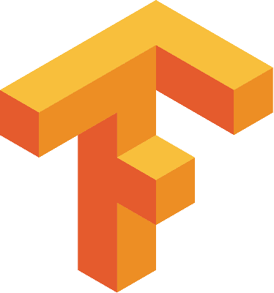

Environment
Image source: https://unity.com/
Image source: https://optitrack.com/
Image source: https://tensorflow.org/
Image source: https://python.org/

Slide 5
Problem Statement
OptiTrack
Python-Interface
Unity
Prediction
Research question boils down to:
Is it possible to increase user perfomance/ immersion by prediciting movement using NN?
Quantify it!

Slide 6
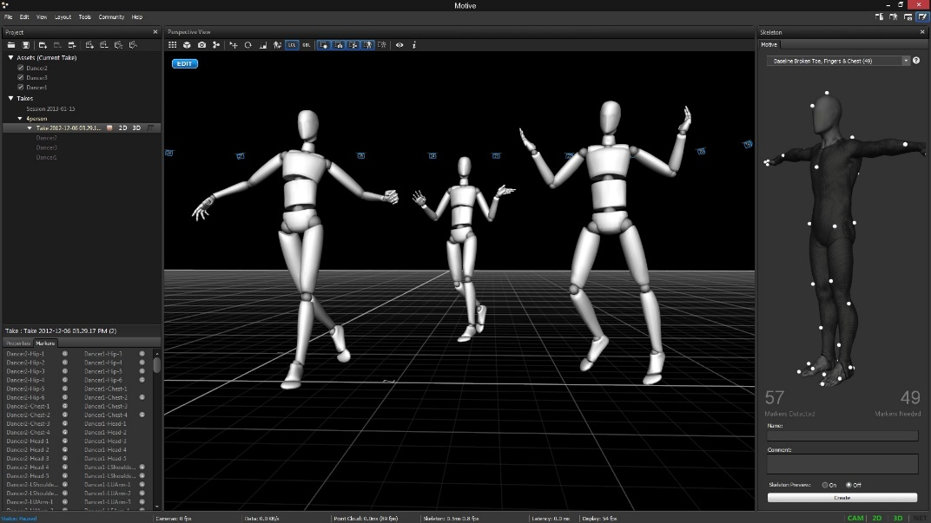
Methods: Step 1
Analyzing which data we actually need
Collect motion capturing data
Image Source: https://optitrack.com/

Slide 7
Methods: Step 1
Designing a python application to intercept data between OptiTrack and Unity
OptiTrack
Python-Interface
Unity
Prediction

Slide 8
Methods: Step 2
Creating and training the neuronal network models
Validating predictions with already gathered data
Tuning of the hyperparameters
Creation of a Unity application to display the data collected via motion capturing and adapted with the help of the NN

Slide 9
Methods: Step 3
Conducting user study for performance measuring
Level of presence
Limb ownership

Slide 10
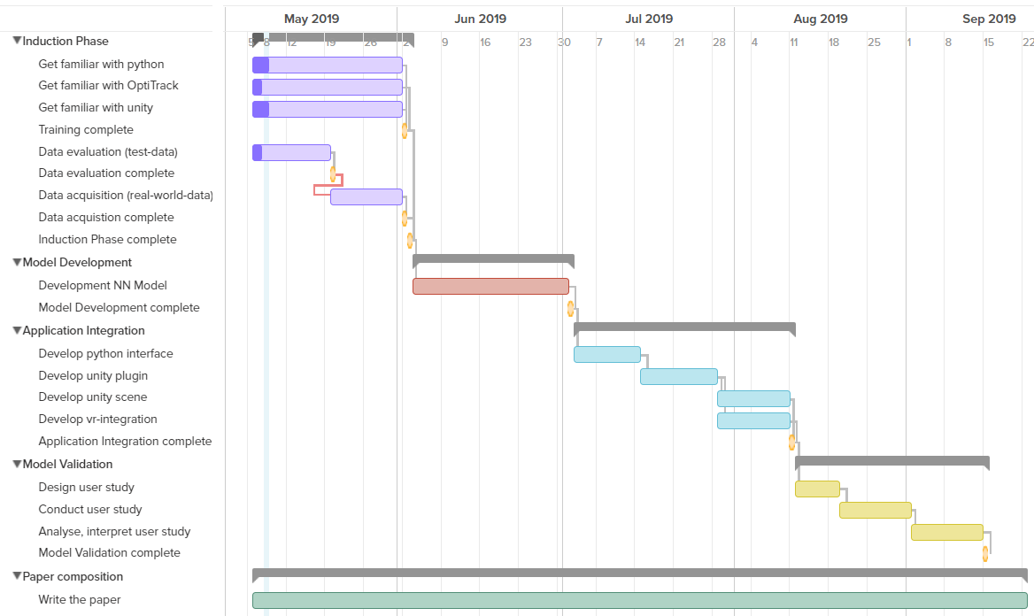
Project Plan
Notes:
Für Projektplan Meilensteine festgelegt/datiert -> Gantt-Diagramm
Jeder Meilenstein mit Puffer von 1-2 Wochen

Slide 11
User Stories
As user I want to move in VR without latency to have a realistic experience
As developer I want to create a VR without latency in order to ensure an optimal immersion
As scientist I want to monitor the effects of latency on the users' immersive experience in VR in order to compare various latency levels with those of various users
As scientist I want to measure the effects of latency towards the users' performance in VR in order to quantify those.
Notes:
User Stories mit verschiedenen Stakeholdern

Slide 12
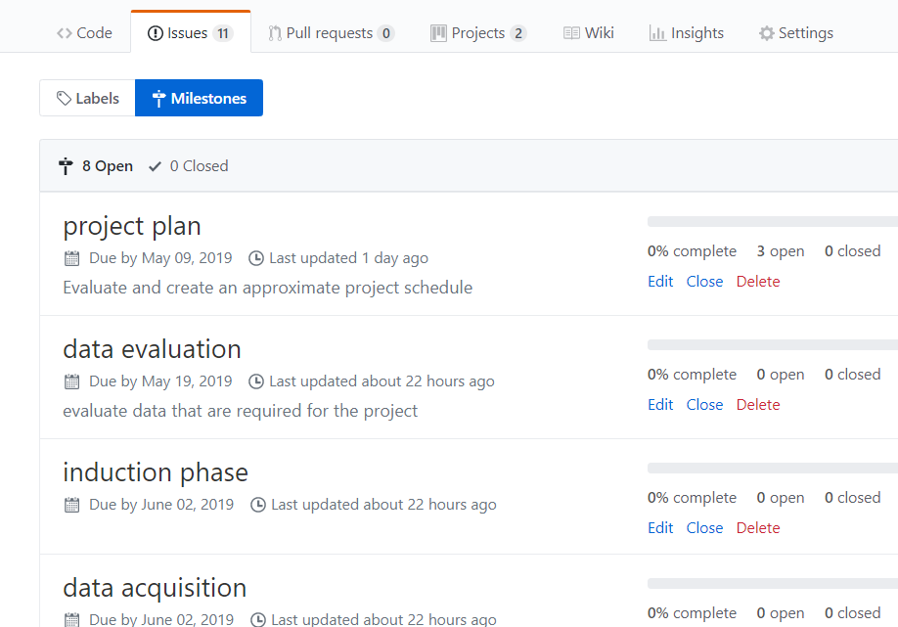
GitHub

Slide 13
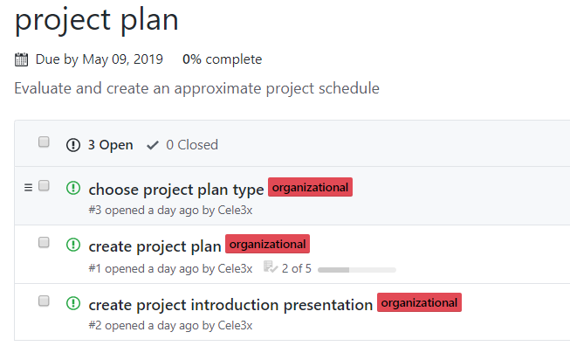
GitHub

Slide 14
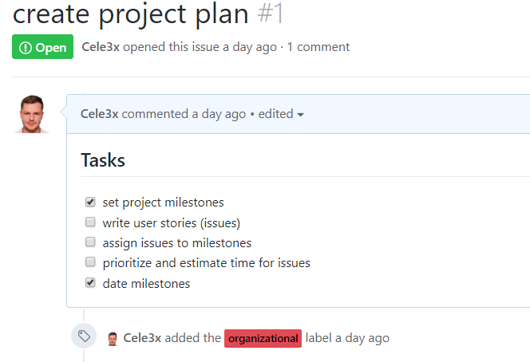
GitHub

Slide 15
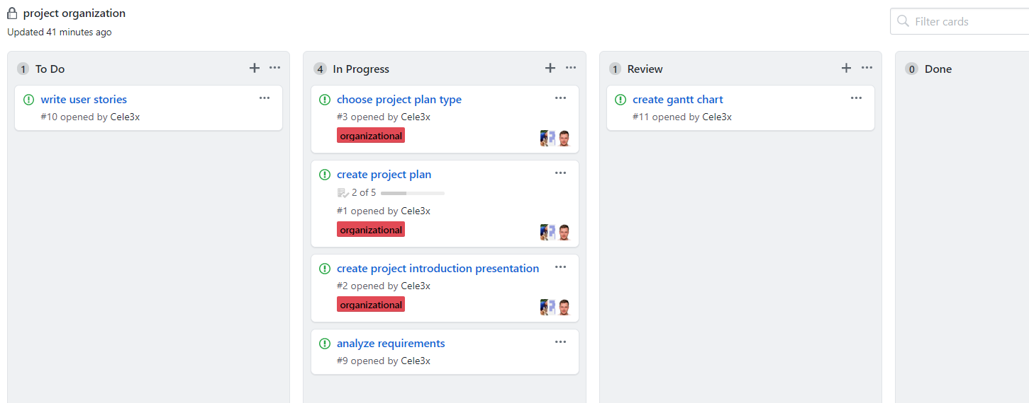
GitHub
Notes:
Kanban-System
Design Thinking: Verstehen, Beobachten, Sichtweise definineren, Ideenfindung, Prototyp, Testen

Slide 16

Vielen Dank für Ihre Aufmerksamkeit!

