Slide 1
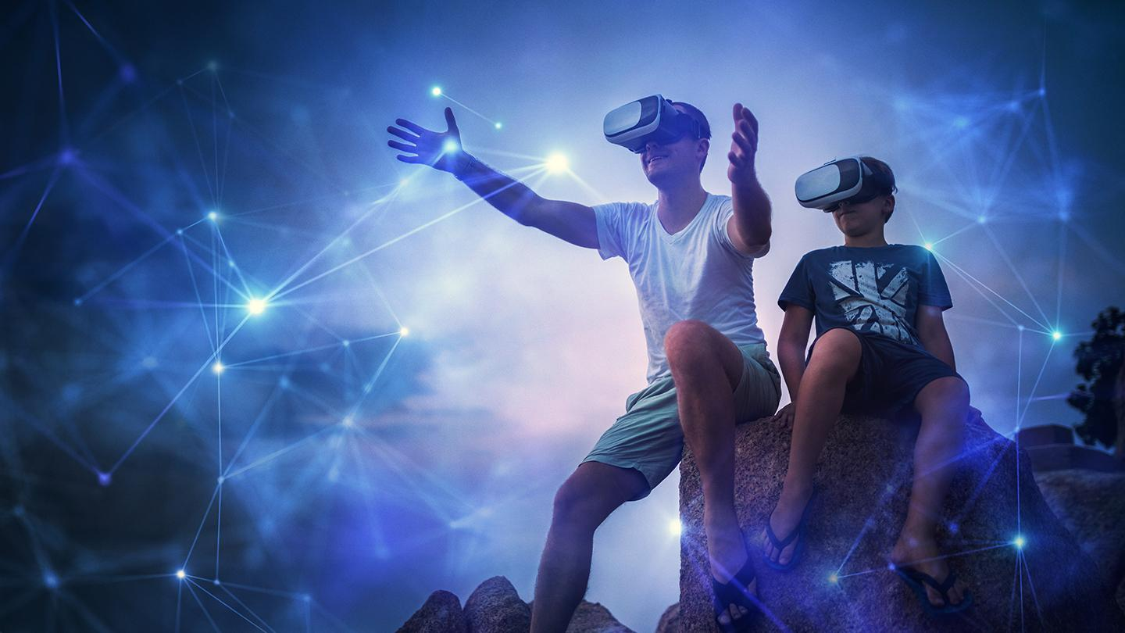
Predicting Avatar Movement in Virtual Reality using Neural Networks
Jakob Fehle, David Halbhuber and Jonathan Sasse
Notes:
Image: https://www.foundry.com/insights/vr-mr-ar/immersive-vr-experiences

Slide 2
Introduction
Latency in virtual reality hinders human performance while completing tasks
Neural networks can be used to predict movement of avatars
Utilize prediction mechanisms to compensate for latency
Our goal is to proof that lowering system latency increases performance

Slide 3
Method
Using our system of predicting body movements erasing latency we conduct a study where the game performance is evaluated
Full body movement based game developed with Unity
Player is getting attacked by a bee or balloon (yet to be decided)
Play-area is a cage
Number of incoming “enemies” increases exponentially
Enemies engage from 4 varying spawn points (defined sequence)
Objective is to kill incoming enemies by using hands or feet
Enemy fades when killed or when its attack was successful (reached players avatar)
Game ends after 120 seconds

Slide 4
Method
Within-subjects study design
Independent variables:
System Latency (-12ms, 0ms , 12ms, 24ms, 36ms, 48ms)
Dependent variables:
Kills
Bee lifetime
Questionnaires: IPQ + Limb Ownership

Slide 5
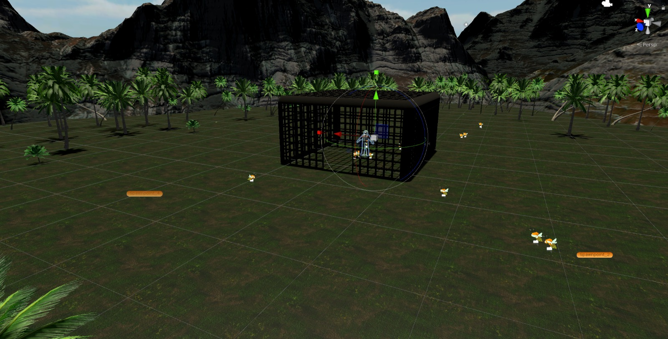
Game

Slide 6
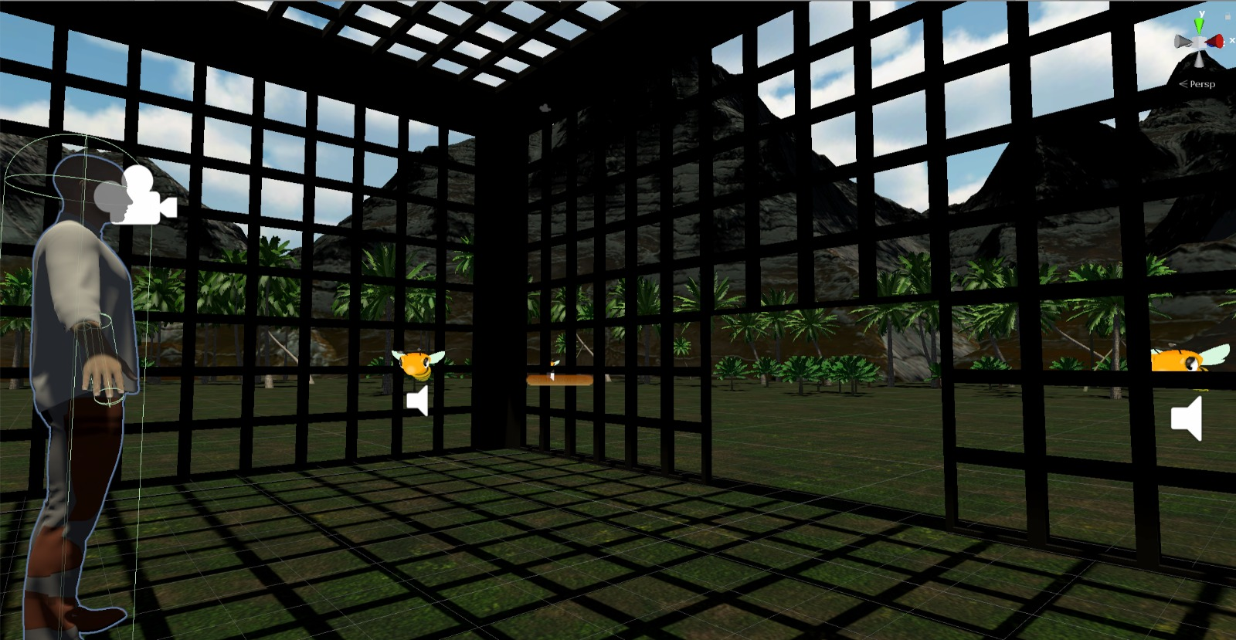
Game

Slide 7
Next
Study test and approval in CW4
Study start in CW5

