Slide 1
Task 4 – Dashboard Design
Data Analyst Internship – Elevate Labs
Presented by: Celein Mathew
Date: 16-05-2025

Slide 2
Objective
- Build an interactive Tableau dashboard
- Use the Superstore dataset to visualize KPIs
- Provide business insights using sales data

Slide 3
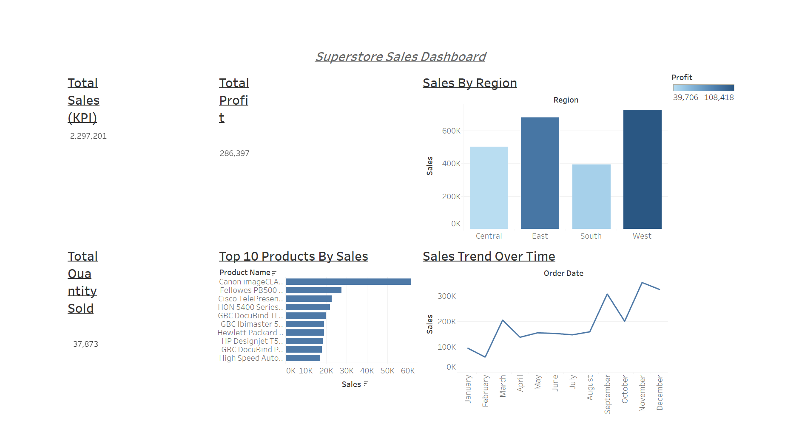
Superstore Sales Dashboard

Slide 4
Key Business Insights
- West region had the highest sales overall
- Sales peaked in November (holiday season)
- Canon products topped in total sales
- East region showed highest profit
- Central and South regions had lower performance

Slide 5
Tools Used & Submission Details
- Tools: Tableau Public, PowerPoint
- Dataset: Sample – Superstore.csv
- Files Submitted:
• Tableau Dashboard (.twbx)
• Dashboard Screenshot
• PowerPoint Summary
• README.md
- Submission via GitHub repository

