Slide 1



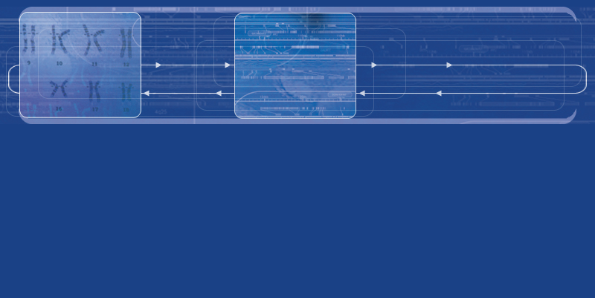




Slide 2

The Celera Genome Browser:
A Tool for Visualizing and Annotating the Human Genome
Russell Turner, Ph.D.
Celera Genomics
May, 2002

Slide 3
Genome Browser - Purpose and History
Purpose
  To provide a tool for visualization and structural annotation of large eukaryotic genomes
  To support Celera’s internal scientists and customers
History
  Version 1 (1999) – Annotation of first assembly of Drosophila Melanogaster genome
  Version 2 (2000) – Annotation of Celera’s first assembly of the human genome
  Subsequent versions support ongoing internal annotation (including the mouse genome) as well as the needs of Celera’s customers
  Version 4.2 currently in development

Slide 4
Genome Browser - Capabilities
Visualization
  Navigation and display of selected regions of a large genomic database
  Overlay of XML data via local files or HTTP service
  Multiple views of data, including high-performance graphical display
  Continuous pan and zoom from chromosome to nucleotide level
  Interactive Sequence Analysis
  Direct hyperlink to Celera Discovery System
Annotation
  Interactive “drag and drop” creation and editing of human-curated features
  Infinite undo capability
  Export of local annotations as XML file

Slide 5
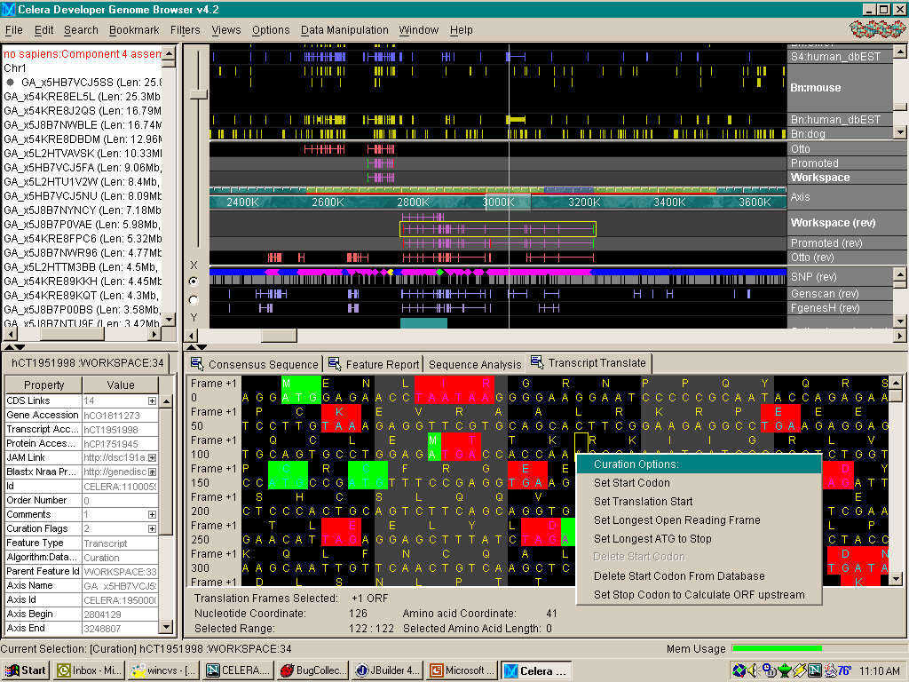
Genome Browser - GUI Overview
Zoom Bar
Zoom Focus Bar
Annotation View
Loading Indicator
Outline View
Selected Region
Genomic Axis
Annotation Workspace
Tier
Selected Feature
Promoted
Tier
Property Inspector View
Subviews
Popup
Curation
Menu
Description Line
Memory
Usage
Meter

Slide 6
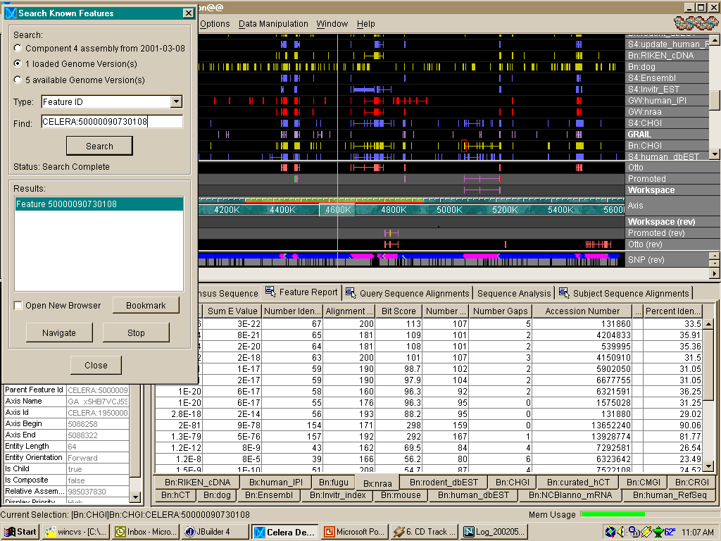
Genome Browser - Navigation/Feature Report

Slide 7
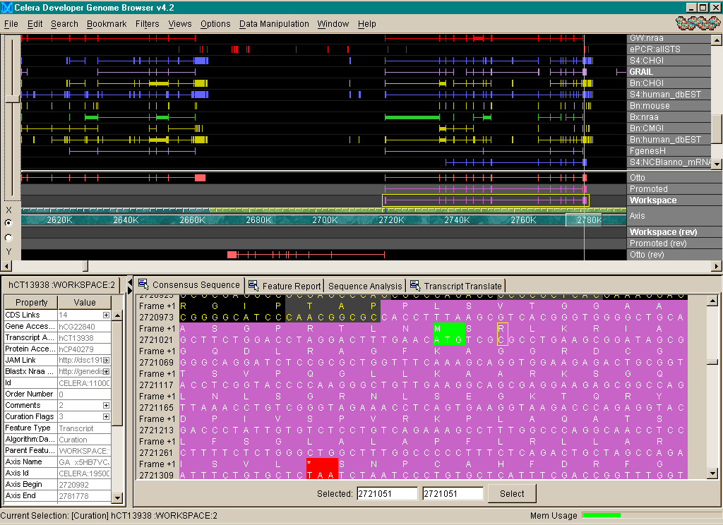
Genome Browser - Consensus Sequence View

Slide 8
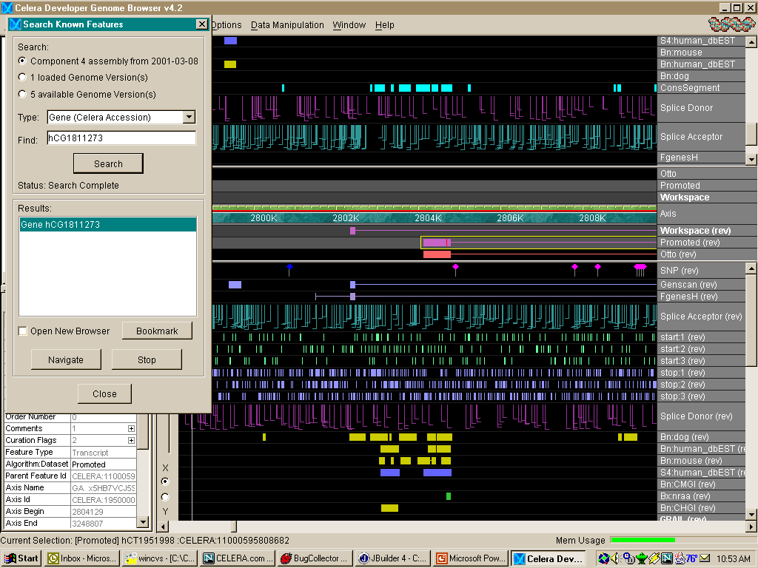
Genome Browser - Splice Sites/Gene Search

Slide 9
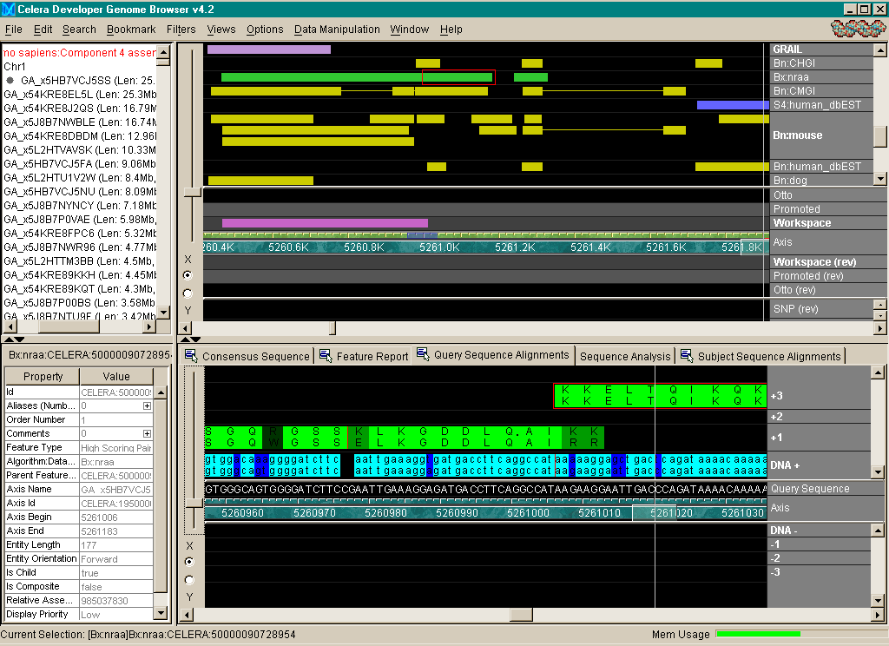
Genome Browser - Sequence Alignment

Slide 10
Genome Browser – Transcript Translate View

Slide 11
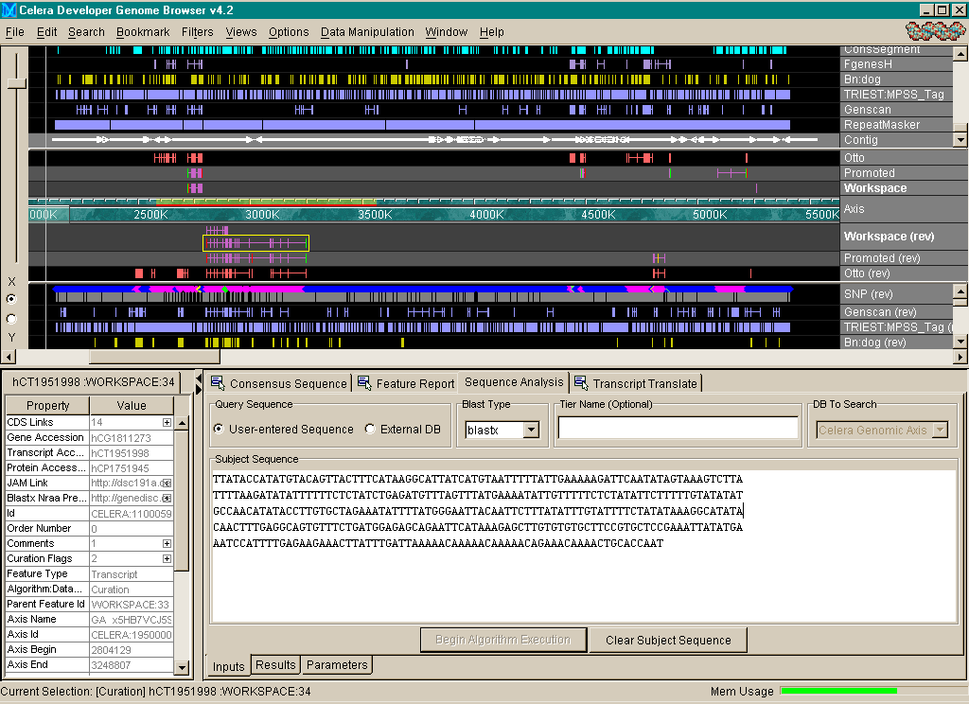
Genome Browser – Sequence Analysis View

Slide 12
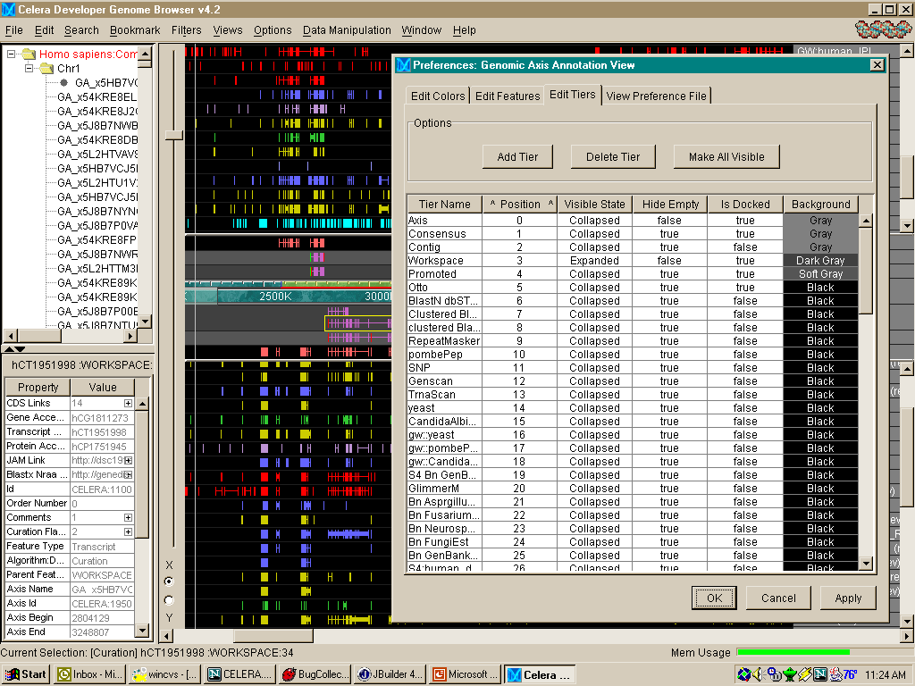
Genome Browser – Tier Preferences

Slide 13
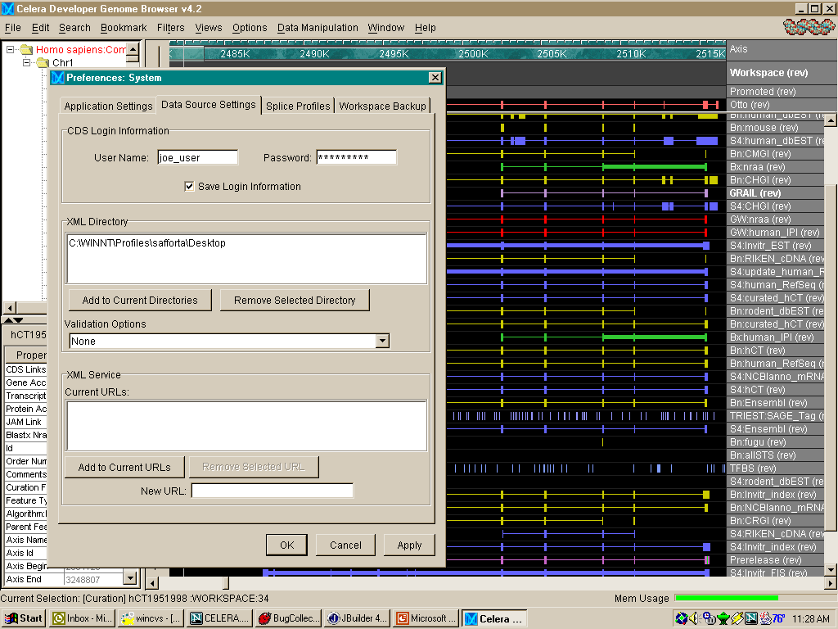
Genome Browser – Data Source Preferences

Slide 14
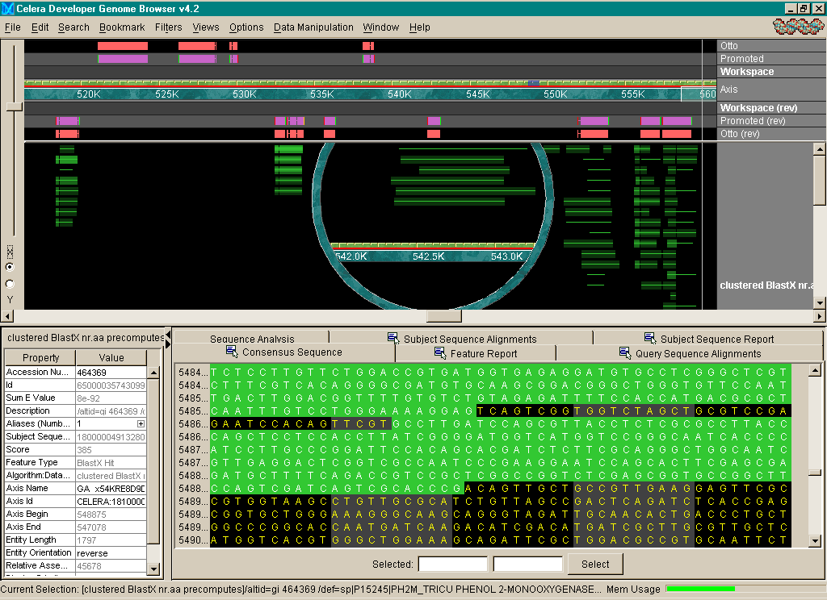
Genome Browser – Intensity Mapping

Slide 15
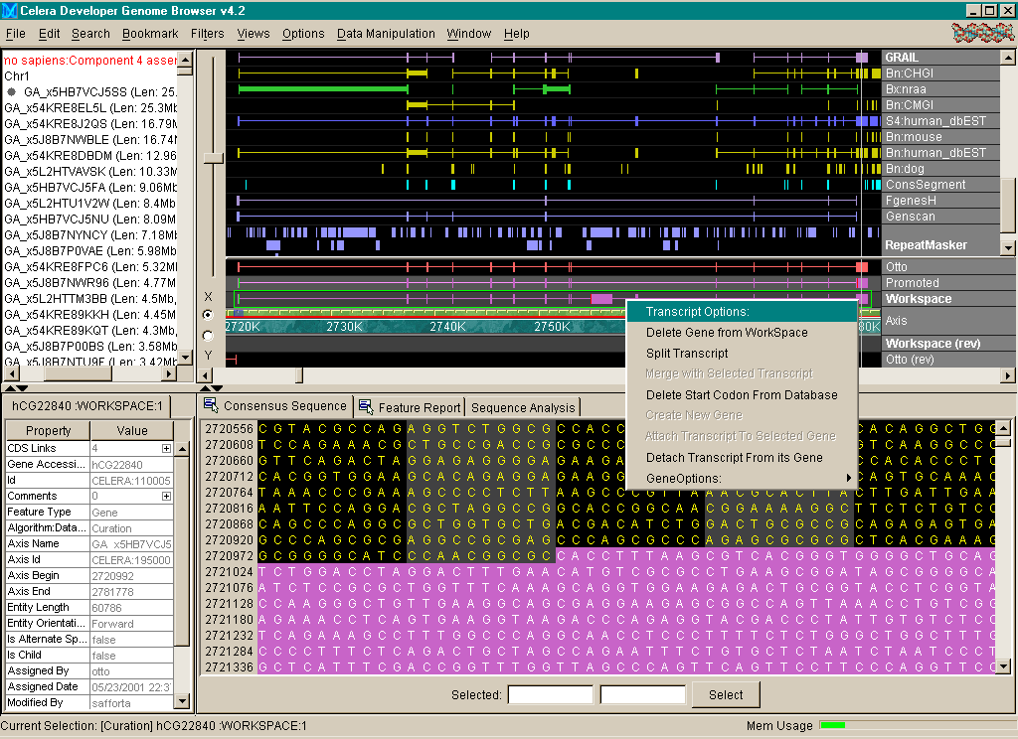
Genome Browser – Curation Operations

Slide 16
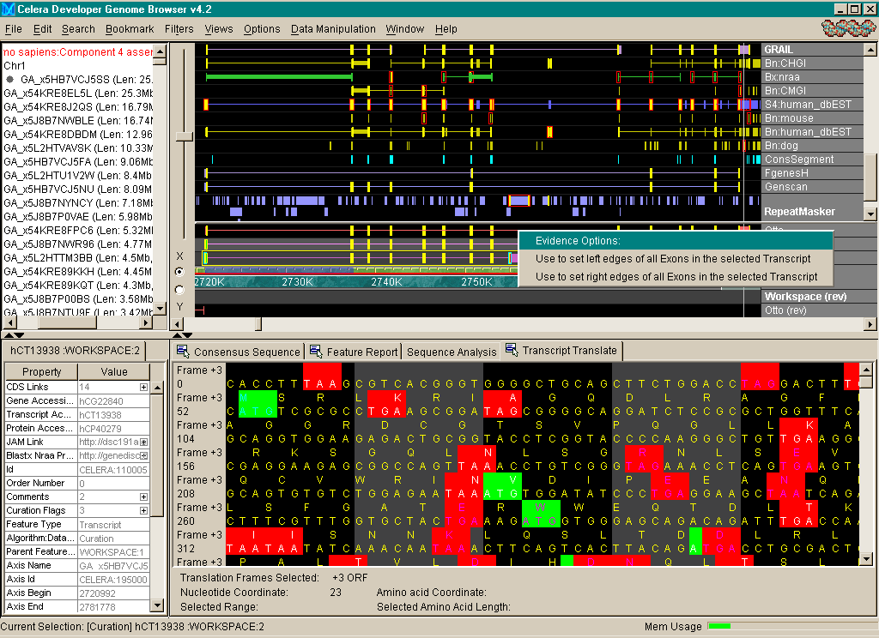
Genome Browser – Evidence Highlighting

Slide 17
Genome Browser – Systems Architecture
3-Tiered Architecture
  Interactive graphical client front end
  J2EE application server middle tier
  Oracle relational database back end
Pure Java client and server implementation
Standalone Java “thick” client
  High-performance, interactive graphics
  Client-side data analysis
  Client-side data integration via XML
Two-way HTML browser connectivity with search capability
Downloadable installation with self-updating client

Slide 18
Genome Browser – Data Flow
precomputes
annotations
Import
Features
Extract
Feature (.gbf) Files
OR
XML
Service
Celera DB
assembly
precomputes
annotations
GB Client
assembly
precomputes
annotations
precomputes
annotations
annotations’
User DB
precomputes
annotations
GB
App
Server
relational
data
object
data
Import
Workspace
Promote
Export
Workspace
annotations’
annotations’’
Workspace (.gbw) File

Slide 19
Genome Browser – Software Architecture
precomputes
annotations
Feature (.gbf) Files
Database
GB Client
Database Query
GB
App Server
Load Query
Annotation
View
relational
data
object
data
Consensus
Residues
View
Outline
View
Relational to Object Mapping
Client Model
Client Views
Celera Relational Data Model
Celera Object Model
annotations’
Workspace (.gbw) File

Slide 20
Genome Browser – Runtime Data Model
Curation
Precompute
Assembly
Gene
Transcript
Transcript
BlastHit
Start
Codon
Exon
Exon
Stop
Codon
Exon
HSP
HSP
HSP
Contig
Contig
Contig
alignment relationship
hierarchy relationship
evidence relationship
Genomic Axis
= Axis Alignment

Slide 21
Notable Visualization Features
Main View Tiered Feature Display
  High-performance zoom
  Dragable Tiers
  Dockable Tiers
  Color coding of feature types
  Full user preferences for tiers, features, colors, orders etc.
  Color intensity mapping of arbitrary feature properties
  Highlighting of curation evidence, exon edge/splice matching, feature edge matching
  Thick Intron lines for adjacent HSP’s in subject space
  Length of splice site glyph denotes score
  SNP glyphs shape and color
Notes:
Die meisten assembly programme gehen davon aus das die Eingabedaten mit denen sie arbeiten
durch das sogenannte shotgun sequencing erzeugt werden.
Diese Technik laesst sich wie folgt illustrieren. Nehmen wir an wir haben viele Kopien der uns unbekannten DNA zur Verfuegung. Um die Sequenz zu ermitteln gehen wir wie folgt vor:
Die DNA wird nun mittels Schall oder Druck an prinzipiell zufaelligen Stellen aufgebrochen
und so in eine grosse Menge von Teilen verschiedener Laenge zerschossen. Mit Hilfe von Gel-electrophoresis werden nun Teile bestimmter Laenge selektiert und durch die Einpflanzung
in einen sogennannten Vector und clonen desselben vervielfaeltigt.
Wenn eine genuegende Menge eines Sequenzstuecks vorliegt, werden nun ein Ende oder beide Enden dieses inserts
gelesen. Gaengige Technologie erlaubt momentan das Lesen von 500-600 bps mit hoher Qualitaet.

Slide 22
Notable Visualization Features (Cont’d)
Subviews
  Provide simultaneous micro-macro views with linked visual cues
  Nucleotide Sequence
  Spliced Transcript View with start/stop codons and reading frames
  Color-coded comparison of DNA and Protein sequences
Navigation
  Bookmarks
  Searching
  Navigation launched from web browsers, email, (URL’s)
  Sequence Analysis on the fly

Slide 23
Notable Curation Features
Direct Manipulation Operations
  “Drag and Drop” creation of transcripts, evidence
  Dragging exon edges to resize
  Infinite-level undo
  Annotation logging
Right-click popup actions
  Deleting exons
  Splitting/Merging transcripts
Reloadable Curation “Workspace”

Slide 24
Genome Browser - Statistics
Redraw Rate: 150,000 features/sec
Data Load Rate: 600 features/sec
Client Memory Footprint: 8 Mbyte + 700 byte/feature
Typical Database Size: 1 Terabyte, 150 Million features
Development Human Resources: ~20 person-years
Number of Classes: 1250 (client and server)
Lines of Code: 87,000 (client and server)

Slide 25
Acknowledgements
For help preparing this talk
  Todd Safford, Patrick Dunn, Peter Davies, James Baxendale
Visualization Team
  Deepali Bhandari, Peter Davies, Les Foster, Michael Harris, Olivier Jojic, Mark Lewis, Doug Mason, Rick Wise, Todd Safford, Jay Schira, Eric Sun, David Wu
Apiary Team
  James Baxendale, Lou Blick, Bob Crandall, Ken Graham, Joe McDaniel, Michael Simpson, Mary Wen
And many more…
  Mark Adams, Matteo di Tommaso, Patrick Dunn, Scott Henderson, Jackie Keeling, Frank Mayberry, M’Liz Robinson, Marian Skupski, and many others…

