Slide 1
The Celera Genome Browser:
Visualizing and Annotating the Human Genome
Russell Turner
Johns Hopkins University
Applied Physics Laboratory
James Baxendale
Synaptic Science, LLC
Peter Davies
Howard Hughes
Medical Institute
Patrick Dunn
Northrop Grumman
IT Health Solutions
Leslie Foster
J. Craig Venter
Institute
Todd Safford
J. Craig Venter
Institute
Scott Henderson
Celera
Notes:
Thank you
Talk today about Celera Genome

Slide 2
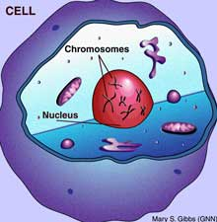
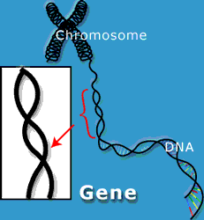
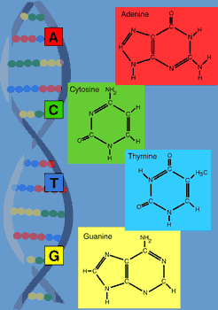

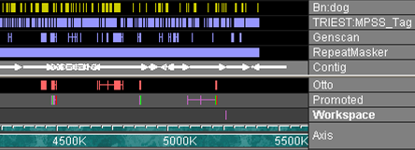
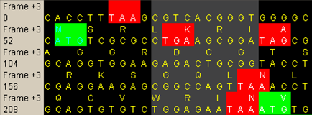
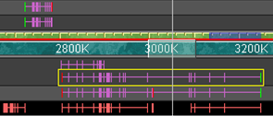
Genome Annotation
Courtesy of the J. Craig Venter Institute
In order to interpret an organism’s raw genomic sequence, the location of its biologically meaningful features such as genes must be annotated.
Computational Annotation
  Automated searches against sequence databases
  Gene prediction algorithms
Manual Curation
  Human expert biologists review evidence
  Determine definitive gene structure
Interactive Visualization Tools
  Visual analysis of genomic data
  Creation and editing of gene annotations

Slide 3
Genome Visualization
Genomic Axis

Slide 4
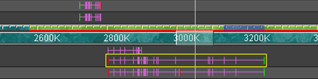
Genome Visualization
Genomic Axis
Gene Annotations

Slide 5
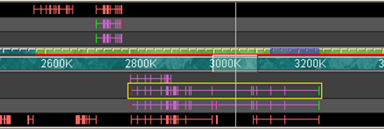
Genome Visualization
Genomic Axis
Gene Annotations
Gene Predictions

Slide 6
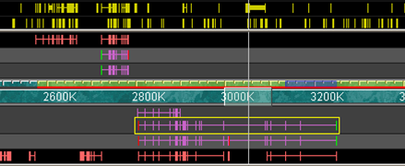
Genome Visualization
Genomic Axis
Gene Annotations
Gene Predictions
Automated Searches

Slide 7
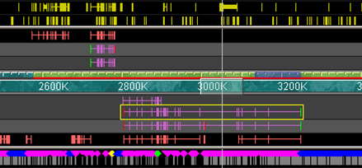
Genome Visualization
Genomic Axis
Gene Annotations
Gene Predictions
Automated Searches
Polymorphisms

Slide 8
Genome Visualization
Genomic Axis
Gene Annotations
Gene Predictions
Automated Searches
Polymorphisms
Codons

Slide 9

Genome Visualization
Genomic Axis
Gene Annotations
Gene Predictions
Automated Searches
Polymorphisms
Codons
Splice Sites

Slide 10

Sequence Visualization
Consensus Sequence View

Slide 11
Sequence Visualization
Consensus Sequence View
Transcript Translate View

Slide 12
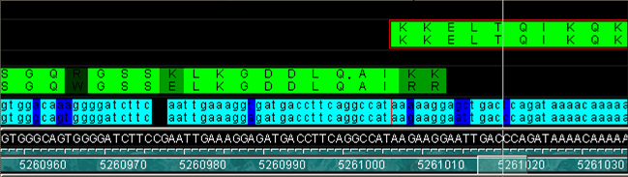
Sequence Visualization
Consensus Sequence View
Transcript Translate View
Alignment View

Slide 13
The Celera Genome Browser
Purpose
  To support Celera’s scientists and customers in annotation of large eukaryotic genomes such as the human genome
History
  Version 1 (1999) – Annotation of first assembly of fruitfly genome
  Version 2 (2000) – Annotation of Celera’s first assembly of the human genome
  Subsequent versions supported Celera annotation projects including the mouse and rat genome assemblies
  Version 4.2 (2002) completed
  Open Source Release (2006)

Slide 14
Demo
Comparative View of CFTR Region

Slide 15
Related Annotation Tools
Apollo (Berkeley)
Artemis (Sanger Institute)
Early Work
  BioPerl
  BioTK
  Neomorphic GeneViewer

Slide 16
Notable Visualization Features
Main View Tiered Feature Display
  Overview with high-performance zoom
  Dragable, dockable tiers
  Full user preferences for tiers, features, colors, orders etc.
  Color intensity mapping of arbitrary feature properties
  Highlighting of curation evidence, exon edge/splice matching
  Thick Intron lines for adjacent HSP’s in subject space
  Length of splice site glyph denotes score
  SNP glyphs shape and color
Subviews
  Simultaneous micro-macro views with linked visual cues
  Spliced Transcript View with start/stop codons and reading frames
  Color-coded comparison of DNA and Protein sequences
  Property view for details-on-demand
Navigation
  Bookmarks
  Searching
  Navigation launched from web browsers
  Sequence Analysis on the fly

Slide 17
Notable Annotation Features
Direct Manipulation Operations
  “Drag and Drop” creation of transcripts, evidence
  Dragging exon edges to resize
  Infinite-level undo
  Annotation logging
Right-click popup actions
  Deleting exons
  Splitting/Merging transcripts
Reloadable Curation “Workspace”

Slide 18
System Architecture
precomputes
annotations
Feature Files
Database
GB Client
Database Query
GB
App Server
Load Query
Annotation
View
relational
data
object
data
Consensus
Residues
View
Outline
View
Relational to Object Mapping
Client Model
Client Views
Celera Relational Data Model
Celera Object Model
annotations’
Workspace File

Slide 19
Availability
The Celera Genome Browser has been released under an LGPL license and will be available soon on Source Forge:
http://sourceforge.net/projects/celeragb

Slide 20



Acknowledgements
Thank you to others who helped create the Celera Genome Browser:
Mark Adams, Deepali Bhandari, Lou Blick, Rosane Charlab, Ken Graham, Michael Harris, Gregg Helt, Olivier Jojic, Jackie Keeling, Kennen Kellaris, Chinnappa Kodira, Mark Lewis, Anne Deslattes-Mays, Joe McDaniel, Natalia Milshina, John Otridge, Todd Pihl, Randall Ribaudo, M’liz Robinson, Michael Simpson, Jay Shira, Marian Skupski, Deepak Srinivasan, Eric Sun, Jennifer Wortman, Rick Wise, David Wu, and Qing Zhang.

Slide 21
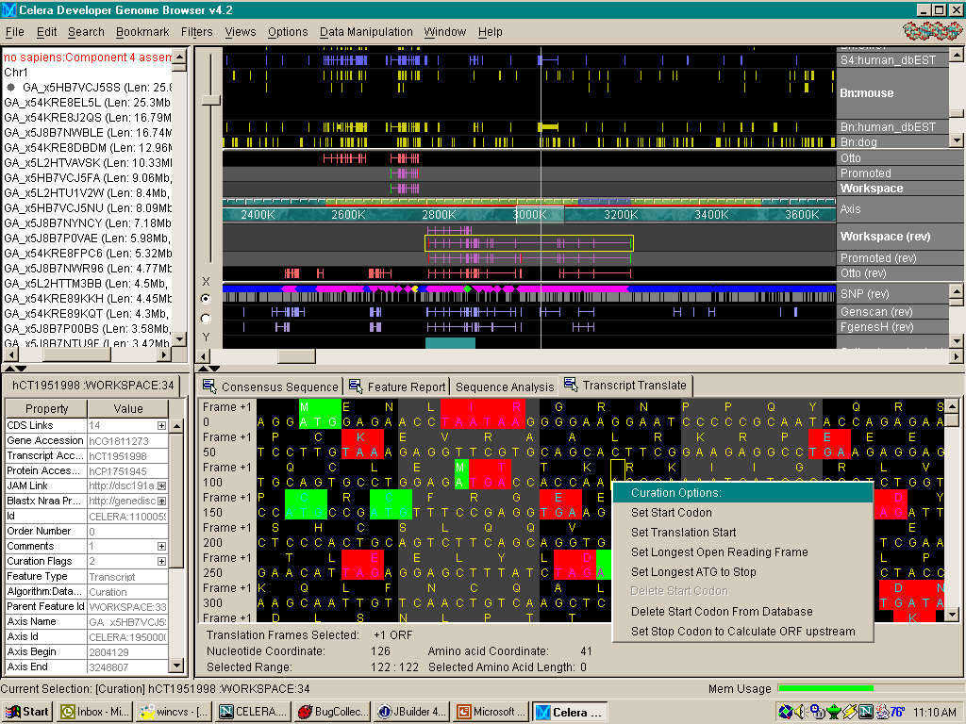
Graphical User Interface Overview
Annotation
View
Zoom
Slider
Zoom
Focus
Slider
Selected
Region
Loading
Indicator
Outline
View
Selected
Feature
Annotation Workspace
Tier
Genomic Axis
Promoted Annotation
Tier
Property
Inspector
View
Subviews
Popup
Curation
Menu
Description
Line
Memory
Usage
Meter

