Slide 1



File Manager
Name: Yash Kumar Singh
Project Title: File Manager
GitHub Username: Celestial-0
edX Username: Celestial_0
City and Country: Pratapgarh, UP, India
Date of Recording: 26-06-2024
PROJECT REPO :
https://github.com/Celestial-0/FILE-MANAGER
by Yash Kumar Singh

Slide 2
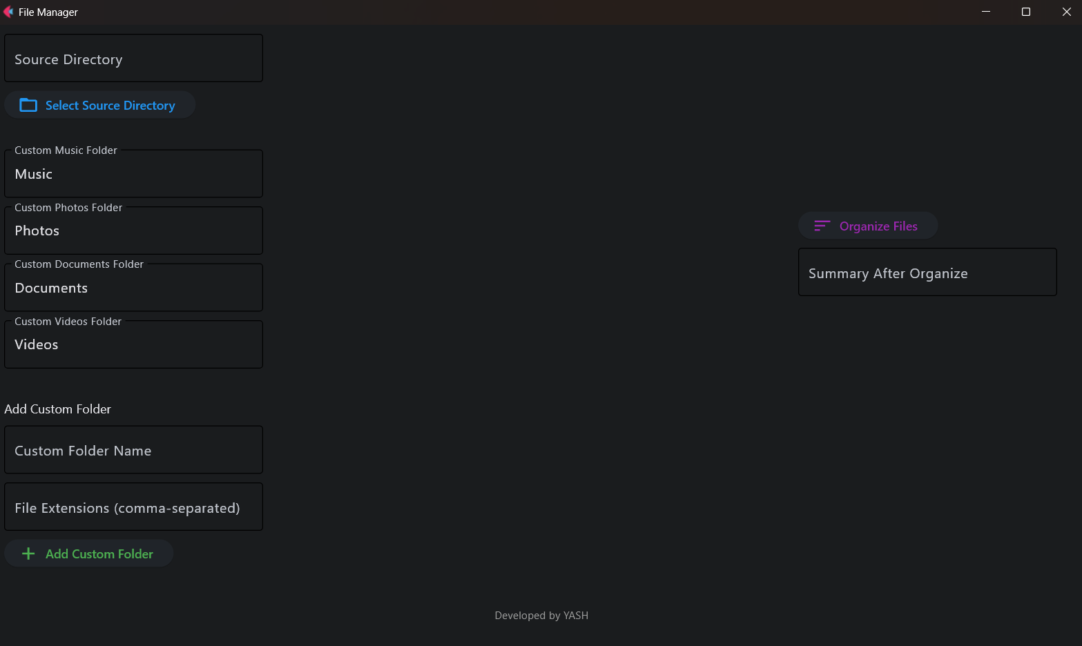

Streamline your digital file organization with a powerful file management tool.
Easily navigate, backup, and sort files with a user-friendly interface.
Organize files into customizable folders and categories.
File Manager Application
by Yash Kumar Singh

Slide 3
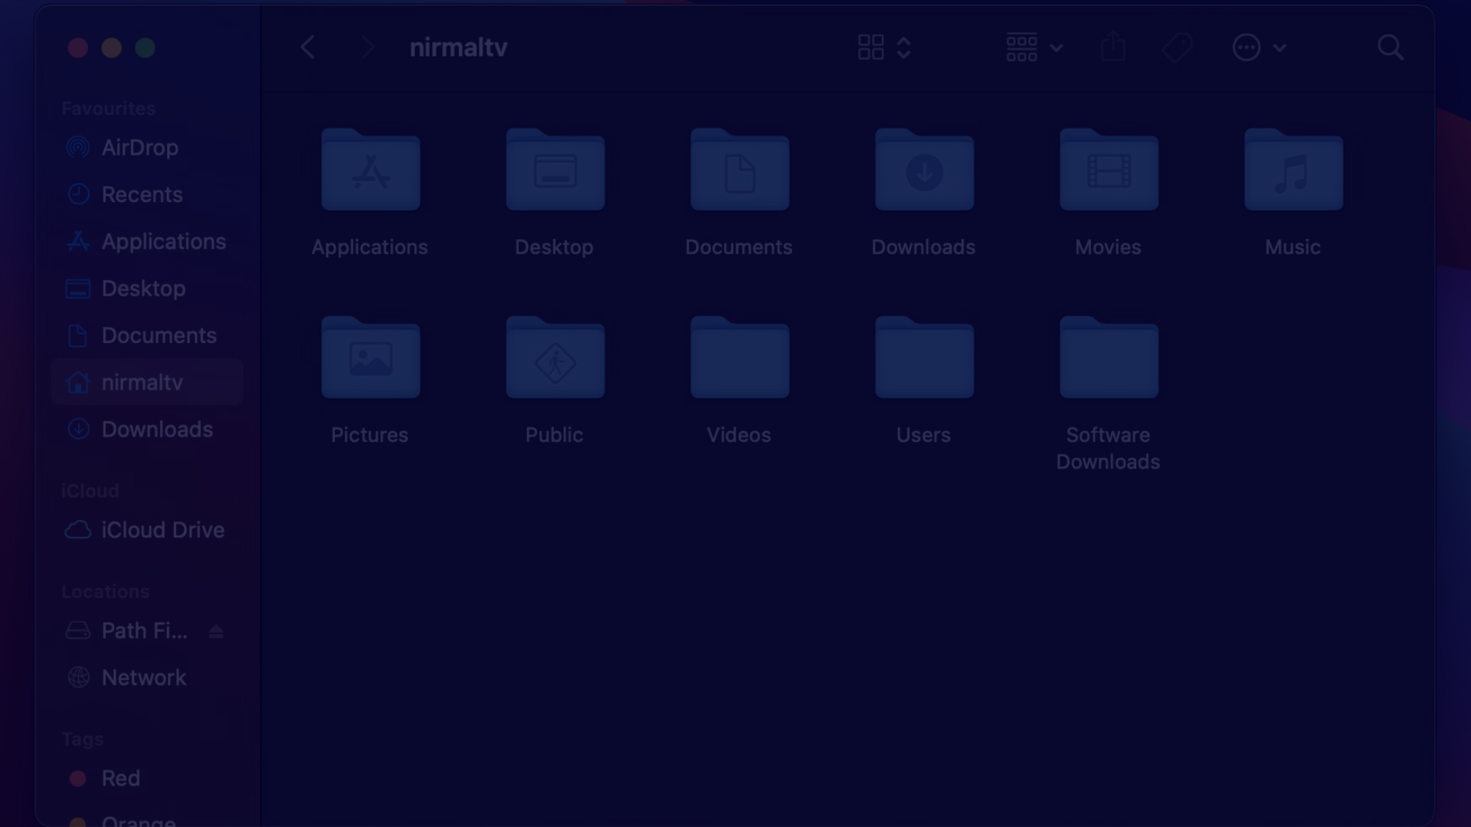
Introduction
1
Comprehensive File Control
2
Automated Workflows
3
Visual Analytics
Gain insights into your file usage and storage with detailed summaries and visualizations.
Manage your files and folders with advanced features for organizing, securing, and accessing your digital content.
Save time with customizable actions to sort, backup, and optimize your file system.

Slide 4
Source Directory Selection
Browse Directories
Recent Locations
Custom Paths
Easily navigate your file system to choose the desired source directory for organization.
Quick access to previously used source directories for efficient repeat tasks.
Ability to enter specific file paths to manage remote or cloud-based content.

Slide 5
Folder Options
Predefined Folders
Custom Folders
Choose from a set of common organizational folders like "Documents", "Photos", "Music", and more.
Create your own specialized folders to match your unique file organization needs.
Naming Conventions
Folder Hierarchy
Apply intelligent naming patterns to new folders for consistent and clear file storage.
Organize files into a nested folder structure for advanced organization and searchability.

Slide 6

Backup Functionality
Automatic Backup
Error Handling
Creates a backup of the source directory before organizing files.
Logs errors during the backup process and displays error messages to the user.
1
2
3
Timestamped Backups
Backups are labeled with the current date and time for easy identification.

Slide 7
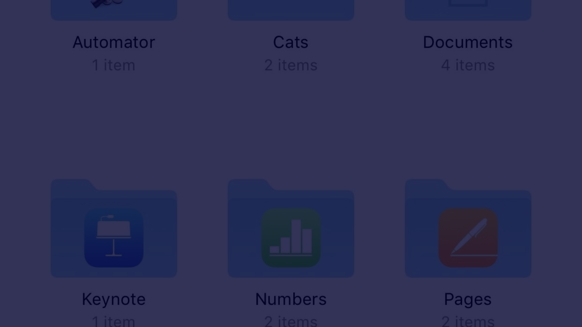



File Organization by Extension
Detect Extensions
Create Folders
Move Files
Identify the file types present in the source directory.
Automatically generate folders based on the detected file extensions.
Relocate files to their respective folders for clean organization.

Slide 8
Summary Report
File Type
Count
Total Size
Documents
142
256 MB
Images
789
1.2 GB
Videos
45
512 MB
Audio
67
128 MB
Others
23
64 MB

Slide 9
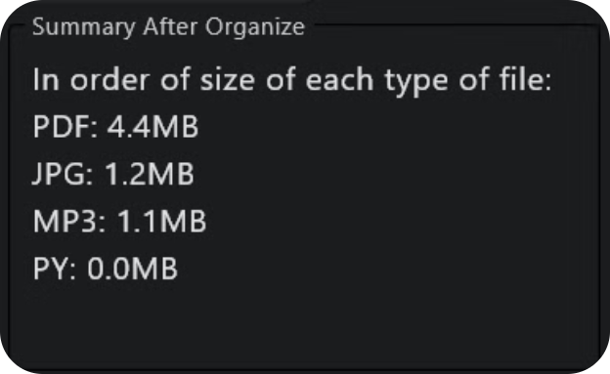
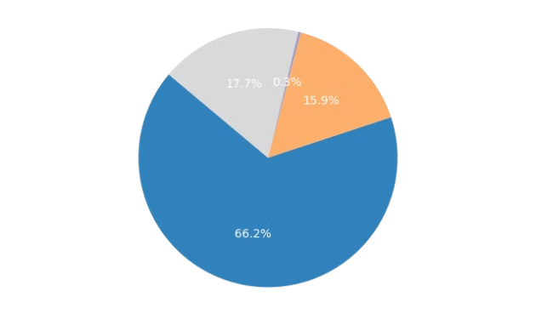
Visualization of Summary
File Type Distribution
Storage Usage
A clear visual breakdown of the file types and their relative sizes within the source directory.
A concise pie chart illustrating the overall storage consumption and allocation across different file categories.

Slide 10




Intuitive User Interface
Simple Navigation
Customizable Options
Informative Dashboard
Automated Workflows
Easily browse and manage files and folders with a clean, intuitive directory tree.
Tailor the application's behavior and appearance to suit your personal preferences.
Gain at-a-glance insights into your file storage with real-time data and visualizations.
Streamline repetitive tasks with powerful automation tools to save time and effort.

