Slide 1




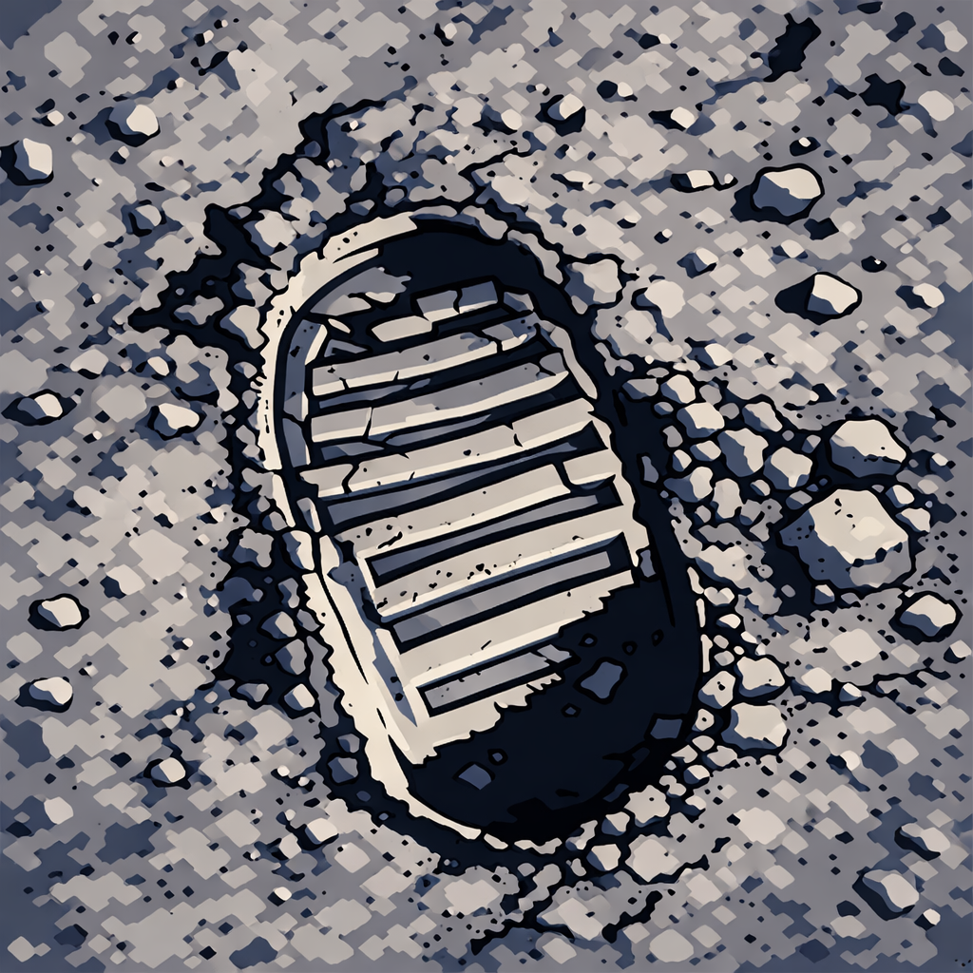
Elevator swaying
Monte Carlo simulation
Cost
Elevator breakdown
Risk-Aware Decision
Data
Collection
Times
Rocket failure
Probability
Robustness Analysis
...
Sensitivity Analysis
Assumptions and Justifications
（c)Task 2: Risk Assessment
（a)Preparation for modeling
Water Demand Model
Optimal Monthly Transport Allocation
Optimized Phased Water Management Strategy
Equivalent rocket payload calculation
Water Recycling Efficiency Model
Multi-Scenario Result Analysis
Wright Learning Curve Extension
(d)Task 3:Water Resource Transportation Scheme
Queuing theory load model
Environmental Pressure Modeling
A
LETTER
TO
MCM
Final optimization
Carbon-Tax-Adjusted Cost
(b)Task 1:Compare three transportation strategies
(e)Task 4:Environmental Impact Assessment

