Slide 1



HUFFMAN CODING
(TEXT COMPRESSION ALGORITHM)
JITHIN JOHN - AM.EN.U4AIE20135
N.MONEESH - AM.EN.U4AIE20150

Slide 2


OVERVIEW
Lossless data encoding algorithm.
Variable Length coding to reduce the total size.
Prefix Coding is followed to avoid ambiguity while decoding.
Less Frequent characters → Longer codes.
More Frequent characters → Shorter codes.
Two main steps in Huffman Coding:
Build a Huffman Tree.
Traverse through the Huffman tree to assign codes.
Commonly used in transmitting fax and text and also used in conventional compression formats like PKZIP, GZIP, etc.
In this project – Algorithm implemented in Java, GUI made with Swing and AWT and visualised with Graphviz.

Slide 3


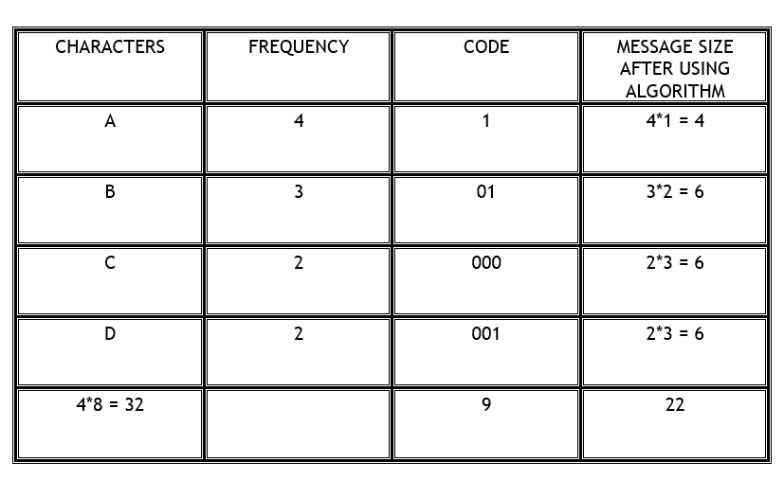

EXAMPLE
INPUT STRING

Slide 4


Main Classes and Functions Used in the program
HuffMan Class:
numberofWords():Takes characters from the string and assigns the frequency .This function is basically counting the number of times each character is repeated in the string.
buildHeap(): in this method we traverse to all elements of charactertofrequency map and add it to the priority queue to sort in efficient manner.
buildTree():It first invokes the buildHeap() function, then by using priority queue which is built from buildheap(), by its functions we will build tree and this building of this tree continues until the priority queue gets empty.
build CodeTable():This just initialises string and node with the root node and starts a recursive function called buildCodeRecursion() which runs until the it reaches the leaf node, appends a 0 if it goes left or 1 if it goes right,these output cdes are added to hashmaps.
checkifleafornot():It checks if the given node is a terminal node or not by checiking if the left and right nodes are null nodes or not or if they have values in it.

Slide 5
Main Classes and Functions Used in the program
Node Class:
Node constructor 1:Used only for terminal nodes and has only arguments as character, weight. The object variables weight and character will be assigned their values respectively and it automatically assigns null to the left and right node.
Node constructor 2:This is used only for non terminal or non leaf nodes where all the character, weight, left and the right node should be passed as the arguments and it will set the weight, character and the left node and the right node to the current node.
Coding Class:
encode() : does the encoding by taking each character of the given string and appending the coded values to a string and completes the encoding process. It makes use of the charactertocode hashmap.

Slide 6
Main Classes and Functions Used in the program
decode() : The decode function makes use of the code to character hashmap which searches for every code values one by one and decodes the character out of it using similar processes to what we did in encode()
Priorityqueue Class:
insert():Used for inserting the specified element into this priority queue.
retrieve():to check whether any element is there in the priority queue or not , if there are elements it will retun root.
size():The number of elements in the priority queue.
serve():To get an element, Take the root node (the first element of the array)After removing the first element, move the last element to the index = 0 position, then compare the element with index = 1, index = 2, if The last element is larger than two children, finds smaller in the left and right children, as a root node.

Slide 7
Main Classes and Functions Used in the program
Main Class:
Starting time recording by storing the time before program execution.
Calculating the total time used and the total memory used by the algorithm.
Defining the invokeLater function for awt to build the gui at the end of the Event Dispatching Thread
Running the terminal script for converting dot file to png using the graphviz module
Uses BufferReader to read the file line by line
Invokes methods for calculating the sizes, generating the Huffman tree and for writing into the dictionary as a text file.
Specifies the locations of the input file and the dot file used for making the visualisation of the Huffman tree(Experimental - Will not work for trees having the same weight sum in the nodes)

Slide 8
Main Classes and Functions Used in the program
HuffManGUI class:
Uses JLabel for printing results and fields in the UI
Printing the Input string size, encoded string size, reduction percentage and the status of tree generation
Showing the table for the letter, frequency and the corresponding huffman code using Jtable
Shows the result string after encoding and decoding
Gives a button with a file chooser for choosing the input file using JFileChooser and Jbutton
Uses JSeparators in the GUI to separate the UI elements
Acts as a css file for the GUI : )

Slide 9
Main Classes and Functions Used in the program
HuffMan Display class:
Gets the Encoded String, Decoded String and dot file of Graphviz from respective class methods.
Generates the Data array for building the Character-Frequency-Code Table in the GUI by iterating through the HashMaps : characterToFrequency and characterToCode
Calculates the size of the input string by multiplying 8 with the length of the characters to convert ASCII to bytes
Calculates the size after Coding by just getting the length of the Encoded String since it is binary.
Calculates the percentage of reduction did on the original string.
Invokes class functions for Huffman, Coding and gDescriptionWriter classes.

Slide 10

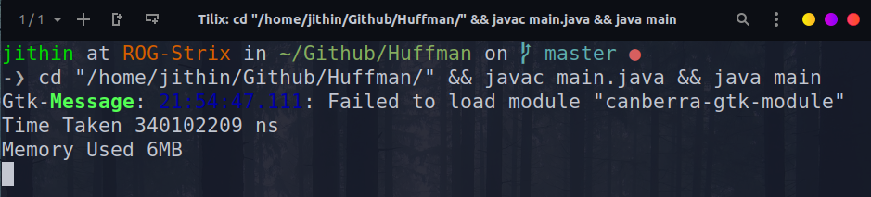
PERFORMANCE ANALYSIS
Time Complexity of Huffman Coding: O(nlogn)
Performance analysis of an algorithm depends upon two factors i.e. amount of memory used and amount of compute time consumed on any CPU.
Time Taken and the Space used by the program :

Slide 11


CONTRIBUTION
The Huffman Algorithm Implementation was done by N.Moneesh (AM.EN.U4AIE20150)
The GUI Implementation and the Integration of the Algorithm was done by Jithin John(AM.EN.U4AIE20135)

Slide 12




