Slide 1
Dissertation
Diabetes Prediction Using Machine Learning

Slide 2
Introduction
Health is currently one of the most discussed agenda in the world as more effort is being put into the development of new drugs and vaccines to combat various diseases especially after the recent pandemic.
Health care systems are being designed to further aid the advancement of medical technologies and prescription accuracies.
Diabetes is a lifelong disease that occurs when the pancreas doesn’t produce enough insulin or when the body cannot effectively use the insulin that it produces. Insulin is a hormone that regulates the blood sugar.
The global prevalence of diabetes has risen sharply from 4.7% in 1980 to 8.5% in 2014. Diabetes prevalence has seen more increase in middle- and low-income countries.
Diabetes is a major cause of blindness, kidney failure, heart attacks, stroke, and lower limb amputation.
The field of big data analytics is an ever-growing field that uses machine learning and other available algorithms to find patterns in datasets. Machine learning is one of the most widely used method for finding patterns and making predictions from dataset and this method is adopted in this research using tools such as R, Weka and PowerBI.

Slide 3
Methodology
Data Set: To create a predictive analysis system a comprehensive dataset to learn from and a test dataset that ensure that the machine learning algorithm reaches the expected accuracy standards.
In order to develop an accurate Diabetes prediction, model the dataset used in this research includes data gather from 130 US hospitals and discusses over 50 features representing patients and hospital outcomes and it includes data from 101, 766 patients.
The dataset contains attributes that discusses the drugs administered to the patients which can be very useful for predicting diabetes type, it also includes attributes on ethnicity as discussed earlier in this paper that race as an effect on the dominance of diabetes. Age which also plays a factor is included in the dataset
. From the set of available data, a split is performed to test and train data, which is a 50% split i.e., 50% of the data is used for test whilst the remaining 50% is used for training data.
The summary function in R was used to find the statistical analysis of the data which includes the mean median and mode function of the data.

Slide 4
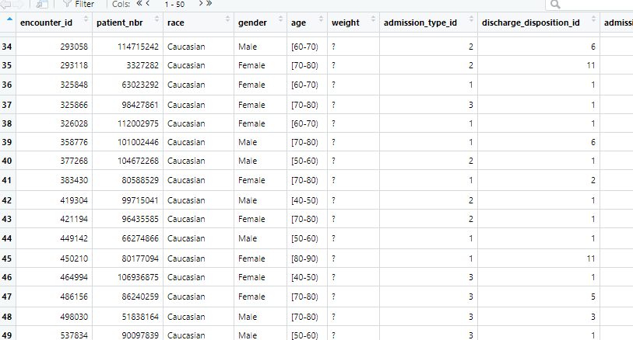
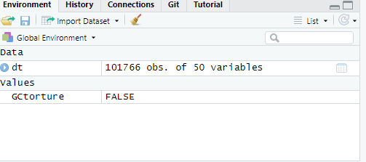
Methodology - Data Set
The pictures show some attributes on the dataset, and the number of attributes, and instances.

Slide 5
Methodology- Feature Selection
As discussed earlier 50 features are available in the dataset, and dataset is also highly diversified due to huge number of patients considered in the dataset. not all available attributes will contribute to the prediction of patient’s diabetes condition therefore feature selection is used to choose from among the many attributes available.
Different statistical techniques have been discussed in literature, but the function used in this paper is the R correlation function known as Caret() that helps remove redundant feature and ranks said feature in order of importance.
The caret function in R is a function that helps remove redundant features based on their correlation with each other that is similarities between the features
The importance of the features was also determined using the traincontrol method.

Slide 6

Machine Learning Algorithms - Clustering Model
Simple K-means: The most popular and widely used clustering algorithm is the Kmeans algorithm.
Kmeans clusters datasets based on a number of clusters K after calculating the distance between each attribute and variables. Kmeans basically works in 3 steps which are:
Selecting the K values
Initializing the centroid
Select group and finds the average
Hierarchical Clustering: In this type of clustering clusters are built by forming hierarchies between the various attributes present in a dataset. There are two types of hierarchical clusters and they include
Agglomerative: clusters are built from bottom-up, i.e., the algorithm continues merging the dataset until desired clusters is formed. It has a time complexity of $θ(n^{3})$ and memory requirement of $Ω(n^{2})$ which makes it slow for even a simple dataset. Its method of merging is usually greedy.
Divisive: this typically starts with one cluster and then divides into various clusters possible. This follows a top-bottom approach. It has time complexity of $θ(2^{n})$.

Slide 7
Machine Learning Algorithms - Classification Model
Random Forest: Is easy to implement with R and it’s used by calling the library random forest and mlbench and caret R package libraries respectively.
It is based on decision trees, and it uses the regression technique for its predictions, it combines various classifying techniques to arrive at its decisions this is possible because of its utilization of ensemble learning.
A random forest consists of many decision trees and the ‘forest’ it generates its trained through bootstrapping or bagging aggregating. It also establishes it outcomes based on the decision tree; it uses the mean output of its decision trees. The more tree it generates the higher the accuracy of its prediction.
J48: Also known as C4.5 makes its decisions by a top-down, recursive, divide and conquer strategy as it searches for a new instance to split for at each stage of the tree.
The split strategies stops if a subset has a place with a similar class in all the instances.
It develops a decision node utilizing the expected estimations of the class and can deal with characteristics, lost or missing attribute estimations of the data and varying attribute costs.

Slide 8
Machine Learning Algorithms - Classification Model
Naive Bayes: It is the most popular and most widely used prediction and classification algorithm.
It uses probability in making its predictions based on applying the Bayes’ theorem and they have strong independence assumptions between the features that is it’s termed as naïve.
It is simplest of the Bayesian network. It is highly scalable and requires a number of parameters linear in the number of variables to learn a problem.
It is a conditional probability model.

Slide 9
Experiments and Results – Clustering Algorithm
Algorithm | Results
Simple Kmeans | Surprisingly, the results showed that it is most dominantly found in adults between the ages of 70-80 years of age after reading through literature again to confirm results it is said that most diabetic patients typically die before the age of 90(WHO, 2012). Its correctly classified instances are 89%. percentage splits of 50% was performed on the algorithm and little difference was shown in its correctly classified instances.
Hierarchical Clustering | When this was performed on the dataset its correctly classified instances were 87 %. Percentage splits was also performed on the dataset at 50% and its correctly classified instance dropped to 78%.

Slide 10
Experiments and Results – Classification Algorithm
Algorithm | Result
Random Forest | Its correctly classified instances were 87% using training set. After a cross validation fold of 10was applied the number of correctly classified instances were 85%, and after a percentage split of 50% the number of correctly classified instances was 87%.
J48 | Its correctly classified instances were 88% using training set. After a cross validation fold of 10 was applied the number of correctly classified instances were 86%, and after a percentage split of 50% the number of correctly classified instances was 70%
Naïve Bayes | Its correctly classified instances were 89% when training set was used on the data. After a cross validation of 10-fold was applied its number of correctly classified instances were 84%, and after a percentage split of 50% its correctly classified instances were still 85%.

Slide 11
Result Analysis
I expected before performing the clustering algorithm and applying it on the dataset, I expected for cluster results to predict that diabetes was more prominent in adults between the age of 90 has from literature it shows that most adults typically get diagnosed a 70.
I expected its precision and accuracy to be higher than that of Hierarchical cluster as their means of clustering are different. I had an expectation that patients referred to the diabetes which is made known via the admission source would mostly be diagnosed with diabetes and have their medication changed.
I also expected Asians to have the leading number of diabetic patients as it is earlier discussed in this paper that ethnicity also plays a role in diabetic distribution but the people with the leading number of diabetic patients are Caucasians.
From the results shown in the experiments conducted above literature research is proven to be true as dataset shows that Random Forest takes longer to build model than the other classification algorithms used.
From literature we know Random Forest build every tree by instance and its precision is determined by the number of trees it builds.

Slide 12
Result Analysis
It took the longest time to build, and its precision value was not much different from the others. From the clustering algorithms we see that the number of correctly clustered instances are high and very low when run on Weka, Simple Kmeans had a 58% correctly clustered instances and hierarchical cluster was the same.

Slide 13
Challenges
I had memory capacity limitations as dataset is very huge and running on my machine proved to be difficult and algorithm might have been slower to build due to that.
I also had challenges converting the variables to nominal value in R. To convert to nominal variables in R the factor function is required due to memory limitations this conversion could not be done all at once but bit by bit by passing each attribute to the factor function.
I had challenges in replacing missing values in R, so I made conversions to each attribute, respectively.

Slide 14
Conclusions & Recommendations
The field of data analytics and data mining uses algorithms to extract patterns in datasets and use them to make a prediction or forecast on what the situation that dataset records will look like in the future.
This study discusses diabetes prediction using machine learning techniques. As is already discussed in earlier chapters some obtained results when outside of expected result outcomes not in a negative way but because of a bias.
It is recommended that other machine learning techniques be explored in predicting diabetes and the diabetic types also be predicted based on dataset. The developed models each had their strengths and weaknesses which has already been discussed in the above sections. Finally, data mining has seen its useful well lived in the health sector most especially but other sectors as well.

Slide 15
THANK YOU

