Slide 1
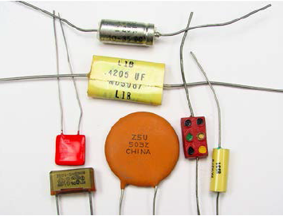
Capacitors
A capacitor is a device used to store electric charge

Slide 2
Capacitors
A capacitor is a device that stores electric charge.
A capacitor consists of two conductors separated by an insulator.
Capacitors have many applications:
Computer RAM memory and keyboards.
Electronic flashes for cameras.
Electric power surge protectors.
Radios and electronic circuits.

Slide 3
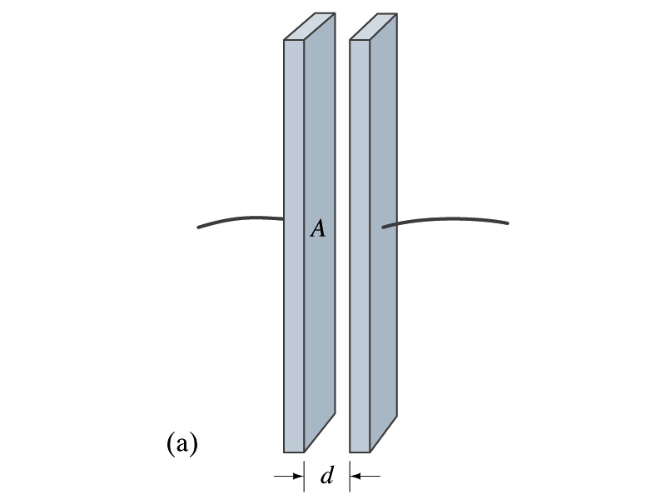
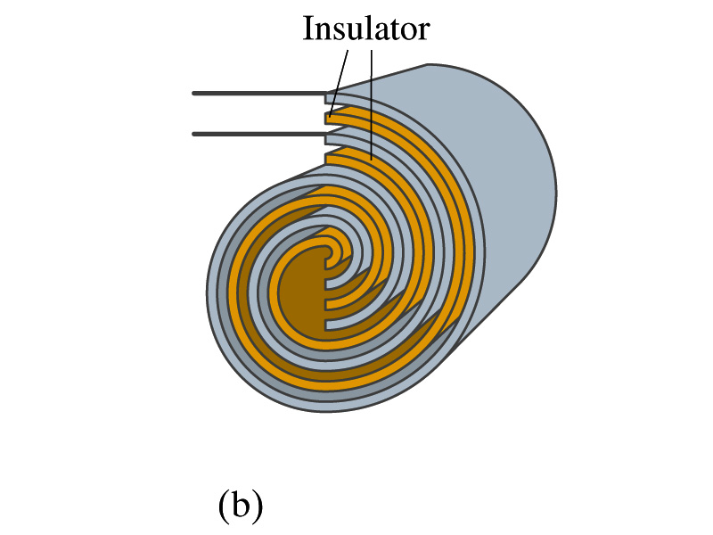
Types of Capacitors
Parallel-Plate Capacitor
Cylindrical Capacitor
A cylindrical capacitor is a parallel-plate capacitor that has
been rolled up with an insulating layer between the plates.

Slide 4
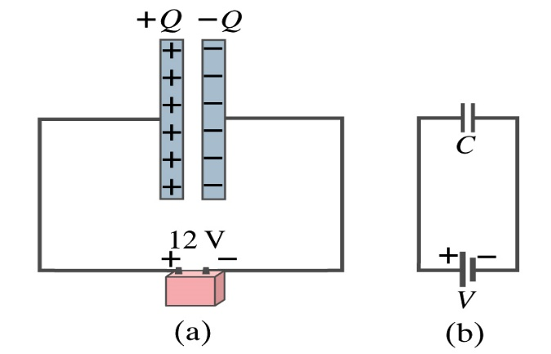


Capacitors and Capacitance
The stored charge Q is proportional to the potential difference V between the plates. The capacitance C is the constant of proportionality, measured in Farads.
$$Q=CV$$
Farad = Coulomb / Volt
Capacitance C is the amount of charge stored divided by voltage
$$C=\frac{Q}{V}$$

Slide 5
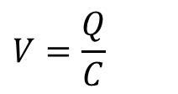
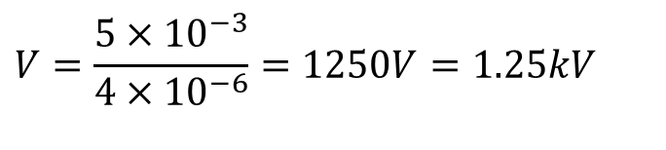
Capacitors and Capacitance
Determine the p.d. across a 4 µF capacitor when charged with 5 mC.
$$V=\frac{Q}{C}$$
C= 4 µF = 4x 10 ⁻⁶ F
Q = 5 mC = 5 x 10⁻³C
$$V=\frac{5×10^{−3}}{4×10^{−6}}=1250V=1.25kV$$

Slide 6

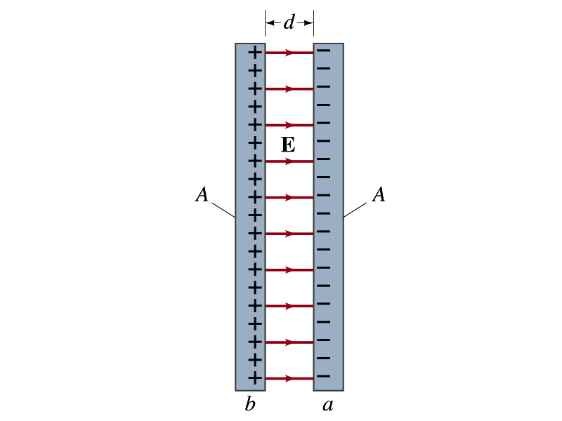
Parallel-Plate Capacitor
Charge +Q is placed on one plate and –Q on the other plate.
+Q
-Q
An electric field E is created between the plates.
A simple parallel-plate capacitor consists of two conducting plates of area A separated by a distance d.
+Q
-Q

Slide 7

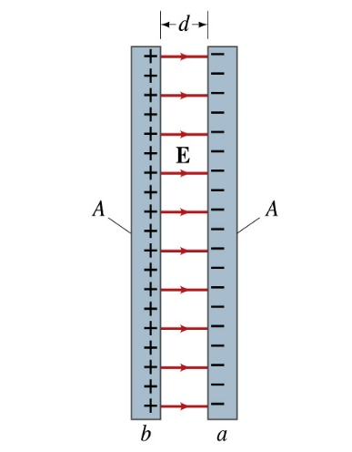
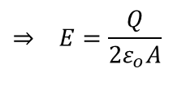
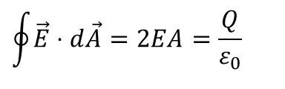
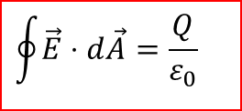
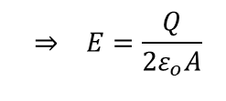
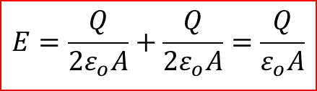
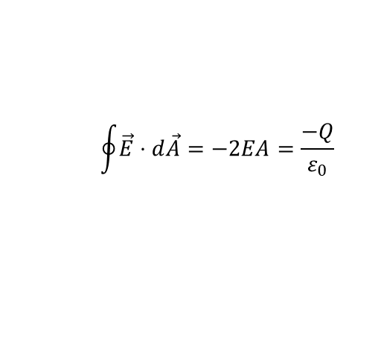
Electric Field Inside a Parallel-Plate Capacitor
From Gauss’s Law:
$$\oint{\vec{E}⋅d\vec{A}}=\frac{Q}{ε_{0}}$$
For positively charged plate:
+Q
-Q
$$\oint{\vec{E}⋅d\vec{A}}=2EA=\frac{Q}{ε_{0}}$$
$$⇒ E=\frac{Q}{2ε_{o}A}$$
For negatively charged plate:
$$\oint{\vec{E}⋅d\vec{A}}=−2EA=\frac{−Q}{ε_{0}}$$
$$⇒ E=\frac{Q}{2ε_{o}A}$$
Between the plates, by the principle of superposition:
$$E=\frac{Q}{2ε_{o}A}+\frac{Q}{2ε_{o}A}=\frac{Q}{ε_{o}A}$$

Slide 8

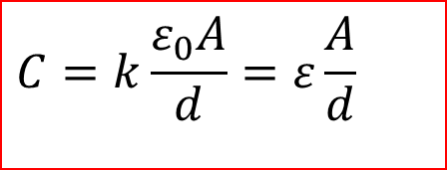
Dielectrics
A dielectric is an insulating material (e.g. paper, plastic, glass).
A dielectric placed between the conductors of a capacitor increases ts capacitance by a factor κ, called the dielectric constant.
C= κC_{o} (C_{o}=capacitance without dielectric)
$$C=k\frac{ε_{0}A}{d}=ε\frac{A}{d}$$
For a parallel-plate capacitor:
permittivity of the material.
$$kε_{0}=ε$$

Slide 9
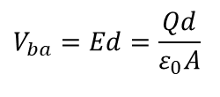
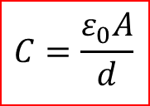
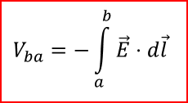

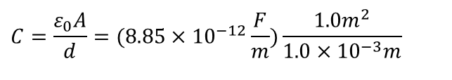
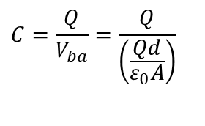
Capacitance of Parallel-Plate Capacitor
$$V_{ba}=−\int_{a}^{b}{\vec{E}⋅d\vec{l}}$$
$$V_{ba}=Ed=\frac{Qd}{ε_{0}A}$$
$$C=\frac{Q}{V_{ba}}=\frac{Q}{\left(\frac{Qd}{ε_{0}A}\right)}$$
$$C=\frac{ε_{0}A}{d}$$
$$C=8.85×10^{−9}F=8.85nF$$
Example
What is the capacitance of a parallel plate capacitor with metal plates, each of area 1.00 m² , separated by 1.00 mm?
$$C=\frac{ε_{0}A}{d}=(8.85×10^{−12}\frac{F}{m})\frac{1.0m^{2}}{1.0×10^{−3}m}$$

Slide 10
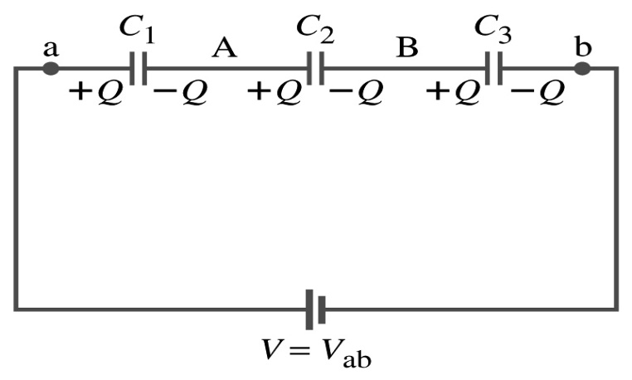


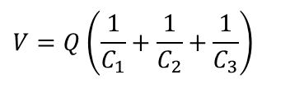
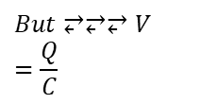
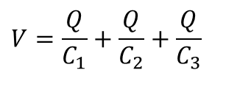


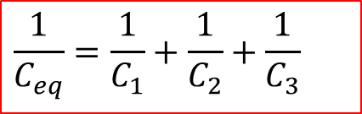
Finding equivalent Capacitance for capacitos in Series
$$Same\text{charge},Q_{1}=Q_{2}=Q_{3}=Q$$
$$Differentvoltages(addvoltages)$$
$$V=V_{1}+V_{2}+V_{3}$$
$$But⥂⥂⥂V=\frac{Q}{C}$$
$$V=\frac{Q}{C_{1}}+\frac{Q}{C_{2}}+\frac{Q}{C_{3}}$$
$$V=Q\left(\frac{1}{C_{1}}+\frac{1}{C_{2}}+\frac{1}{C_{3}}\right)$$
$$\frac{1}{C_{eq}}=\frac{1}{C_{1}}+\frac{1}{C_{2}}+\frac{1}{C_{3}}$$
$$V=\frac{Q}{C_{eq}}$$

Slide 11
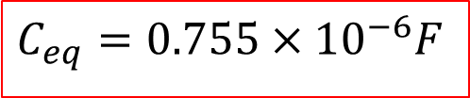
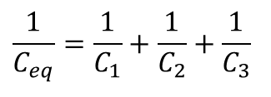
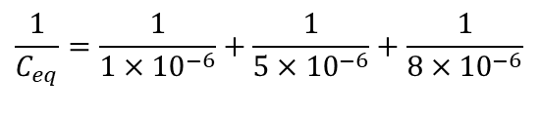
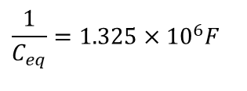
Finding equivalent Capacitance for capacitos in Series
Find the total capacitance for three capacitors connected in series, given their individual capacitances are 1.0, 5.0, and 8.0 μF
$$\frac{1}{C_{eq}}=\frac{1}{C_{1}}+\frac{1}{C_{2}}+\frac{1}{C_{3}}$$
$$\frac{1}{C_{eq}}=\frac{1}{1×10^{−6}}+\frac{1}{5×10^{−6}}+\frac{1}{8×10^{−6}}$$
$$\frac{1}{C_{eq}}=1.325×10^{6}F$$
$$C_{eq}=0.755×10^{−6}F$$

Slide 12
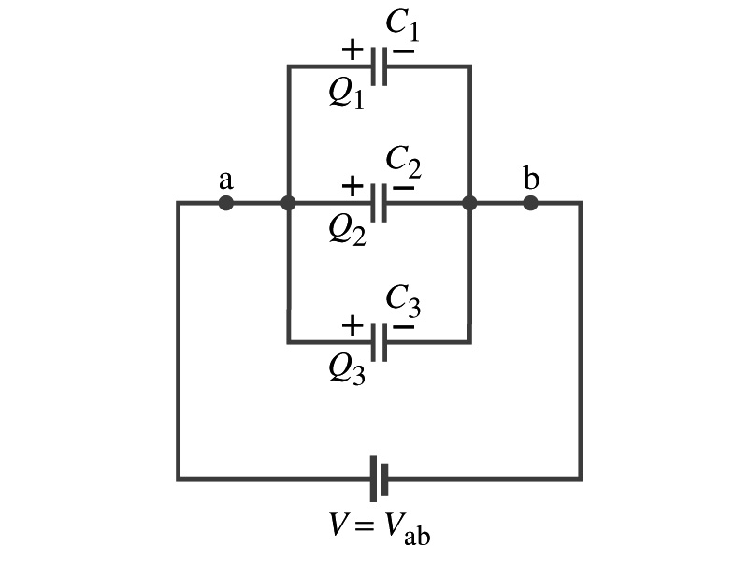








Capacitors in Parallel
$$Samevoltage,V_{1}=V_{2}=V_{3}=V$$
$$Different\text{charges}(\text{addcharges})$$
$$Q=Q_{1}+Q_{2}+Q_{3}$$
$$But⥂⥂⥂Q=CV$$
$$Q=C_{1}V+C_{2}V+C_{3}V$$
$$Q=(C_{1}+C_{2}+C_{3})V$$
$$Q=C_{eq}V$$
$$C_{eq}=C_{1}+C_{2}+C_{3}+...$$

Slide 13
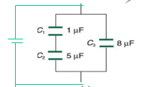
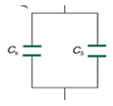



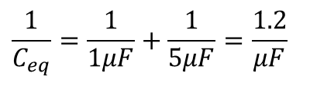
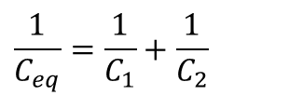
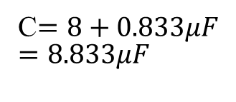
Circuit with Capacitors in Series and Parallel
Find the total capacitance of the combination of capacitors shown in Figure. ( C₁ = 1.0 μF , C₂ = 5.0 μF , and C₃ = 8.0 μF ),.
$$\frac{1}{C_{eq}}=\frac{1}{C_{1}}+\frac{1}{C_{2}}$$
$$\frac{1}{C_{eq}}=\frac{1}{1μF}+\frac{1}{5μF}=\frac{1.2}{μF}$$
C$=8+0.833μF$ $$=8.833μF$$
$$C_{eq}=C_{3}+C_{4}$$
$$C_{eq}=0.833μF$$

Slide 14
Circuit with Capacitors in Series and Parallel
C₁
C₂
15 μF
3 μF
C₄
20 μF
a
b
6 μF
C₃
?
C_{ab}
What is the effective capacitance C_{ab} between points a and b?

Slide 15
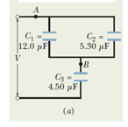
Example, Capacitors in Parallel and in Series:
Find the equivalent capacitance for the capacitances shown in Figure below, across which potential difference V is applied .
$$C_{1}=12.0μFC_{2}=5.3μFC_{3}=4.5μF$$
First evaluate for C₁ and C₂ in parallel

Slide 16
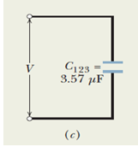
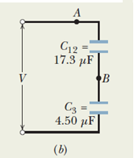
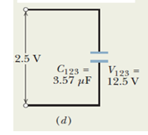





Example, Capacitors in Parallel and in Series:

Slide 17

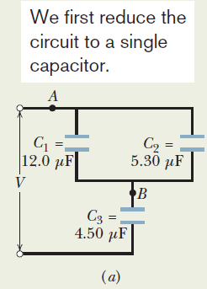
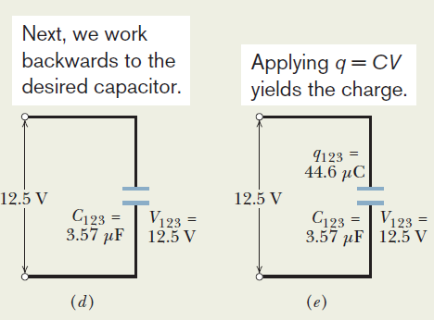

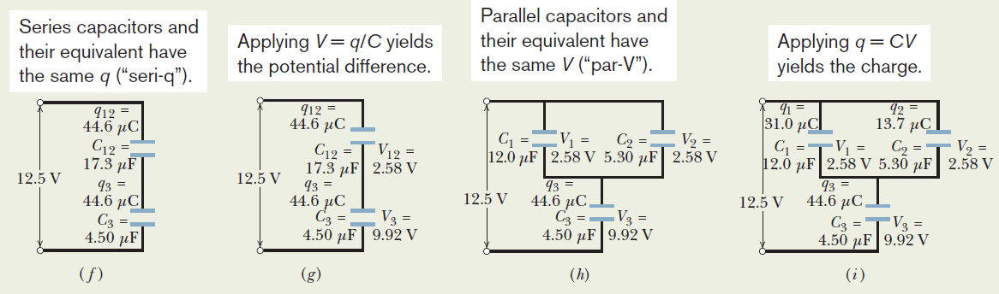
Example, Capacitors in Parallel and in Series:

Slide 18
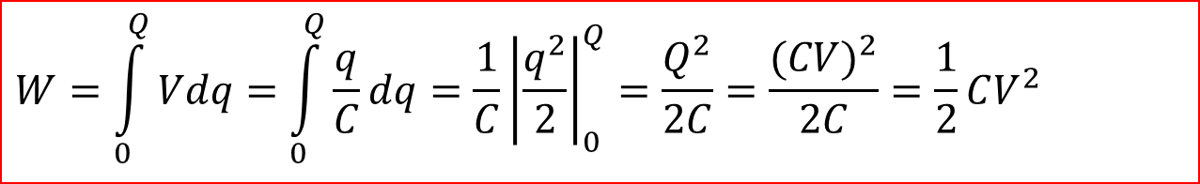
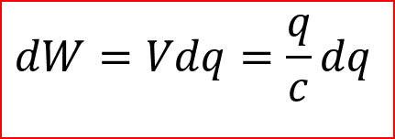
Energy Storage in Capacitors
Since capacitors store electric charge, they store electric potential energy.
Consider a capacitor with capacitance C, potential difference V and charge q.
The work dW required to transfer an elemental charge dq to the capacitor:
$$dW=Vdq=\frac{q}{c}dq$$
The work required to charge the capacitor from q=0 to q=Q:
$$W=\int_{0}^{Q}{Vdq}=\int_{0}^{Q}{\frac{q}{C}dq}=\frac{1}{C}{\left|\frac{q^{2}}{2}\right|}_{0}^{Q}=\frac{Q^{2}}{2C}=\frac{(CV)^{2}}{2C}=\frac{1}{2}CV^{2}$$
Energy Stored by a Capacitor = ½CV² = ½QV

Slide 19
Example: Electronic Flash for a Camera
A digital camera charges a 100 μF capacitor to 250 V.
How much electrical energy is stored in the capacitor?
If the stored charge is delivered to a krypton flash bulb in 10 milliseconds, what is the power output of the flash bulb?

Slide 20
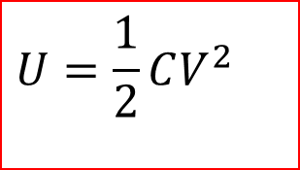
Stored Energy Density of a Charged Capacitor
$$U=\frac{1}{2}CV^{2}$$
Stored Energy:

Slide 21

Dielectrics
A dielectric is an insulating material (e.g. paper, plastic, glass).
A dielectric placed between the conductors of a capacitor increases its capacitance by a factor κ, called the dielectric constant.
C= κC_{o} (C_{o}=capacitance without dielectric)
For a parallel-plate capacitor:
$$C=κ\frac{ε_{0}A}{d}=ε\frac{A}{d}$$
ε = κε_{o} = permittivity of the material.

Slide 22
Properties of Dielectric Materials
Dielectric strength is the maximum electric field that a dielectric can withstand without becoming a conductor.
Dielectric materials
increase capacitance.
increase electric breakdown potential of capacitors.
provide mechanical support.
Material | Dielectric Constant κ | Dielectric Strength (V/m)
air | 1.0006 | 3 x 10⁶
paper | 3.7 | 15 x 10⁶
mica | 7 | 150 x 10⁶
strontium titanate | 300 | 8 x 10⁶

Slide 23
Practice Quiz
A charge Q is initially placed on a parallel-plate capacitor with an air gap between the electrodes, then the capacitor is electrically isolated.
A sheet of paper is then inserted between the capacitor plates.
What happens to:
the capacitance?
the charge on the capacitor?
the potential difference between the plates?
the energy stored in the capacitor?

Slide 24
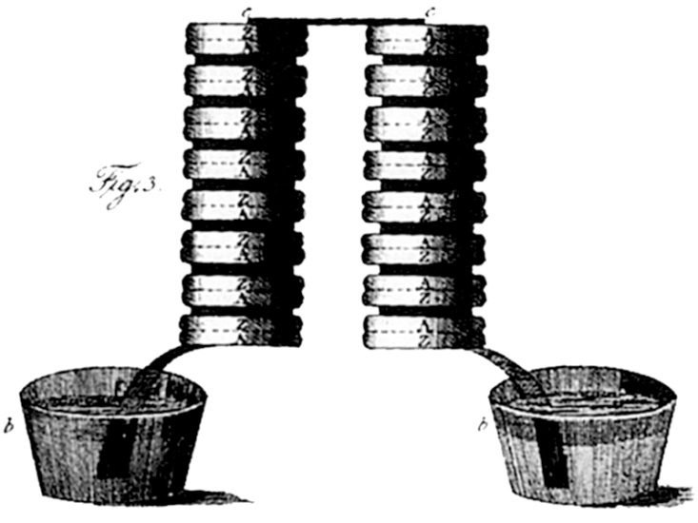

The Electric Battery
Luigi Galvani (Italy, 1780’s) studied the effect of static electricity on the contraction of leg muscles in frogs, and found that the same effect could be produced by inserting two dissimilar metals into the muscle.
Alessandro Volta (Italy,1800) invented the electric battery and demonstrated a flow of electric charge.
Volta’s original battery consisted of
alternate layers of zinc and silver and
a salt solution.
A simple electric cell is the
basis of the common 1.5 Volt
“dry cell” flashlight battery.

Slide 25

Common Dry cell
The electrolyte (acid) reacts with the zinc electrode dissolving part of it.
Each zinc atom enters solution as a positive ion, leaving two electrons behind.
The zinc electrode is left with a net negative charge.
The positively charged electrolyte pulls electrons off the carbon electrode, leaving it with a net positive charge.
Common dry cell.
(AA,AAA, C or D cell)
The net result is that the carbon electrode is left with a net positive
charge and the zinc electrode a net negative charge, creating a
potential difference between them of 1.5 V.

Slide 26
Electric Cell or Battery
An electric cell or battery produces an electric potential difference between two conducting electrodes (terminals) by transforming chemical energy into electrical energy.
Symbol: or
The battery “dies” as one or the other of the electrodes becomes depleted.
Some types of batteries (e.g. Ni-Cd) may be “recharged” by applying an electric potential difference, reversing the chemical process.
+
–
+
–

