Slide 1
Sound Waves
Sound waves are longitudinal waves that travel through a medium like air or water
Compressions: The close together part of the wave
Rarefactions: The spread-out parts of a wave
Sound waves are produced by a vibrating body.
One compression and one rarefaction make up one longitudinal wave.
When we think about sound, we often think about how loud it is (amplitude, or intensity) and its pitch (frequency), loudness , volume
.

Slide 2
Intensity and Pitch
The pitch of a sound depends on the frequency of the tone that the ear receives.
The frequency of a sound wave is called it pitch. High frequency sounds are said to be "high pitched" or just "high";
low frequency sounds are said to be "low pitched" or just "low".
The intensity of a sound is the amount of energy crossing a unit area in unit time or the power flowing through the unit area.
The SI unit is watts per square meter.
The loudness of the sound depends upon the subjective effect of intensity of sound waves on the human ear.
In general, a more intense sound is also louder, but the ear does not respond similarly at all frequencies so that two tones of the same intensity but with different pitches may appear to have different loudness.
The intensity of the threshold of hearing ( I _{o}), which is the intensity that can be barely heard by a normal person, is about 0 ⁻¹² (watt/m ²) when measured by acoustical devices.

Slide 3
Sound Waves
Sound can be modeled as a pressure wave by considering the change in pressure from average pressure,
ΔP = ΔP_{max}sin(kx ∓ ωt + ϕ)
where ΔP is the change in pressure, ΔP_{max} is the maximum change in pressure,
k= 2πλ is the wave number, ω=2π/T=2πf is the angular frequency, and ϕ is the is phase angle.
The wave speed (group velocity) can be determined from
v = ω / k = f λ
Sound waves can also be modeled in terms of the displacement of the air molecules. The displacement of the air molecules can be modeled using a cosine function:
s(x,t) = s_{max}cos(kx ∓ ωt + ϕ)
In this equation, s is the displacement and s_{max} is the maximum displacement.

Slide 4
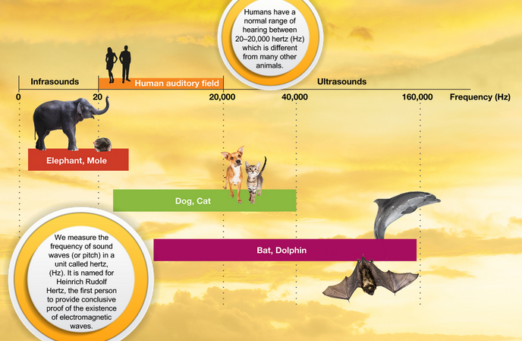
Sound Waves

Slide 5
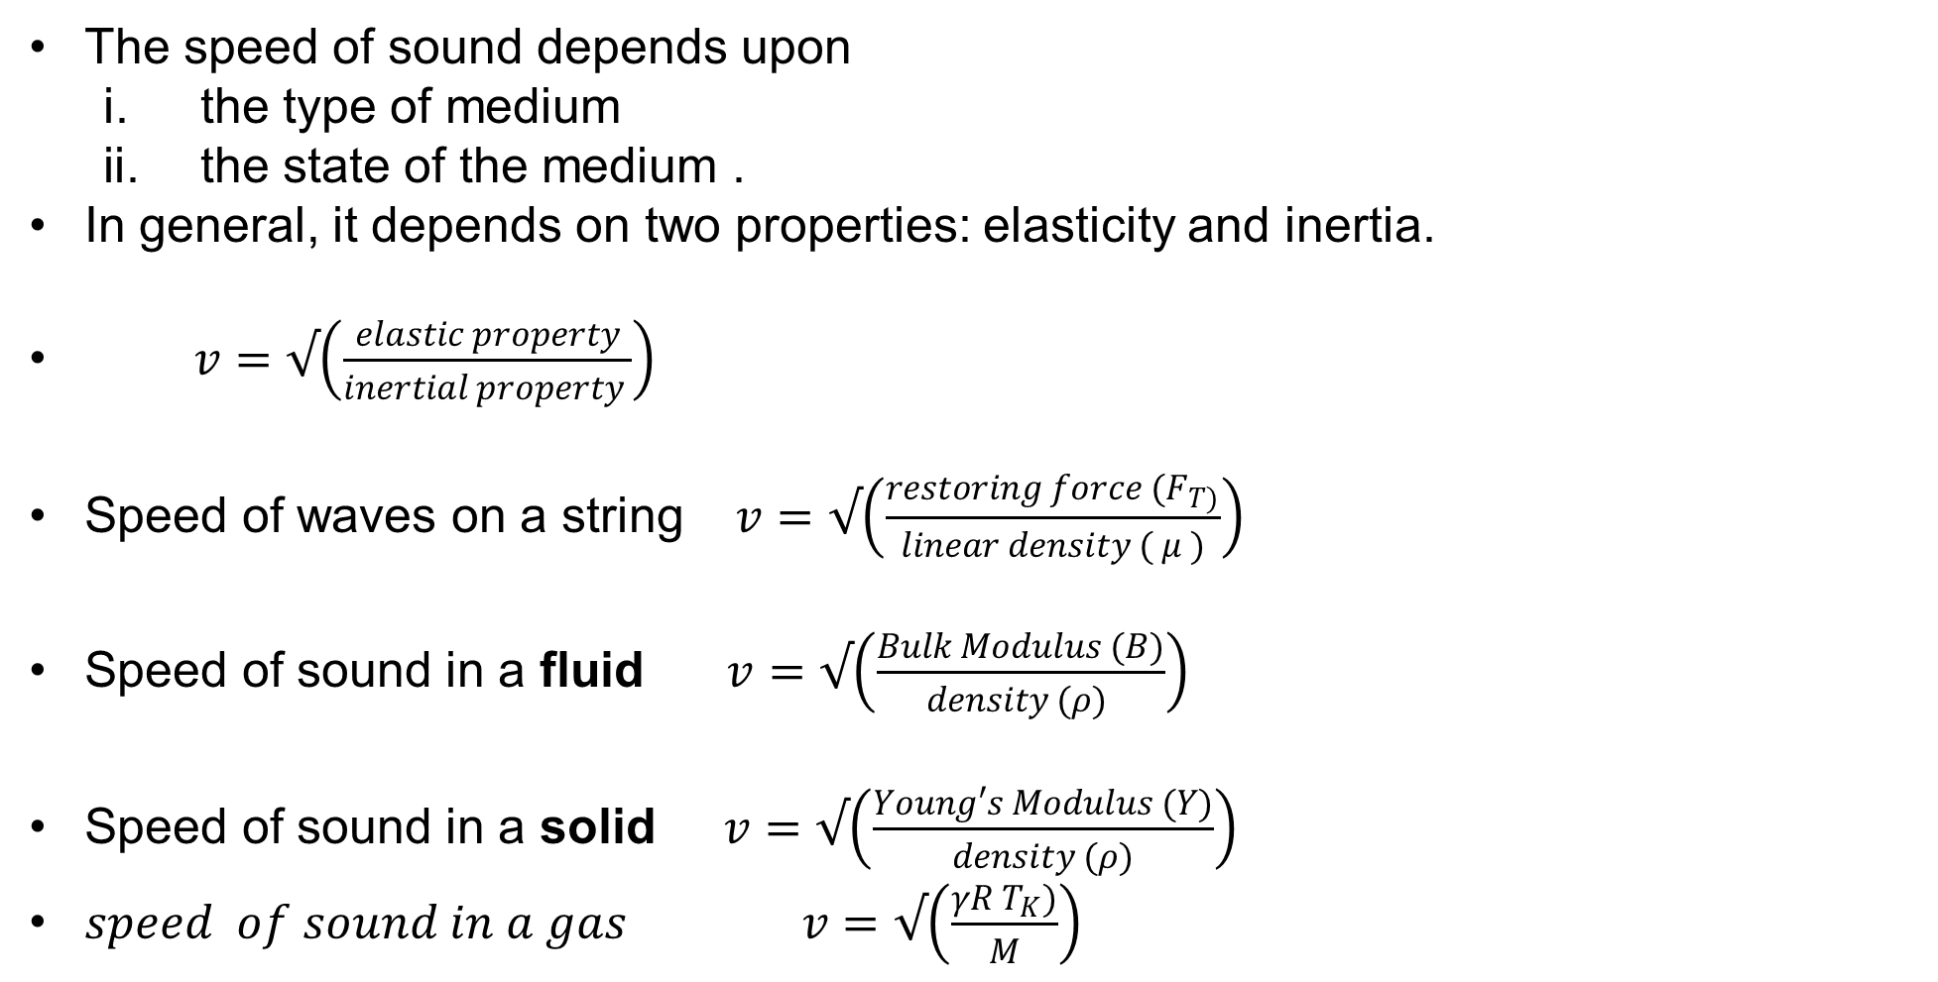
Speed of Sound in Various Materials
The speed of sound depends upon
the type of medium
the state of the medium .
In general, it depends on two properties: elasticity and inertia.
$v=√\left(\frac{elastic property}{inertial property }\right)$
Speed of waves on a string $v=√\left(\frac{restoring force (F_{T)}}{linear density ( μ )}\right)$­­­­­­­­­
Speed of sound in a fluid $v=√\left(\frac{Bulk Modulus (B)}{density (ρ) }\right)$­­­­­­­­­
Speed of sound in a solid $v=√\left(\frac{Young′s Modulus (Y)}{density (ρ)}\right)$­­­­­­­­­
$speed of sound in a gas v=√\left(\frac{γR T_{K})}{M}\right)$­­­­­­­­
where γ is the adiabatic index, R = 8.31 J/mol • K is the gas constant, T_{K} is the absolute temperature in kelvins, and M is the molecular mass.

Slide 6
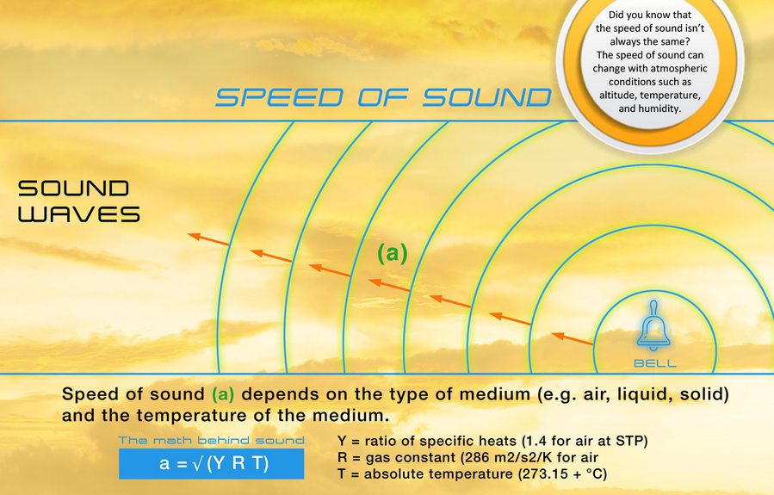
Speed of Sound

Slide 7

Sound Waves
When an airplane flies at or above the speed of sound, air molecules cannot move out of the way of the airplane fast enough, so the pressure waves combine to generate a large shockwave, which people on the ground hear as a sonic boom
A sonic boom is the thunder-like noise a person on the ground hears when an aircraft flies overhead faster than the speed of sound (340m/s)
As the aircraft flies through the air it pushes air out of its way, continuously creating sound waves

Slide 8
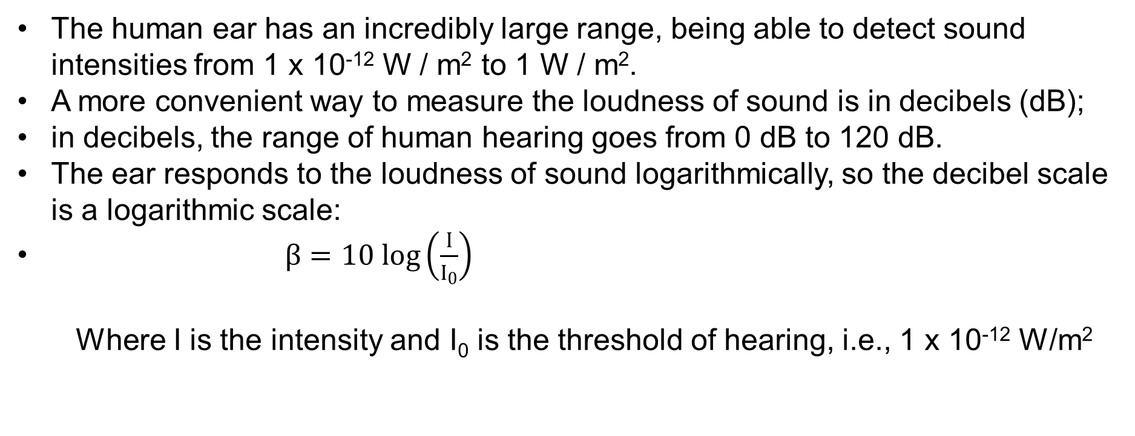
Sound Waves
The human ear has an incredibly large range, being able to detect sound intensities from 1 x 10⁻¹² W / m² to 1 W / m².
A more convenient way to measure the loudness of sound is in decibels (dB);
in decibels, the range of human hearing goes from 0 dB to 120 dB.
The ear responds to the loudness of sound logarithmically, so the decibel scale is a logarithmic scale:
$β=10 log\left(\frac{I}{I_{0}}\right)$
Where I is the intensity and I₀ is the threshold of hearing, i.e., 1 x 10⁻¹² W/m²

Slide 9
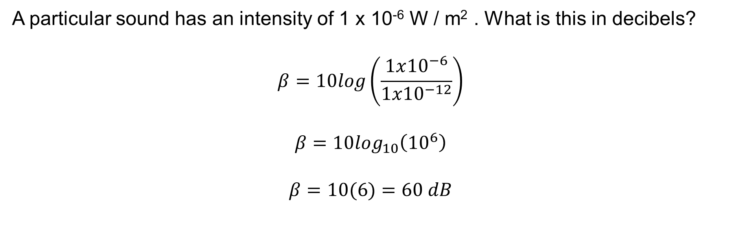
An Example using Decibels
A particular sound has an intensity of 1 x 10⁻⁶ W / m² . What is this in decibels?
$$β=10log\left(\frac{1x{10}^{−6}}{1x{10}^{−12}}\right)$$
$$β=10\log_{10}\left({10}^{6}\right)$$
$$β=10(6)=60 dB$$

Slide 10
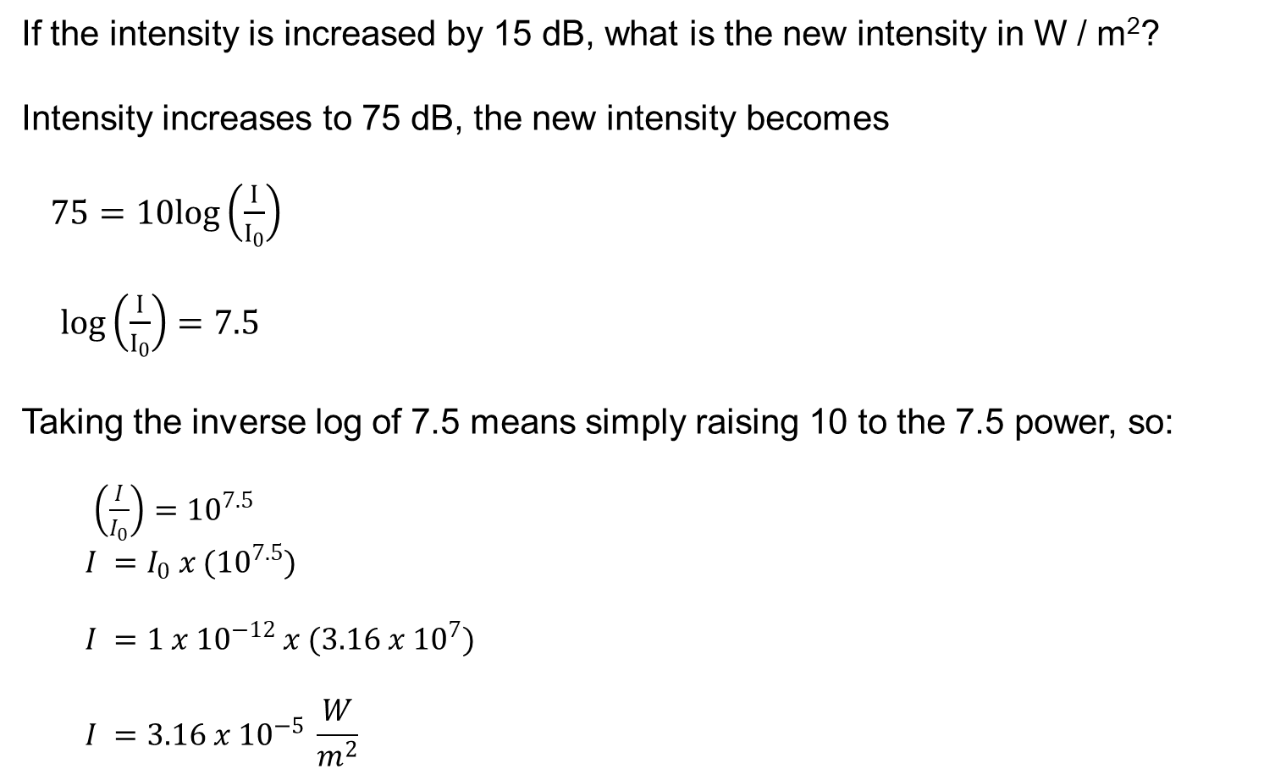
An Example using Decibels
If the intensity is increased by 15 dB, what is the new intensity in W / m²?
Intensity increases to 75 dB, the new intensity becomes
$75=10log\left(\frac{I}{I_{0}}\right)$
$log\left(\frac{I}{I_{0}}\right)=7.5$
Taking the inverse log of 7.5 means simply raising 10 to the 7.5 power, so:
$\left(\frac{I}{I_{0}}\right)={10}^{7.5}$
$$I =I_{0} x ({10}^{7.5})$$
$$I =1 x {10}^{−12} x (3.16 x {10}^{7})$$
$$I =3.16 x {10}^{−5} \frac{W}{m^{2}}$$

