Slide 1
YouTravel Project
Presented by:
Céline Bensoussan
Firmín Sosso
Jose Luis Pérez
Jorge A. Díaz

Slide 2
What is it about?
Youtravel is a webpage intended for people in search of having a good time but far from home, and they do not exactly know where to go or which part of the world to head for.

Slide 3
Layout?
Somethig simple, easy to use
Aesthetic
Harmonious
Ajax

Slide 4
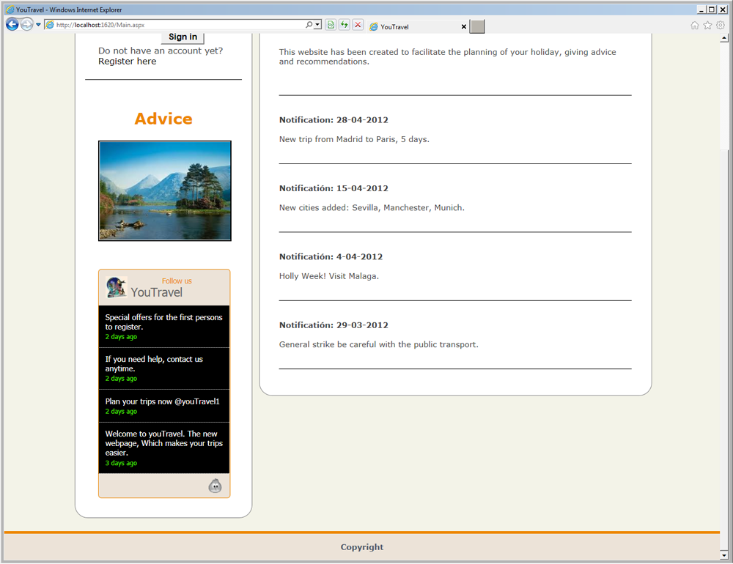
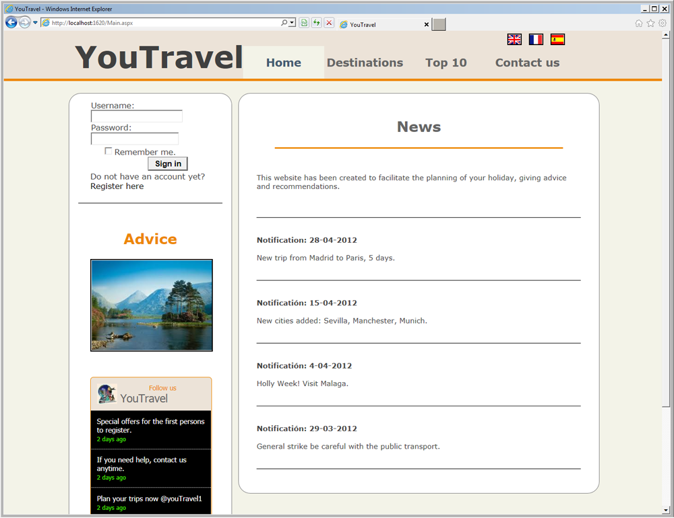

Slide 5
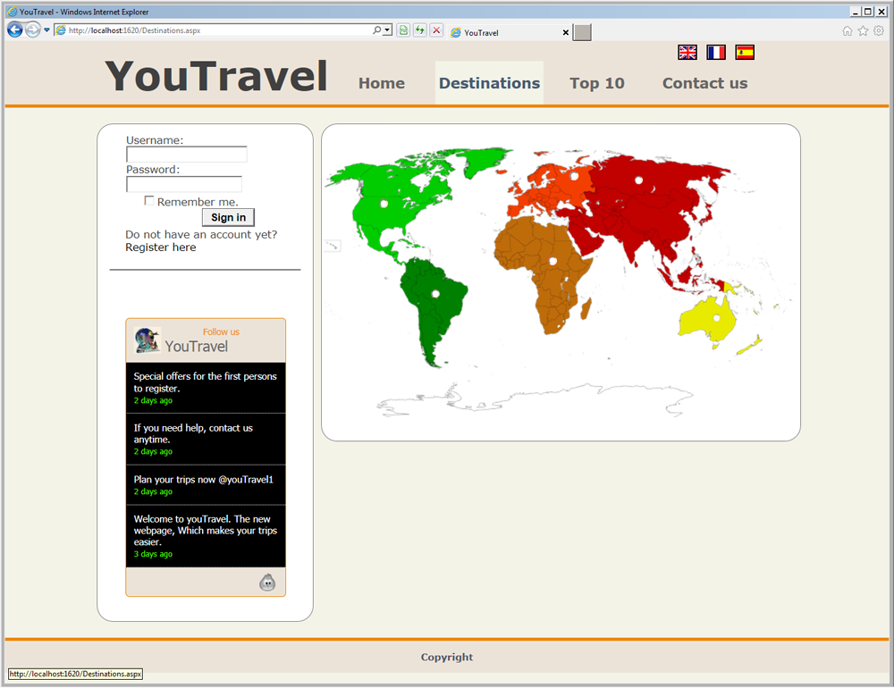


Slide 6
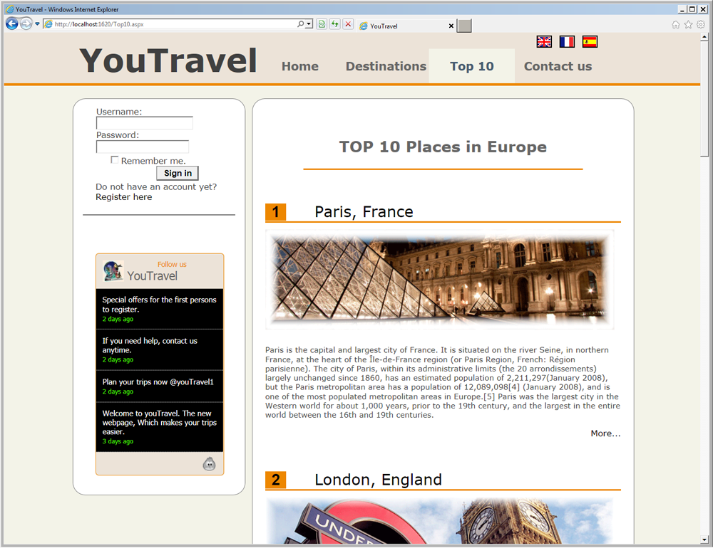

Slide 7
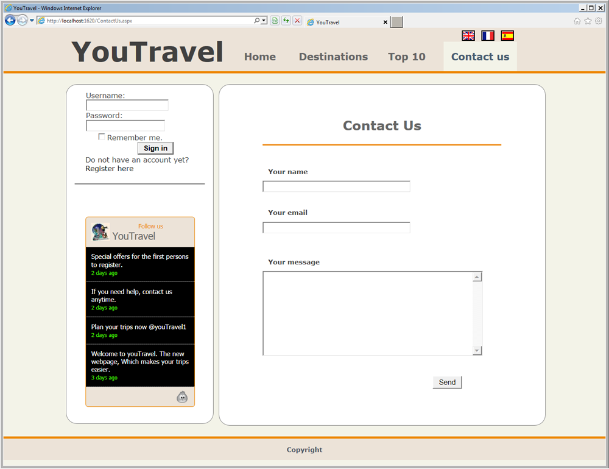

Slide 8
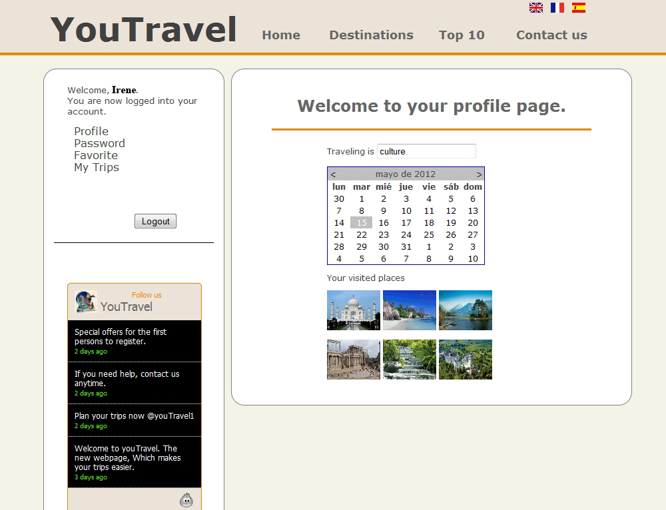
Irene
*********

Slide 9
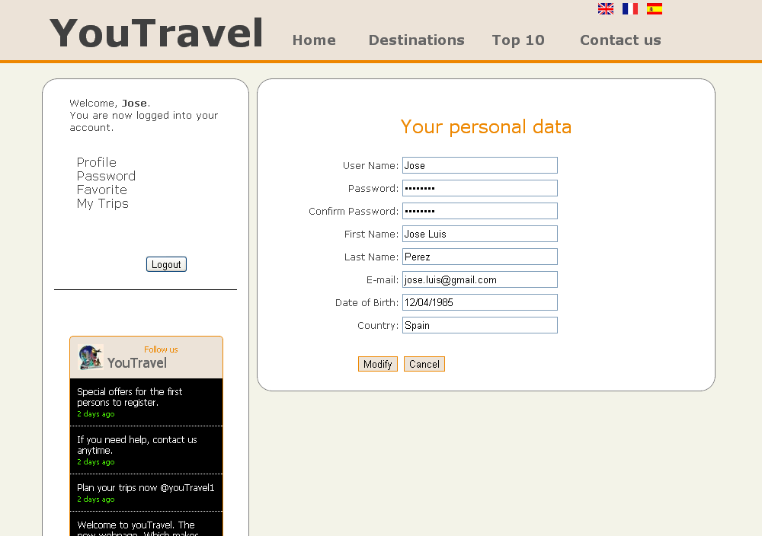

Slide 10
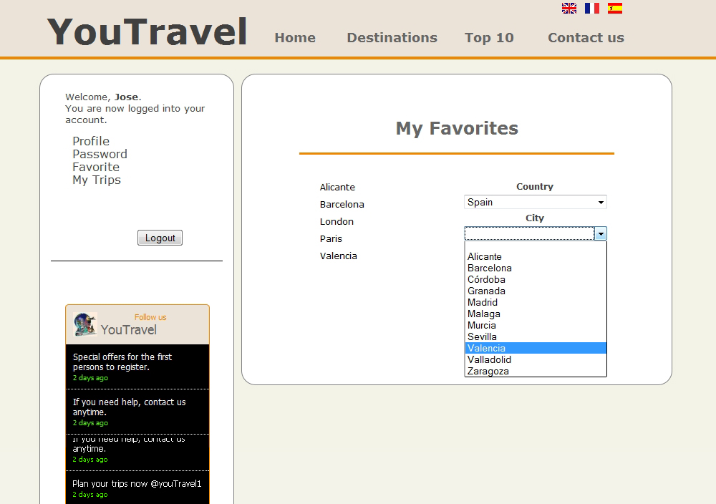

Slide 11
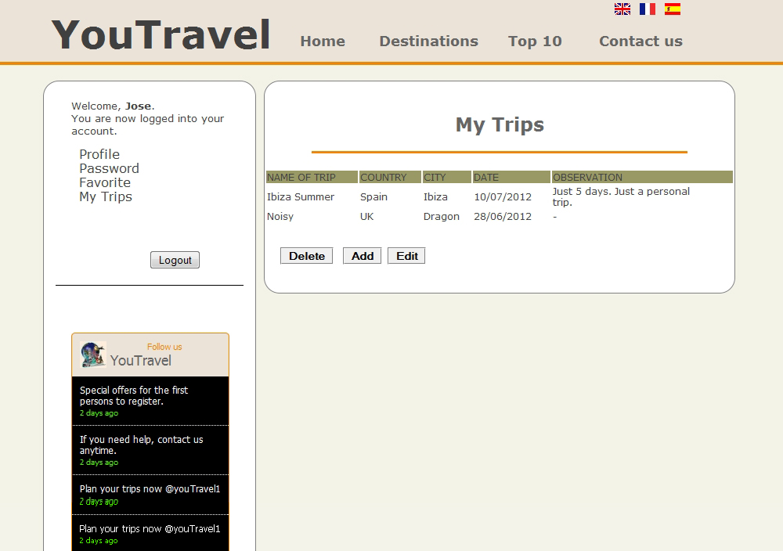

Slide 12
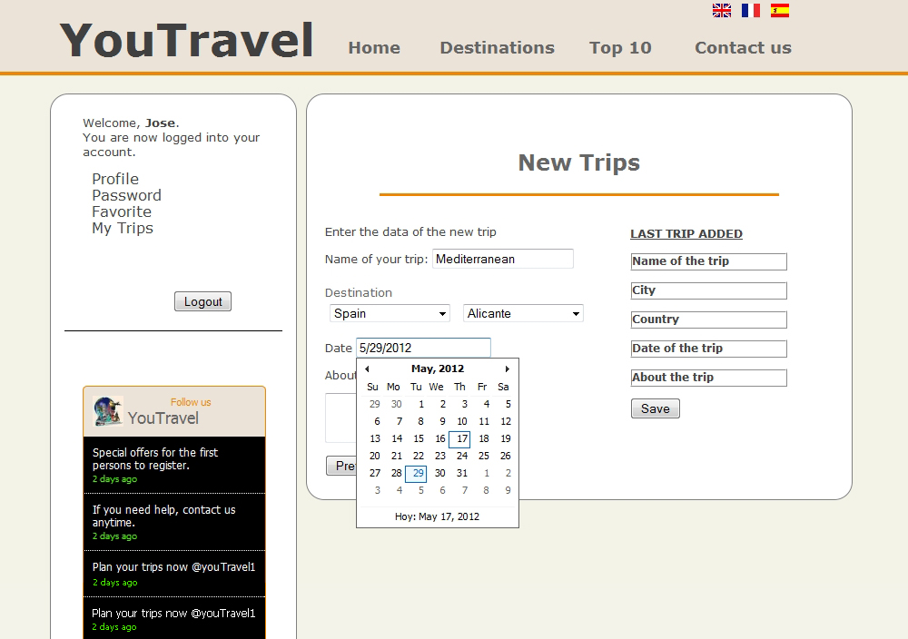

Slide 13
Now, let’s Travel…

Slide 14
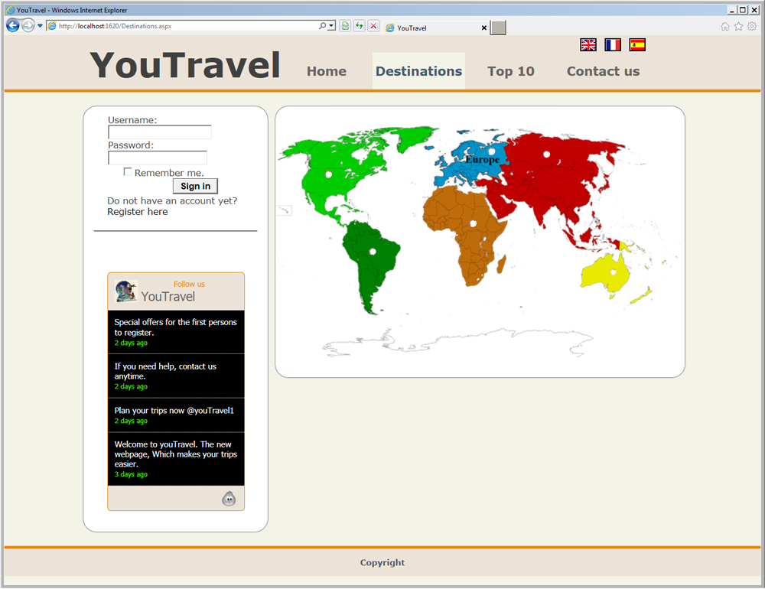
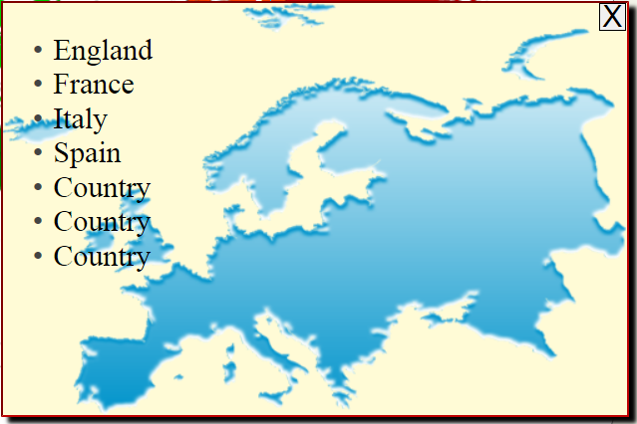

Slide 15
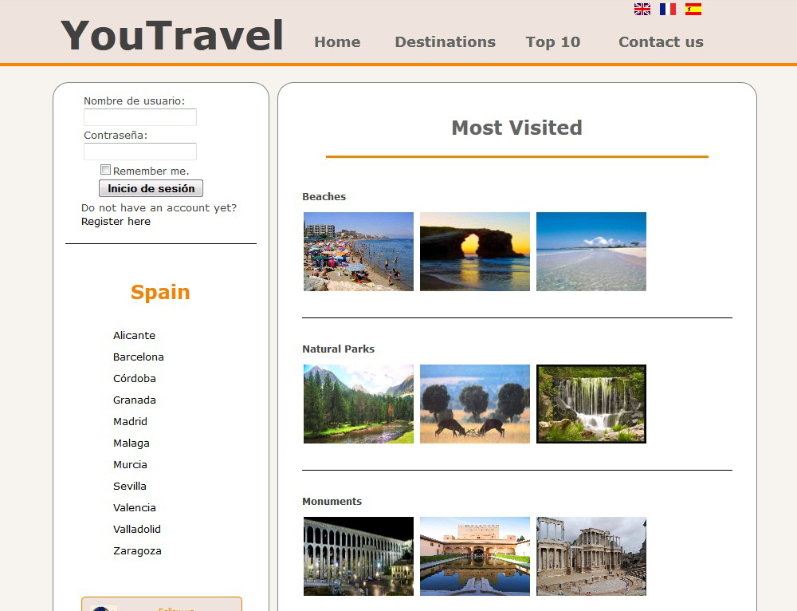

Slide 16
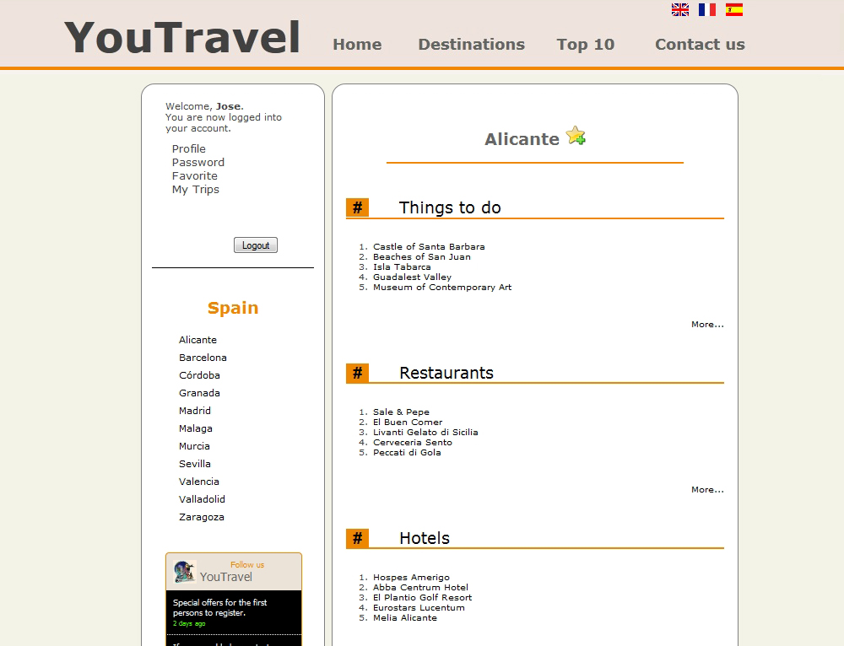

Slide 17
Future implementations…
A Forum
An Admin Part
Sharing Travel Experiences
A City Map

Slide 18
Acknowledgement:
Special thanks to our Professor Irene
Thank you very much
for your attention!

