Slide 1
Job market
da xue & jiewei chen

Slide 2
OUTLINE
Motivation
Project Introduction
Data Description
Methodology
Preliminary Results

Slide 3
MOTIVATION
Motivation
Project Introduction
Data Description
Methodology
Preliminary Results
CHE
MSE
skills
salary
degree
demand
STAT

Slide 4
PROJECT INTRODUCTION
Motivation
Project Introduction
Data Description
Methodology
Preliminary Results
ANALYZE / COMPARE
Skill set (common / specific)
Salary level
Full-time
Internship
Degree requirement (undergrad / graduate)
Job market demand

Slide 5
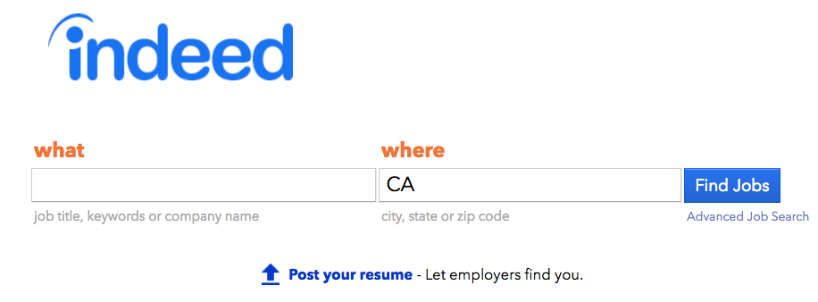
DATA DESCRIPTION
Motivation
Project Introduction
Data Description
Methodology
Preliminary Results

Slide 6
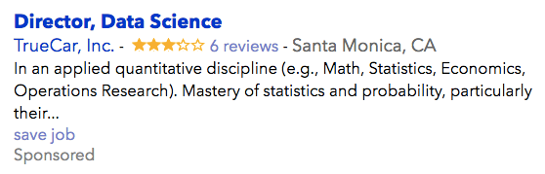
DATA DESCRIPTION
Motivation
Project Introduction
Data Description
Methodology
Preliminary Results
url
job title
location
company
date
job key
…

Slide 7
METHODOLOGY
Motivation
Project Introduction
Data Description
Methodology
Preliminary Results
STEP | METHOD
Data Extracting | API, request, json web scraping with BeautifulSoup
Skill Set | Natural Language Processing / Graphs
Degree Requirement | Natural Language Processing / Graphs
Job Market Demand | Geographical Data Analysis / Data Visualization
Salary | Not Found

Slide 8
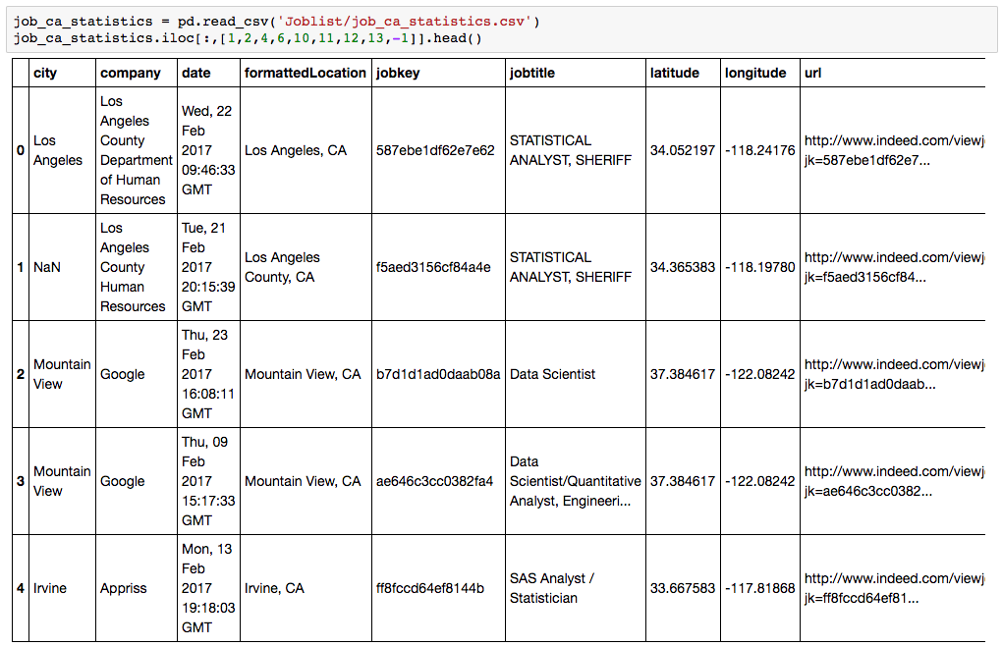
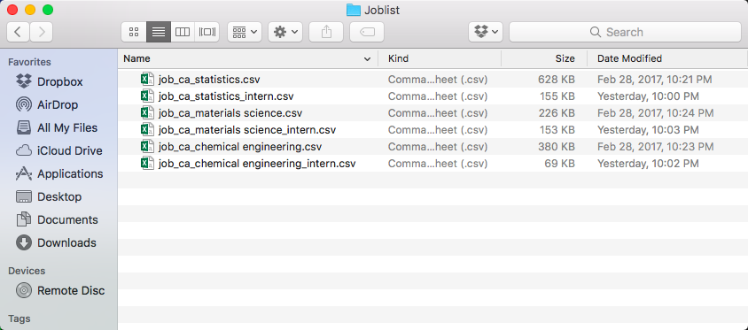
RESULTS Data Acquisition
Motivation
Project Introduction
Data Description
Methodology
Preliminary Results

Slide 9
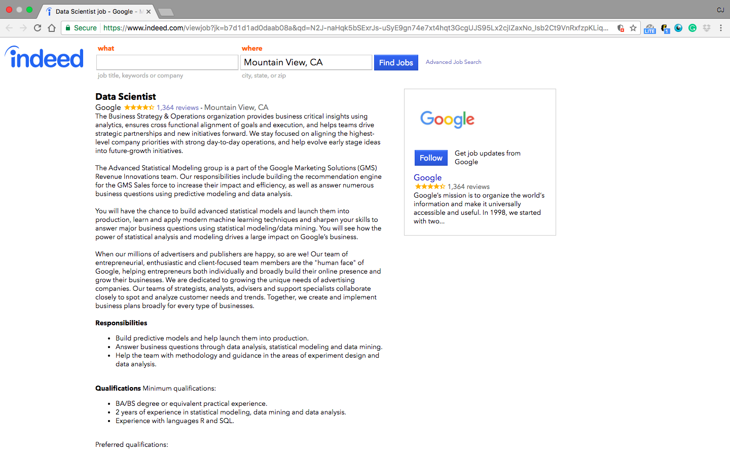
RESULTS Data Acquisition
Motivation
Project Introduction
Data Description
Methodology
Preliminary Results

Slide 10
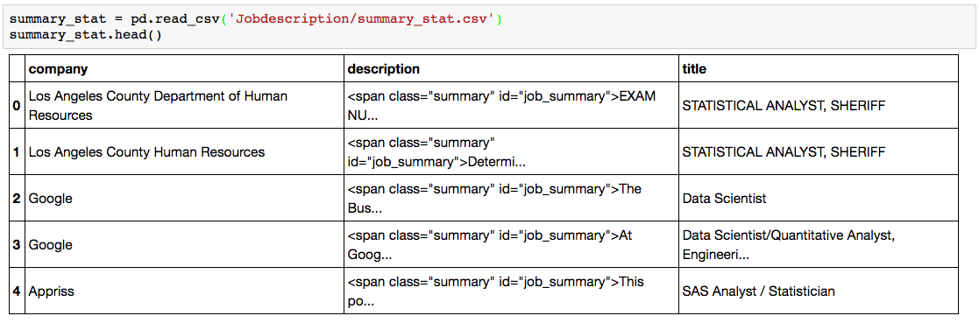
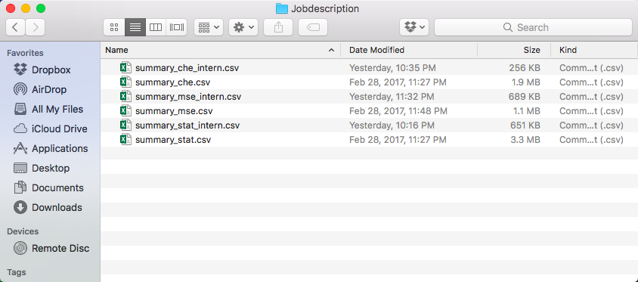
RESULTS Data Acquisition
Motivation
Project Introduction
Data Description
Methodology
Preliminary Results

Slide 11
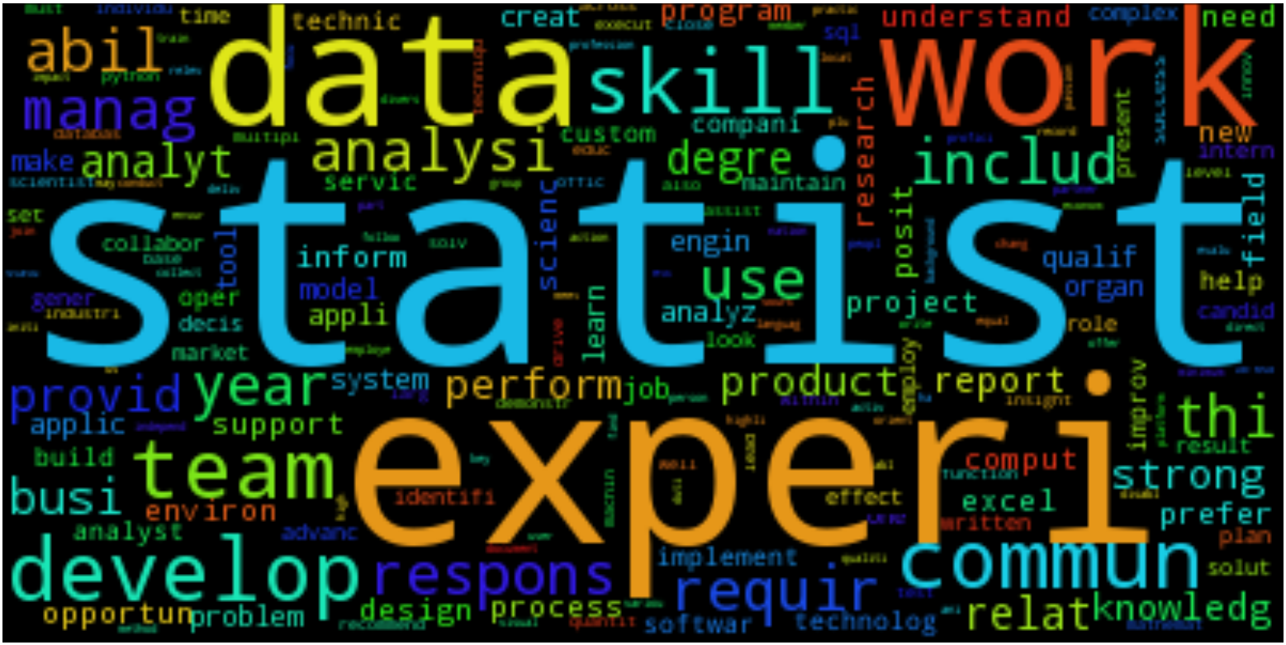
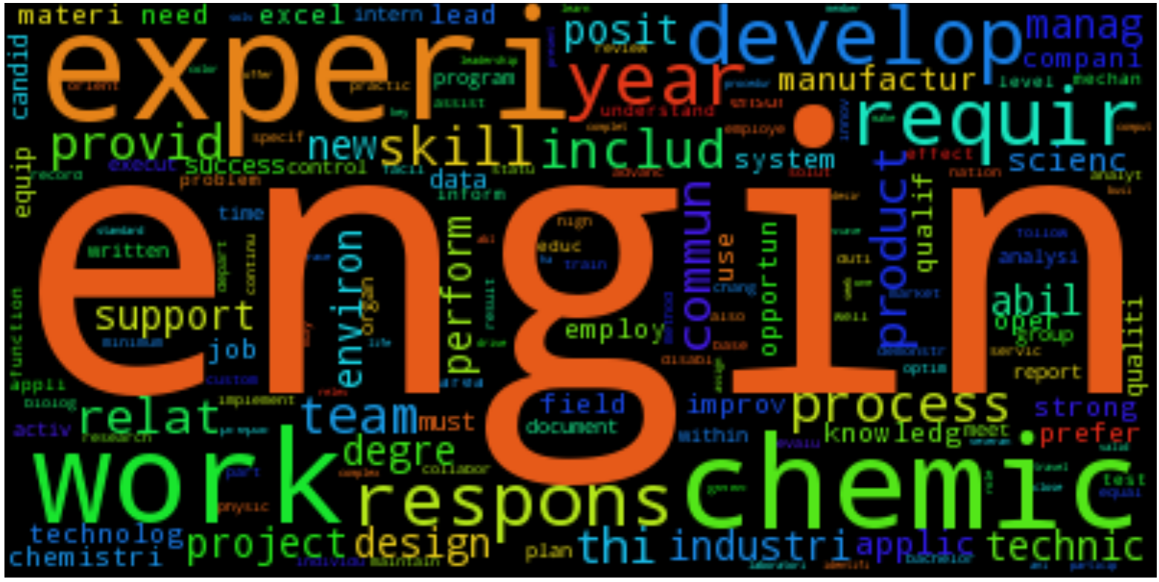
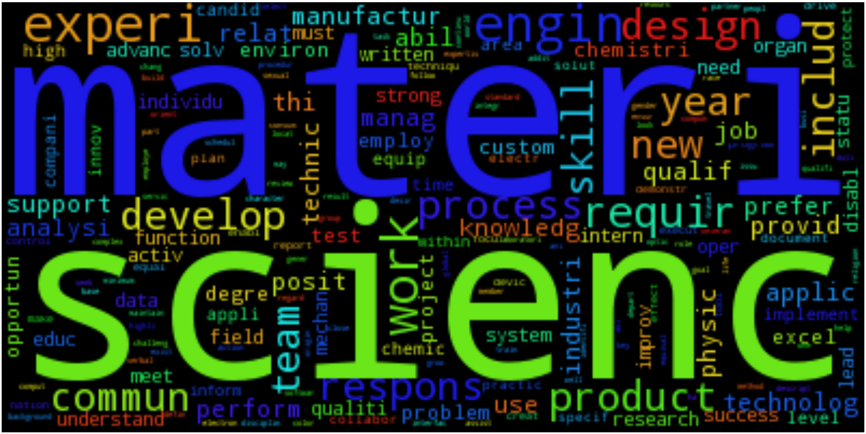
RESULTS Skill Set
Motivation
Project Introduction
Data Description
Methodology
Preliminary Results

Slide 12
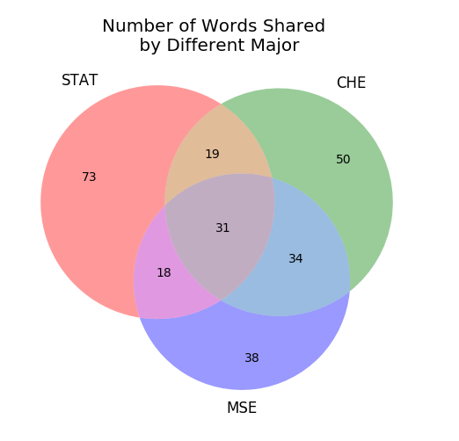
RESULTS Skill Set
Motivation
Project Introduction
Data Description
Methodology
Preliminary Results
The common words shared by all three majors are comput(e), strategi, process, analyz, model, document, verbal, independ(ent), softwar(e), physic, challeng(e), team, supervis(e), collabor(ation), offic(e), optim(al), coordin(ation), assist, task, motiv(ative), excel, r, test, operi(ation), interact(ion), protect, innov(ation), talent, control, program, interperson.
Words share by Stat and CHE are health, autom, monitor, util, assess, larg, approach, vision, type, summari, leader.
Words share by Stat and MSE are expert, access, strateg, power, collect, creativ, passion, dynam, consum
Words share by CHE and MSE are chemic(al), scientif(ic), personnel, transfer, chemistri, lab, cross-funct, mechan(ical), complianc(e), devic(e), travel, commerci(al), laboratori, facil(itate), hands-on, equip(ment), novel(ty), character, electr(ic), safeti, manufactur(e).

Slide 13
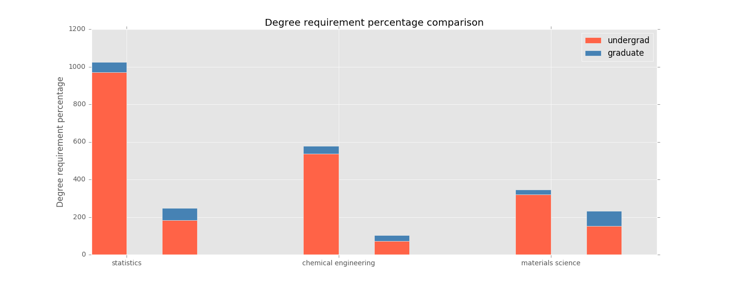
RESULTS Degree Requirement
Motivation
Project Introduction
Data Description
Methodology
Preliminary Results

Slide 14
Next Steps
Motivation
Project Introduction
Data Description
Methodology
Preliminary Results
Job Market Demand --- Geographical Data Analysis / Data Visualization
To be Continued
What Do You Want To Know?

