Slide 1
Job market
da xue & jiewei chen

Slide 2
OUTLINE
Motivation
Project Introduction
Data Description
Methodology
Preliminary Results

Slide 3
MOTIVATION
Motivation
Project Introduction
Data Description
Methodology
Preliminary Results
CHE
MSE
skills
salary
degree
demand
STAT

Slide 4
PROJECT INTRODUCTION
Motivation
Project Introduction
Data Description
Methodology
Preliminary Results
ANALYZE / COMPARE
Skill set (common / specific)
Salary level
Full-time
Internship
Degree requirement (undergrad / graduate)
Job market demand

Slide 5
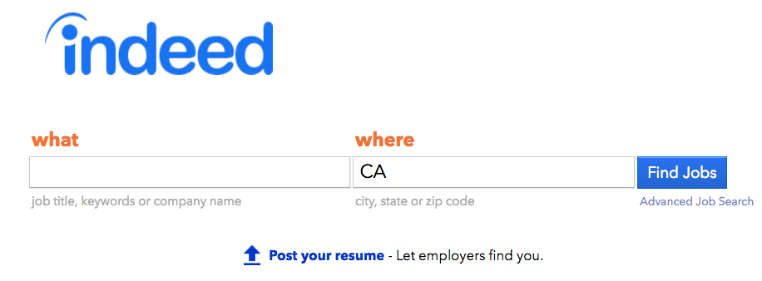
DATA DESCRIPTION
Motivation
Project Introduction
Data Description
Methodology
Preliminary Results

Slide 6

DATA DESCRIPTION
Motivation
Project Introduction
Data Description
Methodology
Preliminary Results
url
job title
location
company
date
job key
…

Slide 7
METHODOLOGY
Motivation
Project Introduction
Data Description
Methodology
Preliminary Results

Slide 8
PRELIMINARY RESULTS
Motivation
Project Introduction
Data Description
Methodology
Preliminary Results

