Slide 1
Job market
da xue & jiewei chen

Slide 2
OUTLINE
Motivation
Project Introduction
Data Description
Methodology
Preliminary Results

Slide 3
MOTIVATION
Motivation
Project Introduction
Data Description
Methodology
Preliminary Results
CHE
MSE
skills
salary
degree
demand
STAT

Slide 4
PROJECT INTRODUCTION
Motivation
Project Introduction
Data Description
Methodology
Preliminary Results
ANALYZE / COMPARE
Skill set (common / specific)
Salary level
Full-time
Internship
Degree requirement (undergrad / graduate)
Job market demand

Slide 5
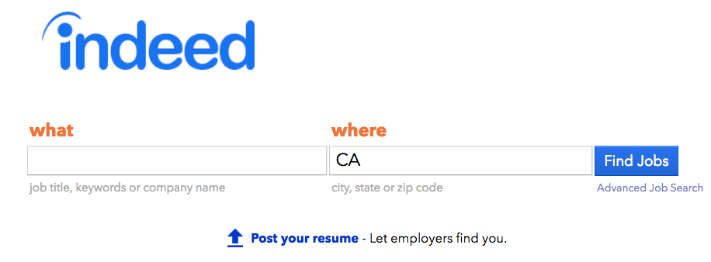
DATA DESCRIPTION
Motivation
Project Introduction
Data Description
Methodology
Preliminary Results

Slide 6

DATA DESCRIPTION
Motivation
Project Introduction
Data Description
Methodology
Preliminary Results
url
job title
location
company
date
job key
…

Slide 7
METHODOLOGY
Motivation
Project Introduction
Data Description
Methodology
Preliminary Results
STEP
METHOD
Data extrating
API, request, json
Web scraping with BeautifulSoup
Skill set
Natural language processing / Graphs
Degree requirement
Natural language processing / Graphs
Salary
Regular expression / Graphs
Job market demand
Geographical data analysis / Data visualization

Slide 8
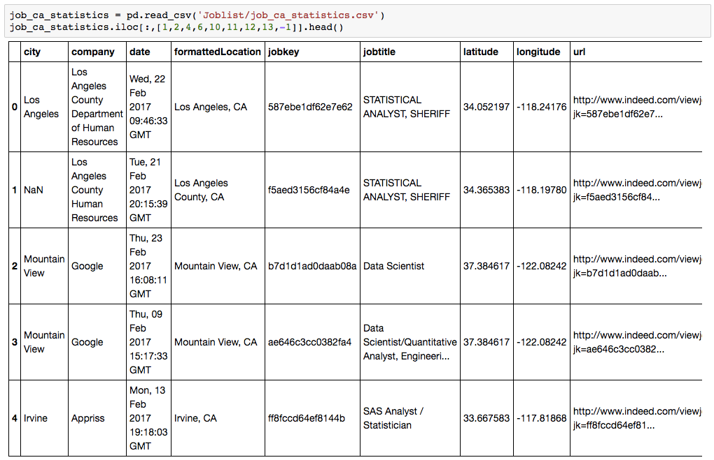
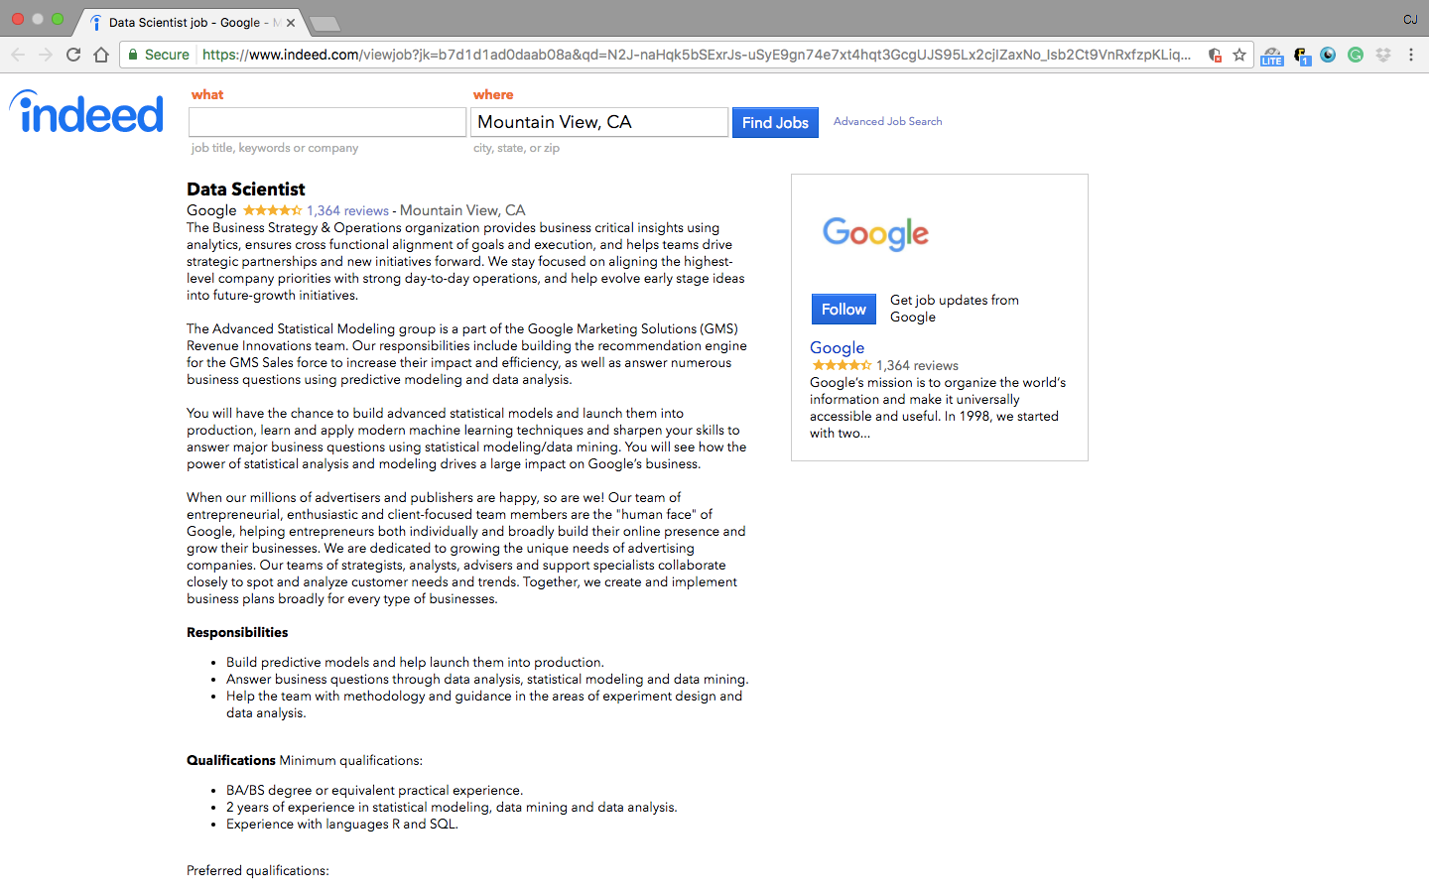
PRELIMINARY RESULTS
Motivation
Project Introduction
Data Description
Methodology
Preliminary Results
 | Full-time | Internship
STAT | 1025 | 249
CHE | 579 | 104
MSE | 347 | 232

Slide 9
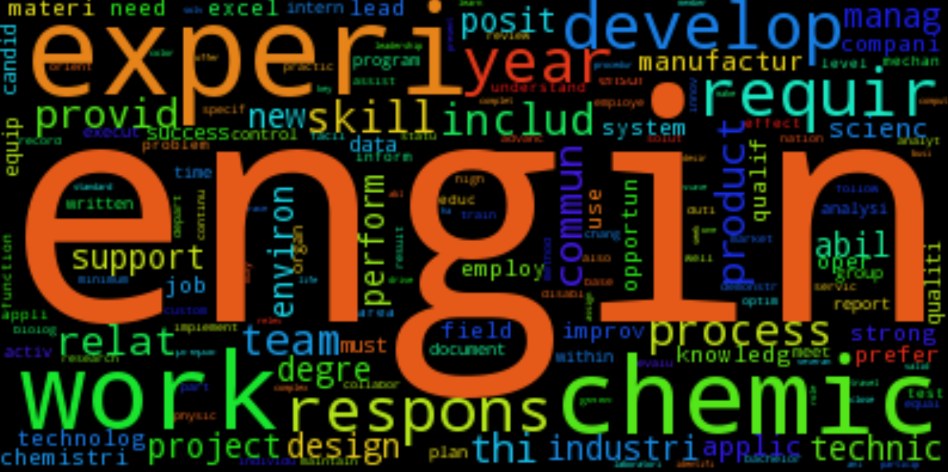
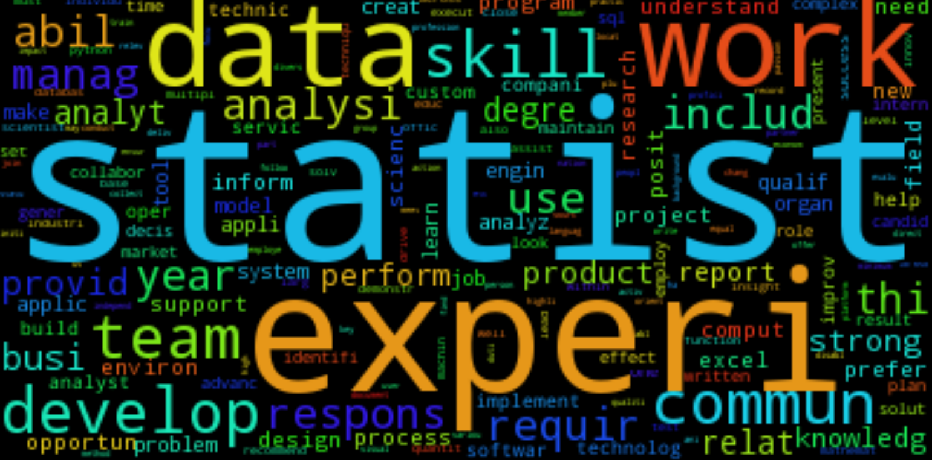

PRELIMINARY RESULTS skill set
Motivation
Project Introduction
Data Description
Methodology
Preliminary Results
STAT
MSE
CHE

Slide 10
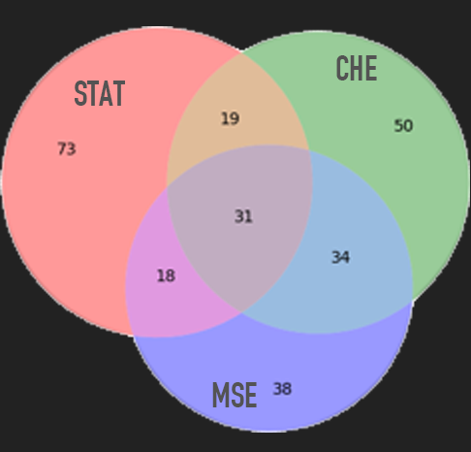
PRELIMINARY RESULTS SKILL SET
Motivation
Project Introduction
Data Description
Methodology
Preliminary Results
19 [health, automation, monitor, util, assess, large, approach, vision, type, summary, leader, …]
18 [expert, access, strategy, power, collect, creative, passion, dynamic, consumer, …]
34 [chemical, scientific, personnel, transfer, chemistry, lab, mechanical, compliance, device, travel, laboratory, facilitate, hands-on, equipment, safety, manufacture, …]
31 [compute, verbal, independent, software, team, supervise, collaboration, office, coordination, assist, excel, r, test, interaction, …]

Slide 11
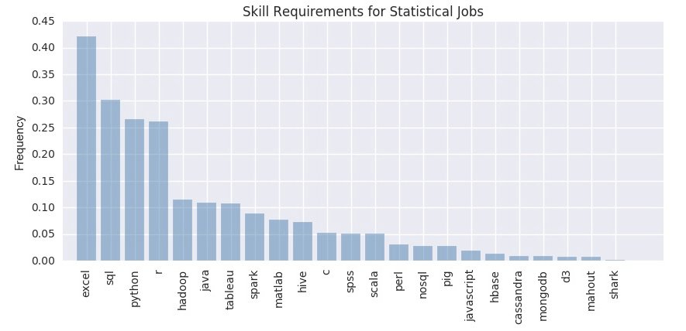
PRELIMINARY RESULTS SKILL SET - stat
Motivation
Project Introduction
Data Description
Methodology
Preliminary Results

Slide 12
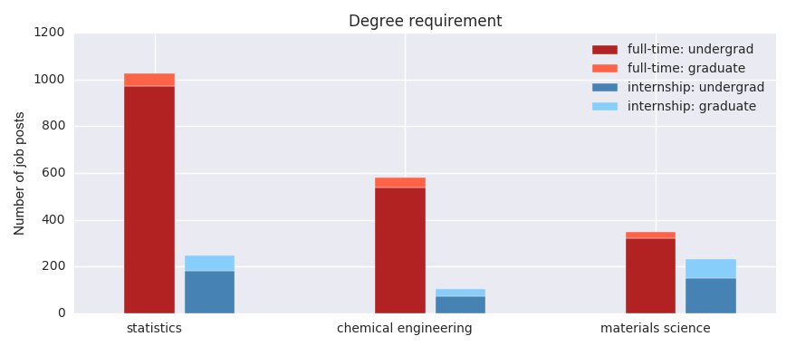
PRELIMINARY RESULTS DEGREE REQUIREMENT
Motivation
Project Introduction
Data Description
Methodology
Preliminary Results

Slide 13
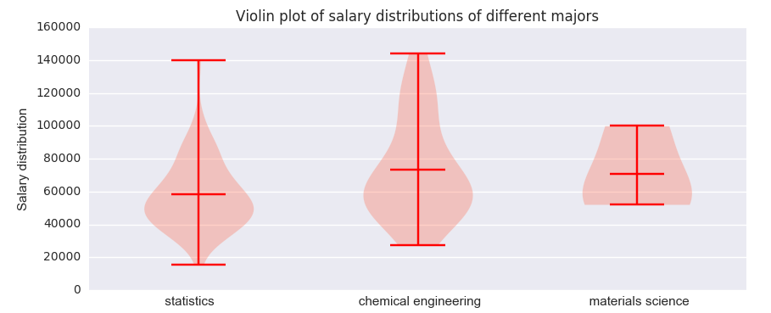
PRELIMINARY RESULTS salary level
Motivation
Project Introduction
Data Description
Methodology
Preliminary Results

Slide 14
What’s next
Motivation
Project Introduction
Data Description
Methodology
Preliminary Results
Job market demand
Geographical data analysis / Data visualization / Time series
correlations?
Salary
Skill set
boosts?
What do you want to know?

