Slide 1
SuperStore
File created on: 2/3/23 11:19:05 AM PST

Slide 2
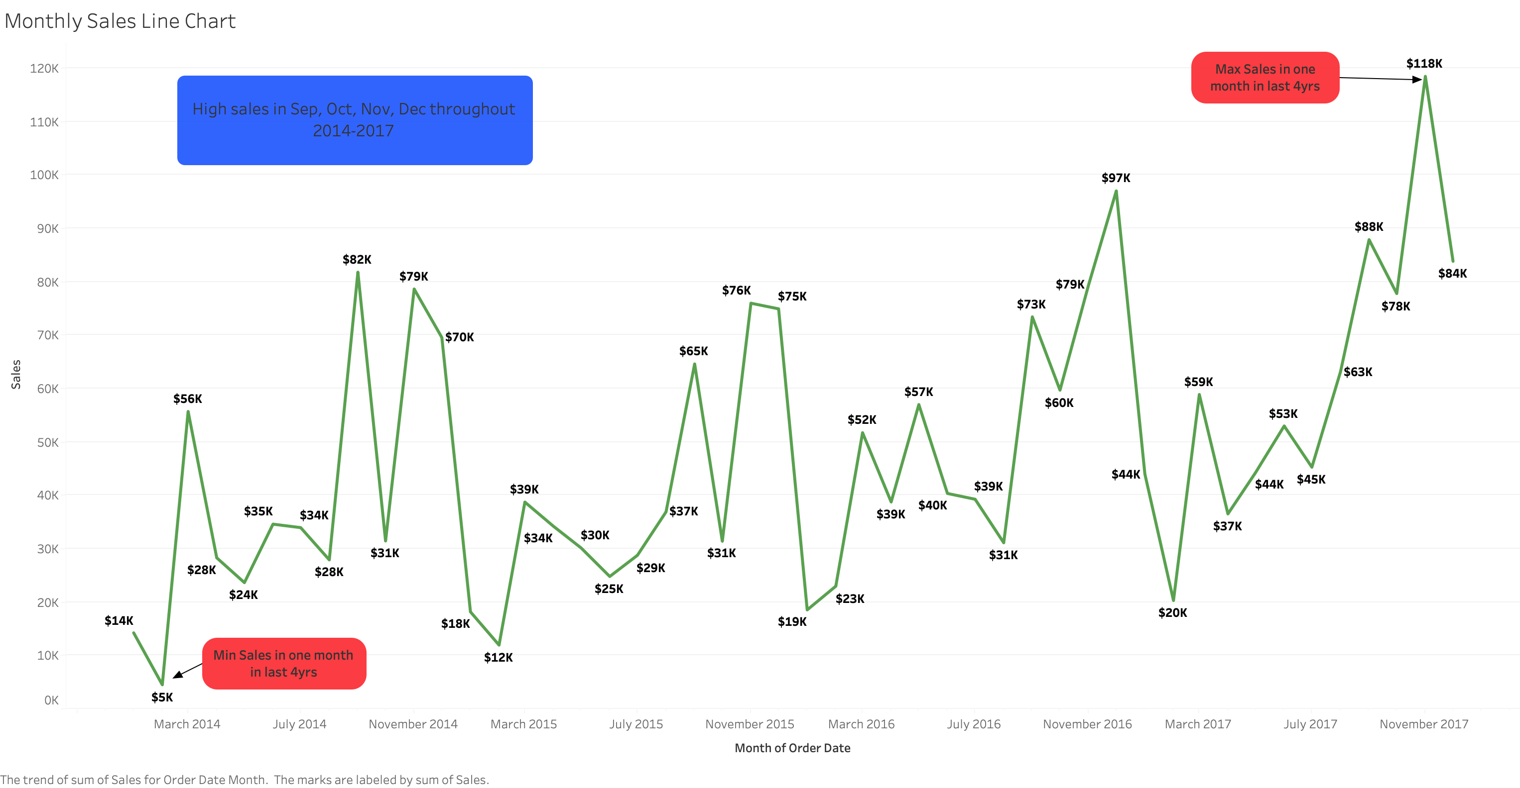

Slide 3


Slide 4


Slide 5


Slide 6
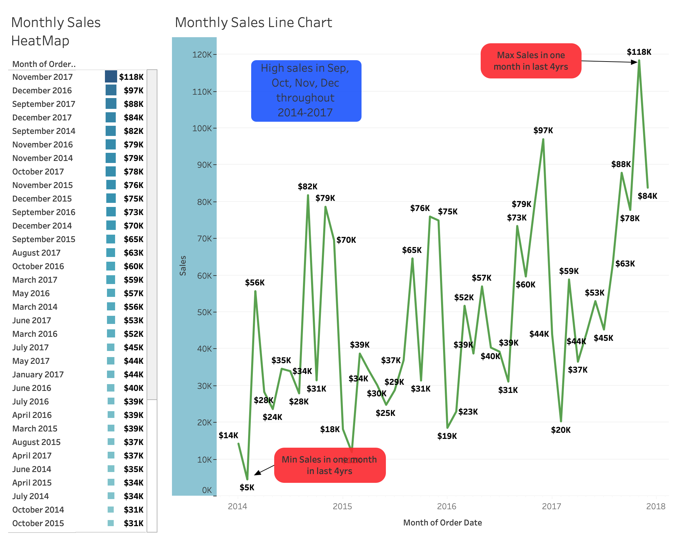

Slide 7
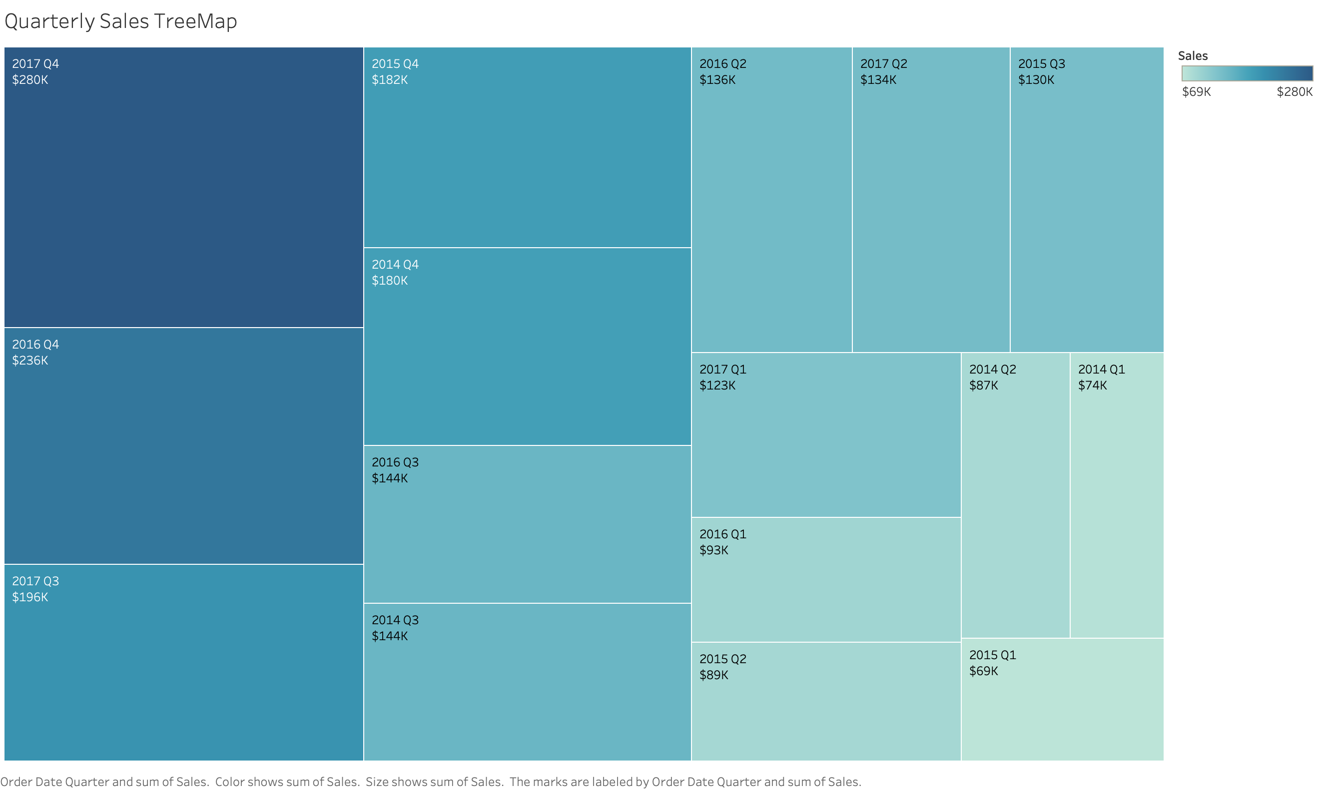

Slide 8
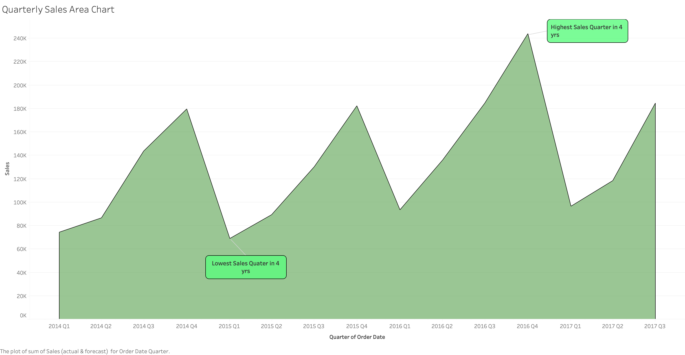

Slide 9
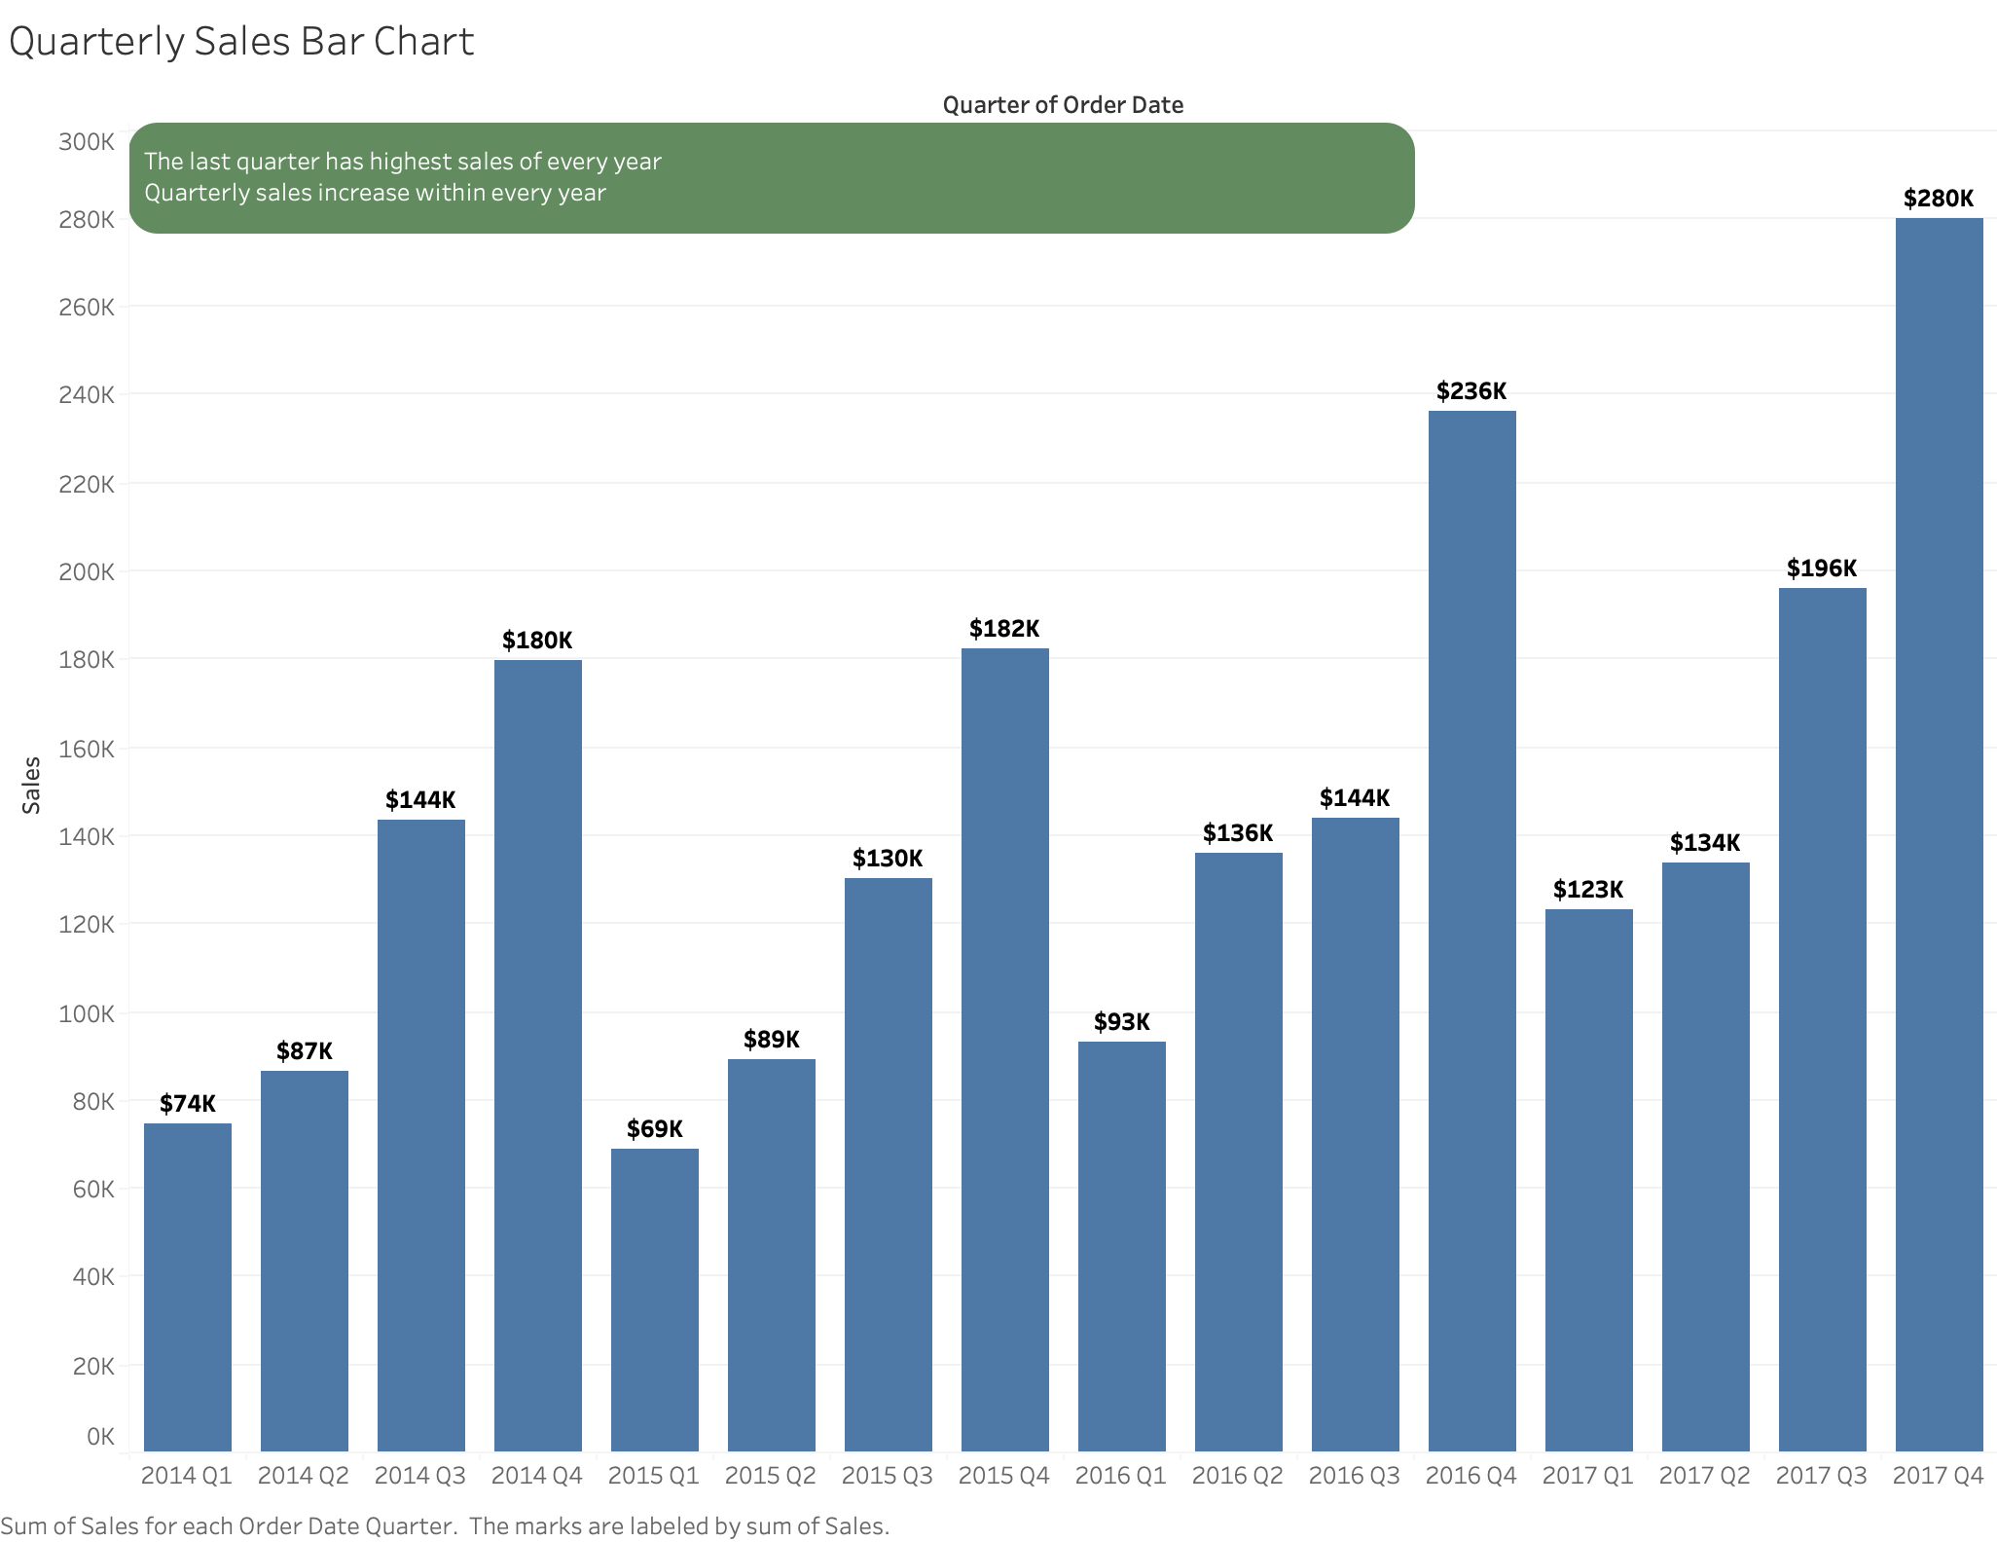

Slide 10
