Slide 1
AmazingMart
File created on: 2/12/23 12:17:02 AM PST

Slide 2
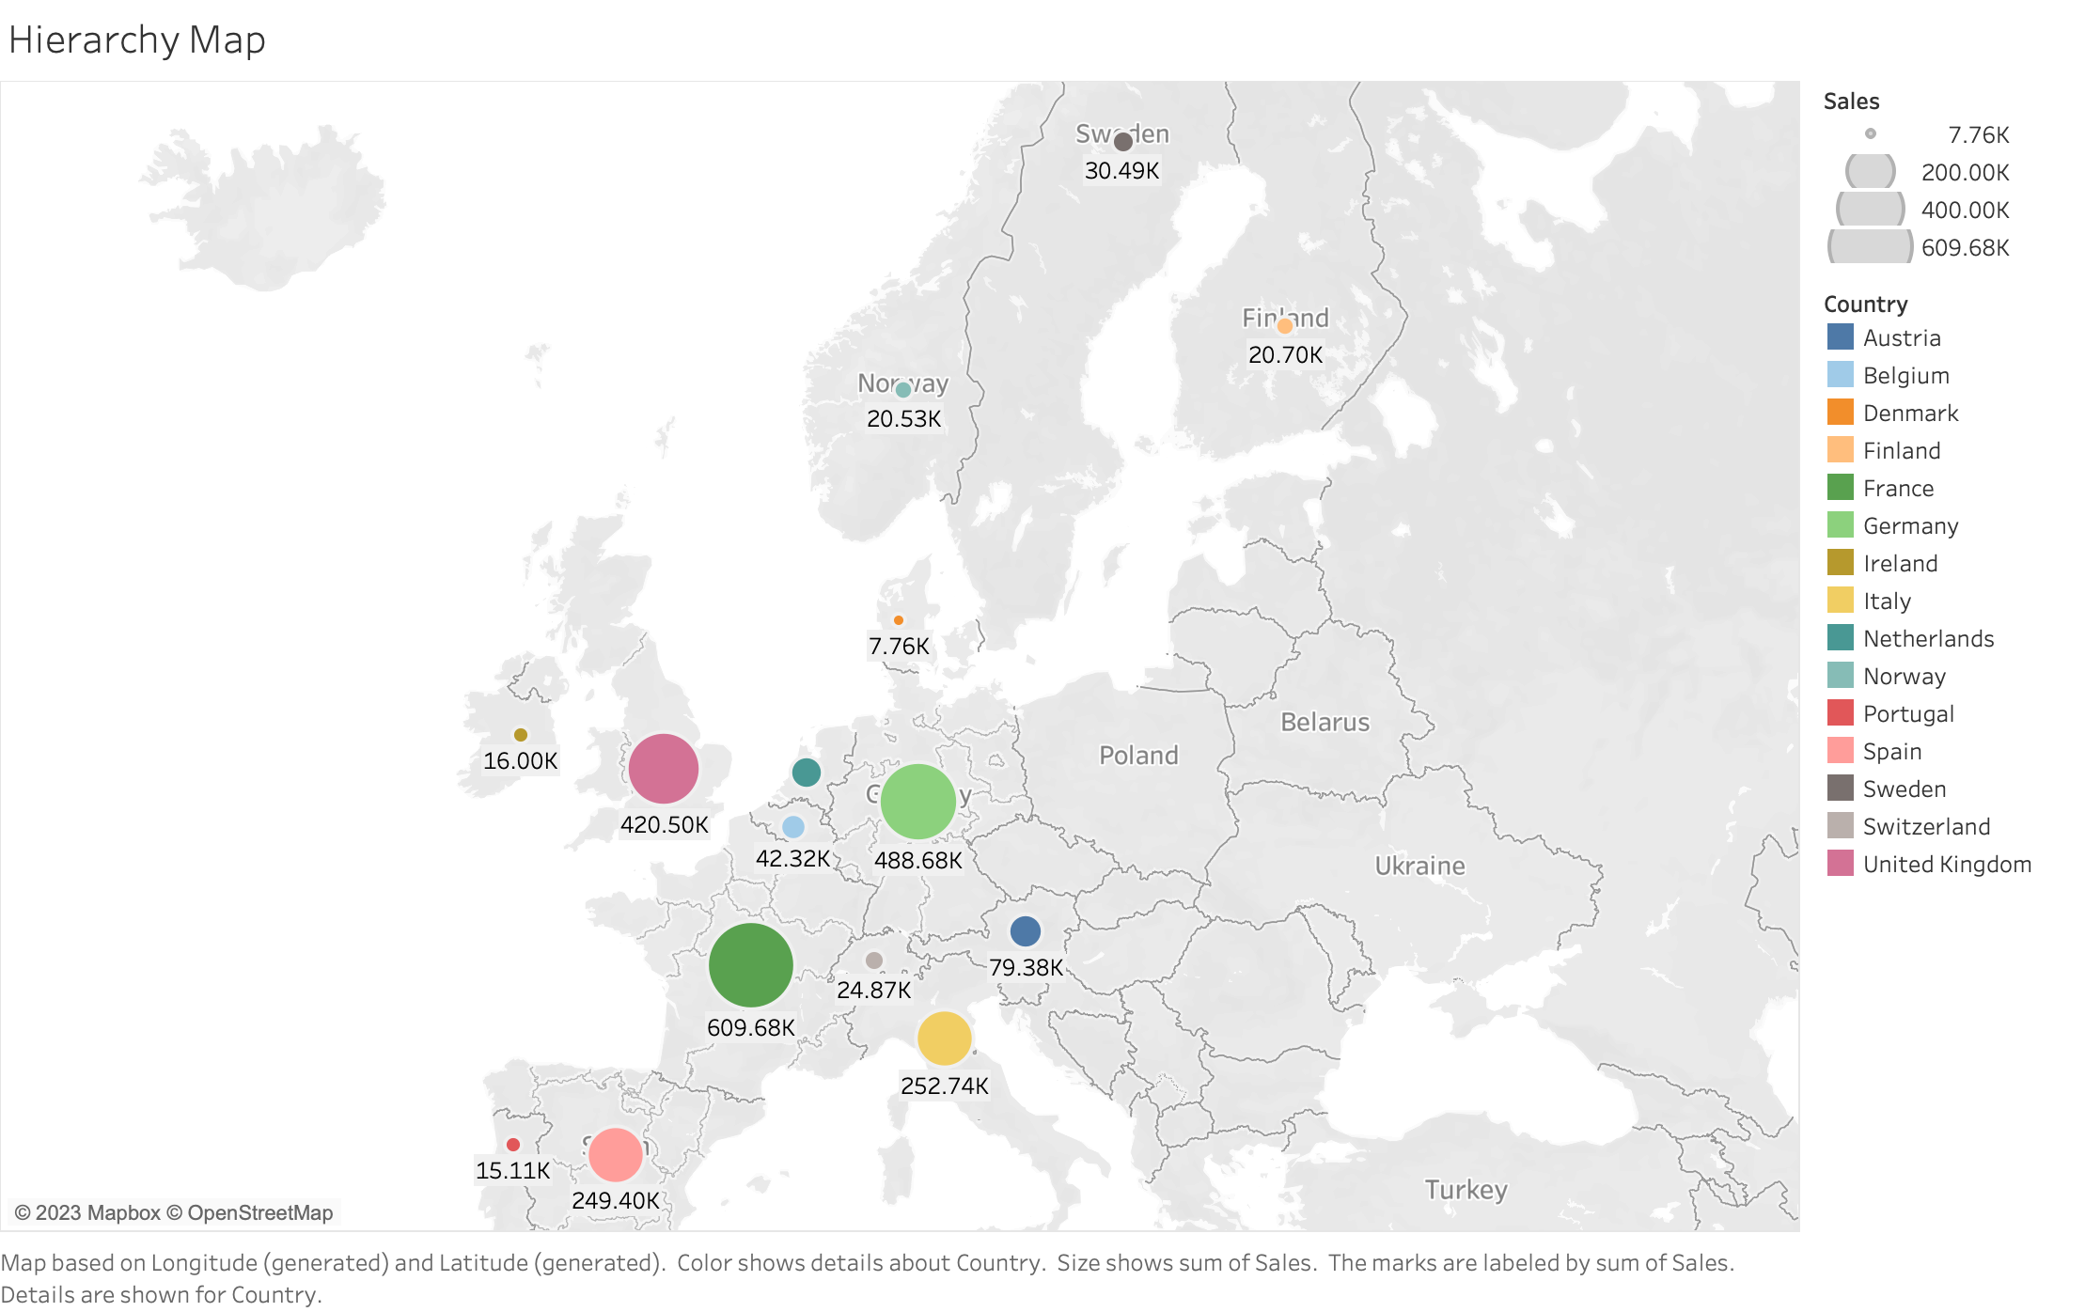

Slide 3
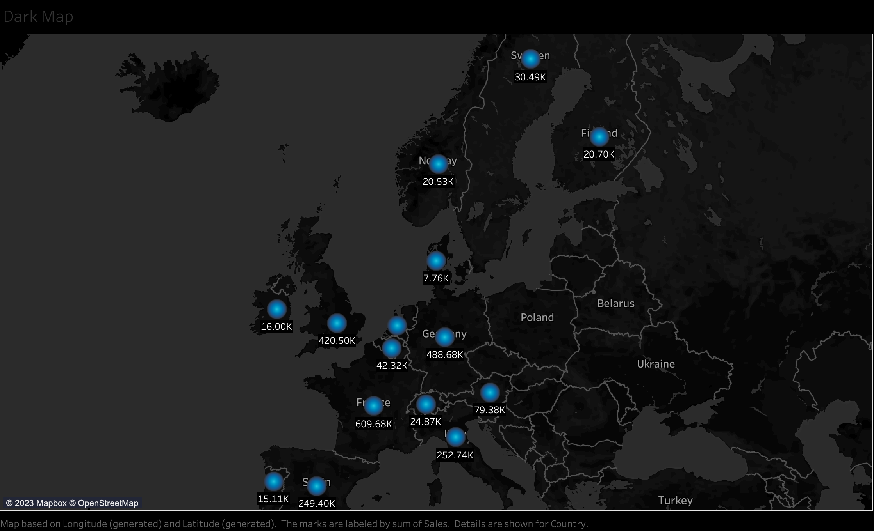

Slide 4
