Slide 1
NLP
By: Alex Celis

Slide 2
Natural Language Processing
The idea of using computers to be able to read in everyday language
And use that to make predictions from the information

Slide 3
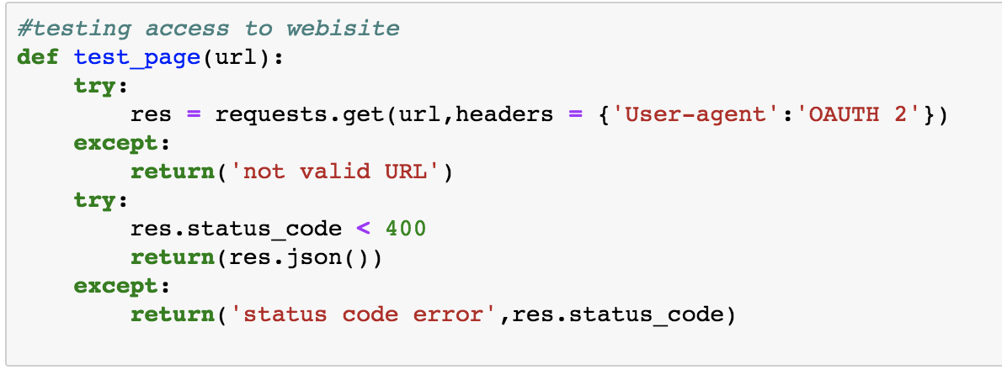
Accessing Website
First we need data to make a predictions.
Testing access to website

Slide 4
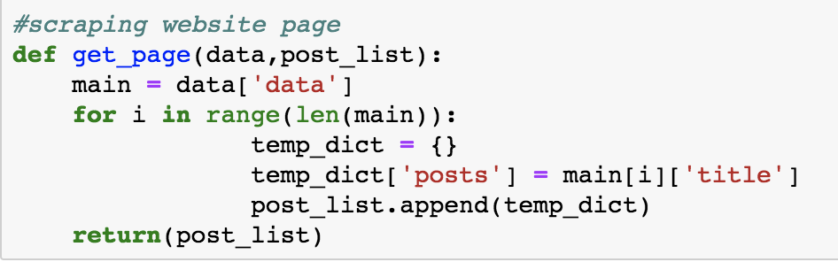
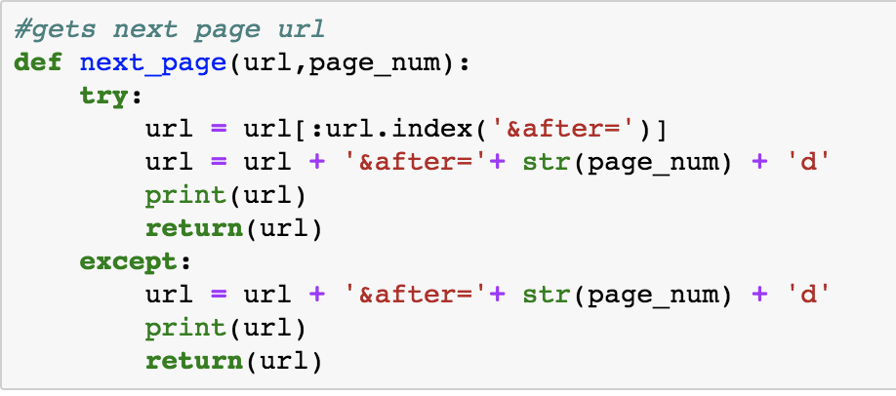
Web Scraping
This first function locates where the posts are stored then adds it to a list
This second function finds the next page to be scraped and makes this the URL

Slide 5
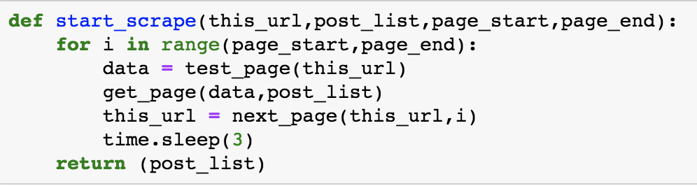
Main Function
Uses the previous functions to access the website, scrape the page and add get to the next page. This repeats until the for loop terminates

Slide 6
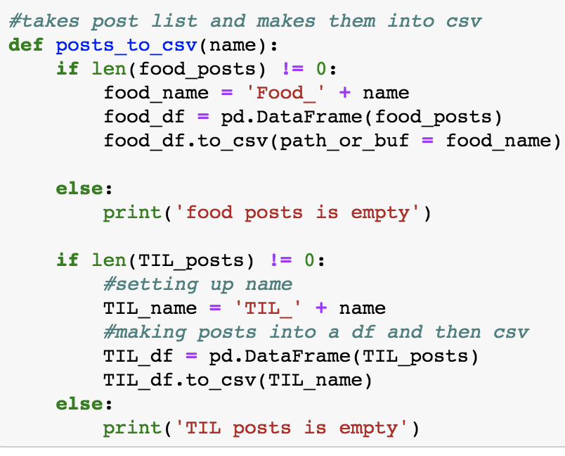
Creating CSV
Takes all the posts in the created list and and transforms it into an csv.
If the list is empty nothing happens

Slide 7
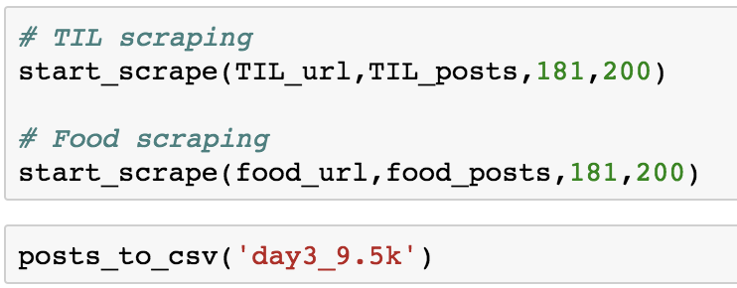
Collecting Data
This is how the finished function looks like and how the functions works together

Slide 8
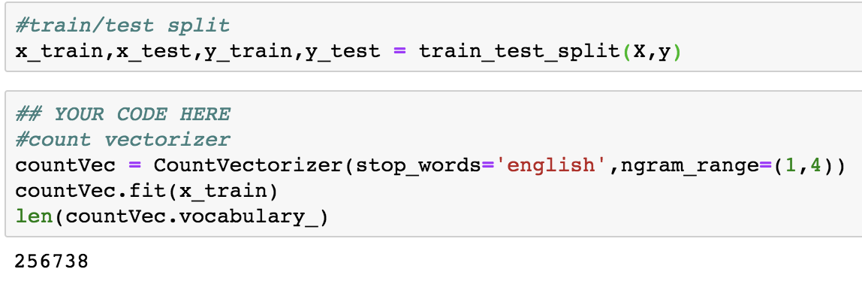
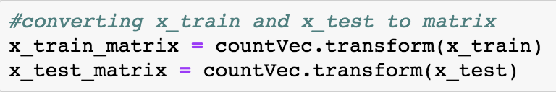
Count Vectorizer
First we train test split then we fit a count vectorizer to the training
lastly we transform the x train and x test so the computer can read in the words

Slide 9
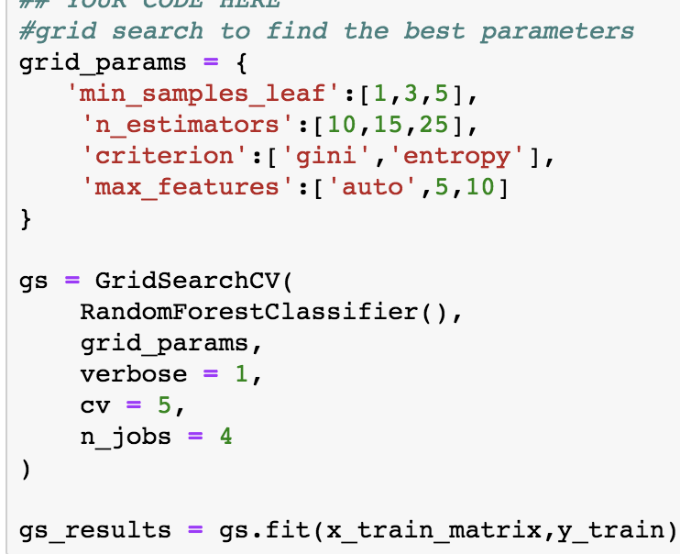
Finding the best parameters
I used grid search in order to find the best parameters
270 fits that took about 25 minutes

Slide 10
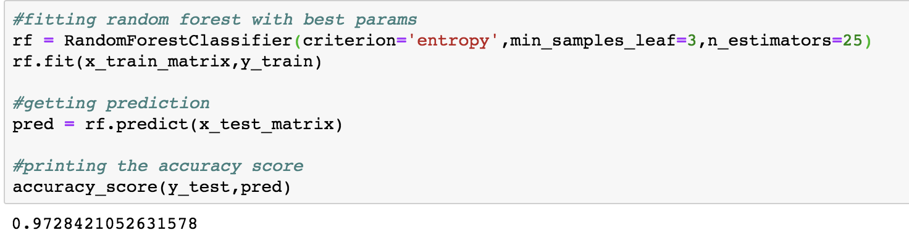
Best Model

