Slide 1

BOA Plugin
ECMM mapping plugin
ROI manager
ANA Plugin
Q Analysis plugin

Slide 2
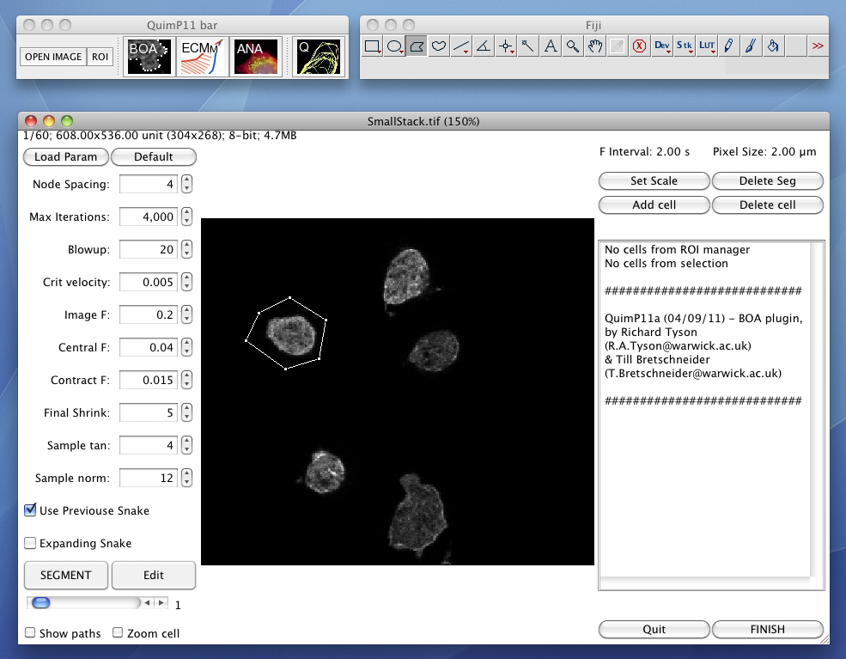

Frame Number

Slide 3
0.00
a) The length of a cell perimeter is normalized to 1, hence nodes have a position p in the range [0 ≤ p < 1].
0.75
0.25
0.50
c) Resulting Data
b)
0.00
0.17
Position | Origin | Speed
#frame 1
6
0.00 | - | -
0.17 | - | -
0.33 | - | -
0.50 | - | -
0.67 | - | -
0.83 | - | -
#frame 2
8
0.00 | 0.00 | -6.1
0.11 | 0.17 | -6.2
0.28 | 0.33 | -1.1
0.30 | 0.49 | +3.1
0.50 | 0.52 | +5.4
0.59 | 0.65 | +5.3
0.74 | 0.73 | +2.9
0.87 | 0.83 | -0.9
0.83
0.00
Origin: 0.00
0.11
Origin: 0.17
0.33
0.87
Origin: 0.83
0.28
Origin: 0.33
0.74
Origin: 0.73
0.67
0.50
0.30
Origin: 0.49
0.59
Origin: 0.65
0.50
Origin: 0.52

