Slide 1
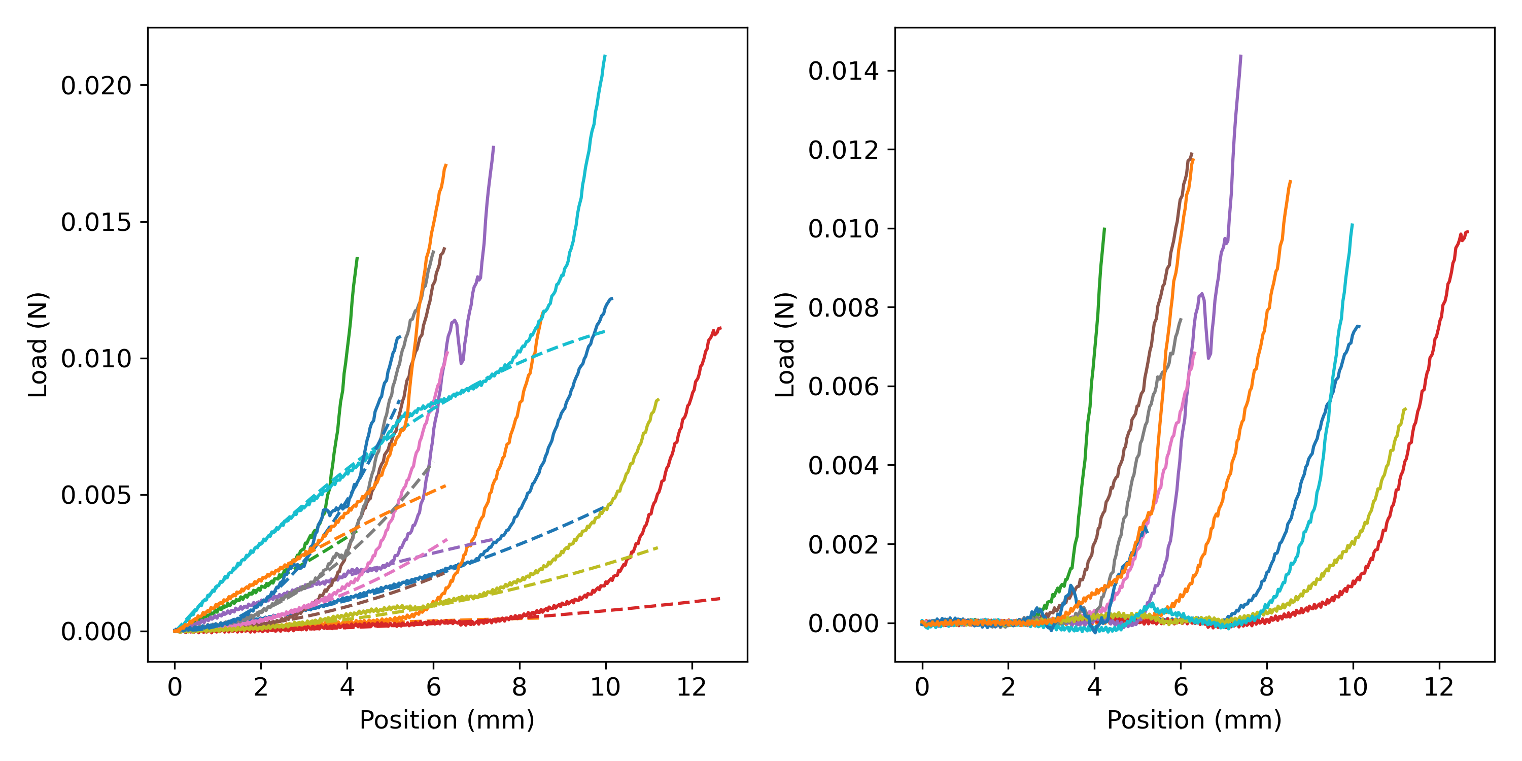
Representative data from Cs
Raw data
Detrended data
Polynomial fit
Notes:
A polynomial function was first fitted to the initial portion of the data (the portion where the noodle is getting into tension but it is not being stretched – Figure on the left), and the fit used to detrend the raw data to create a fictitious flat baseline (Figure on the right).
This property was used to discern the portions of the curve where the noodle was getting into tension, and where the noodle was actually being stretched.

Slide 2
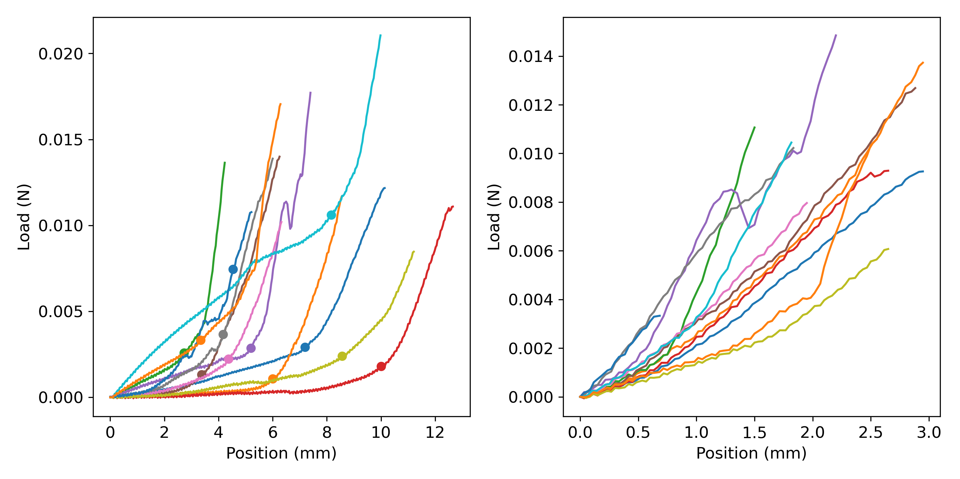
Notes:
Following this, the detrended data was used to find the point where the noodle starts being consistently stretched (left figure).
Then, this point was subtracted from the data (right figure) and the maximum force used to quantify the strength of the noodles.

