Slide 1
CellProfiler Developer Tutorial
Broad Institute Imaging Platform

Slide 2
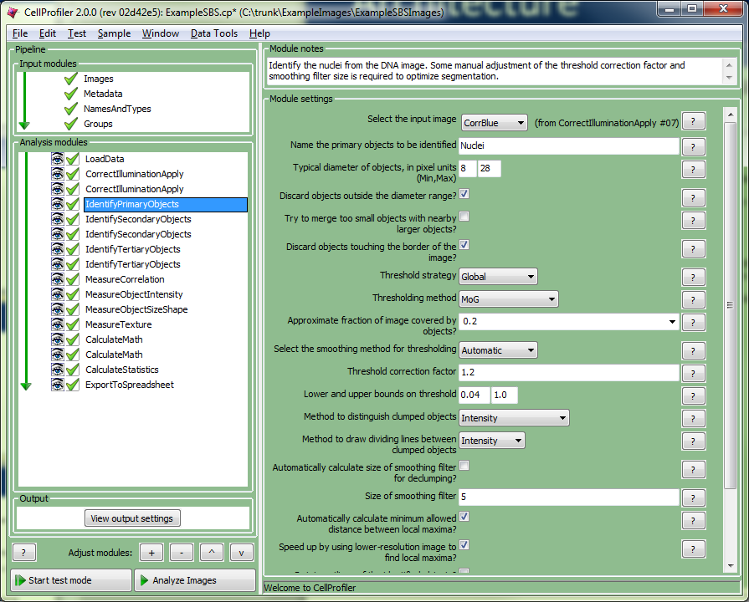
Tutorial overview
CellProfiler demo
CellProfiler Architecture
Python warmup and refresher
Writing CellProfiler modules
Hackathon

Slide 3
Architecture
Python
Numpy / Scipy
WX user interface
Matplotlib plotting
HDF5 – data storage
MySql / Sqllite database
ZMQ – multiprocessing communication
Java
JVM / JNI runs inside CP
Bioformats – image reader
ImageJ
Javascript
User Interface
Pipeline execution
Workspace
Pipeline
Image Set
Object Set
Measurements
File list
Image processing libraries
Java bridge Bioformats ImageJ

Slide 4
Architecture: Terminology
Image set: images for a single site
Image set list: all image sets in experiment
Group: subset of image sets
Objects: ROIs for site
a segmentation
Analysis: run of pipeline on image set list
Cycle: run of pipeline on image set
Measurement: Datum recorded for one image set or object
Feature: A measurement’s name
User Interface
Pipeline execution
Workspace
Pipeline
Image Set
Object Set
Measurements
File list
Image processing libraries
Java bridge Bioformats ImageJ

Slide 5
Architecture: Workspace
Workspace
Communication between modules
Storage & HDF5 data format
Pipeline
Modules
Settings
Image Set
Dictionary of images
Object Set
Dictionary of segmentations
Measurements
Data structure addressed by object name / feature name / image # / object #
File list
Image file names for input modules
User Interface
Pipeline execution
Workspace
Pipeline
Image Set
Object Set
Measurements
File list
Image processing libraries
Java bridge Bioformats ImageJ

Slide 6
Architecture: Image set
Image set
Holds a cycle’s images
Original microscope images
Module image outputs
Get / set by name: e.g. “DNA”
Image
pixel_data: an NxM or NxMx3 numpy array of intensities
mask: boolean NxM numpy array of region of interest
Image set list
Image measurements produced during prepare_run()
Image locations + per-image set metadata
User Interface
Pipeline execution
Workspace
Pipeline
Image Set
Object Set
Measurements
File list
Image processing libraries
Java bridge Bioformats ImageJ

Slide 7
Architecture: Object set
Object set
Dictionary of objects by name
Objects
A segmentation
Labels flavor
Objects.segmented: an NxM integer numpy array
Value = 0: background
Value = N: pixels for object # N
IJV flavor
Objects.ijv: an N x 3 integer numpy array
ijv[:, 0:2]: i, j coordinates of pixel
Ijv[:, 2]: pixel object #
User Interface
Pipeline execution
Workspace
Pipeline
Image Set
Object Set
Measurements
File list
Image processing libraries
Java bridge Bioformats ImageJ

Slide 8
Architecture: Pipeline
Pipeline
List of modules
Module
Code unit – CPModule class
Image processing step
Settings
Module configuration
Numbers / choices / other
UI elements
Buttons / checkboxes
Module I/O
Provider = module output
Subscriber = module input
Pipeline
NamesAndTypes
IdentifyPrimary
IdentifySecondary
Object subscriber Nuclei
Image subscriber
GFP
Object provider:
Cells
Image subscriber
DNA
Object provider
Nuclei
Image provider
DNA
Image provider
GFP
DNA
GFP
Nuclei

Slide 9
Architecture: Pipeline execution
Prepare_run
Identify image sets
Group image sets
Prepare_group
Initialize aggregation state
Run
Perform image analysis operations
Post_group
Finalize aggregate
Save aggregate images
Post_run
Experiment-wide analysis
Cleanup
prepare_run
prepare_group
run
post_group
post_run

Slide 10
Architecture: Module lifecycle
Loading / settings
Loading lifecycle
Module configuration lifecycle
Output discovery (not shown)
Image / object / measurement outputs
Execution lifecycle
Mirror of pipeline execution lifecycle
Most modules only implement run()
Settings
create_settings()
prepare_run()
prepare_group()
Execution
settings()
visible_settings()
upgrade_settings()
run()
post_group()
post_run()
prepare_settings()

Slide 11
Architecture: Module load lifecycle
Pipeline load
Determines module to load
create_settings() – make the settings needed by your pipeline
upgrade_settings()
Module versioning
Adust setting values from old version to match new
prepare_settings()
Add / remove setting groups
Setting vals -> initialize settings
create_settings
upgrade_settings
prepare_settings
Setting assignment

Slide 12
Architecture: Module editing lifecycle
visible_settings()
Returns settings to display
Fancy – display only relevant settings based on choice or checkbox
UI display
Create or update UI elements to match settings
UI event
Setting modifications
Button press (DoSomething)
visible_ settings()
Setting UI update
UI Event

Slide 13
Example Overview
Example format – simple -> advanced + tests
Example1 – module settings
Setting types, help, conditional settings, setting groups
Example2 – image processing
Image I/O, numpy / scipy intro, masks
Example3 – intro to measurements
Measurement I/O, being nice, measurement settings
Example4 – object processing
Object I/O, numpy / scipy operations on objects, overlapping objects
Example5 – object measurements
Example6 – Analysis lifecycle
Prepare / post run/group, image sets, batch processing

Slide 14
Example Format
Examples: from basic to advanced
① A basic lesson which is crucial to coding any module
② A lesson that makes things “nice” = better ui/interop.
③ Pedantic and advanced, undertake only if you have time
Set your plugins directory to the “tutorial” directory
Complete the lesson
Check it by running the unit test python –m nose.core --exe –v --with-kill-vm tutorial.tests.test_example1
Try it in CellProfiler
See if you can test example # 1 as above. If so, ① for you.

Slide 15
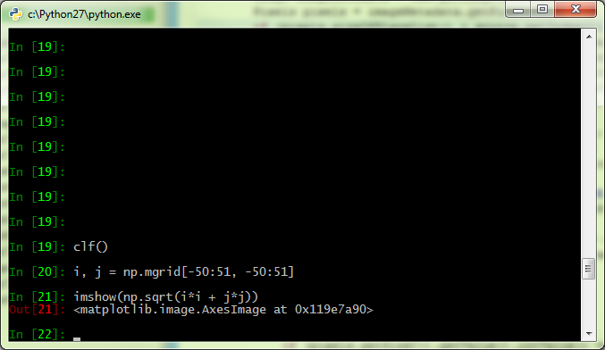
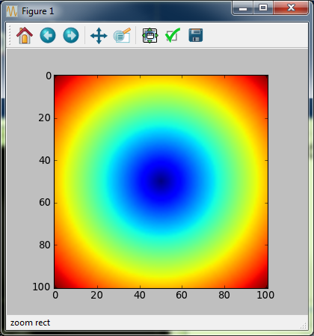
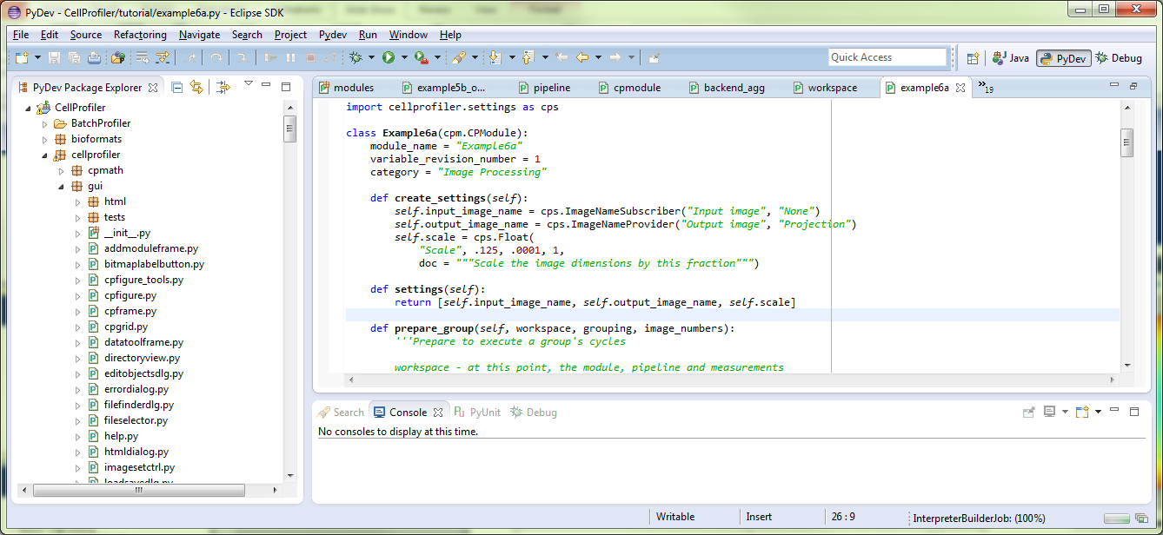
Tools: IPython / Eclipse

Slide 16
Warm-up
Using Numpy, Scipy and Matplotlib – in case anyone is rusty
Start IPython
IPython --pylab=qt
Try some stuff
i, j = np.mgrid[0:256, 0:256]
Imshow(i*i+j*j)
From scipy.ndimage import gaussian_filter
img = imread(“<path-to-tif>”)
img.shape # if it’s (?, ?, 3) then maybe img=np.mean(img, 2)
Imshow(gaussian_filter(img, 3))

Slide 17
①Settings
Settings
Configuration for your module
UI elements for your module
Look in cellprofiler.settings – help(cellprofiler.settings)
Types of settings
Text / Integer / Float – simple values
Choice / Binary – pick from a list or check a box
Measurement / Provider / Subscriber – lets you take from prior modules or give to later ones
… and many more

Slide 18
①Module settings
The module
A class derived from cellprofiler.cpmodule.CPModule
module_name / category
create_settings(self) – define your module’s settings
settings(self) – tell CellProfiler what your settings are
run(self, workspace) – do your thing
Workspace – has all of the state for your analysis

Slide 19
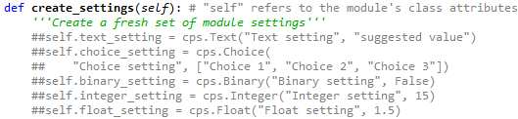
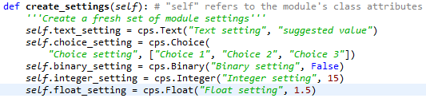
①Example1a – basic settings
Copy example1a_settings.py from the CellProfiler/tutorial directory to your plugin directory
To complete the exercise, uncomment the double-comments
Add the settings to create_settings():
Add the settings to settings()
Make run() use the settings
Test it. See it in CP.

Slide 20
②Visible settings
You can customize what a user sees in the CP UI.
Useful if some settings are only relevant under some conditions.
Return a different list in visible_settings(self)
Exercise
Copy exercise1b_visiblesettings.py to the plugins directory
Uncomment the double-commented lines in visible_settings
Run CellProfiler, add the module and check and uncheck the binary setting in CP

Slide 21

②Module / Setting help
You can add HTML help to your module
CellProfiler harvests a module’s docstring (1st in module)
You can specify a setting’s help by adding a doc argument
The help_settings(self) method
Default = return self.settings(), but you can override.
Exercise
Copy example1c_help.py to your plugins diretory.
Uncomment the doc arguments in create_settings()
Try it in CellProfiler. Click the help buttons and look at the module help.

Slide 22
②Display
To display results in your module:
In run(), save images and data in workspace.display_data
In display(), use the contents and Matplotlib to show data
Matplotlib hierarchy:
Figure – the whole window
Axes – a subplot (see http://matplotlib.org/api/axes_api.html)
The signature of the display method will change for next release
Exercise
Open up example1d.py
Run it to see it create a display
Do something fun on your own to modify the code

Slide 23
③Setting groups
Problem: how to do the same thing multiple times
Solution: SettingsGroup + prepare_settings
In create_settings, create a list to hold cps.SettingsGroup instances.
Create a cps.HiddenCount
Make a method to add an additional instance
Put your group’s settings here
Add a RemoveSettingButton to the group
Create a cps.DoSomething that adds an instance when pressed.
Make prepare_settings read the hidden count and add enough instances
See example1e.py to find out how it’s done.

Slide 24
③upgrade_settings
Problem – what if you need to change the settings to improve your module?
The old version may not load ☹
variable_revision_number
Stored for every module in pipeline
Tells you the version of your module
upgrade_settings
Setting_values – the string value of each setting
Use variable_revision_number to figure out what to do
Return upgraded setting_values, new variable_revision_number, True
Exercise1f.py
add self.sigma = cps.Float… to create_settings and settings
Change the spelling of S_GAUSSIAN to “Gaussian”
Change the variable revision # and implement upgrade_settings
Run the test to see how you did

Slide 25
①Image Processing modules
Input is an image / output is an image
cps.ImageNameSubscriber – knows about all image providers
cps.ImageNameProvider – promises that we will provide an image
Only names, not images
ImageSet
Get from workspace.image_set
workspace.image_set.get_image(name) -> Image
Workspace.image_set.add(name, Image)
Image
①image.pixel_data is your image data
②image.mask is the region of interest for the image
②image.parent is the image it came from if a derived image

Slide 26
①Image Processing modules: exercise 2
Copy example2a_imageprocessing.py to your plugins folder
create_settings()
Uncomment the image subscriber and provider lines
run(self, workspace)
image_set = workspace.image_set
image = image_set.get_image(self.input_image_name.value)
pixel_data = image.pixel_data
② do something to your pixel data if you like
output = cpi.Image(pixel_data, parent_image=image)
image_set.add(self.output_image_name.value, output)
② the display() method displays the images
Make a pipeline that includes the module
Test it

Slide 27
②Image types
Images types that might be in the image set
Color: a floating point NxMx3 image
the third dimension is R=0, G=1, B=2
Values usually between 0 and 1
Grayscale: an NxM image with values usually between 0 & 1
Binary: an NxM image with values of True or False
Illumination function: an NxM image with values >= 1
If your module needs a certain kind, CP will try and make it
Image_set.get_image(name, must_be_grayscale=True)
Image_set.get_image(name, must_be_color=True)
Image_set.get_image(name, must_be_binary=True)

Slide 28
②Image Processing: mask
Image.mask is CellProfiler’s region of interest
Only use the data for which Image.mask = True
Convention for image processing, leave masked data as-is
No mask if image.has_mask is False
By default, mask is inherited from parent image
But you can set it
Corner cases
Whole image could be masked out
You might get a color image and have to apply the mask to all three channels.
Exercise 2b
Copy exercise2b_mask.py to the plugin directory
Uncomment the double-commented lines in run()
Make a pipeline that crops the image, then processes it with the module

Slide 29
①Measurements
cellprofiler.measurements.Measurements()
2-level hierarchy
object_name = cpmeas.Image or object name like “Cell”
Feature_name = category_ftr_image_scale
Release version
Value = m.get_measurement(oname, ftr)
m.add_measurement(oname, ftr, value)
Trunk build
Value = m[oname, ftr]
M[oname, ftr] = value

Slide 30
①Declaring measurements: the minimum
ExportToSpreadsheet / ExportToDatabase
Need to know what measurements will be output
Need to let users pick
get_measurement_columns(pipeline)
Implement get_measurement_columns if you add measurements
Format is a list of 3-tuples
(Object_name, feature, column_type)
Column types
COLTYPE_VARCHAR = string data
COLTYPE_INTEGER
COLTYPE_FLOAT
COLTYPE_BLOB
Example: return [(“Image”, “AreaShape_Area”, COLTYPE_INTEGER)]

Slide 31
①Measurements: Exercise 3a
Copy example3a_measurements.py to the plugins folder
In run(), uncomment the double-commented lines that compute the variance
② Note how we only calculate the variance in the masked region if the image has a mask
In get_measurement_columns(), uncomment the line that returns the column definitions.
Run in CellProfiler

Slide 32
②Measurements: Being nice
The Measurement setting lets the user pick a measurement
It’s hierarchical = category / feature / image / scale
A nice module lets CellProfiler know the hierarchy using
get_categories(pipeline, object_name)
get_measurements(pipeline, object_name, category)
get_measurement_images / objects()
get_measurement_scales()
Exercise3b
Copy example3b.py to the plugins directory
Read the documentation in cellprofiler.cpmodule for above
Uncomment the double comments in get_categories, get_measurements, get_measurement_images
Start CellProfiler, add Example3b to your pipeline, followed by the CalculateMath module
See if you can set the numerator measurement to use the Example3b variance image measurement

Slide 33
①Object Processing
“objects” = multiple regions of an image
ObjectSet - an image set’s objects, organized by name
object_set.get_objects(name) to get them
object_set.add_objects(objects, name) to add new ones
Objects – where the data is stored
Objects.segmented – the labels matrix
Labels matrix
NxM integer array
Value = 0 -> background
Similarly-valued pixels belong to same object
Object settings
cps.ObjectNameSubscriber to get an object name
Cps.ObjectNameProvider to name new objects

Slide 34
①Object processing: Exercise 4a
Copy example4.py to example4a.py and change module name
In create_settings(), uncomment the double commented lines to create object subscriber and provider settings
In settings(), uncomment the double commented lines to return the subscriber and provider
In run(), uncomment the double commented lines
The code fetches the object set, gets the objects, skeletonizes the labels and stores the resulting objects
Create a pipeline in CellProfiler that uses IdentifyPrimaryObjects to make objects and then uses Example4 to skeletonize them.

Slide 35
②Object processing: adding expected measurements
CellProfiler users expect all objects to have locations & count
Helper routines in cellprofiler.modules.identify
add_object_location_measurements -> Location_Center_X/Y
add_object_count_measurements -> Count_<object name>
get_object_measurement_columns ->the list of measurement columns for get_measurement_columns
Exercise 4b
Copy example4b.py to the plugins directory
Uncoment the double-commented lines in run() to add the measurements
Uncomment get_measurement_columns() to report the measurements
Uncomment get_categories and get_measurements to inform the measurement settings system of the measurements.
Modify the pipeline from Exercise 4a to use Example4b and add a DisplayDataOnImage module to display one of the measurements.

Slide 36
②Object processing: recording relationships
TO_DO

Slide 37
②Object Processing: objects touching border and other
TO_DO

Slide 38
③Object processing: cropping and parent image
TO_DO

Slide 39
③Object Processing: ijv and overlapping objects

Slide 40
①Object Measurements
Object measurements are similar to image measurements
Object measurement is 1d array of values per object
Three ways of accessing objects
Objects.segmented – a single 2d labels matrix
Module will raise an exception if overlapping objects
Objects.get_labels() – returns a list of (label, indices)
You can loop over each of the labels in turn
Objects.ijv – returns an Nx3 array of i, j coordinates + label
Very efficient for a binning strategy
Always make sure your stuff works if there are 0 objects
A comprehensive example: cellprofiler.modules.plugins.measurementtemplate

Slide 41
①Object Measurements: Example5a
scipy.ndimage: a scipy package for processing objects
distance_transform_edt – find distance to background
mean – find the average value per object
Copy example5a_objectmeasurements_basic.py to the plugin folder
Uncomment the commented lines in the run() method
The code creates a distance-transformed image of the foreground and then computes the mean, per object
There’s a bug: the distances are wrong if objects touch (see 5b)
Build a CellProfiler pipeline with an IdentifyPrimaryObjects module and this module.
Run it and see the results.

Slide 42
②Testing: CellProfiler unit tests
Python unittest package
class MyTest(unittest.TestCase)
def test_whatever(self) = test to run
Tests run in alphabetical order: test_01_01 < test_01_02
Things to test
Load a pipeline that contains your module
Create typical test inputs, compare outputs against expected
Corner cases that historically crash CellProfiler
Totally masked images
No objects
Images of different sizes

Slide 43
②test_example5a – adding a test
Test pipeline loading of example5a
Recipe for making a pipeline file: from cellprofiler.modules import instantiate_module from cellprofiler.pipeline import Pipeline module = instantiate_module(“Example5a”) module.module_num = 1 pipeline = Pipeline() pipeline.add_module(module) pipeline.savetxt( “<my-file-name>”, save_image_plane_details=False)
Recipe for loading a pipeline: from cStringIO import StringIO data = r”””<paste contents of my-file-name here””” pipeline = Pipeline() pipeline.load(StringIO(data))
Edit tutorial/tests/test_example5a.py
Make test_02_01_load(self):

Slide 44
②Analysis lifecycle: prepare/post group
Groups: aggregate over image sets
prepare_group – initialize for aggregation
Run – accumulate per cycle
Finalize the aggregation in run() on the last cycle or in post_group
GroupNumber image meas. same for all cycles in group
GroupIndex image meas. = 1 -> # cycles in group
Use the module’s dictionary to store state
Groups
Uses of groups
Producing an aggregate image (z-projecction)
Treating groups as mini-analyses (e.g. 1 csv per group)
Performing an aggregate analysis at end (e.g. TrackObjects)
But think about doing this outside of CellProfiler

Slide 45
②Analysis Lifecycle: prepare_group
Prepare group runs before any of the group’s cycles
In current code base = always
In multiprocessing, if a module is an aggregation module
CPModule.is_aggregation_module returns True
prepare_group arguments
workspace
Only measurements and pipeline are valid
grouping – the metadata tags used for grouping (legacy)
image_numbers – the image numbers for the cycles in the group.

Slide 46
②Analysis Lifecycle: post_group
Runs after all cycles have completed
In multiprocessing, runs on worker.
post_group arguments
Workspace
Image_set / object_set / measurements all valid
Grouping – grouping metadata keys for grouping
Legacy – you can get them from measurements.get_grouping_keys() now
Caveats
Runs after ExportToDatabase, etc have written measurements
Runs before SaveImages writes per-group images

Slide 47
②Analysis lifecycle: group exercise6a
A median projection module
Copy exercise6.py to exercise6a.py
Look at functions e6_state_init, append, median
Call e6_state_init inside prepare_group()
Initializes module dictionary for group
Call e6_state_append inside run()
Saves an image plane to the z-stack
Call e6_state_median inside run() on last cycle
Calculates the median projection
Save the output image
Test it, try it on SBS data set

Slide 48
②Analysis lifecycle: prepare_run
When is prepare_run called?
Before CreateBatchFiles / not when running a batch file
When going into test mode (unless previously cached)
Prior to calling workers for multithreaded
What does it do?
Write image & experiment measurements
Write GroupNumber & GroupIndex to define groups
Uses
Create an image set list
Initialize a database for an experiment
Robotics? Analysis server?

Slide 49
②Analysis lifecycle: prepare_run
prepare_run’s workspace
Pipeline / module are valid
Measurements
Write per-experiment measurements here
Write image measurements for all cycles
FileName_<image-name>
PathName_<image-name>
Url_<image-name>
Metadata_<metadata-name>
Return True from prepare_run if everything is OK
Implement “is_load_module” if your module loads images

Slide 50
②Analysis lifecycle: prepare_run exercise
A module that makes image sets using today’s .tif files
Edit example6b.py
In prepare_run
add an experiment measurement called “Example6b_FirstTime” to record the earliest acceptable file creation time
Add FileName and PathName measurements for each file
In run
Read the cycle’s FileName and PathName measurements
Call load_using_bioformats to read the image
Add the image to the image set
Test it, try it

Slide 51
③Analysis lifecycle: CreateBatchFile
Making a load module batch-friendly
In prepare_run, don’t do anything if workspace.pipeline.in_batch_mode()
Implement prepare_to_create_batch
Purpose:
windows -> Linux paths
Client filesystem -> cluster filesystem
Call measurements.alter_path_for_create_batch with each of your image names
Call DirectoryPath.alter_for_create_batch_files
Exercise 6c. Make Exercise6b.py batch-friendly

Slide 52
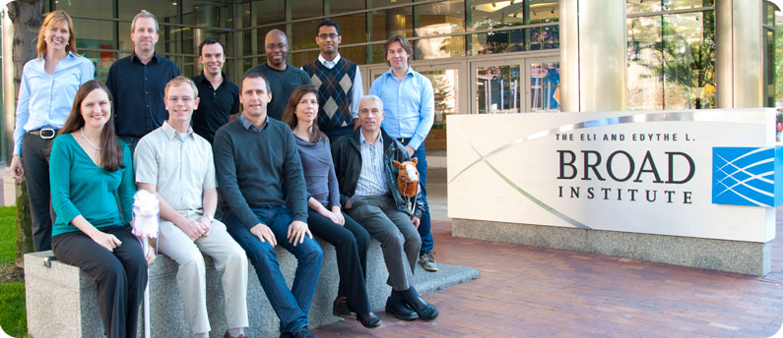
CellProfiler team / acknowlegements
Mark Bray – IAD / education
Anne Carpenter – Director
Lee Kamentsky – Software eng.
Vebjørn Ljoså – Data mining
David Logan – IAD
Samuel Markson – Build engineer
Shantanu Singh – Data mining
Matt Venesky – Admin
Carolina Wählby
NIH R01 GM089652, GM095672
NSF RIG DBI 1119830

