Slide 1
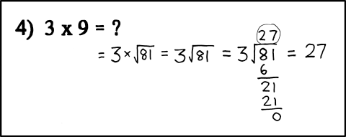
Pass By Reference + Exam Review
Notes:
XKCD Comic

Slide 2
Announcements
Exam on Wednesday!

Slide 3
Pass By Reference
Pass by reference allows a function to directly modify the original values of parameters passed to it without returning anything.
Why use pass by reference:
You need to modify multiple related variables simultaneously
You need to swap variable values
You are passing a huge type into a function and don’t want to waist valuable memory space copying it

Slide 4
Value vs. Reference
Pass by Value
Pass by reference
The value of the passed function parameter is copied into a local variable
Only one value can be returned from a function
You can have implicit casting
Can pass a variable, literal, or expression
The passed function parameter refers to the same place in memory as the original variable
Multiple variables can be modified from one function
No implicit casting allowed
Must pass a variable

Slide 5
Pass by Value example
What prints? Is there a logic error? Can you think of a case where this would fail? If so, what fixes need to be made
void addMinutes(int &hours, int &min, int minAdded) {
hours += minAdded / 60;
min += (minAdded % 60);
minAdded = 0;
return;
}
int main () {
double h = 2;
int m = 10;
int min2Add = 65;
addMinutes(h, m, min2Add);
cout << h << “ hours and “ << m << “ minutes: We added: “ << min2Add << “ minutes” << endl;
}
Notes:
Play with const and other good stuff like that

Slide 6
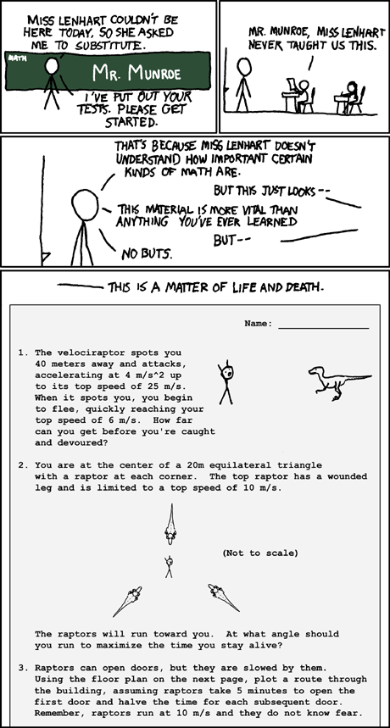
EXAM REVIEW
Notes:
XKCD substitute

Slide 7
EXAM REVIEW
Strings
Variables
Branching
Functions
Testing Functions
Pass by Value
Pass By Reference
Loops (while and for)
Nested Loops
qBoolean Logic
Input/Output
STUDY TIPS:

Slide 8
Exam Review

