Slide 1
🐦 BigBird
Breaking the Quadratic Barrier
Deep Dive into the BigBird Transformer Model
Mohammad Nassar

Slide 2
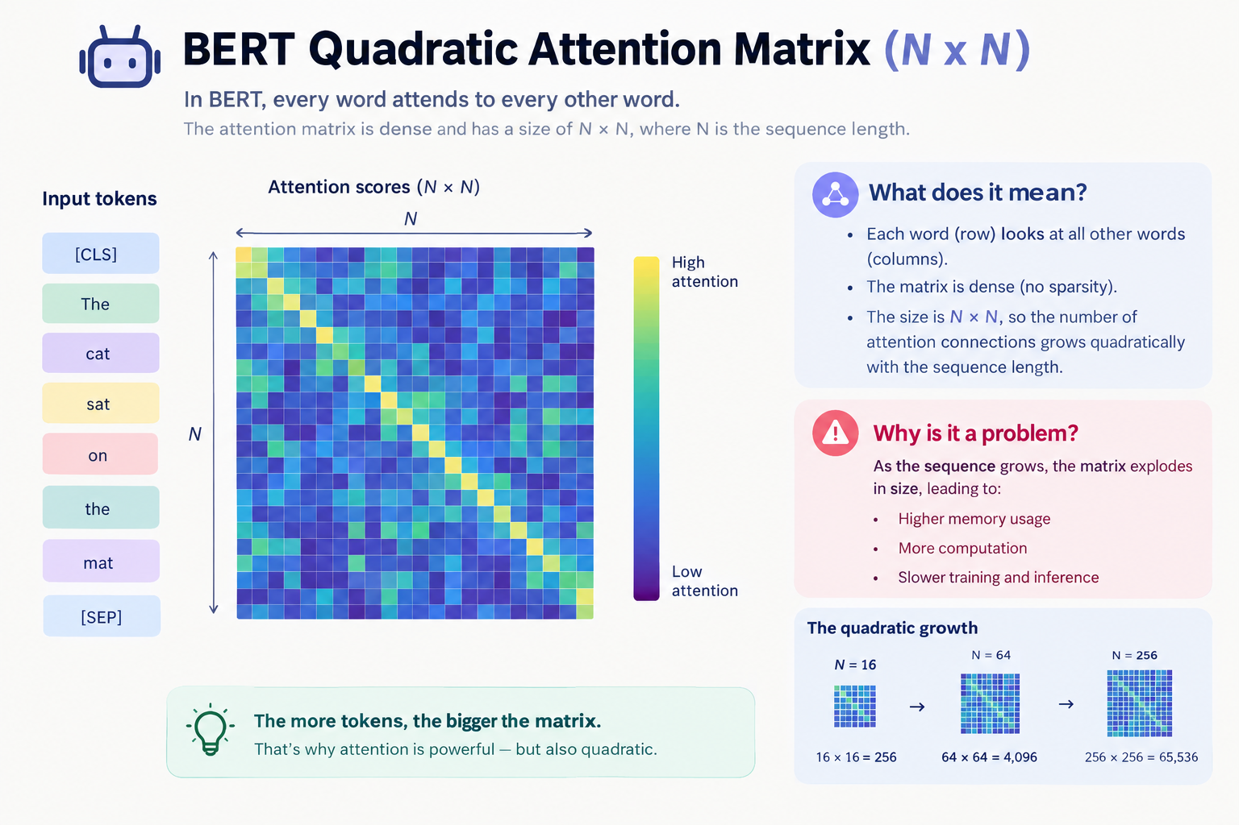
The Problem: BERT's Quadratic Bottleneck
Dense self-attention creates an N x N matrix, causing quadratic memory growth.
Standard Transformers use dense self-attention.
Every token attends to every other token.
Creates an N x N matrix → O(N²) complexity.
Example: Doubling sequence length quadruples memory usage.
Limitation: BERT is capped at 512 tokens.
BigBird Model Research | Slide 2

Slide 3
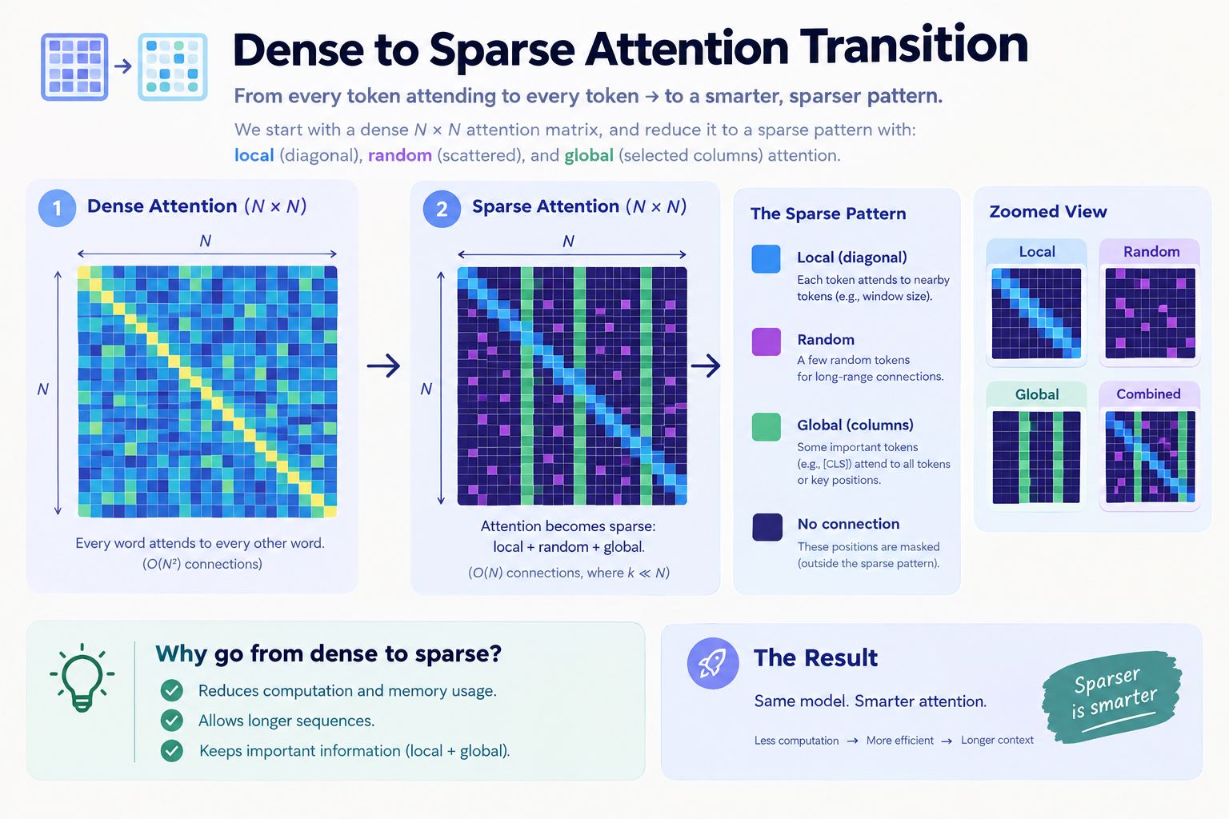
The Solution: Dense to Sparse Transition
BigBird strategically reduces connections to achieve linear O(N) complexity.
BigBird replaces dense attention with a sparse mechanism.
Local (Diagonal): Attends to nearby tokens (window).
Random (Scattered): Attends to a few random tokens.
Global (Columns): Key tokens attend to everything.
Result: Computation drops from O(N²) to linear O(N).
BigBird Model Research | Slide 3

Slide 4
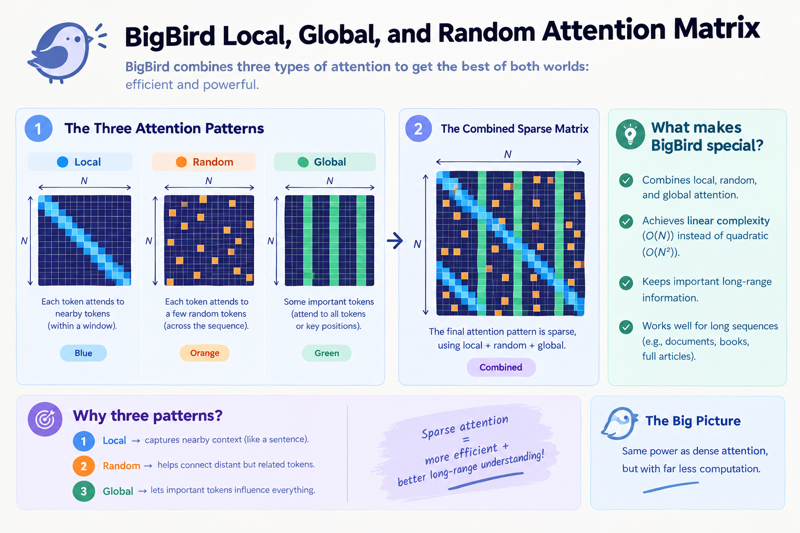
The Architecture: The BigBird Matrix
Combining three distinct attention patterns to capture both short and long-range context.
Local: Captures short-range syntax (like a sentence).
Random: Connects distant but related tokens.
Global: Lets key tokens (like [CLS]) influence everything.
The Secret: Each token only attends to 6-7 other tokens (for example).
This keeps computation strictly linear regardless of length.
BigBird Model Research | Slide 4

Slide 5
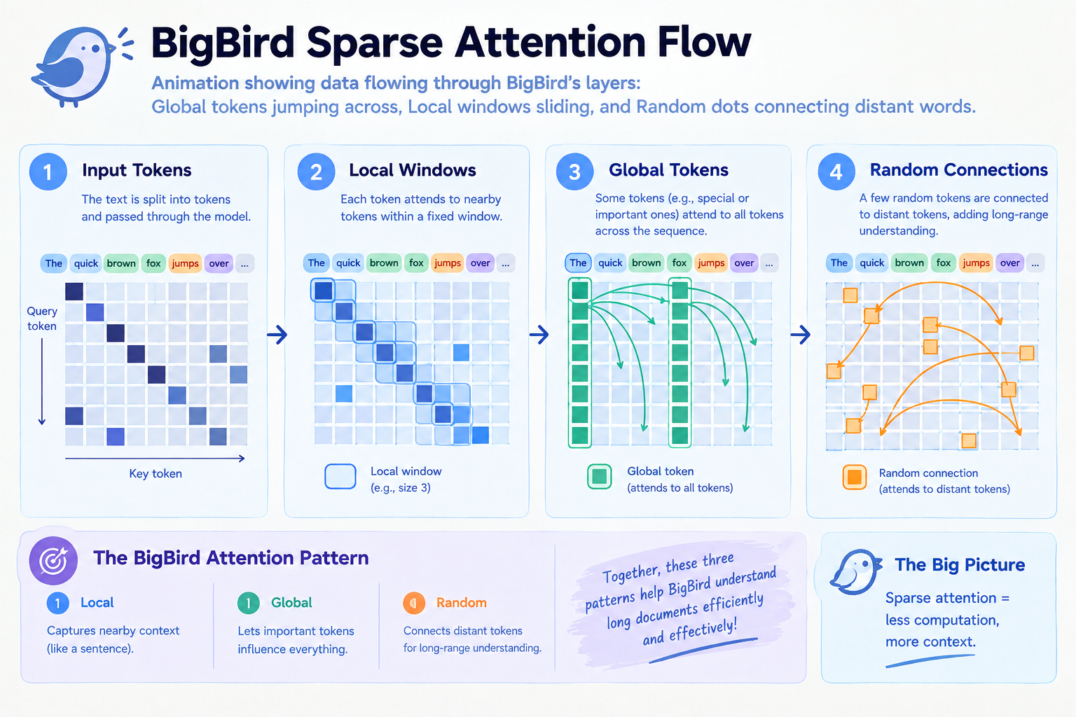
How It Works: Sparse Attention Flow
A visual journey through BigBird's layers: Global, Local, and Random connections.
Input Tokens: Text is split and passed through the model.
Local Windows: Each token attends to nearby tokens.
Global Tokens: Special tokens attend to all tokens.
Random Connections: A few tokens connect to distant ones.
The Big Picture: Less computation, more context.
BigBird Model Research | Slide 5

Slide 6
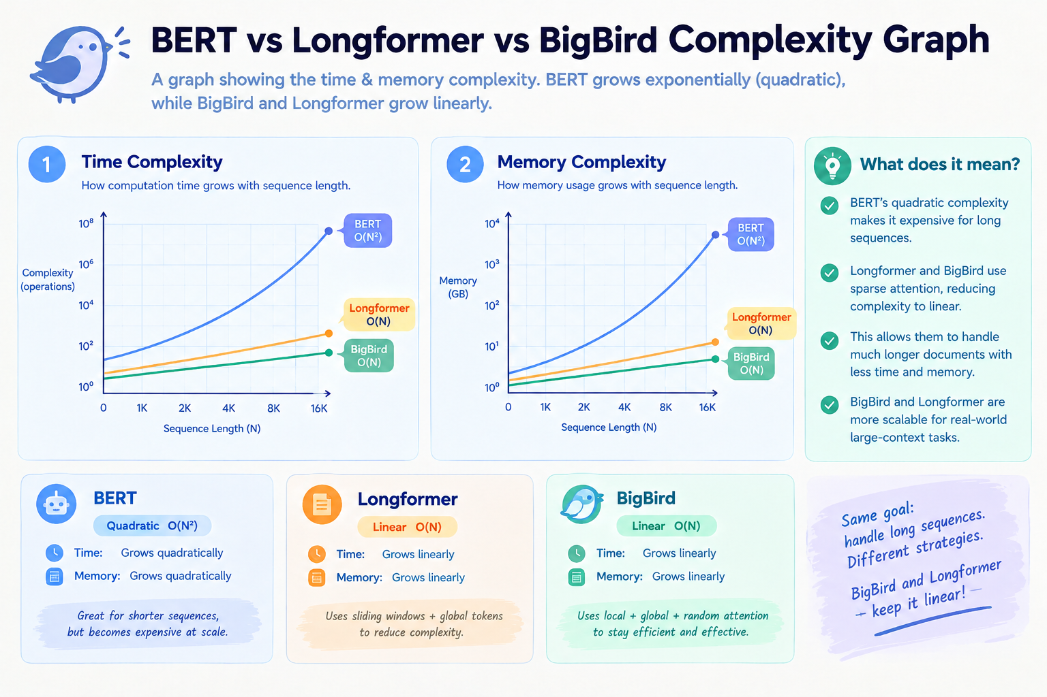
Complexity Showdown: BERT vs. Longformer vs. BigBird
BigBird maintains linear complexity with theoretical guarantees.
BERT: O(N²) - Full dense attention. Best for < 512 tokens.
Longformer: O(N) - Sliding window + Global attention.
BigBird: O(N) - Local + Global + Random attention.
Winner: BigBird is the only model with theoretical guarantees (Turing complete) while maintaining linear complexity.
BigBird Model Research | Slide 6

Slide 7
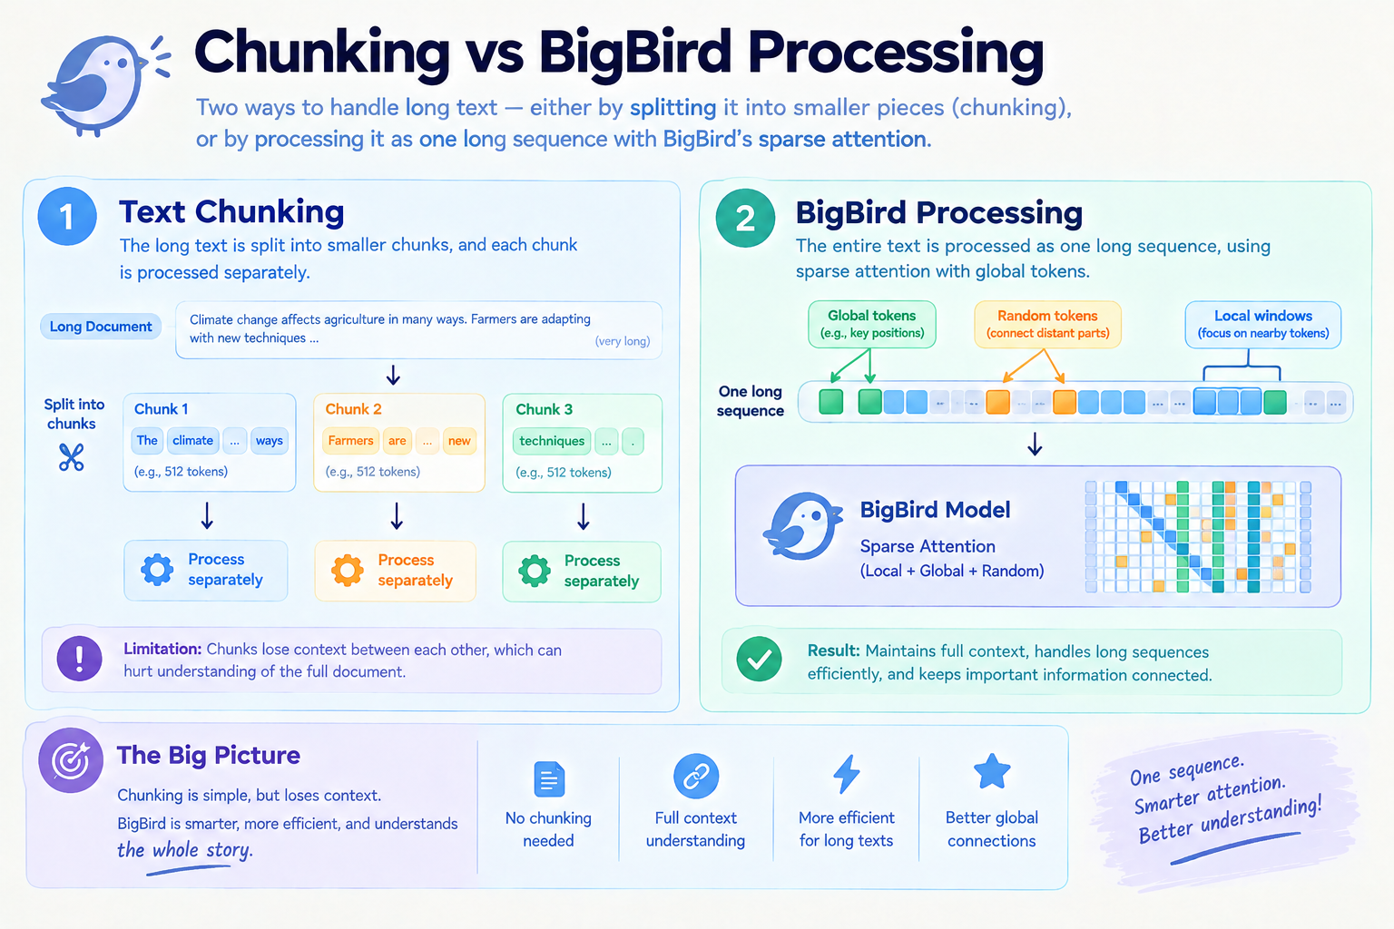
BigBird vs. Chunking
Why BigBird is smarter than simply cutting long text into pieces.
Chunking: Split document into 512-token chunks. Loses context between chunks.
BigBird: Process entire text as one long sequence.
Advantage: Maintains full context, handles long sequences efficiently.
Verdict: One sequence. Smarter attention. Better global understanding.
BigBird Model Research | Slide 7

Slide 8
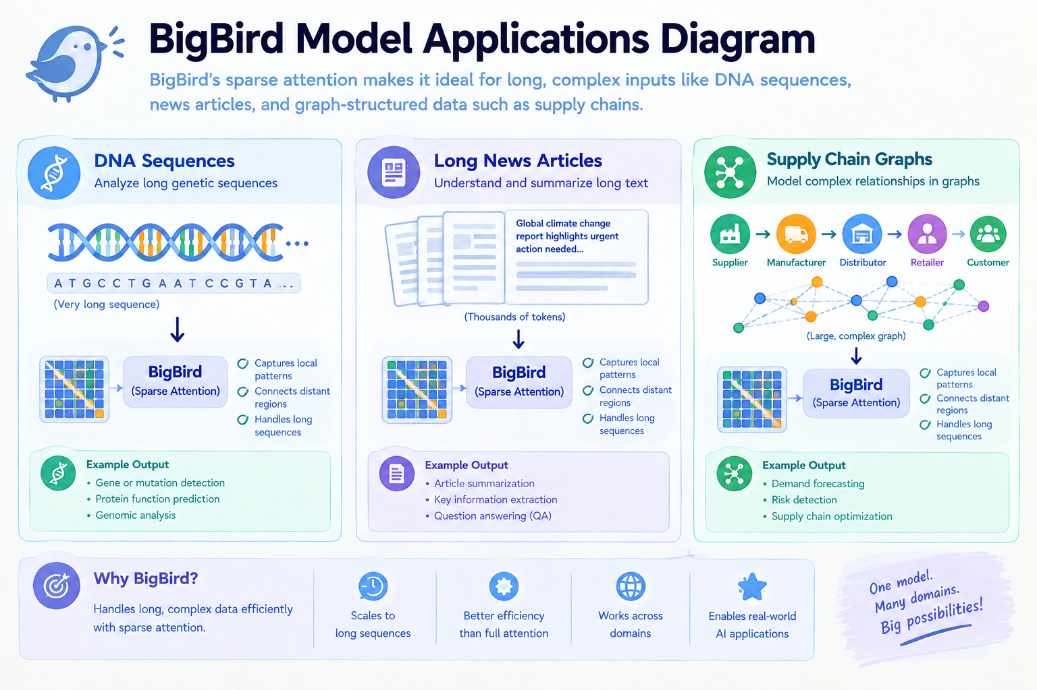
Where to Use BigBird: Applications
Built for long, complex, and structured data across multiple domains.
🧬 DNA Sequences: Analyzing long genetic sequences.
📄 Long News Articles: Summarizing thousands of tokens.
🕸️ Supply Chain Graphs: Modeling complex relationships.
🔬 Scientific Text Mining: Extracting formulas and co-references.
❓ Long-Form QA: Answering questions from entire books.
BigBird Model Research | Slide 8

Slide 9
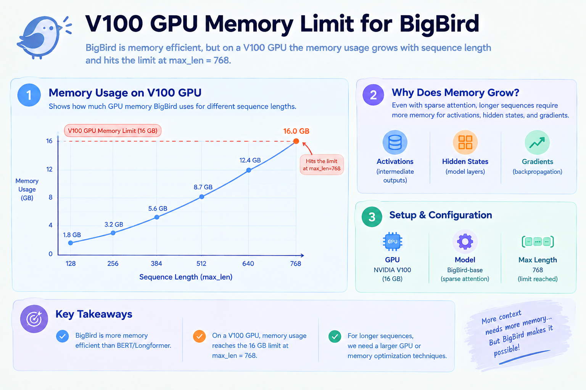
The Reality Check: Limitations & Performance
Practical constraints when deploying BigBird in real-world scenarios.
Hardware Constraints: On V100 (16GB), max_len=768, batch_size=4 hits the limit.
Fixed PE Limit: max_position_embeddings=4096.
Short-Input Inefficiency: Slower than BERT for < 1024 tokens.
Multi-GPU Complexity: Requires careful tuning of batch size and learning rate.
BigBird Model Research | Slide 9

Slide 10
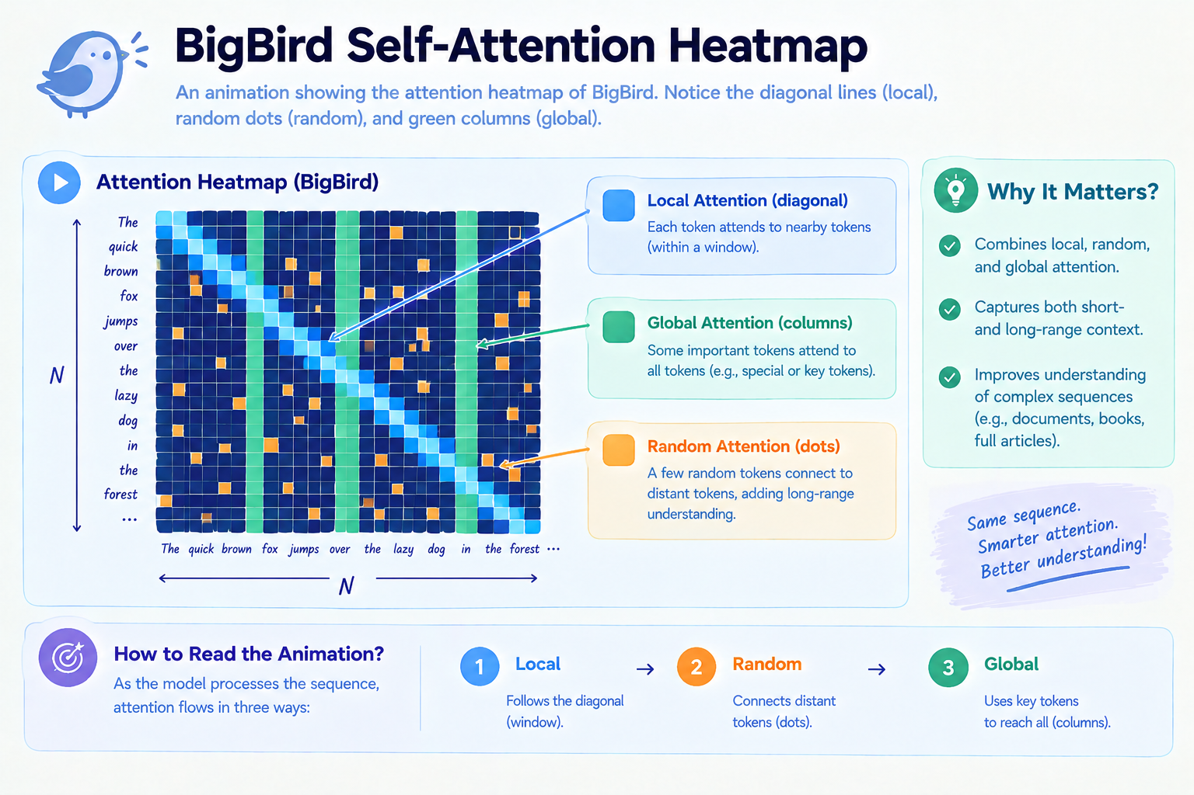
🔍 Inside the Heatmap: Visualizing the Attention
How to read the diagonal lines, green columns, and random dots.
Diagonal Lines: Local Attention (window).
Green Columns: Global Attention (key tokens reaching all).
Random Dots: Random Attention (long-range connections).
Why It Matters: Captures both short- and long-range context.
BigBird Model Research | Slide 10

Slide 11
💎 Conclusion & Key Takeaways
BigBird combines Global, Local, and Random attention to achieve linear complexity, bridging the gap between expressive Transformers and computational reality.
Use BigBird for sequences exceeding 1024 tokens. For sequences of 1024 tokens or fewer (especially 512–1024), standard BERT remains the more efficient choice.
Key Takeaway: Use BigBird to process long documents efficiently without losing global context.
BigBird Model Research | Slide 11

Slide 12
References
Zaheer, M., et al. (2020). Big Bird: Transformers for Longer Sequences. NeurIPS.
Hugging Face Transformers Documentation. BigBirdModel.
InnerWorkingsAI Channel YouTube ( BigBird Research Course).
BigBird Model Research | Slide 12

