Slide 1
Final Project
TABLE OF CONTENTS
01
Introduction
02
Application Analysis
Course Name: Algorithms and Data Structures – IT013IU
03
Student: Nguyen Minh Thuan – ITCSIU22269
04
Used Data Structures
& Algorithms
Application Demo & Conclusion

Slide 2
TABLE OF CONTENTS
01
02
03
04
Introduction
Application Analysis
Used Data Structures
& Algorithms
Application Demo & Conclusion

Slide 3


01
Introduction
Used Tools
Github’s Version Control System
Main IDE

Slide 4
Phases of Development
Research
Code Implementation
Testing, Debugging
& Completion

Slide 5

Introduction
Used Tools
Main IDEs
Github’s Version Control System

Slide 6
Remarkable Features
Application Analysis
02
File Processing
Text Formatting
Text Viewing
Create new text document
Open an existing text document
Save document
Word wrap
Font, font size and color adjustability
Search/repleace words in the document
Zoom in/out

Slide 7
02
Application Analysis

Slide 8
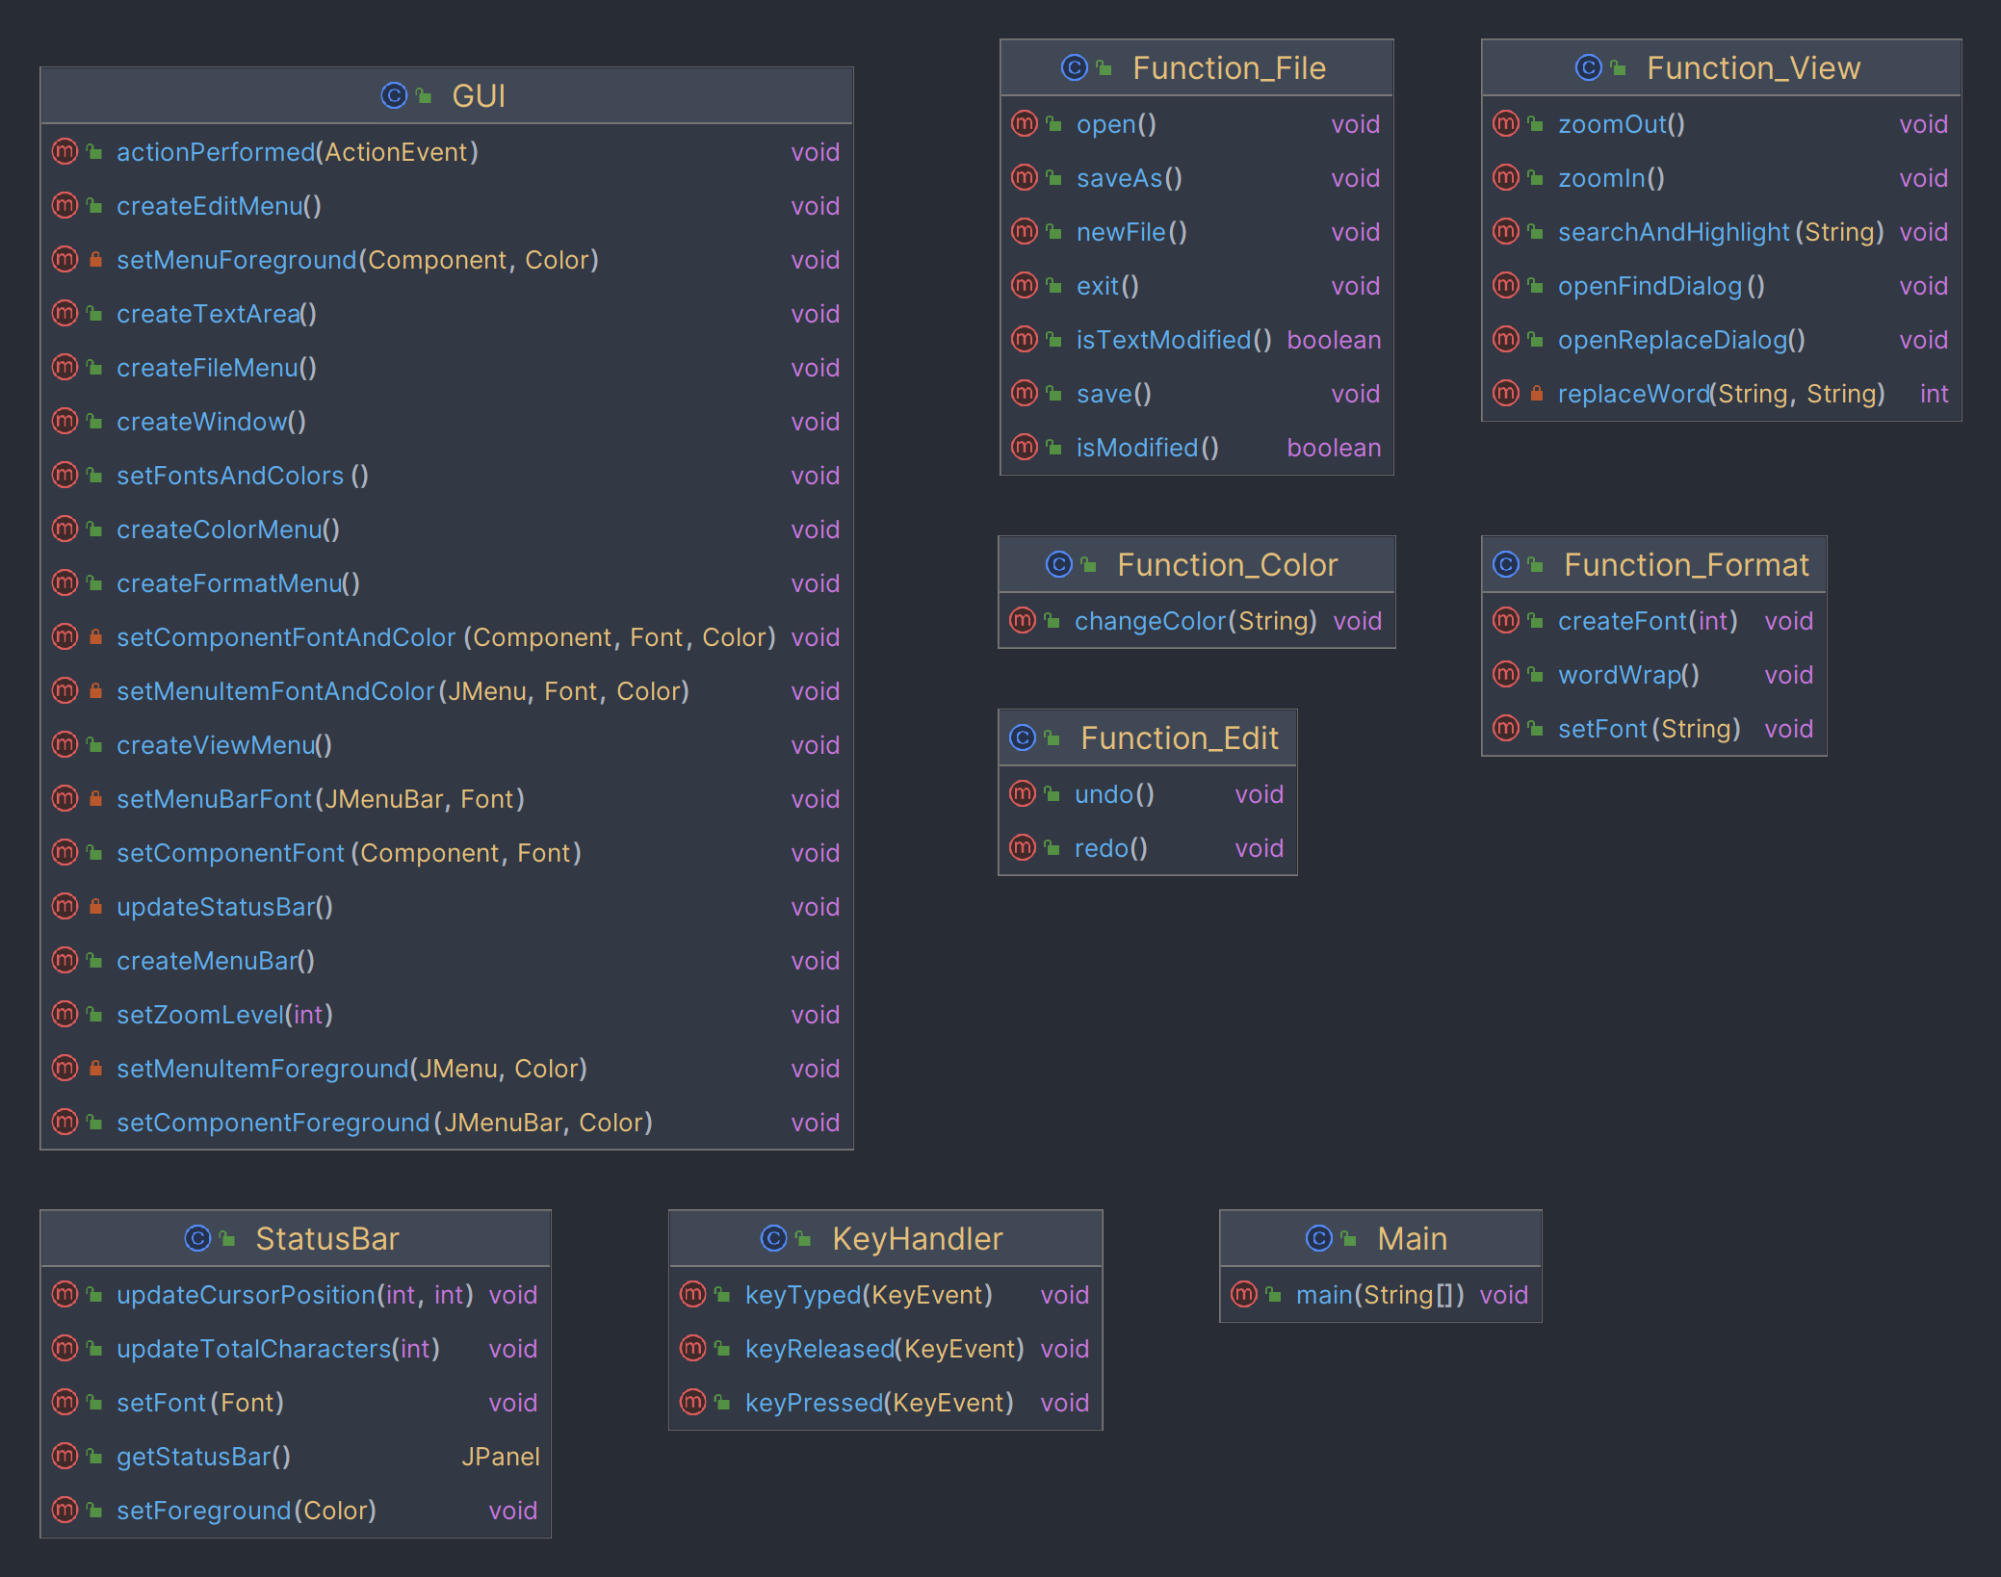
Used Data Structures & Algorithms
03

Slide 9
03
Used Data Structures & Algorithms

Slide 10

public void searchAndHighlight(String word) { Queue<Integer> positions = new LinkedList<>(); String content = gui.textArea.getText(); int index = content.indexOf(word); int count = 0; // Counter for occurrences while (index >= 0) { positions.add(index); index = content.indexOf(word, index + 1); count++; } Highlighter highlighter = gui.textArea.getHighlighter(); ..................................................................... if (count > 0) { JOptionPane.showMessageDialog(null, "Total occurrences of '" + word + "': " + count, "Word Search Result", JOptionPane.INFORMATION_MESSAGE); } else { JOptionPane.showMessageDialog(null, "Word not found.", "Word Search Result", JOptionPane.INFORMATION_MESSAGE); } }

Slide 11
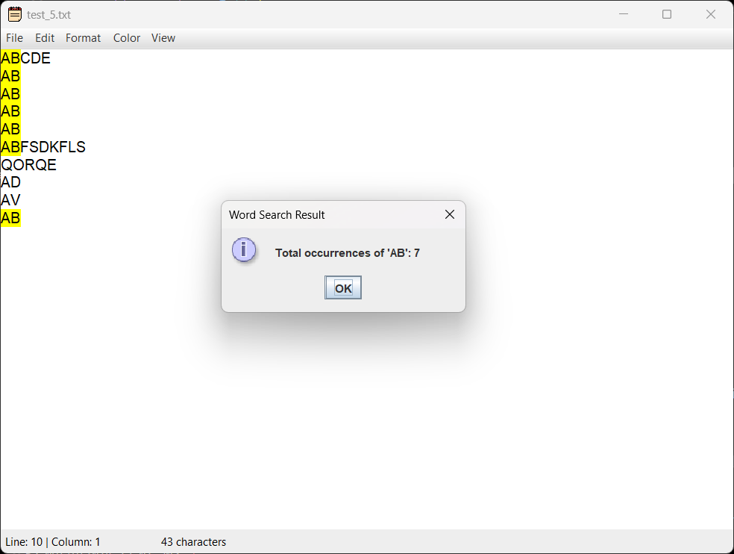

Slide 12
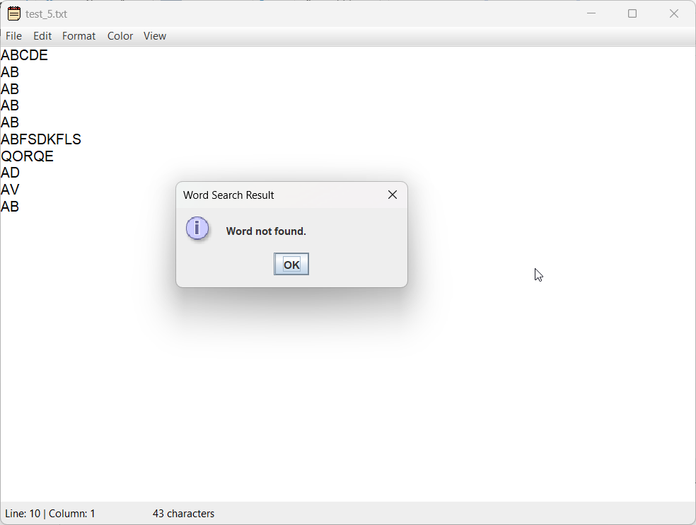
Application Demo & Conclusion
04

Slide 13
04
Application Demo & Conclusion

Slide 14
DEMO SESSION

Slide 15
Conclusion
Overview
Difficulties
Development of a simple text editing application
Version Control: Github
Limited features
Troubles with Data Structures

Slide 16

Thanks for paying attention !!
02

