Slide 1
SORSOGON STATE UNIVERSITY
BULAN-CAMPUS DOCUMENT
MANAGEMENT SYSTEM

Slide 2
Team Composition
Norjan Eneria - Capstone Adviser
Leony Brizuela - Project Leader
Sarah Joy Celso - Back-End Developer
Jeanahmae Carezo - Front-End Developer
Dazel Catabuena - Technical Writer

Slide 3
Objectives of the Study
This proposed capstone project aims to develop a Document Management System for Sorsogon State University - Bulan Campus. Specifically, the project aims to:
1. To create a User Account Management module for administrator that has a functionality of:
1.1 Create/Add,
1.2 Edit,
1.3 and Archive User Account
2. To design and develop a Web-based Document Management System with the following modules:
2.1 Submission Bin
2.2 User Account Archive

Slide 4
2.3 Document Monitoring
2.4 Document Trash Bin
2.5 Notification
2.6 Document Checking
3. To test and evaluate the deployed system using ISO/IEC 25010 Software product quality in terms of:
3.1 Functional Suitability
3.2 Performance Efficiency
3.3 Usability

Slide 5
Client's Profile
The users of the system are categorized into four roles: Dean, Faculty, Program Chair, and Quality Assurance Officer (QAO). The system is designed to be used by the College of Information and Communications Technology (CICT) and the College of Business Management and Entrepreneurship (CBME) departments at Sorsogon State University, Bulan Campus.

Slide 6
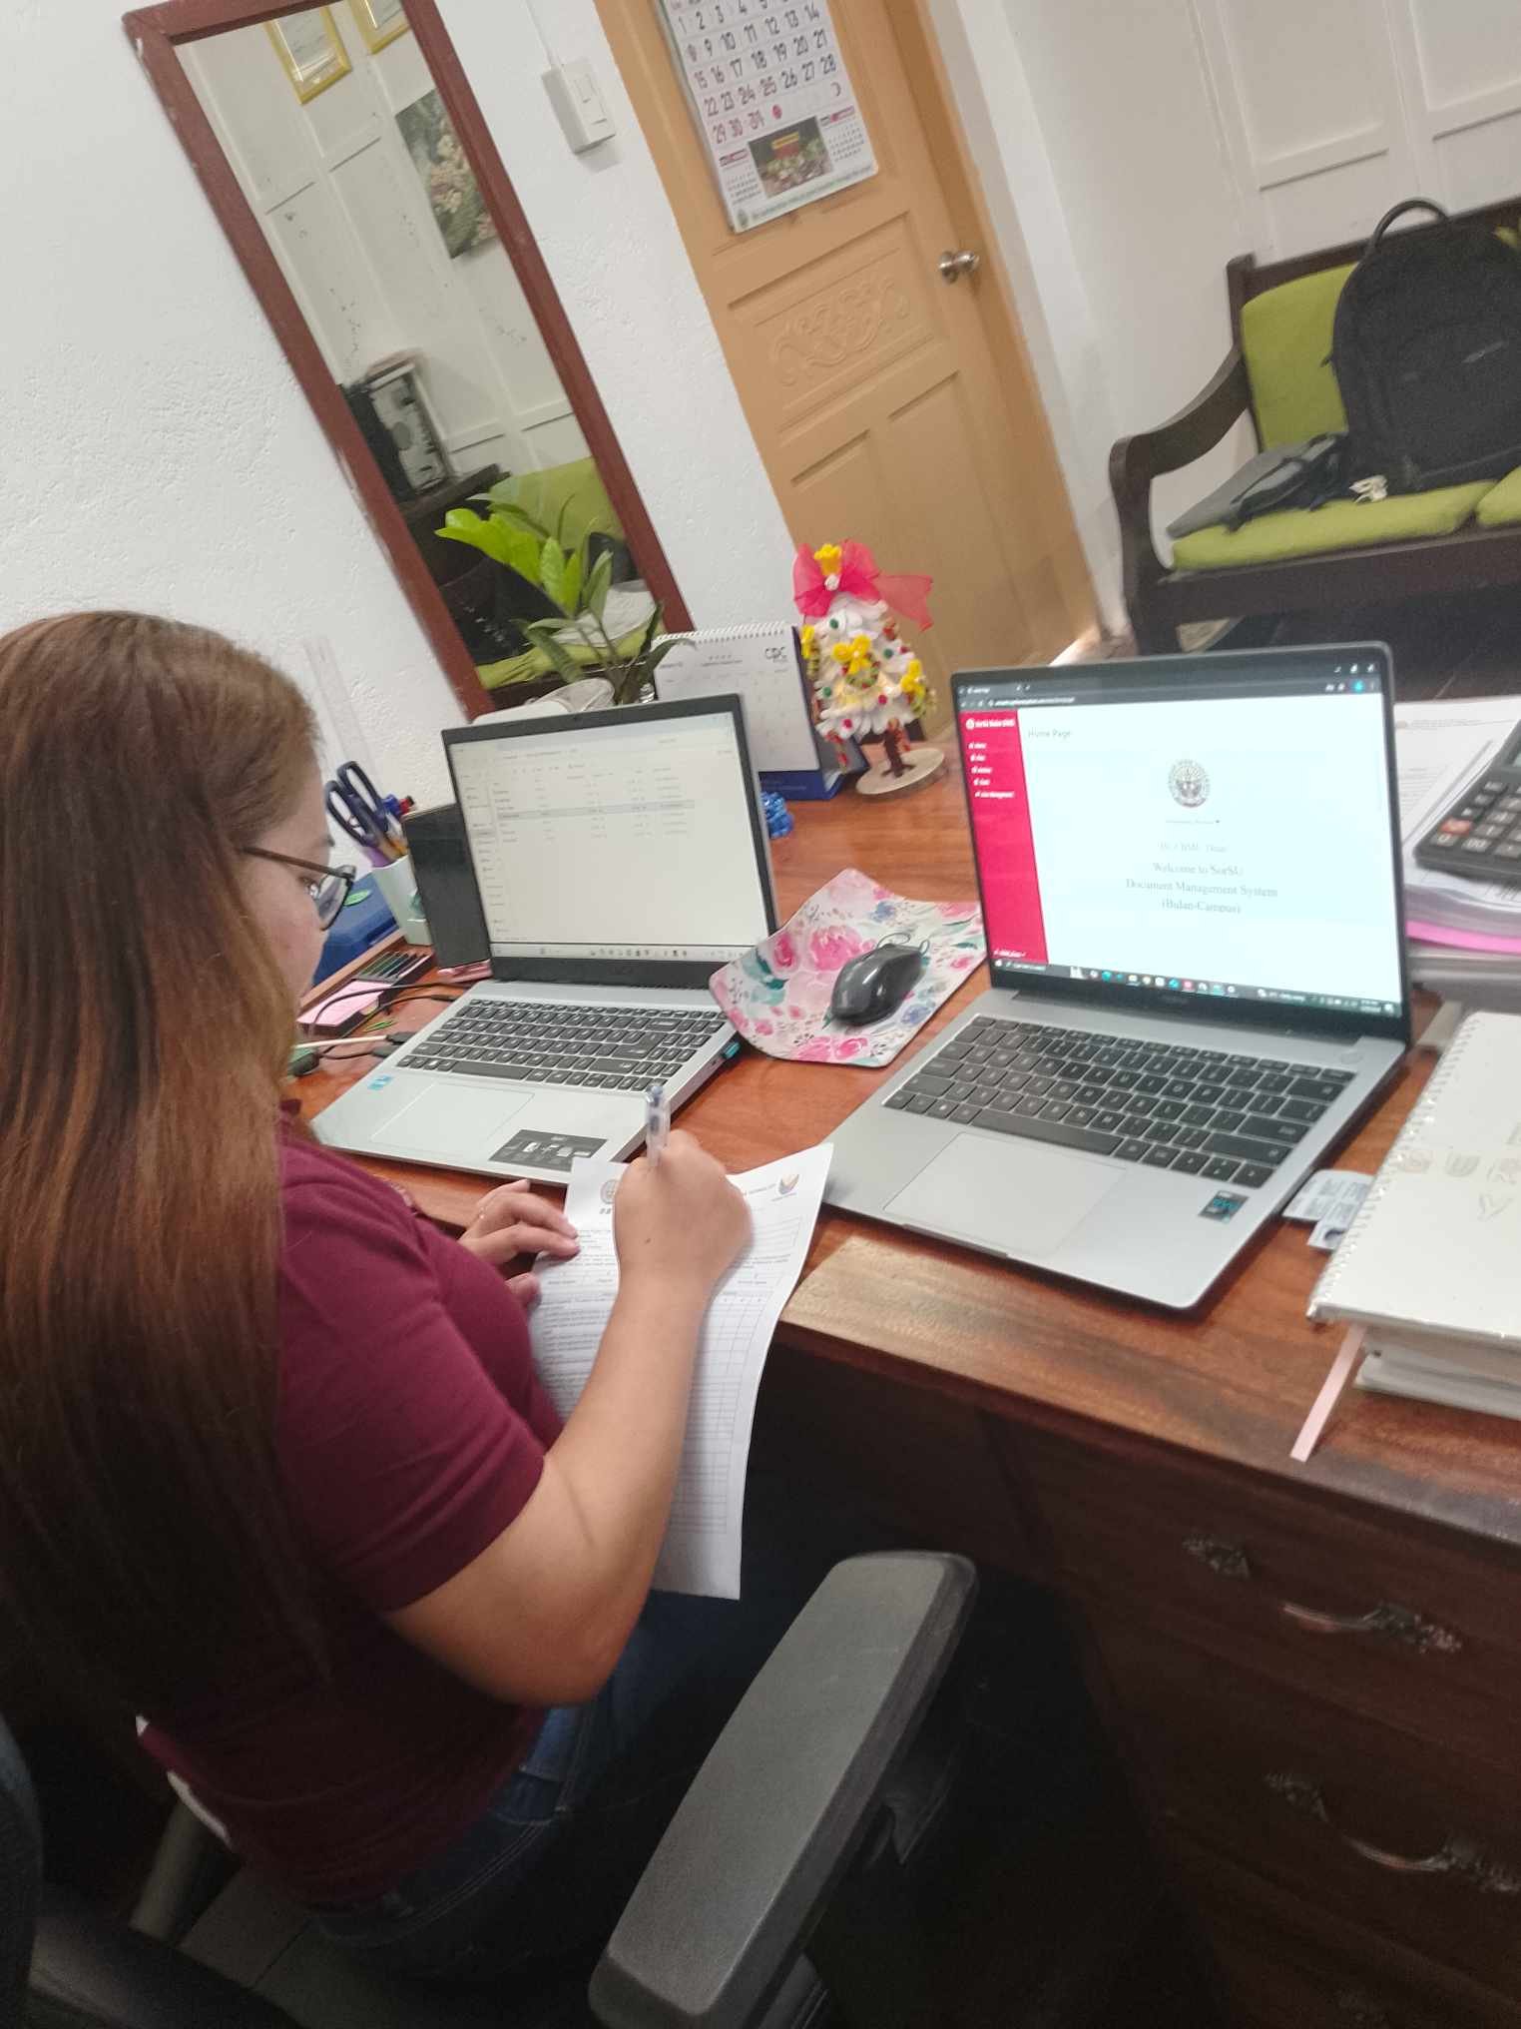
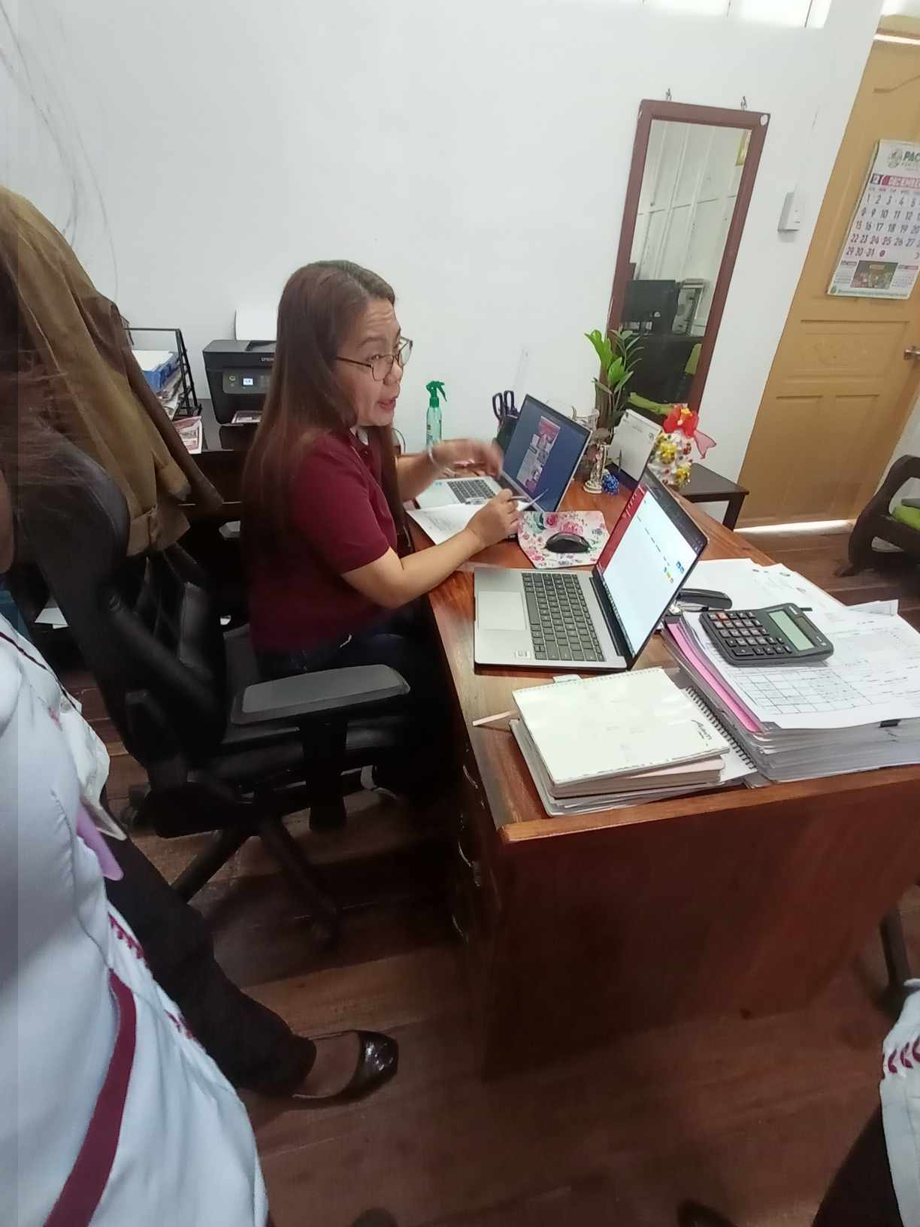
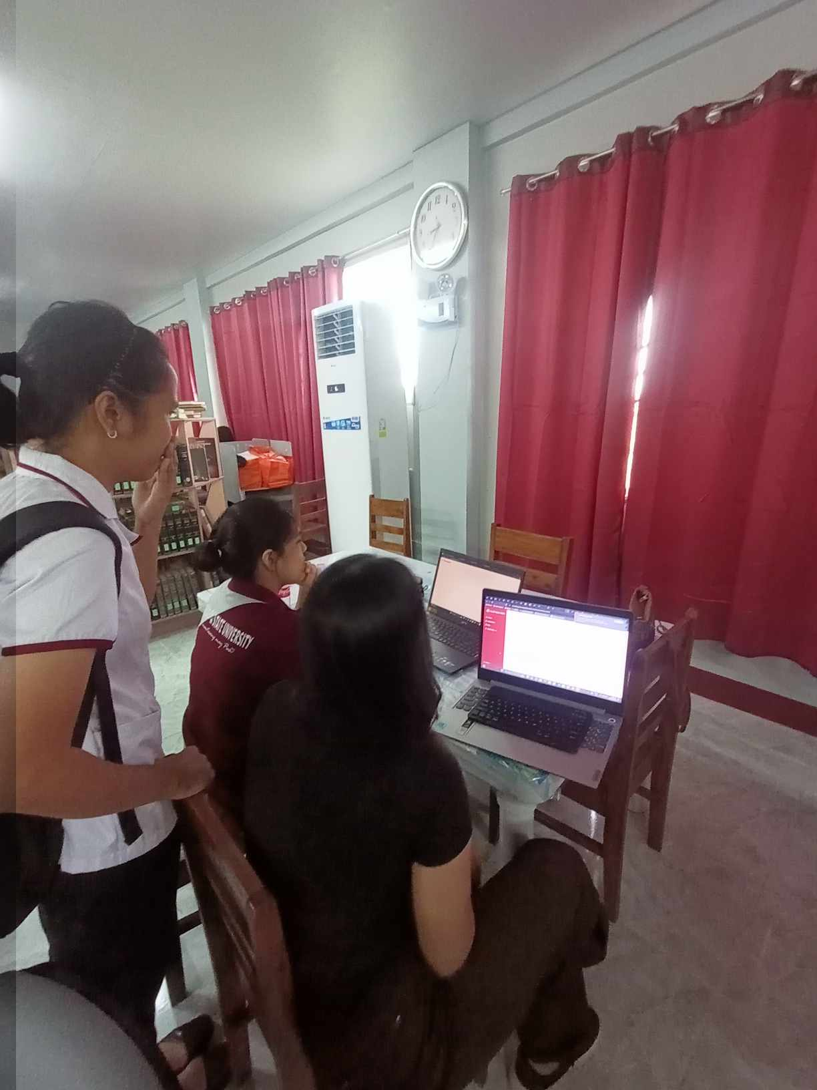
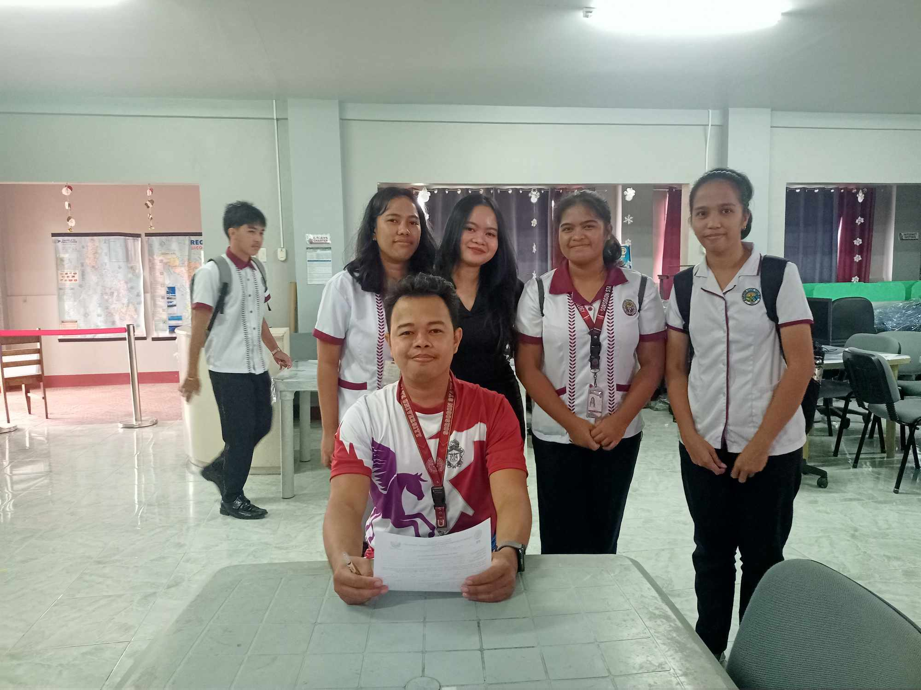
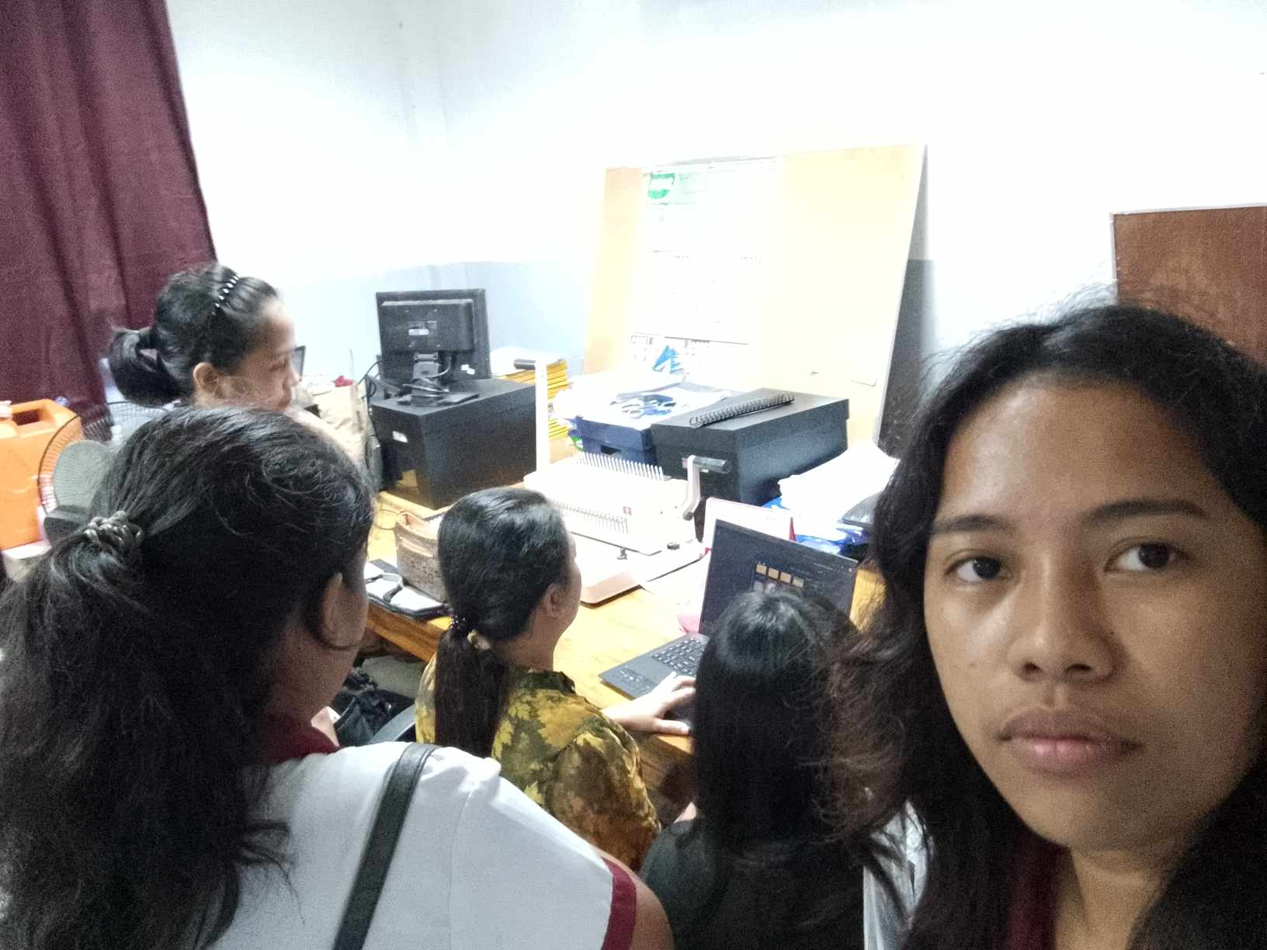
Client Testing Initiatives

Slide 7
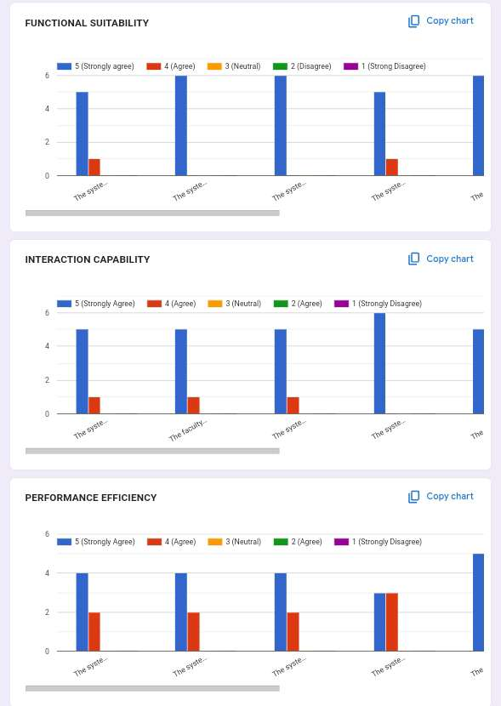
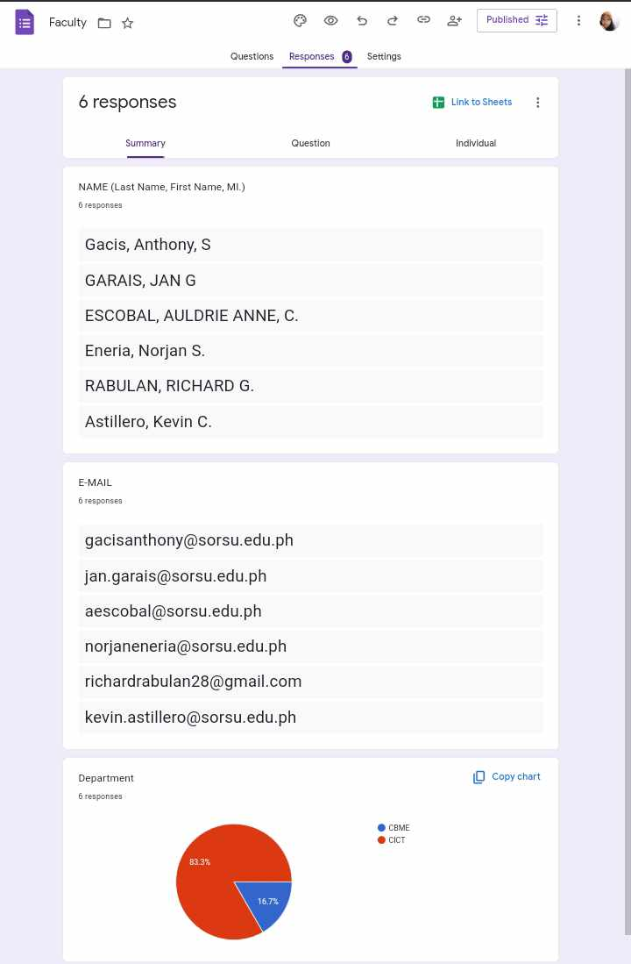
Client Testing Initiatives

Slide 8
Data Collection Methods and Tools Used
Feedback Survey
Google Form

Slide 9
Data Analysis and Interpretation

Slide 10
Conclusion
Based on the findings and implementations of this study, the following are formulated.
1. Modules for collecting, checking, and storing documents were successfully implemented on the system. The modules were the following: submission, user account management, user account archive, document monitoring, document trash bin, notification, and document checking. However, there were some missing features in other modules and limitations, they were as follows:
• The system does not notify the program chairman and faculty members about the remaining documents that each faculty member needs to submit.
• The system does not organize the documents of each user into designated folders.
• The submission of documents is limited to one category per submission and one document at a time.

Slide 11
2. The system was successfully tested and assessed following the ISO/IEC 25010 Software Product Quality standards. It achieved a weighted mean score of 3.82 for functional suitability, 3.81 for performance efficiency, and 4.21 for interaction capability. Overall, the system attained an average weighted mean of 3.96.

Slide 12
Recommendations
Based on the conclusions, the following recommendations are hereby offered:
The current capstone project process for collecting, checking, and storing documents of the Sorsogon State University-Bulan Campus may improve through the implementation of the missing features.
As there are limitations to the functionality of the features of the system, it is recommended to fill those gaps to be able to collect, check, and store documents properly.

