Slide 1
Sorsogon State University Bulan Campus Document Management System

Slide 2
Objectives
Design and develop a web-based document management platform that performs the following functions:
[1.1] User Authentication and Authorization
[1.2] Document Management Activity
[1.3] Account Management
[1.4] Assigning Documents
[1.5] Requesting Documents
[1.6] User Profile Management
[1.7] Image to PDF Converter
[1.8] Shared Documents Tracker
2. Test the developed system

Slide 3
3. Evaluate the deployed system using ISO/IEC 25010 Software product quality in terms of:
[3.1] Functional Suitability
[3.2] Performance Efficiency
[3.3] Compatibility
[3.4] Usability
[3.5] Reliability
[3.6] Security
[3.7] Maintainability; and
[3.8] Portability of the system

Slide 4
Scope and Limitation
quality assurance officer, faculty, and process owners of Sorsogon state university bulan campus a
[1.1] User Authentication and Authorization
[1.2] Document Management Activity
[1.3] Account Management
[1.4] Assigning Documents
[1.5] Requesting Documents
[1.6] User Profile Management
[1.7] Image to PDF Converter
[1.8] Shared Documents Tracker
2. Test the developed system

Slide 5
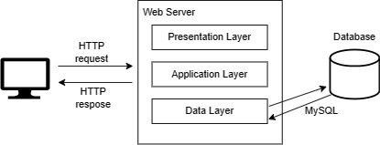
Methodology and Design
System architecture diagram

Slide 6
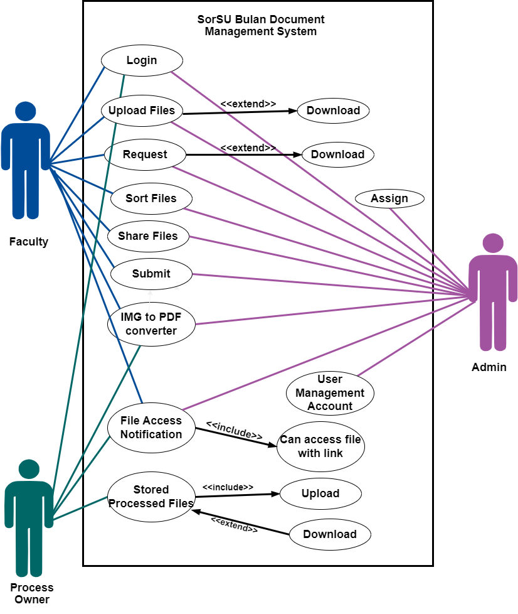
Methodology and Design
Use Case diagram

Slide 7
Analysis and Design
object
oriented
analysis and
design

Slide 8
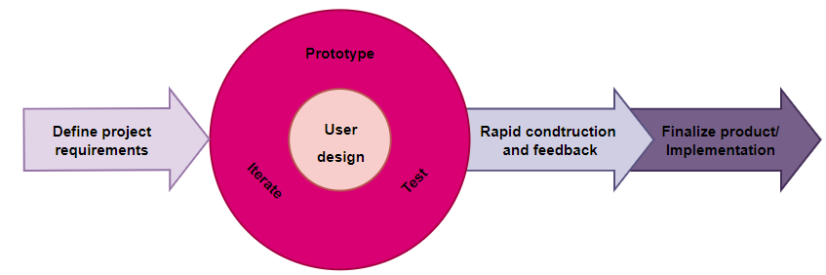
Development Model
rapid application development (rad) model

Slide 9
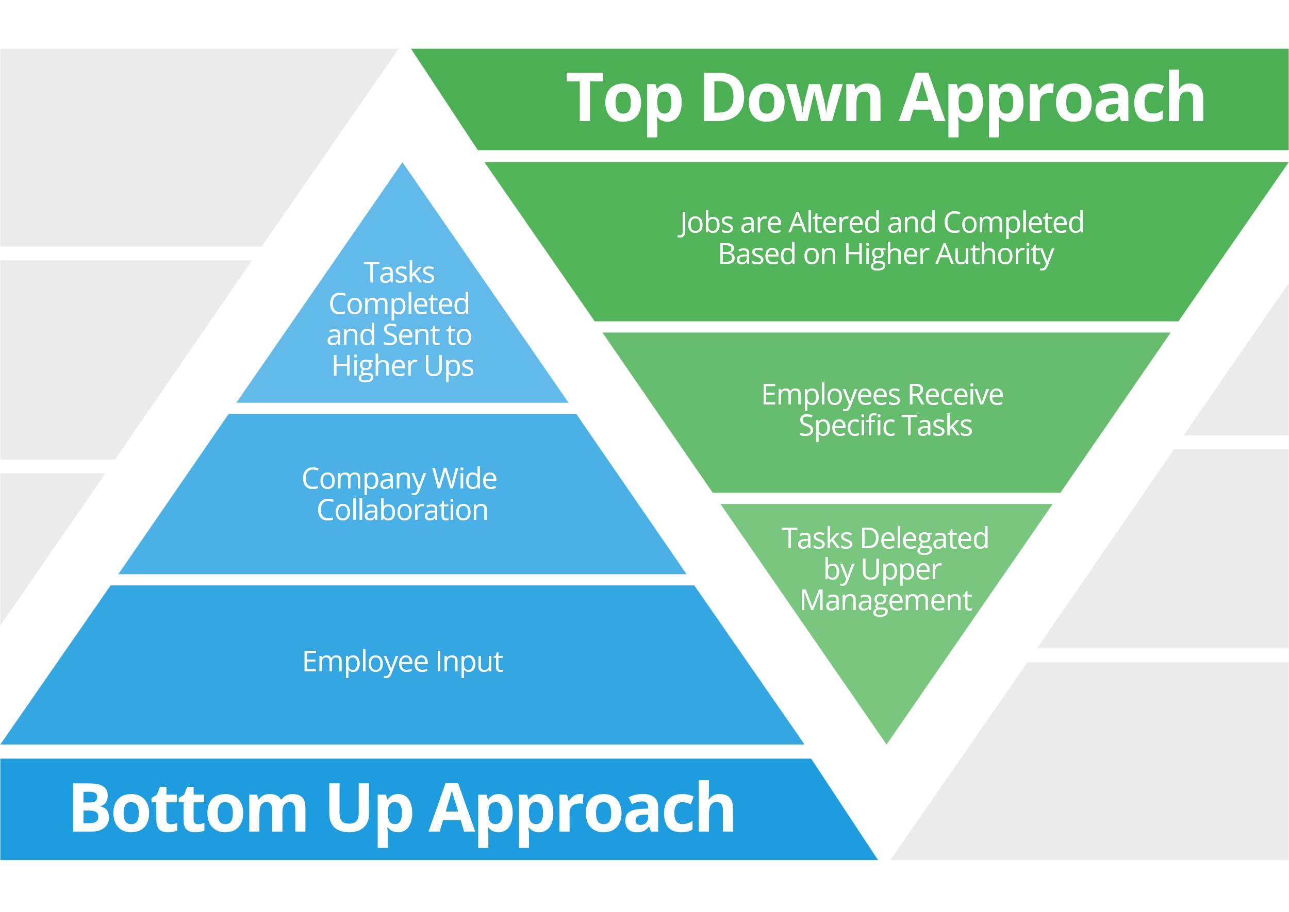
Development Approach
hybrid approach

Slide 10








Software Development Approach
Front-End Development
Back-End Development
Text Editor and IDE
Version Control System

Slide 11
Validation
Verification
verified and checked by the client:
Review of the design
Survey questionnaire
Likert scale
Testing
Black box testing

Slide 12
The System

Slide 13
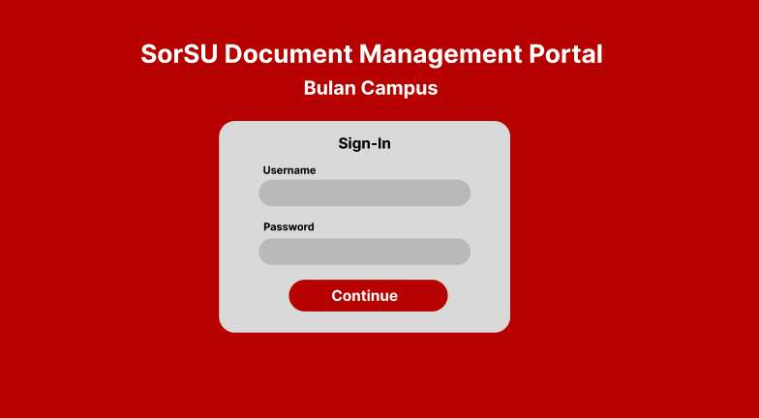
admin

Slide 14
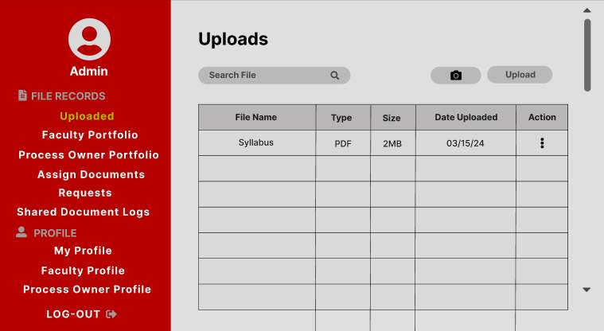
admin

Slide 15
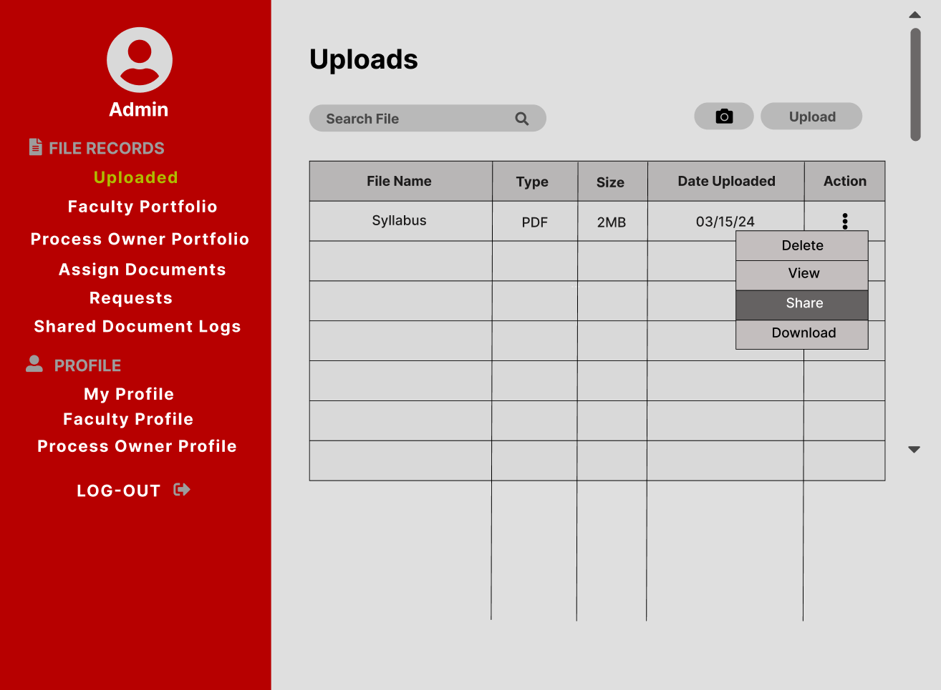
admin

Slide 16
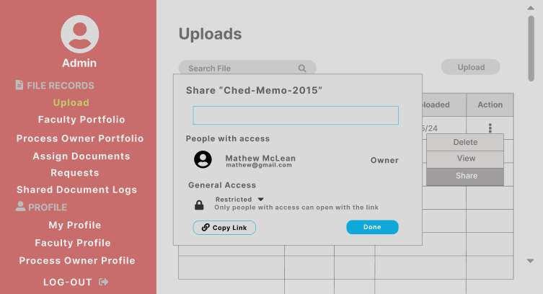
admin

Slide 17
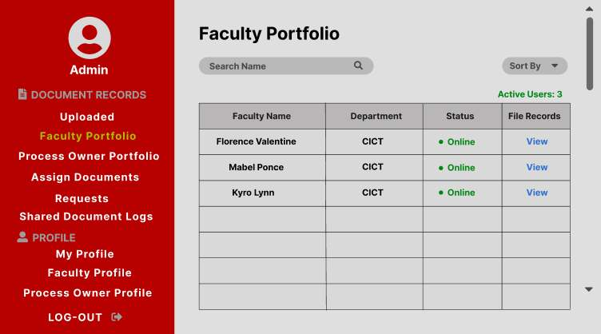
admin

Slide 18
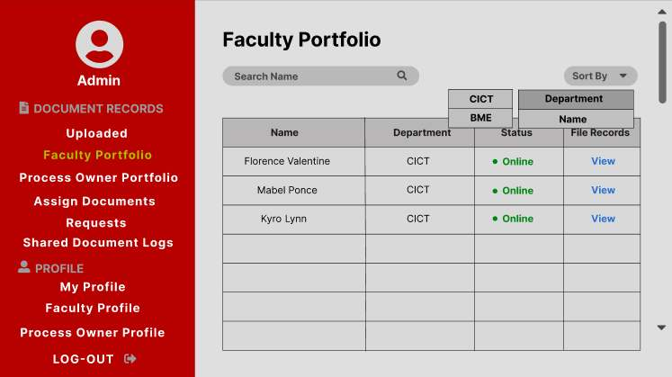
admin

Slide 19
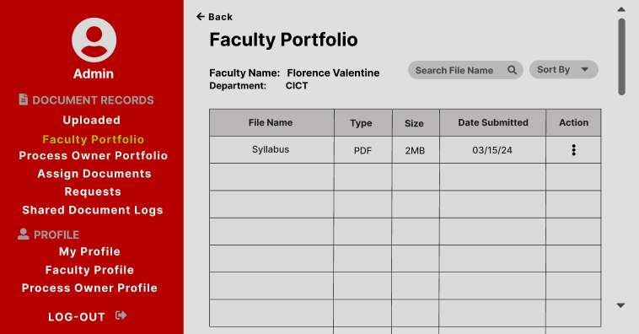
admin

Slide 20
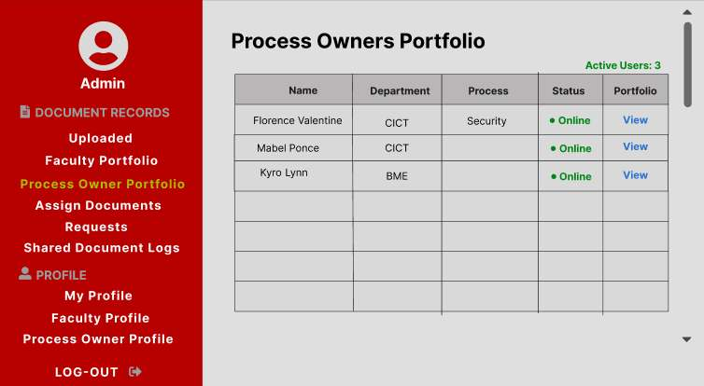
admin

Slide 21
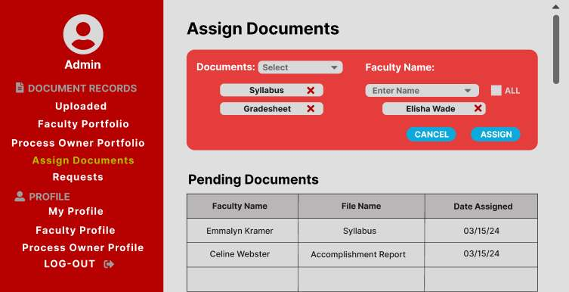
admin

Slide 22
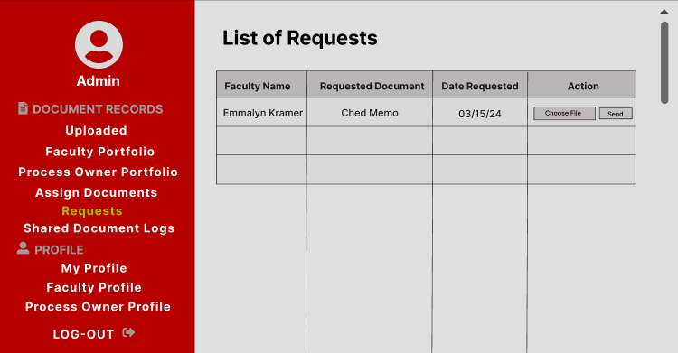
admin

Slide 23
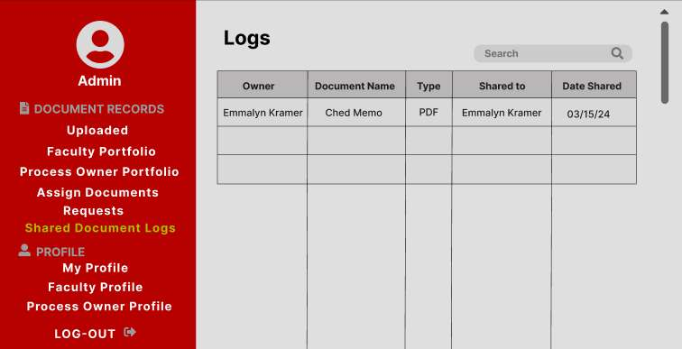
admin

Slide 24
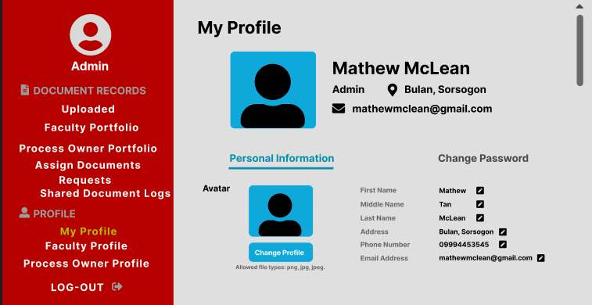
admin

Slide 25
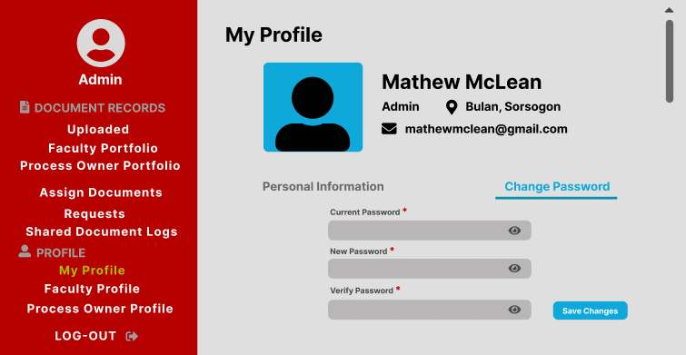
admin

Slide 26
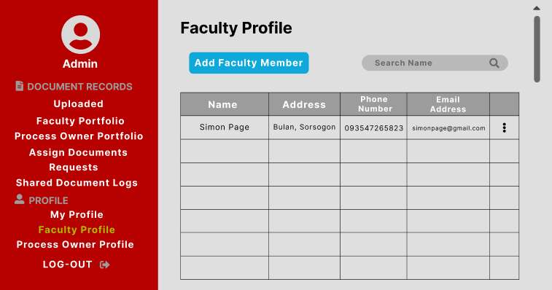
admin

Slide 27
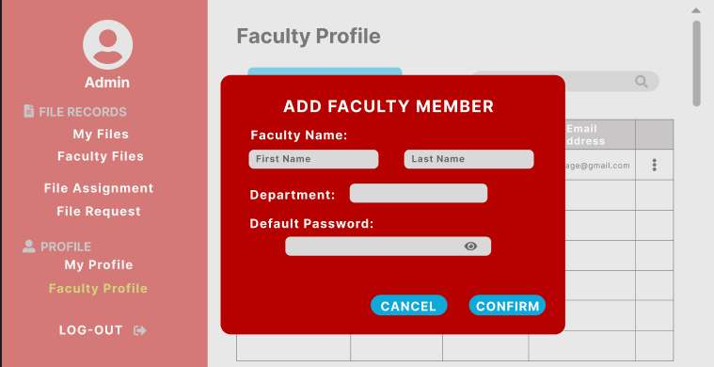
admin

Slide 28
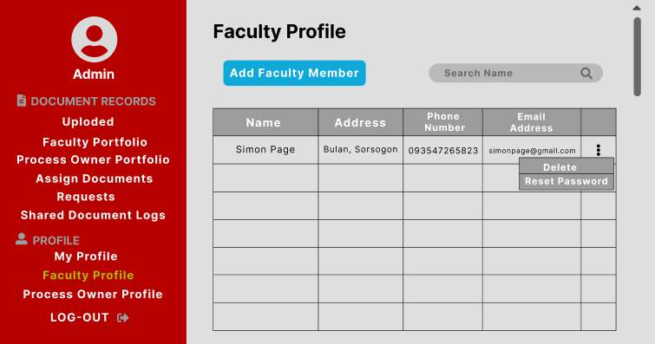
admin

Slide 29
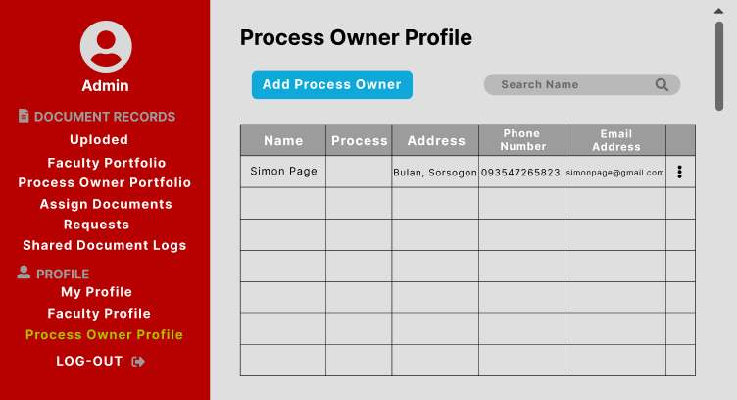
admin

Slide 30
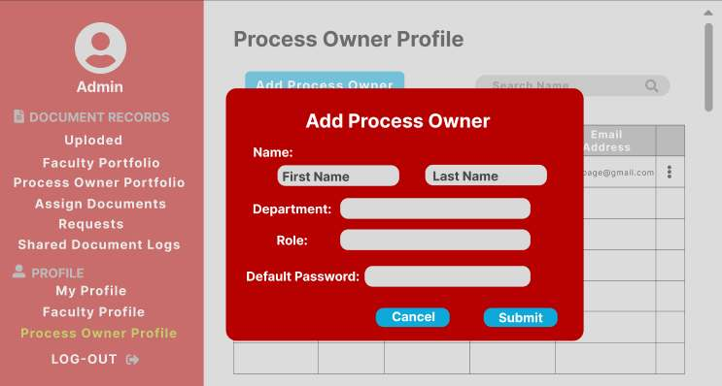
admin

Slide 31
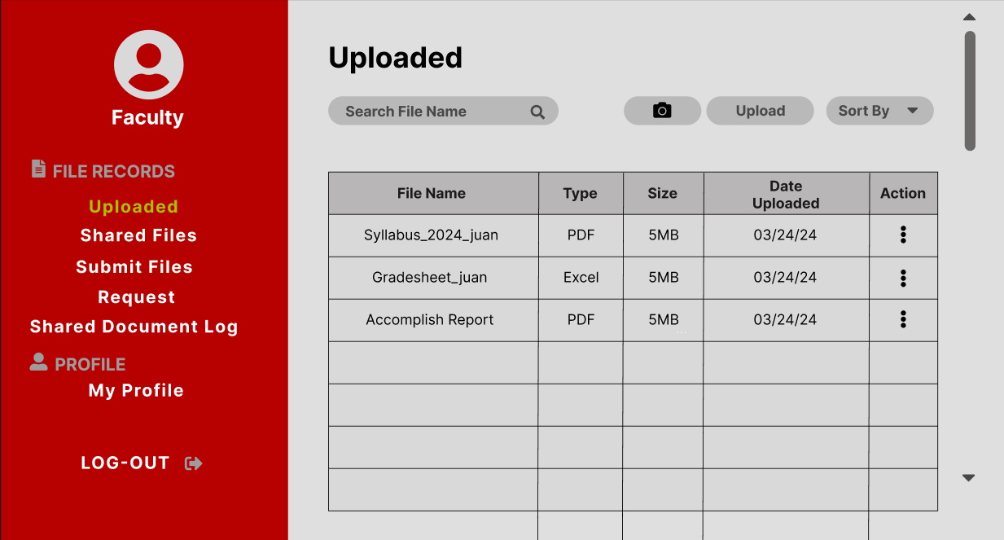
faculty

Slide 32
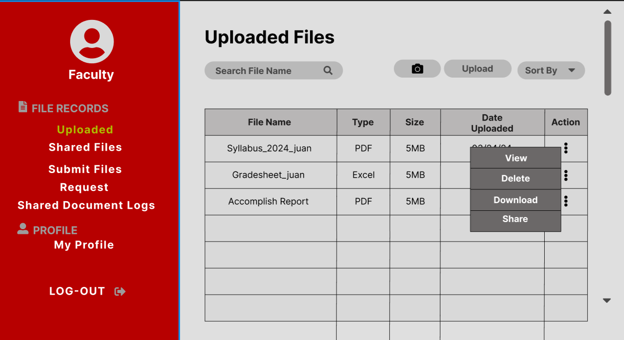
faculty

Slide 33
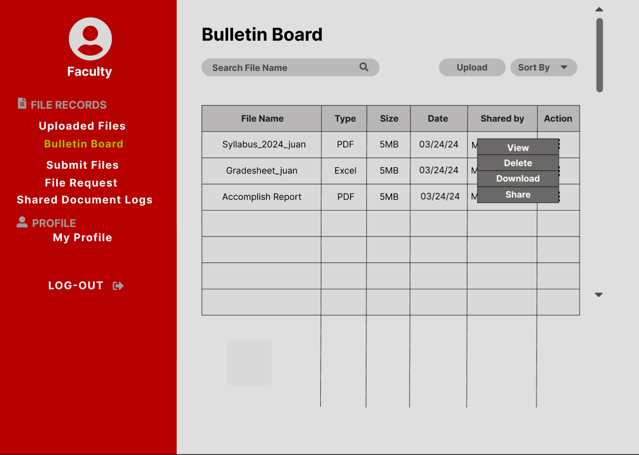
faculty

Slide 34
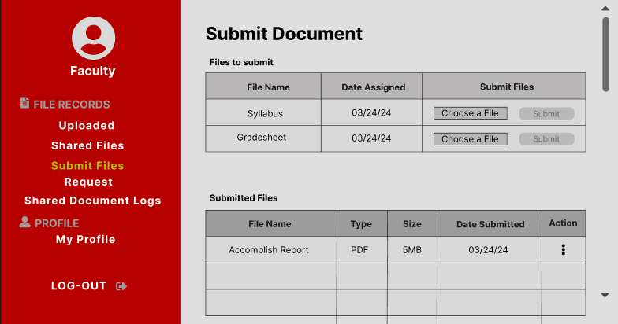
faculty

Slide 35
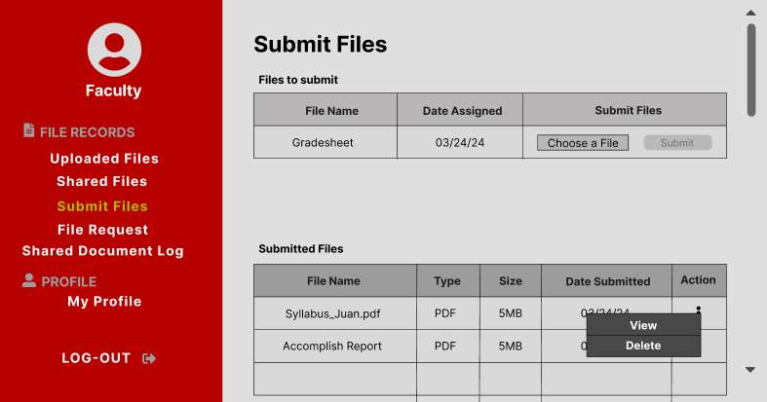
faculty

Slide 36
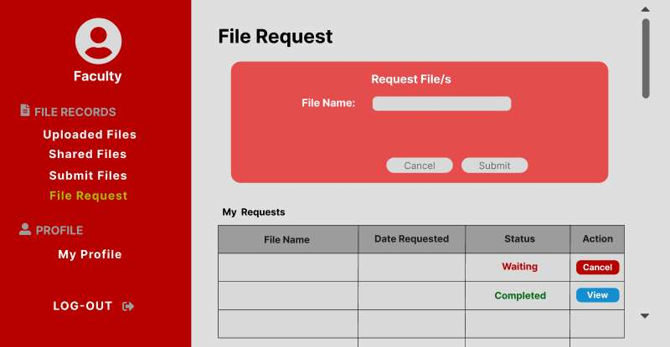
faculty

Slide 37
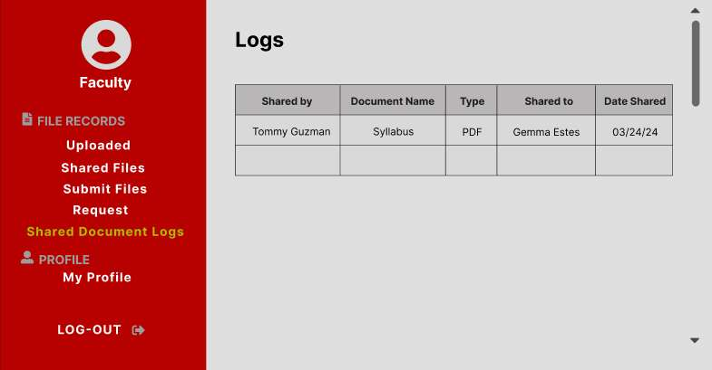
faculty

Slide 38
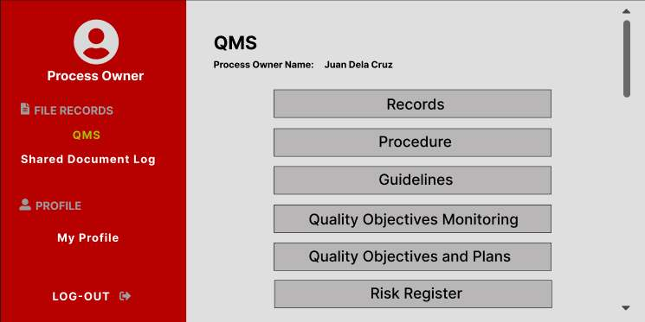
PROCESS OWNER

Slide 39
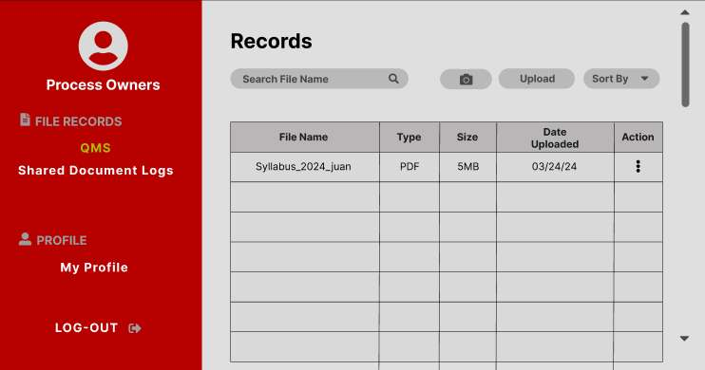
PROCESS OWNER

Slide 40
TEAM MEMBERS:
Leony Brizuela
Jeanahmae carezo
Sarah joy celso
Dazel catabuena

