Slide 1
FRAUD DETECTION WITH MACHINE LEARNING TECHNIQUES
Caner Dağdaş - 150716001 Ceyhun Vardar - 150317022 Büşra Gökmen - 150116027 Cem Güleç - 150117828
Ömer Faruk Çakı -150117821
CSE4062 - Group 8

Slide 2
Goal:
Our project will take the financial sector one step further by identifying fraud, which is the
bleeding wound of the financial sector, through machine learning by modeling in a way to detect fraud using the data set we have obtained.

Slide 3
Story of Dataset
Fraud detection research in the financial domain suffers from a serious problem which is the lack of public available data for the testing, evaluation and comparison of results using standard data sets
Our dataset is generated dataset to provide source about this topic.
Original logs are provided from multinational company which operates over 10 countries.

Slide 4
Topics
Data description
Data Analysis
K-Mean Clustering
Classification Methods
Conclusion

Slide 5
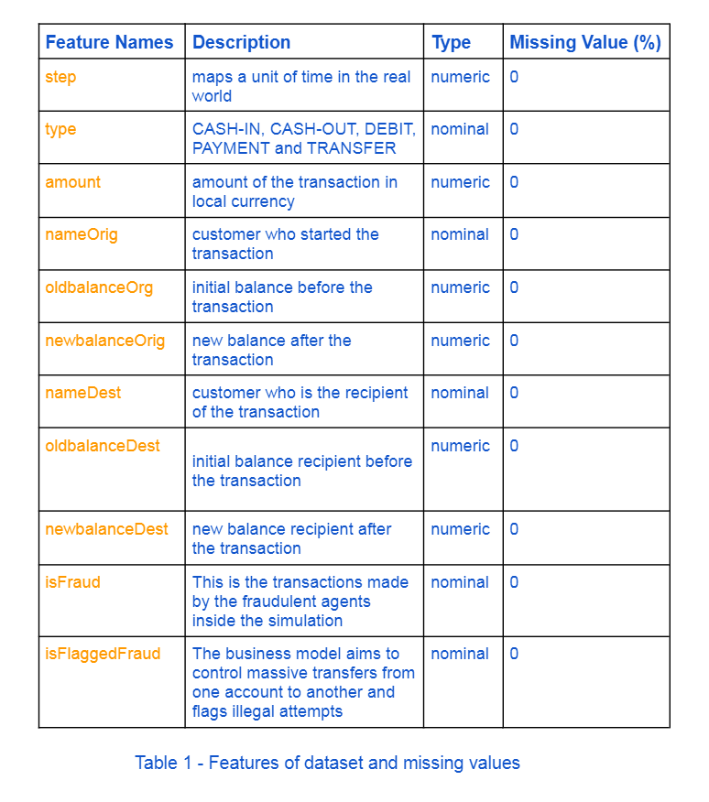
Data Description

Slide 6
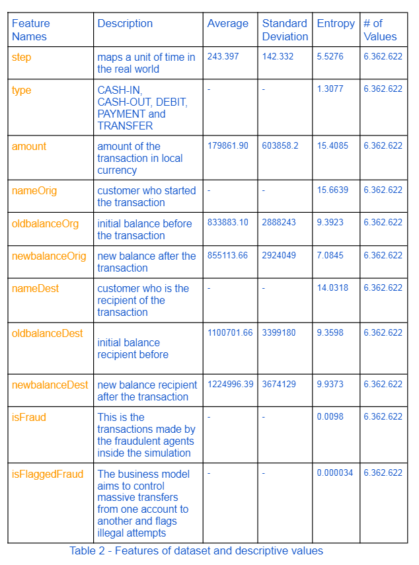
Data Analysis

Slide 7
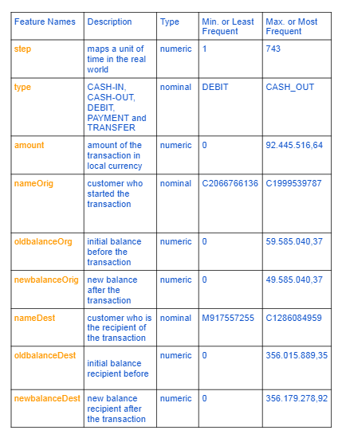
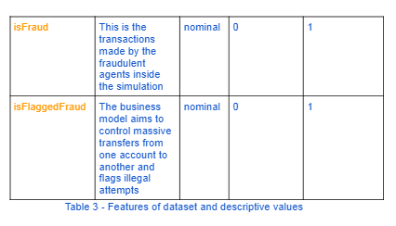
Data Analysis

Slide 8
Data Analysis
We find that of the five types of transactions. Fraudness occured only in 2 types named as TRANSFER and CASH_OUT. That’s why we reduced our instances to 2.7 million.

Slide 9
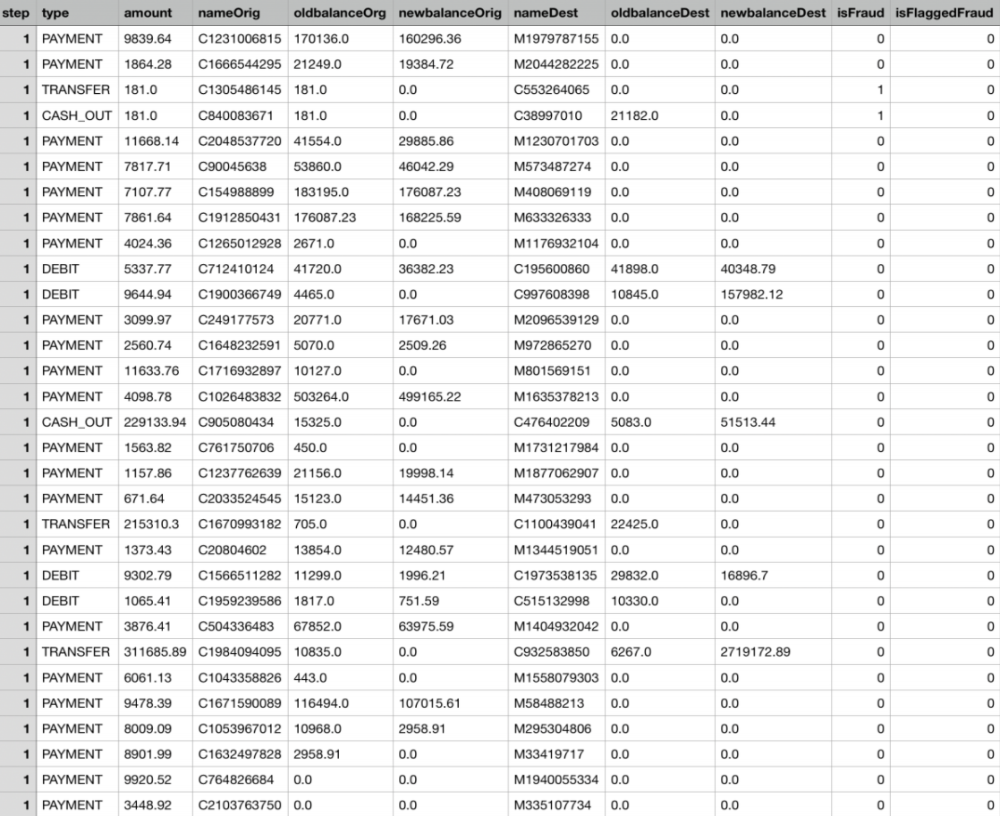
Dataset Sample

Slide 10
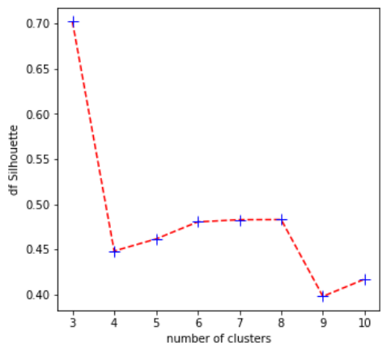
Descriptive Analysis-K-means Clustering
Silhouette: A measure of how similar an object is to its own cluster compared to other clusters. Different number of clusters are experimented. To find best possible silhouette score.
In our trials, we obtained the highest silhouette score (0.70) at k=3. In other words, the experiment in which the data is most consistently distributed to the clusters is the experiment where the k value is 3. The lowest score is the experiment with 0.39 and k=9.

Slide 11
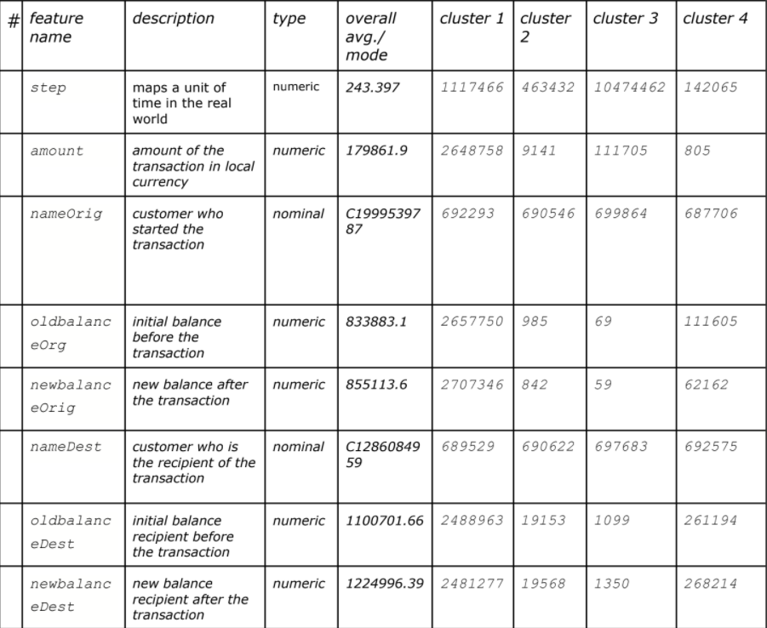
Descriptive Analysis-K-means Clustering

Slide 12
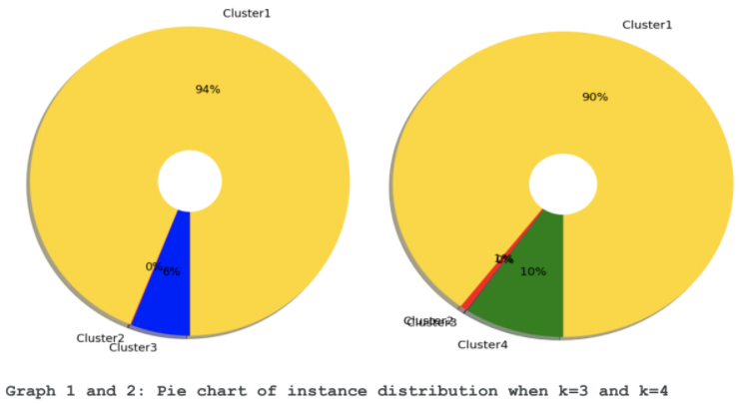
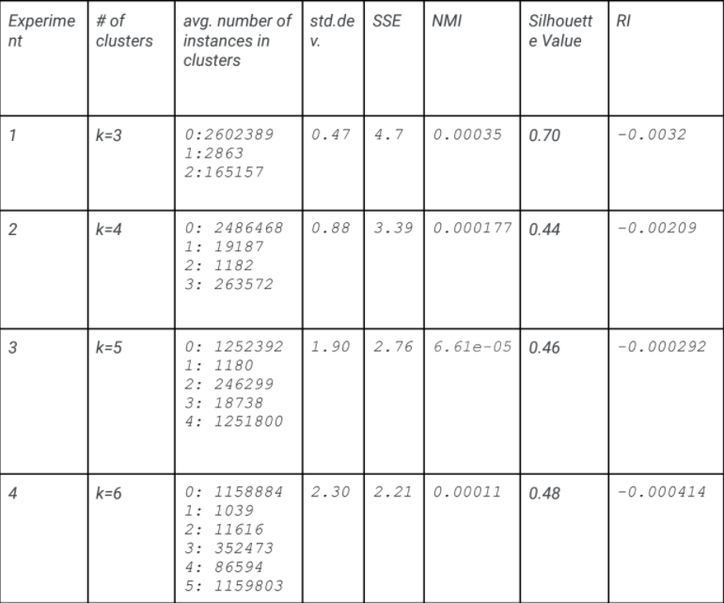
Descriptive Analysis-K-means Clustering

Slide 13
Predictive Analysis-Classification
At this stage, we need to guess whether the money transfer made on a certain date is an example of fraud or not.

Slide 14
Predictive Analysis-Classification
Steps of Classification
Train
Test
Evaluate

Slide 15
Predictive Analysis-Classification
ML algorithms that We have Used
KNN
KNN works on a principle assuming every data point falling in near to each other is falling in the same class. In other words it classifies a new data point based on similarity.
Naive Bayes Classifier
Bayes Optimal Classifier is a probabilistic model that finds the most probable prediction using the training data and space of hypotheses to make a prediction for a new data instance.
Decision Tree Classifier
Grow the tree: splitting the space by setting rules
Prune the tree: removing the unnecessary splits
Assign the class: using the class with majority votes as the prediction
MLP
MLPClassifier stands for Multi-layer Perceptron classifier which in the name itself connects to a Neural Network. MLPClassifier relies on an underlying Neural Network to perform the task of classification.

Slide 16
Predictive Analysis-Classification
Cross Validation
We used 3 techniques for cross validation:
Train-Test Split (changing parameter test_size)
Test size: 10% of data
K-Fold (changing parameter k)
We used 10 fold for cross validation
Shuffle (shuffle dataset for every fold)

Slide 17
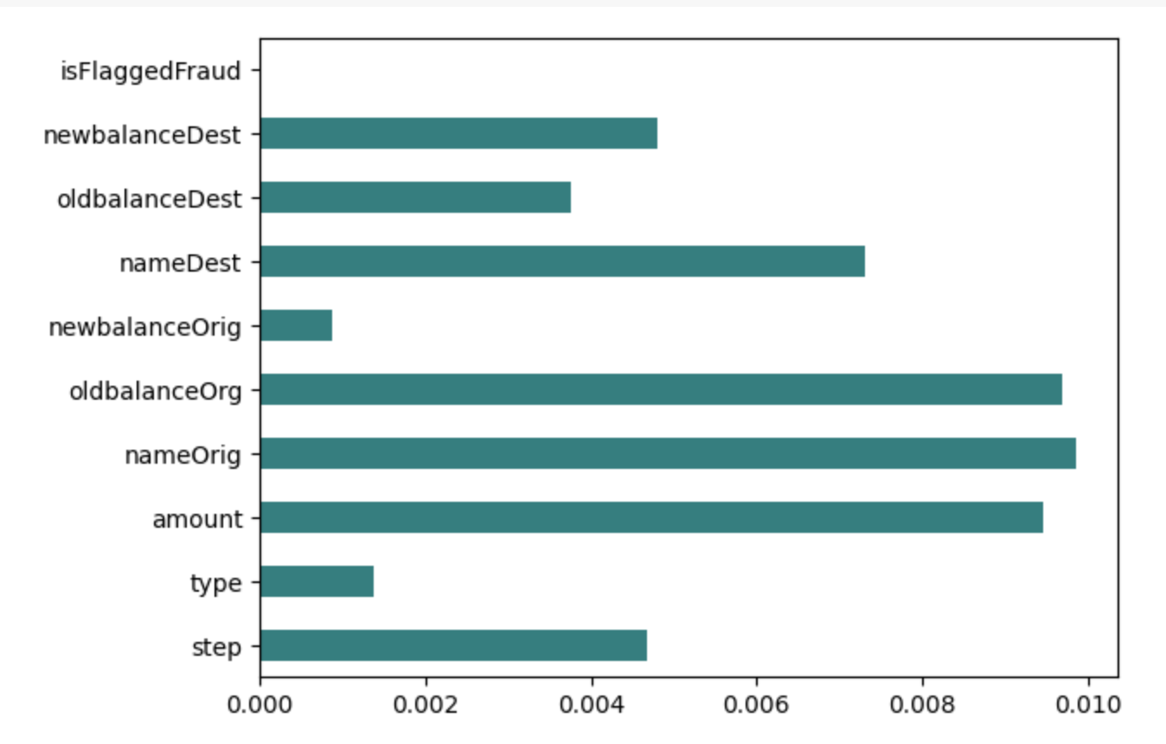
Predictive Analysis-Classification
Feature Selection with Information Gain
Most important feature is nameOrig and less important feature is newbalanceOrig by this method. So we removed newbalanceOrig from our dataset.

Slide 18
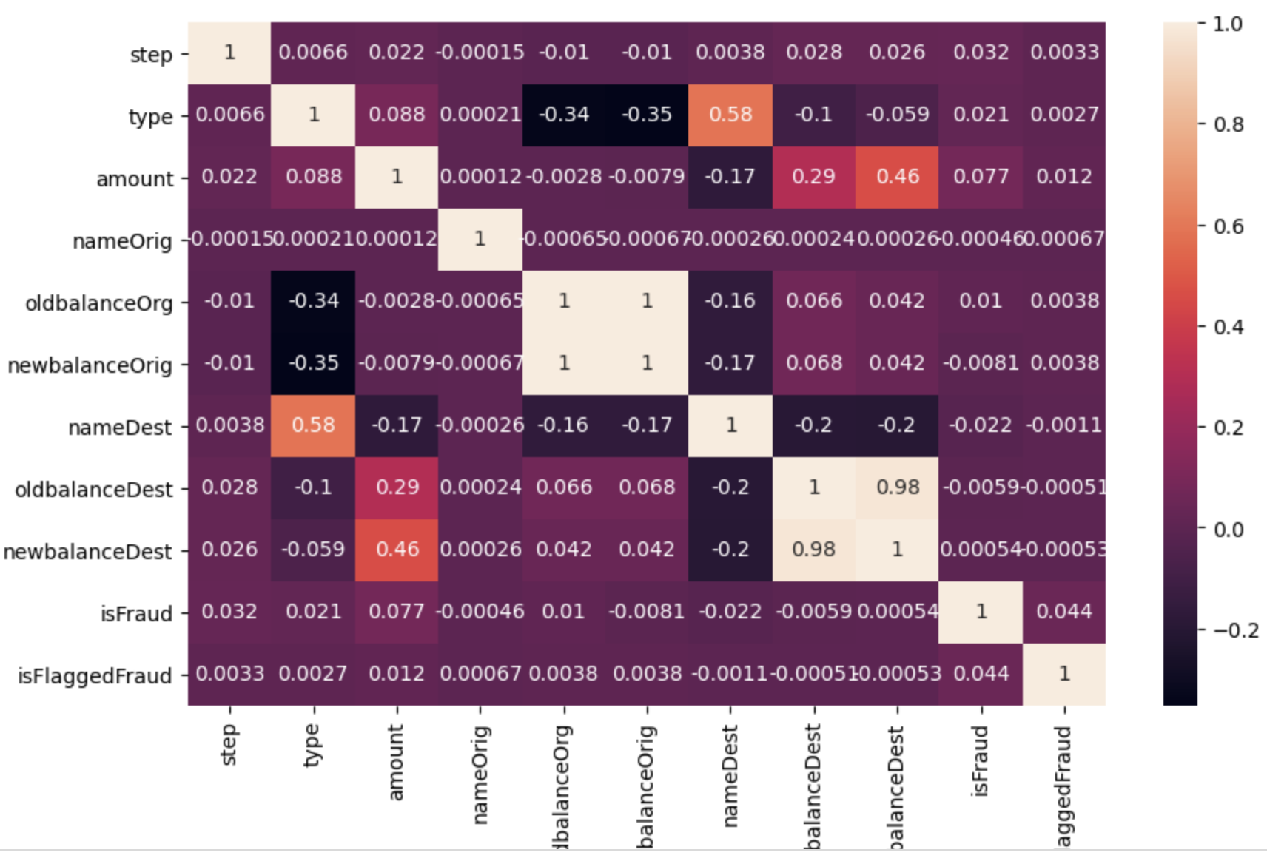
Predictive Analysis-Classification
Feature Selection with Correlation Coefficient
The logic behind using correlation for feature selection is that the good variables are highly correlated with the target. Furthermore, variables should be correlated with the target but should be uncorrelated among themselves.
Less important features are oldbalanceDest, newbalanceOrig and nameDest. So we removed these features from our dataset.

Slide 19
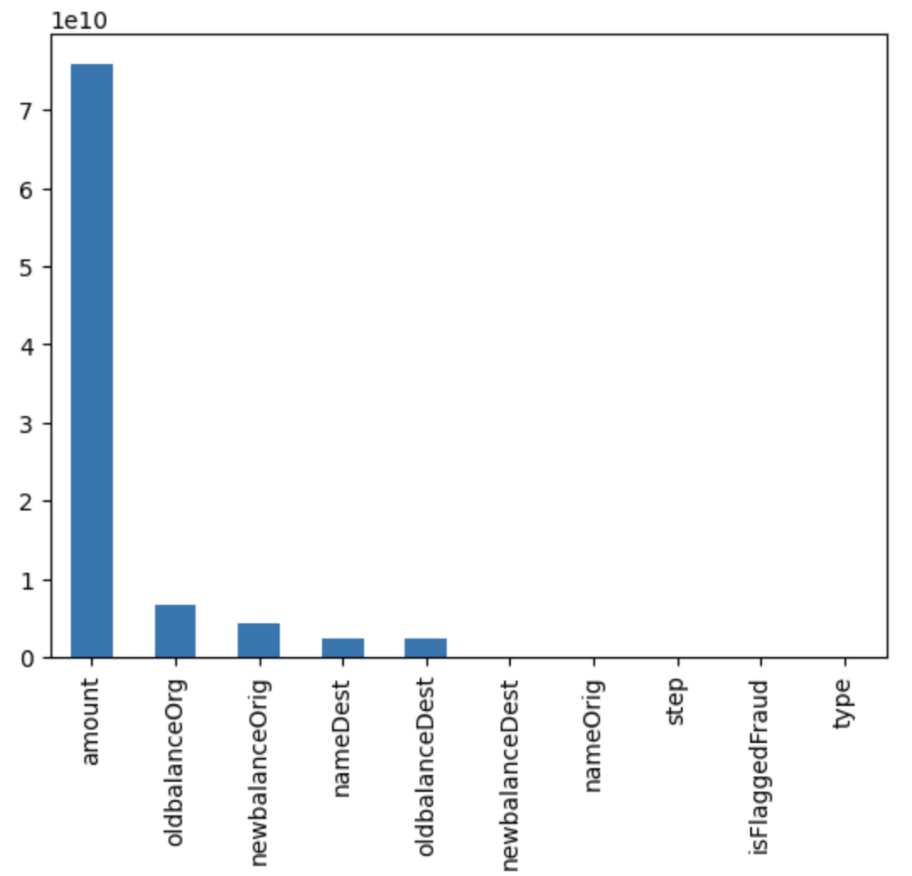
Predictive Analysis-Classification
Feature Selection with Chi Square Test Feature
Most important feature is amount and less important feature are type, step, nameorig, is FlaggedFraud and newbalanceDest by this method. So we removed these feature from our dataset.

Slide 20
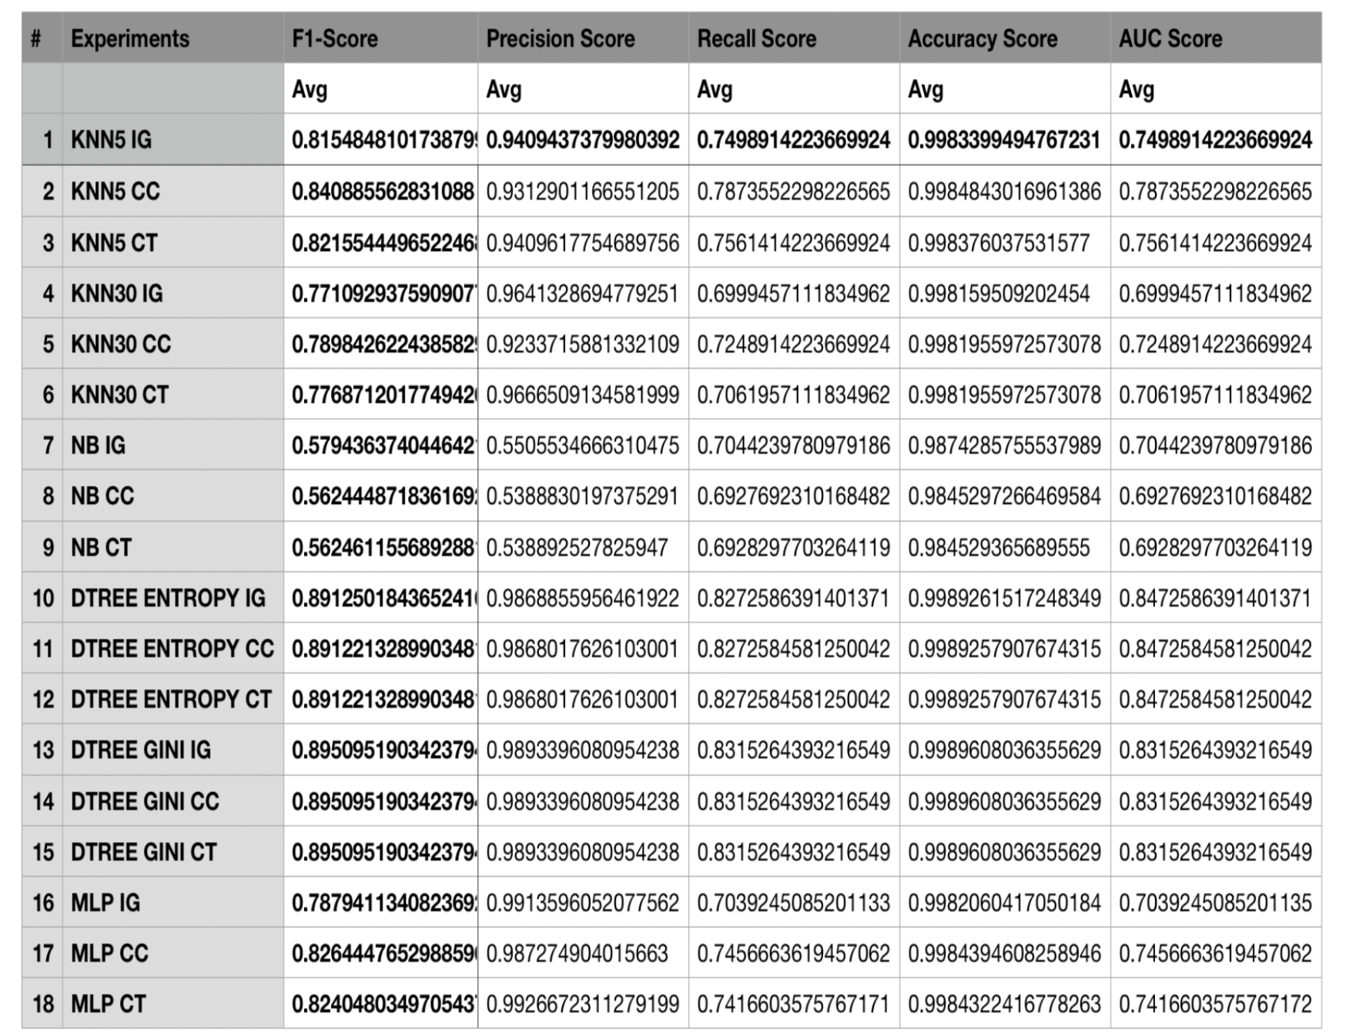
Predictive Analysis-Classification
Results Of Experiments
We have 18 different model experiments in this project. We evaluate our models by F1-Score, Precision, Recall, Accuracy and AUC score.

Slide 21
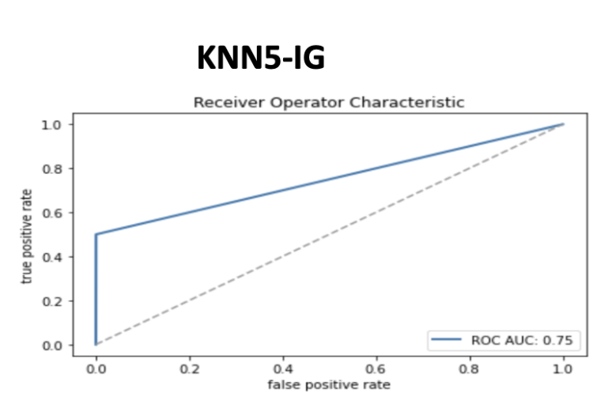
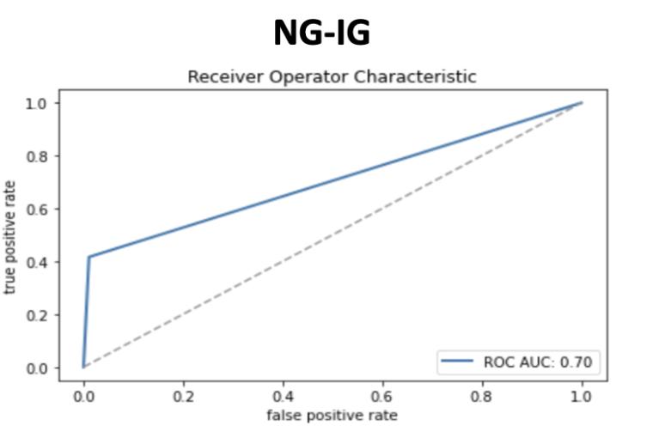
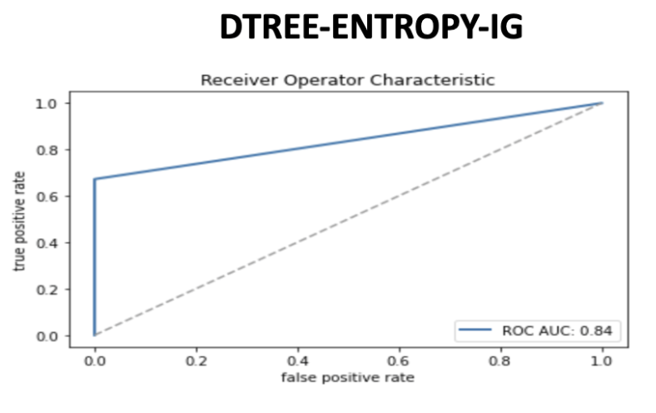
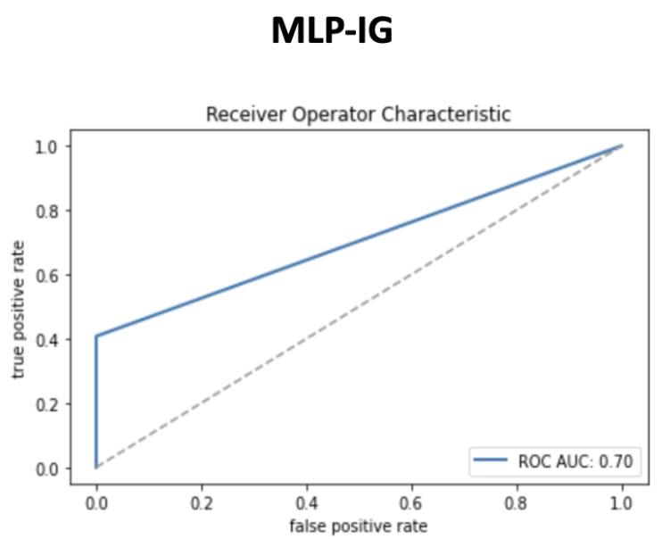
Predictive Analysis-Classification
ROC Curves

Slide 22
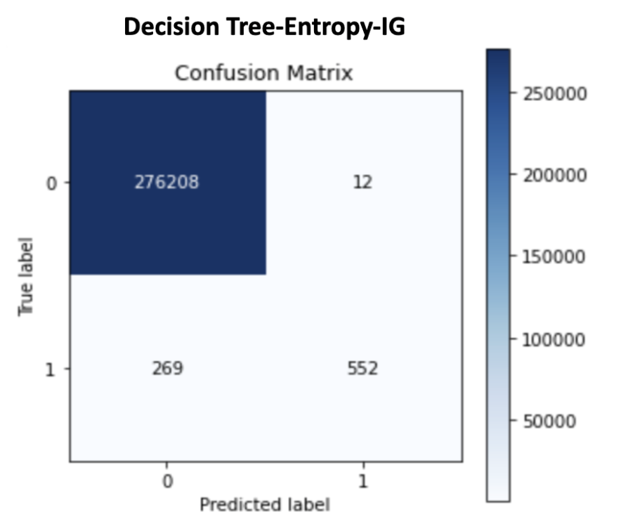
Predictive Analysis-Classification
Best Model
Our aim is to maximize these scores. The model has the maximum scores calculated above can be considered as the best model.
After experiments, best model is chosen, according to 6 different metrics, as decision tree entropy with information gain.
Confusion matrix of the best fold performance of the our best performing model:

Slide 23
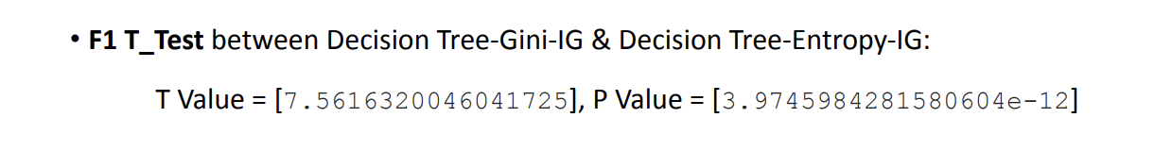
Predictive Analysis-Classification
T-Test Between Two Best Model
For t-test, we chose our top two experiments according to F1-Score and ROC-AUC metric :
1. Decision Tree-Entropy-IG
● F1-Score: 0.89
● ROC-AUC metric: 0.84
2. Decision Tree-Gini-IG
● F1-Score: 0.89
● ROC-AUC metric: 0.83
We compared them by using 5 different metrics(Accuracy, P, R, F1, AUC) according to T-Test. According to all score metric types there’s a significant difference between models. So we can concluded that, Decision Tree-Entropy-IG is our best experiment.
For Example:

Slide 24
Conclusion
According to the elbow plot, the optimum k value is 4 according to the k-means clustering model.
According to all score matric types there’s a significance difference between models. we can concluded that Decision Tree-Entropy-IG is our best experiment.
Our decision tree classifier model performed better than our deep learning model.
In general, the Correlation coefficient and Chi-square test feature selection methods resulted in higher accuracy than the Information gain method in classifier models.

Slide 25
Thank you for listening!

