Slide 1

Enabling cell atlas guided optimal experimental design
Group Day, Cem Güleç
December 8, 2022

Slide 2
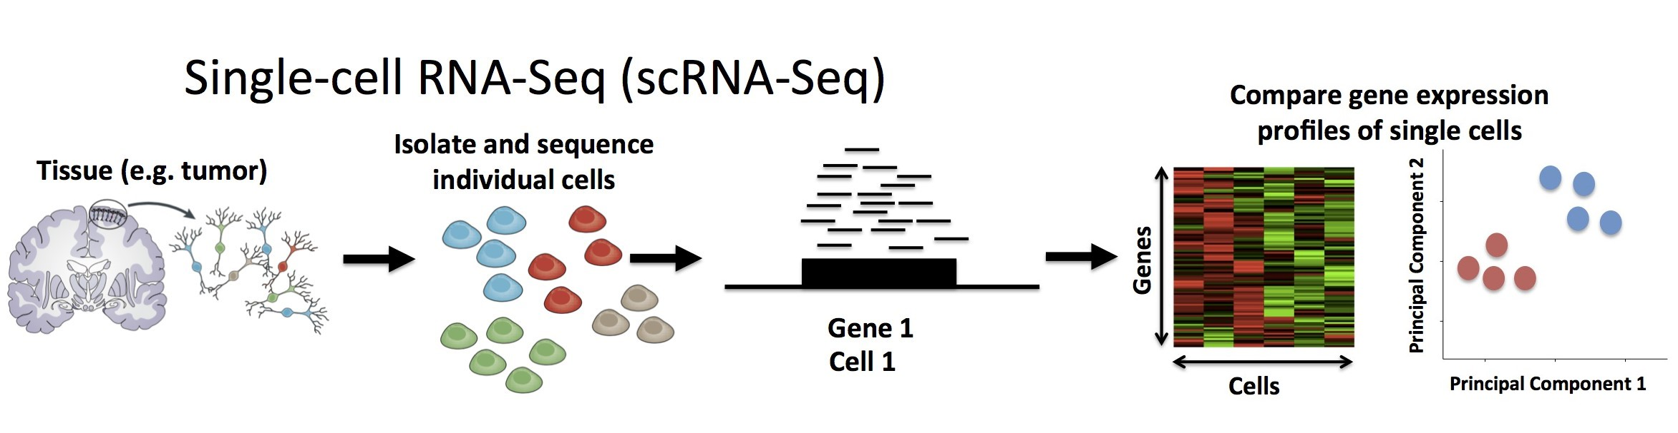




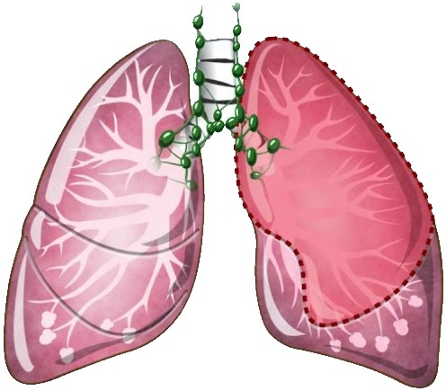


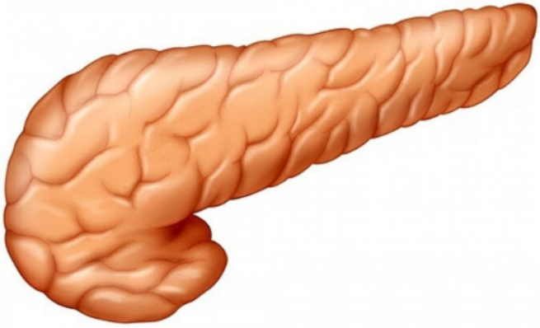


Problem Definition
Priors:
cell x gene … …
25 different cell types
550+ Cell Types
500+ Datasets
33M+ Cells

Slide 3
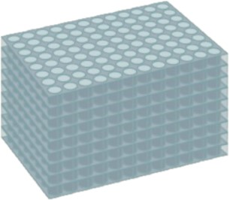
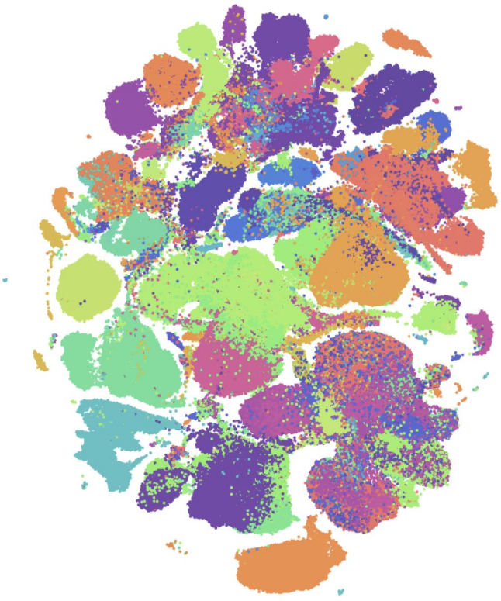

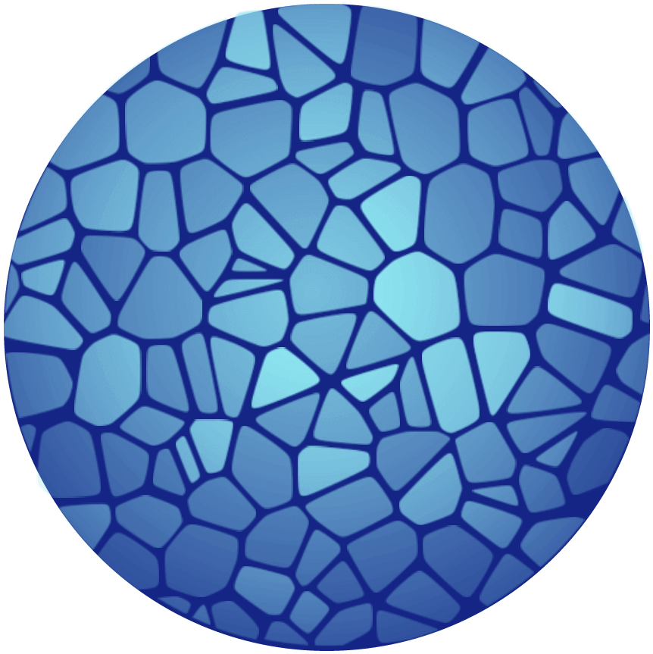

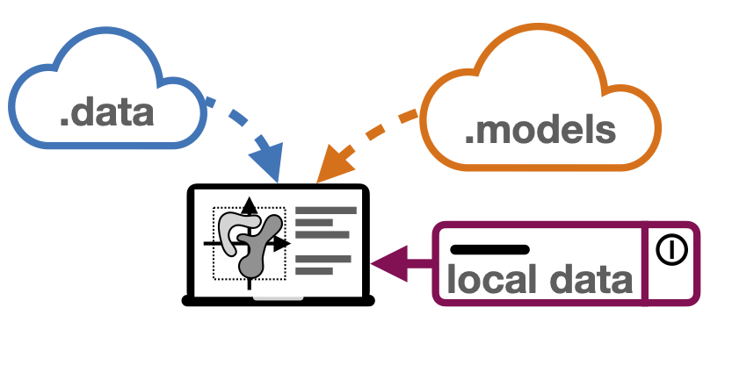

Milestones
: Differential gene expression and eQTL
: Extending model for CRISPR screening
: Planned model extensions
(A) Arrayed CRISPR screen
(B) Cellxgene Portal Visualization
for single reference dataset
(D) sfaira: data and model repository for single-cell data
(E) Business Logic
(C) Human Cell Atlas

Slide 4

Impact
Enabling researchers to design most powerful experiments
Helping scientific community to concentrate their resources well
Increase quality of proposals and the feasibility of the projects
(E) Business Logic

Slide 5
My Data
Marker | Tissue(s) | Disease | Assay(s) | Organism | Number of Cells
1 | muscle tissue muscle of abdomen muscle of pelvic diaphragm | normal | 10x3’v3 | Homo sapiens | 14.507
2 | 17 | normal | 3 | Homo sapiens | 329.762
3 | Prostate gland Urethra | normal | 10x3’v2 10x3’v3 | Mus musculus | 1.647
A benchmark, first-draft human cell atlas of nearly 500,000 cells from 24 organs of 15 normal human subjects. This work is the product of the Tabula Sapiens Consortium.
By surveying the immune compartment of 16 tissues from 12 adult donors by single-cell RNA sequencing and VDJ sequencing generating a dataset of ~360,000 cells.
Used single-cell RNA sequencing to obtain a complete transcriptomic profile of all epithelial cells in the mouse prostate and urethra to objectively identify cellular subtypes.

