Slide 1

Enabling Cell Atlas Guided Optimal Experimental Design
Progress Report, Cem Güleç
January 23, 2023

Slide 2
Topics
1. Problem Definition
- Project Purpose
- Challenges
- Prior Work
2. Way Points To Be Developed - Cell type-specific prior distributions from atlas data
- Experimental design web resource
- Model extension for CRISPR screens and allele-specific expression
3. Milestones
4. Technology Flow and Stack
5. Data
6. Current State
7. Impacts, Targets, and Motivations

Slide 3
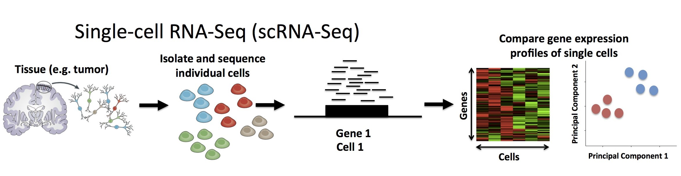




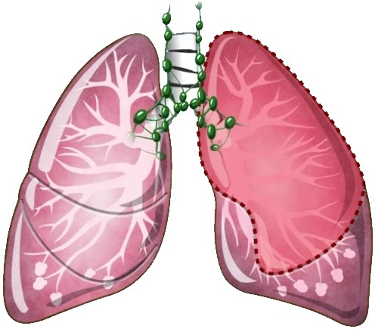


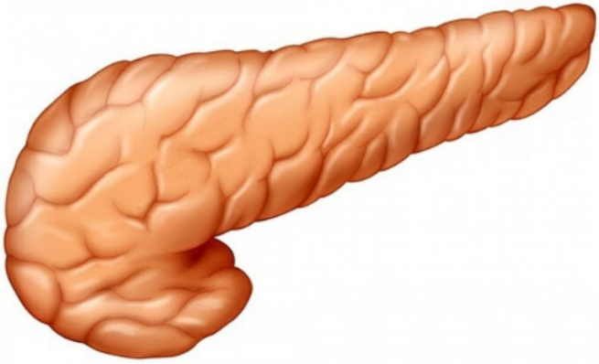


Problem Definition
Priors:
cell x gene … …
25 different cell types
550+ Cell Types
500+ Datasets
33M+ Cells

Slide 4
Milestones
Cell type specific prior distributions from atlas data
Experimental design web resource
Model extension for CRISPR screens and allele specific expression

Slide 5
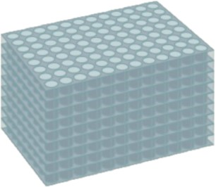
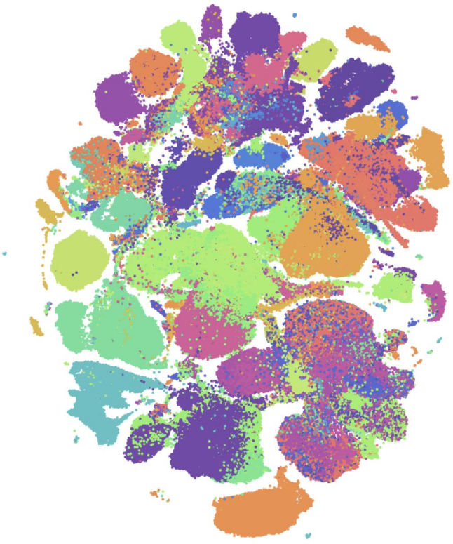


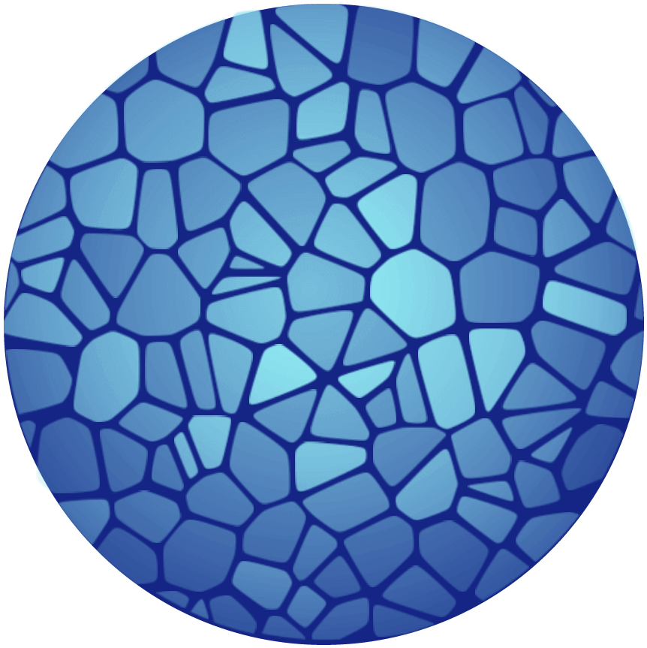
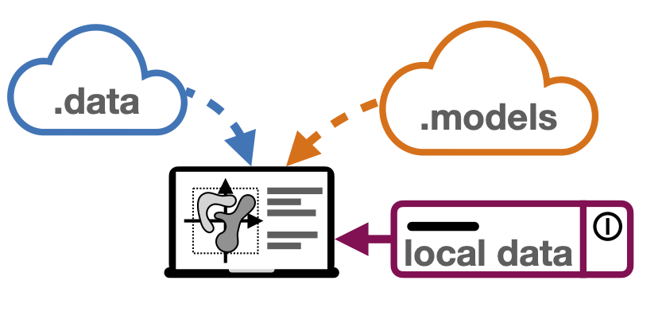


Milestones
: Differential gene expression and eQTL
: Extending model for CRISPR screening
: Planned model extensions
(A) Arrayed CRISPR screen
(B) Cellxgene Portal Visualization
for single reference dataset
(E) Business Logic
(D) sfaira: data and model repository for single-cell data
(F) Redis Server
(C) Human Cell Atlas

Slide 6
Technology Flow
1. Data Integration:
- sfaira
- Collection level data (cellxgene)
- Atlas level data (HCA)
2. Data Processor:
- scPower
- Extension of it with CRISPR methods
- Shiny web package
3. Store / Handle / Browse:
- Database credentials & queries
- Handler Services
- Web Server
- JWT authentication tokenization

Slide 7
Technology Stack
DI : Data Integration DP : Data Processing SHB : Store / Handle / Browse
sfaira : Python
cellxgene : Go, Javascript
HCA : Go
scPower & CRISPR extension : R
Database : PostgreSQL, PgAdmin, TablePlus
Services : Go, Postman
Authentication (middleware) : Redis
Web server : Vue.js
DI
DP
SHB

Slide 8
Data
Marker | Tissue(s) | Disease | Assay(s) | Organism | Number of Cells
1 | muscle tissue muscle of abdomen muscle of pelvic diaphragm | normal | 10x3’v3 | Homo sapiens | 14.507
2 | 17 | normal | 3 | Homo sapiens | 329.762
3 | Prostate gland Urethra | normal | 10x3’v2 10x3’v3 | Mus musculus | 1.647
A benchmark, first-draft human cell atlas of nearly 500,000 cells from 24 organs of 15 normal human subjects. This work is the product of the Tabula Sapiens Consortium.
By surveying the immune compartment of 16 tissues from 12 adult donors by single-cell RNA sequencing and VDJ sequencing generating a dataset of ~360,000 cells.
Used single-cell RNA sequencing to obtain a complete transcriptomic profile of all epithelial cells in the mouse prostate and urethra to objectively identify cellular subtypes.

Slide 9
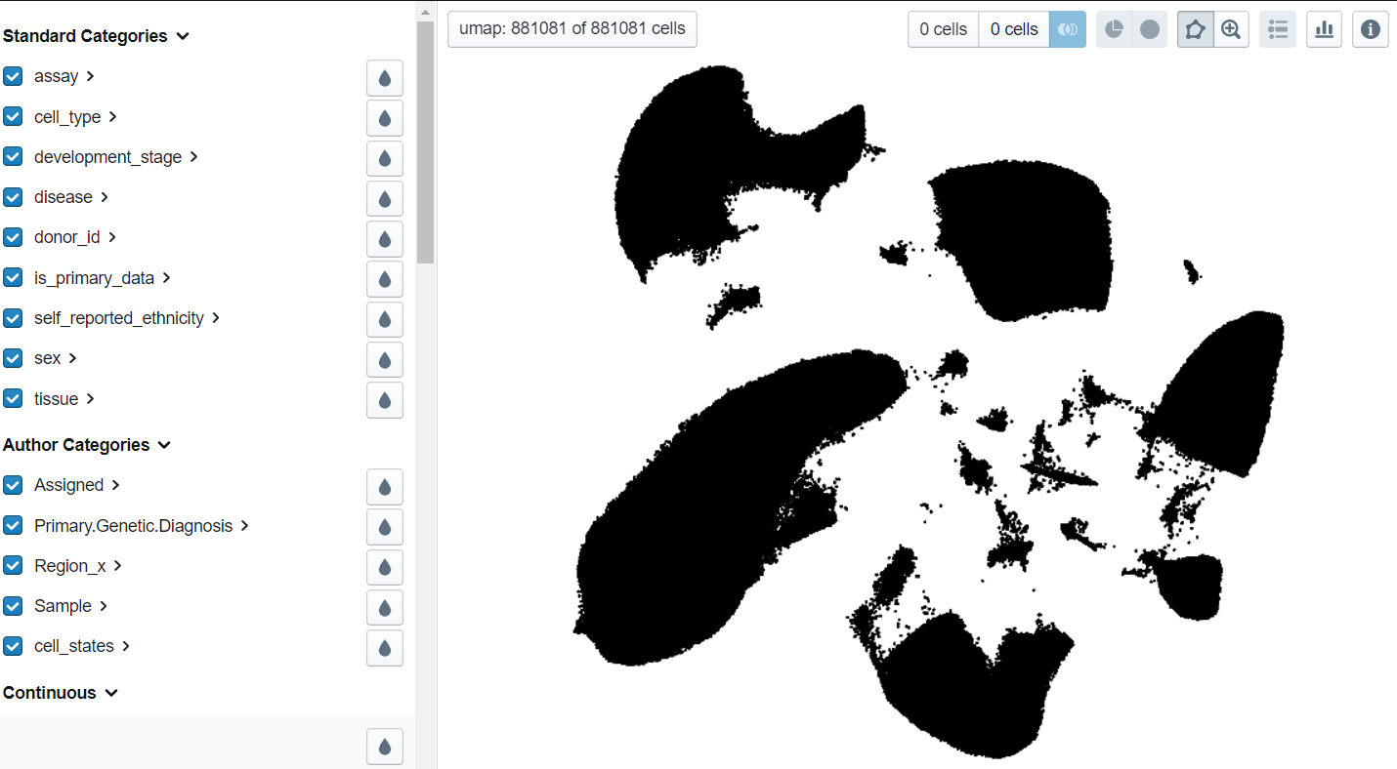
Data: Regularly adding more
Pathogenic variants damage cell composition and single cell transcription in cardiomyopathies; Reichart et al. (2022) Science

Slide 10
Current State and Lacking Parts
Automated pipeline for processing data and getting priors
Outputs: Dataset Body Specific Info (#cell, #assay, #tissue, #cell type) Result Table Specific Info (assay ID, tissue ID, cell type ID) Gamma Linear Fits Dispersion Function Estimation
A basic application is completed for the web server
Validation needs to be improved / extended with application of cellranger
Still requires tryout with different power parameter combinations; especially for debugging purposes of already established issues (warnings / errors)
Unit testing

Slide 11

Impact
Enabling researchers to design most powerful experiments
Helping scientific community to concentrate their resources well
Increase quality of proposals and the feasibility of the projects
(E) Business Logic

Slide 12
Thank you for listening

