Slide 1

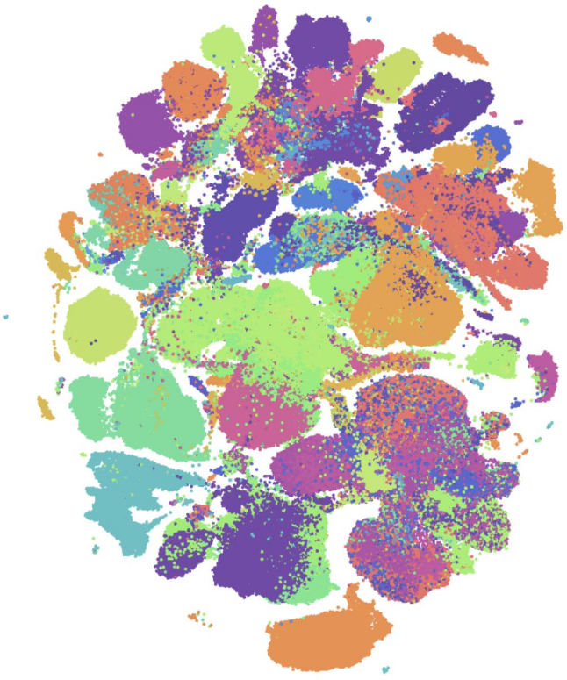
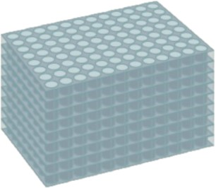




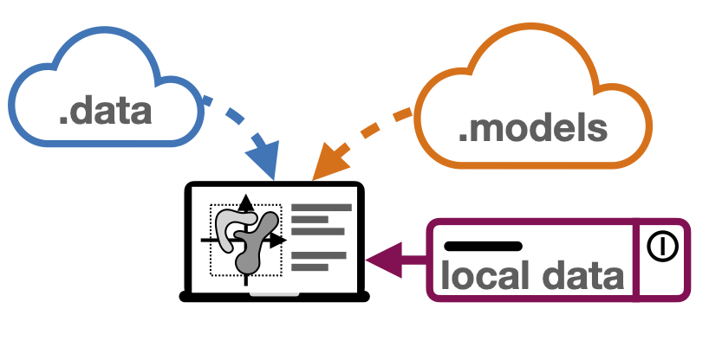

Enabling cell atlas guided optimal experimental design
Enabling researchers to design most powerful experiments
Helping scientific community to concentrate their resources well
Increase quality of proposals and the feasibility of the projects
(A) Arrayed CRISPR screen
(B) Cellxgene Portal Visualization
for single reference dataset
: Differential gene expression and eQTL
: Extending model for CRISPR screening
: Planned model extensions
(D) sfaira: data and model repository for single-cell data
(C) Human Cell Atlas
(E) Business Logic

