Slide 1

Discovering faster matrix multiplication algorithms with reinforcement learning
Journal Club, Cem Güleç
October 27, 2022

Slide 2
Outline
How a primitive task can affect large scale of things
Current approaches to the problem
Quick explanations about some terminologies
Search Problem
What is an agent?
Reinforcement Learning
Deep Reinforcement Learning
Tackling with the problem
Defining it as a search
Gamification of the problem
Methods
Vision About Future

Slide 3
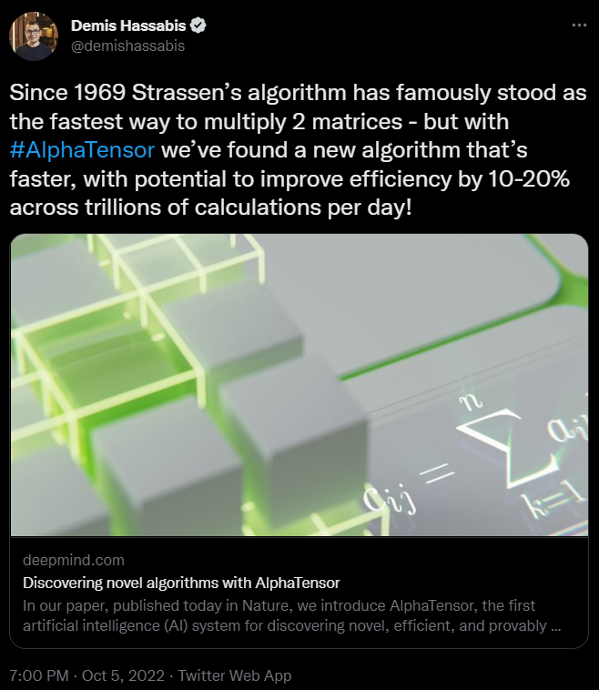

Slide 4
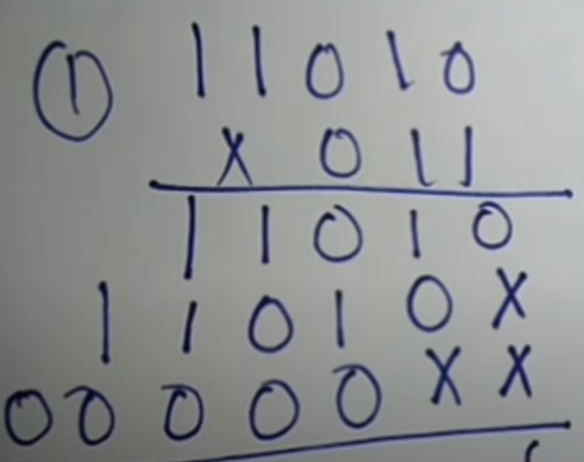
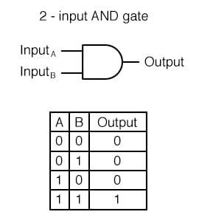
Multiplication as a primitive operation

Slide 5

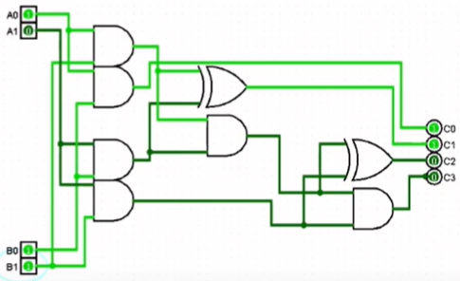
What does a computer understand from multiplication?

Slide 6
Fields that are directly related
Numerical linear algebra
Optimization
Knowing how to deal with large multipliers
Cryptography
Digital Signal Processing
Computer Graphics
Training Neural Networks

Slide 7
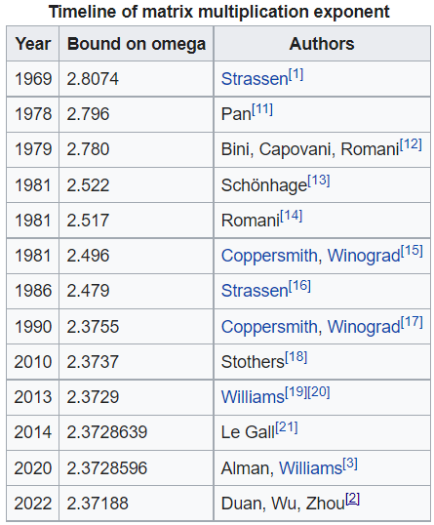
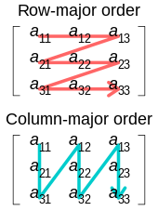
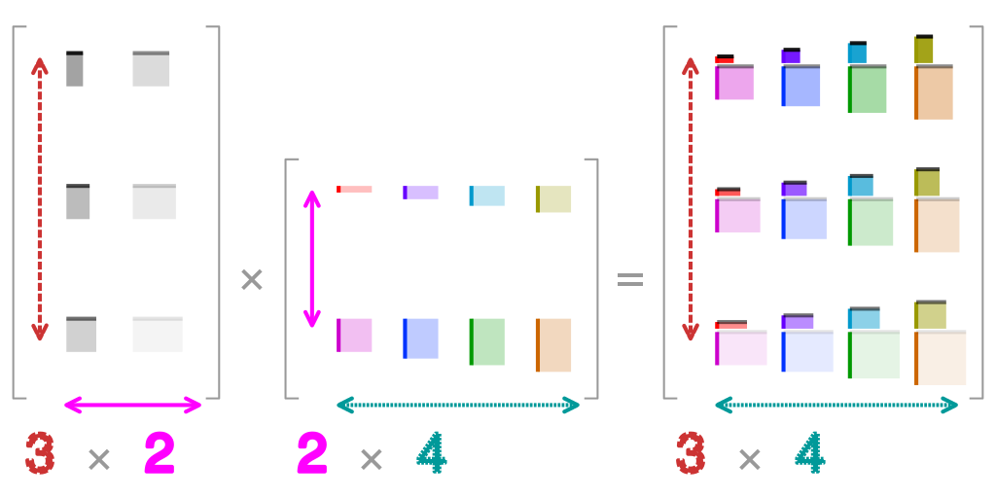
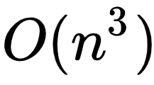
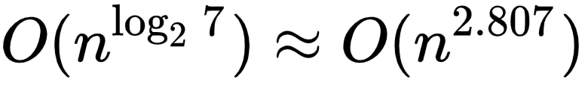
Current approaches to the problem
* Iterative approach * Divide and Conquer approach
Strassen Algorithm

Slide 8
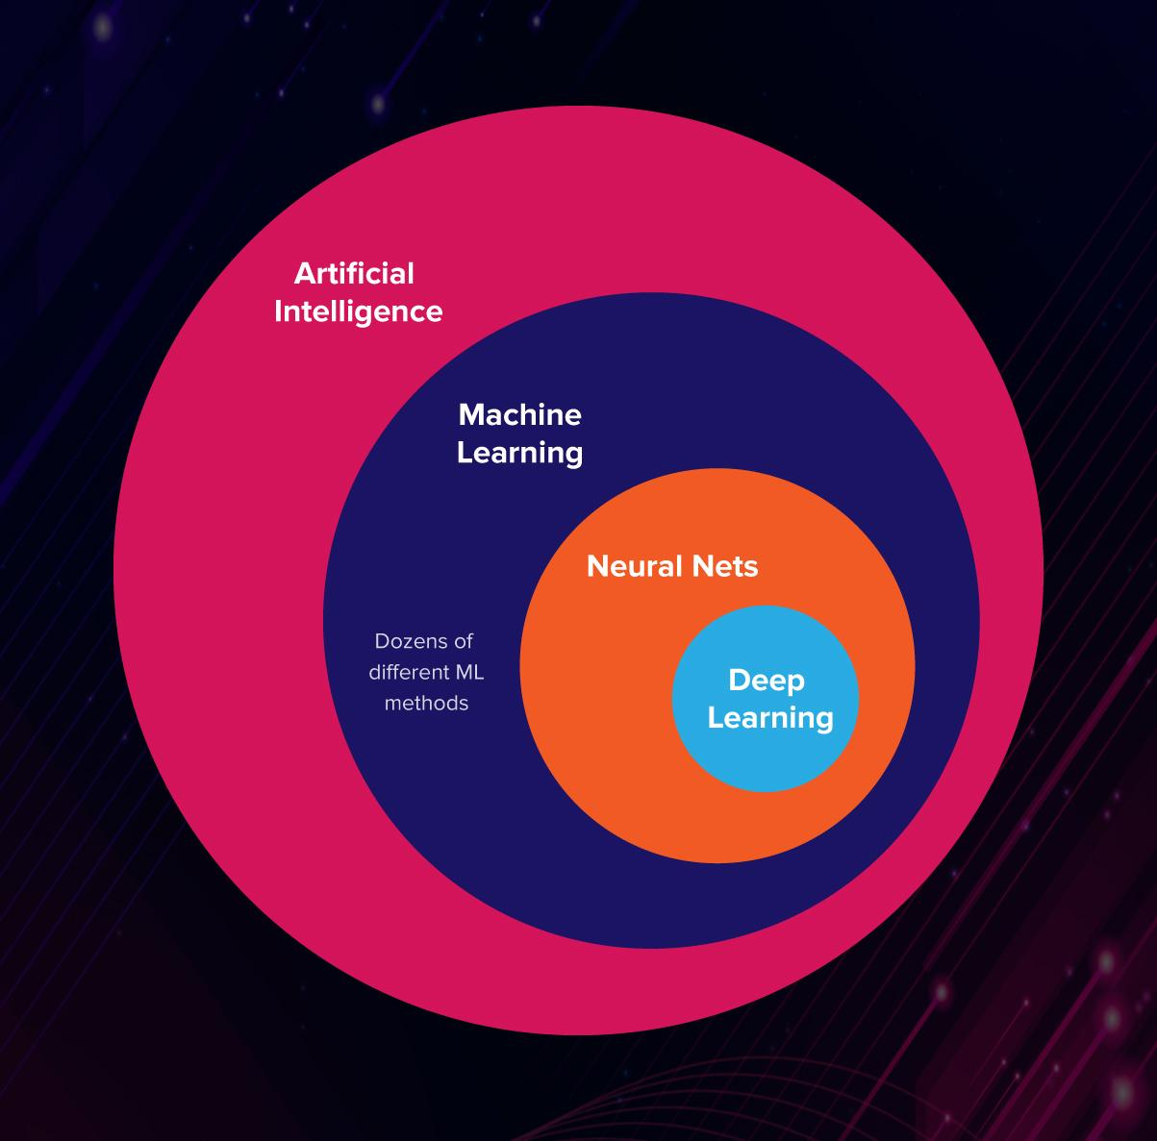
Search Problem
Knowing how to define a search problem and of course, investigating whether a given problem fits the restrictions that will be described later, we can convert any problem type to a search problem.
State
Actions
Transitions
Goal Test
Path Cost

Slide 9
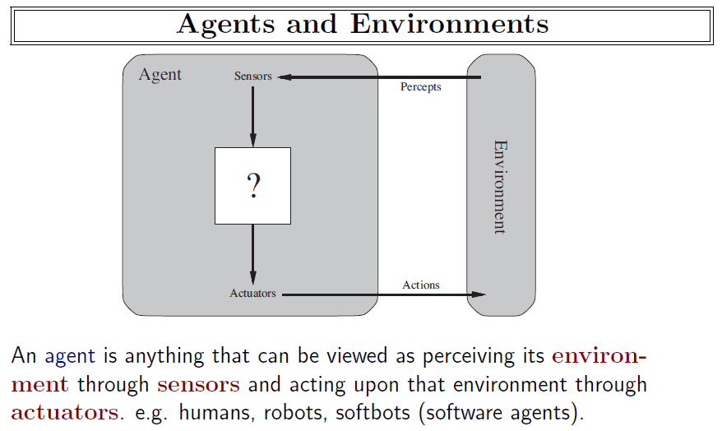

Slide 10
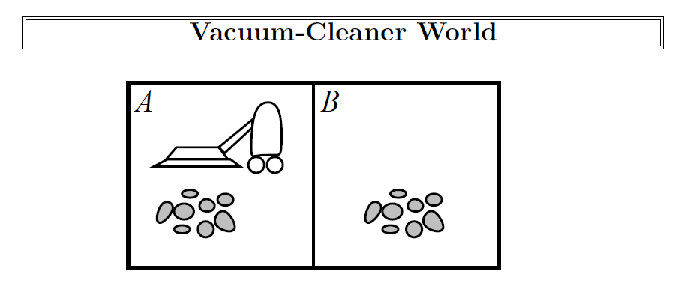
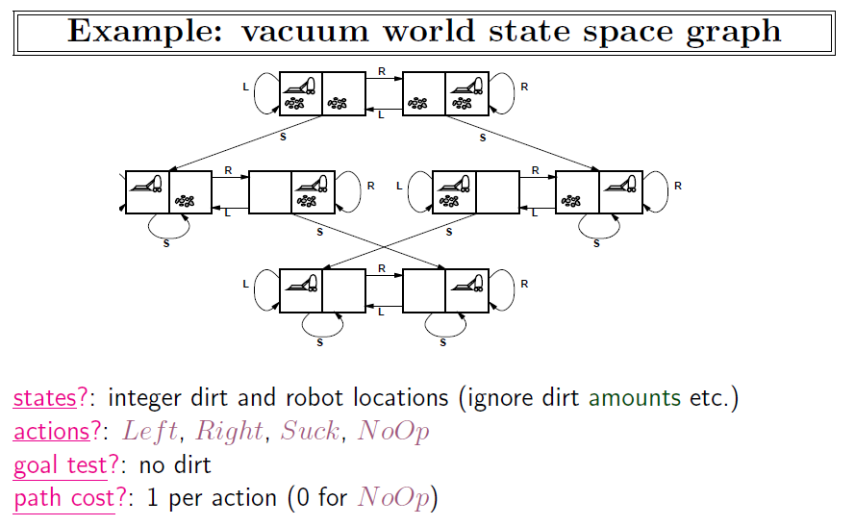

Slide 11
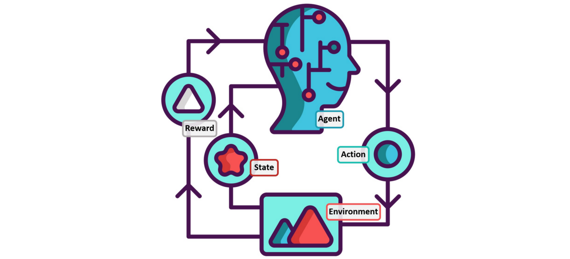
Reinforcement Learning

Slide 12
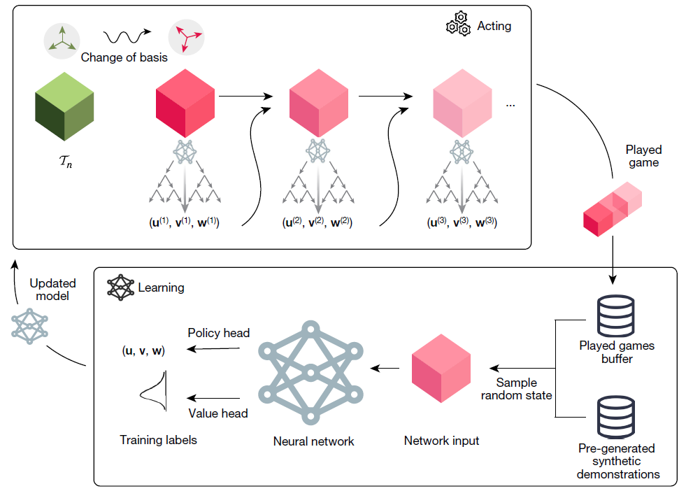
Combining parts together
State: Defined board situation
Action: Multiplication step
Goal Test: Reaching zero tensor
Cost: -1 for each step taken

Slide 13
Deep Reinforcement Learning
Board state
Training Neural Network via self play
Connection between MCTS (unvisited node) and Neural Network
Making move

Slide 14
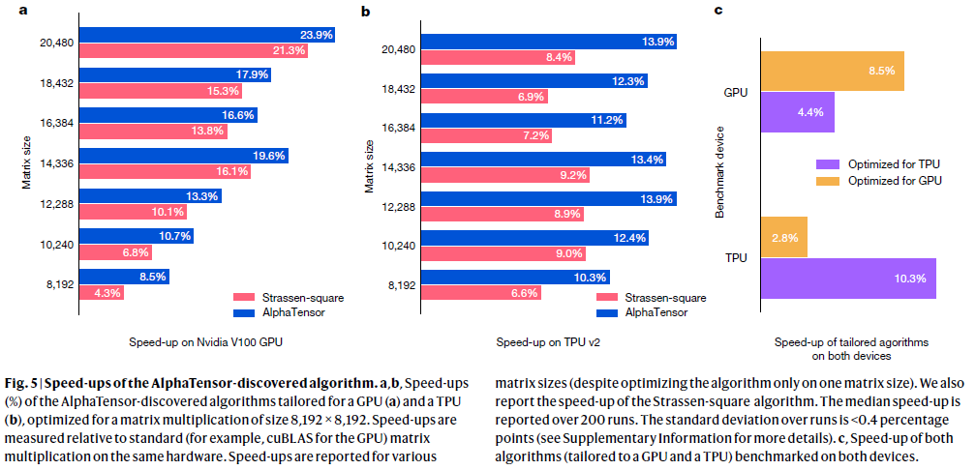
Results

Slide 15
Thank you for listening

