Slide 1



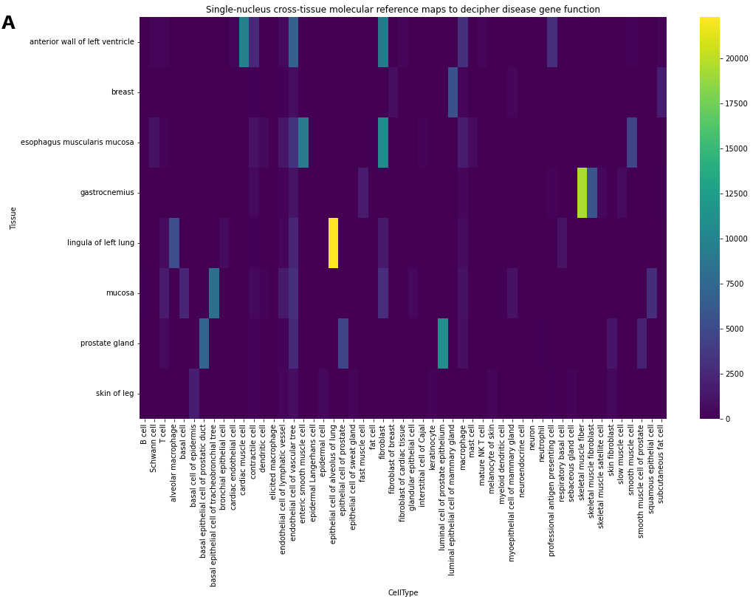
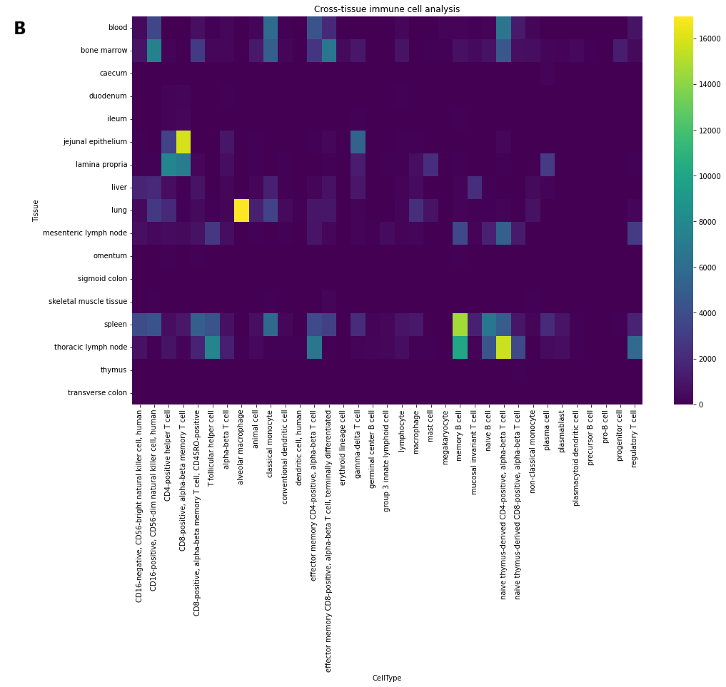


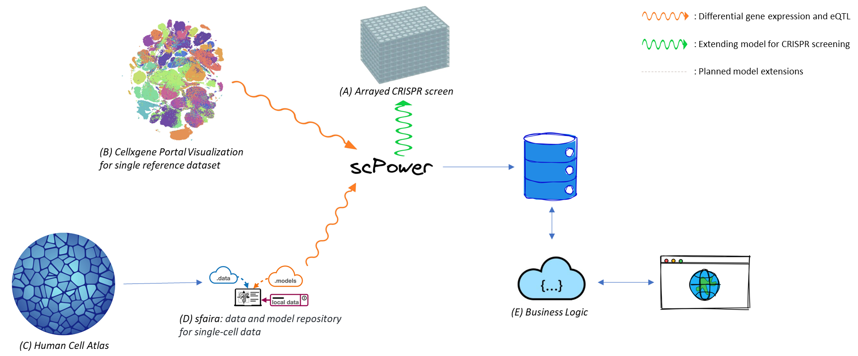
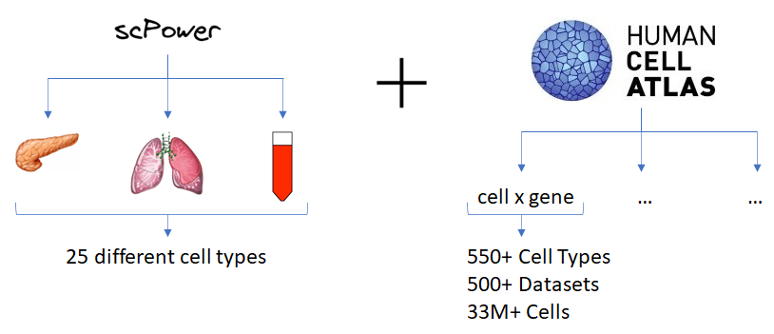
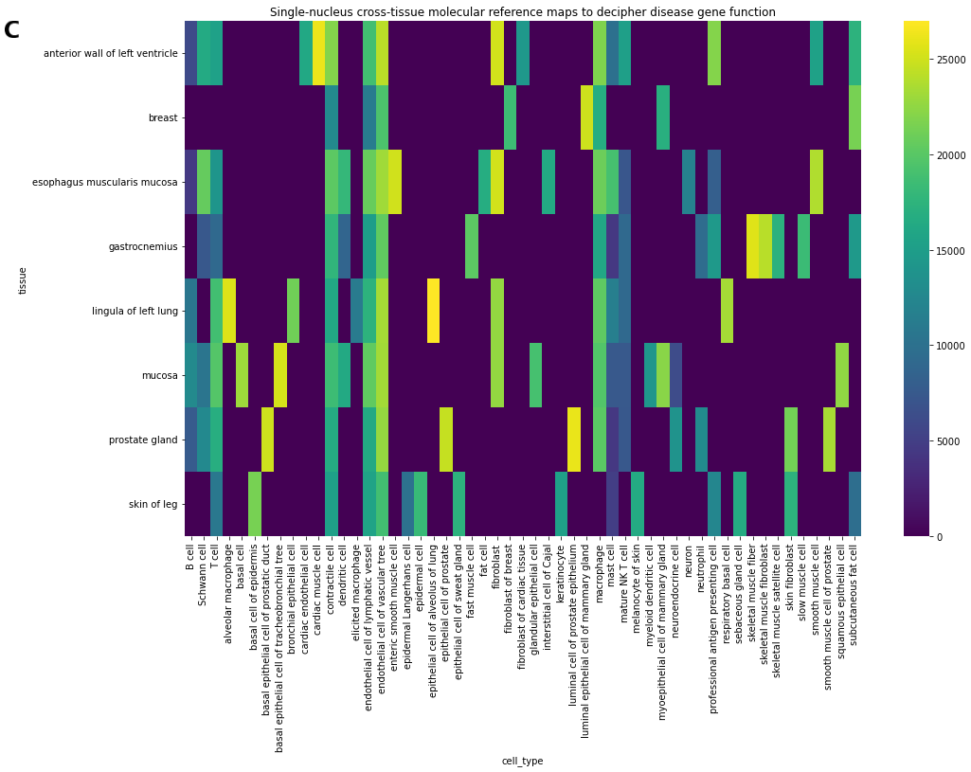
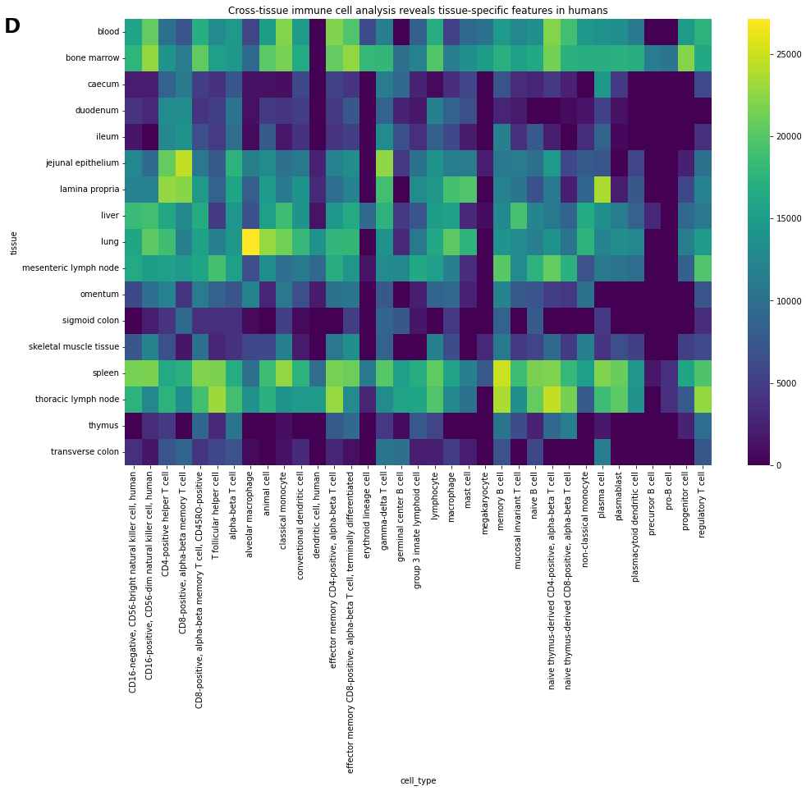
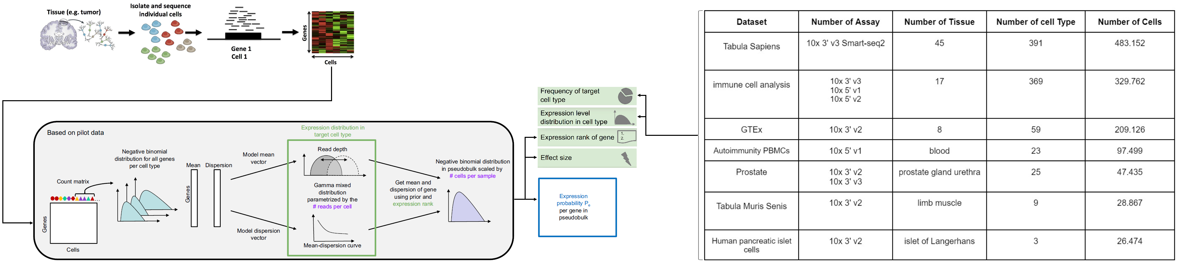
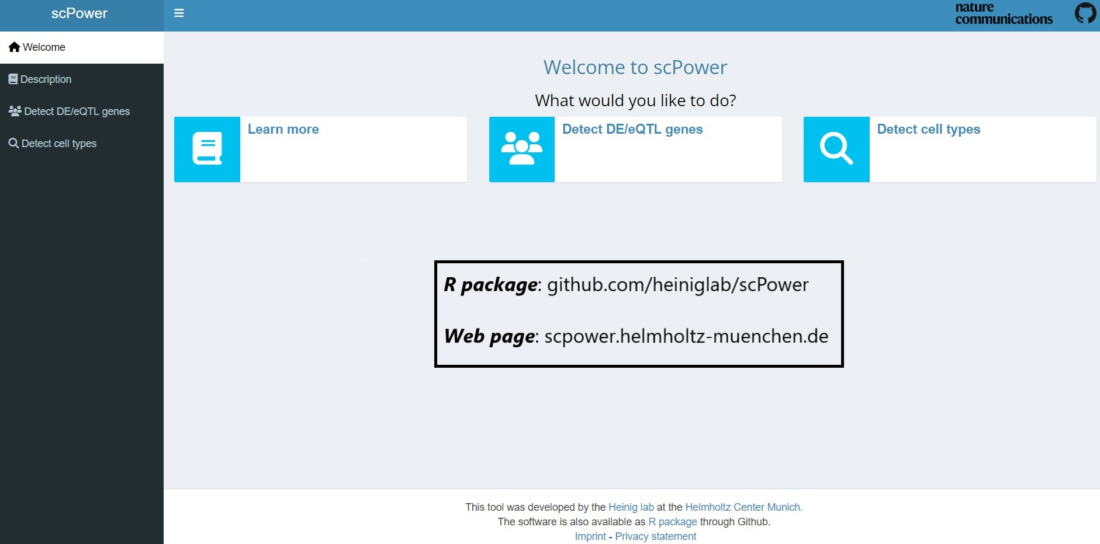
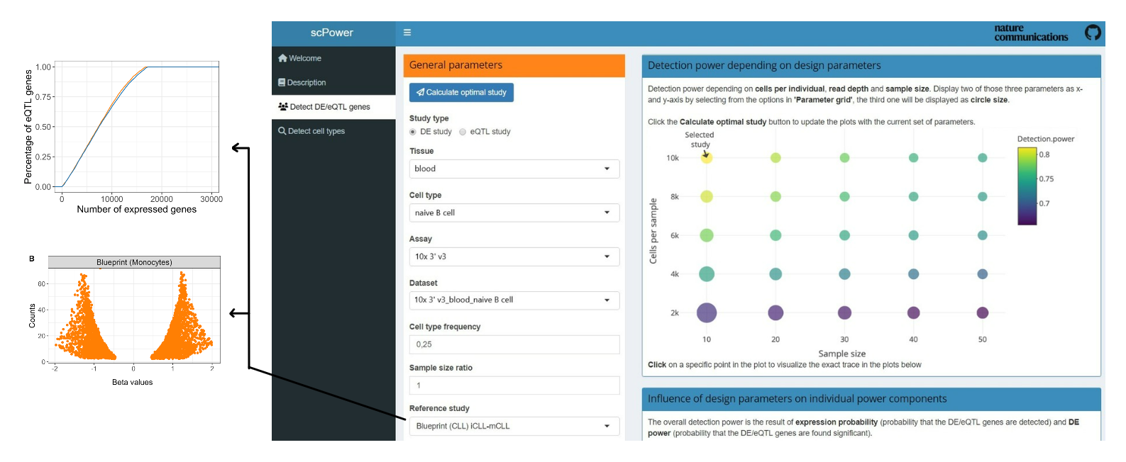
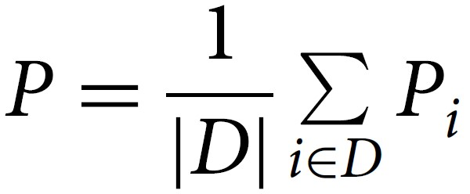
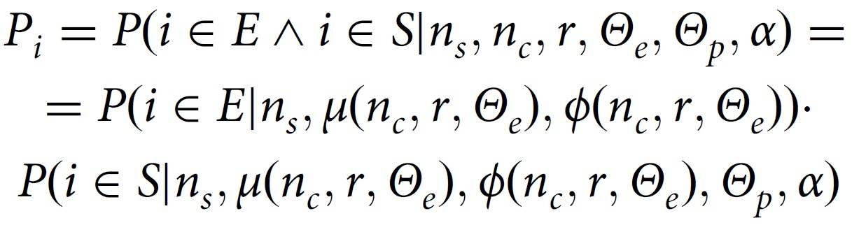
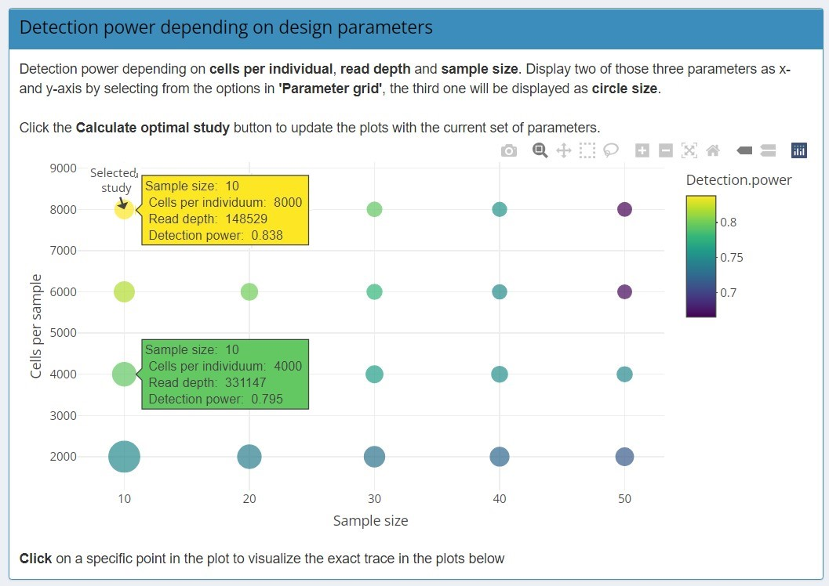
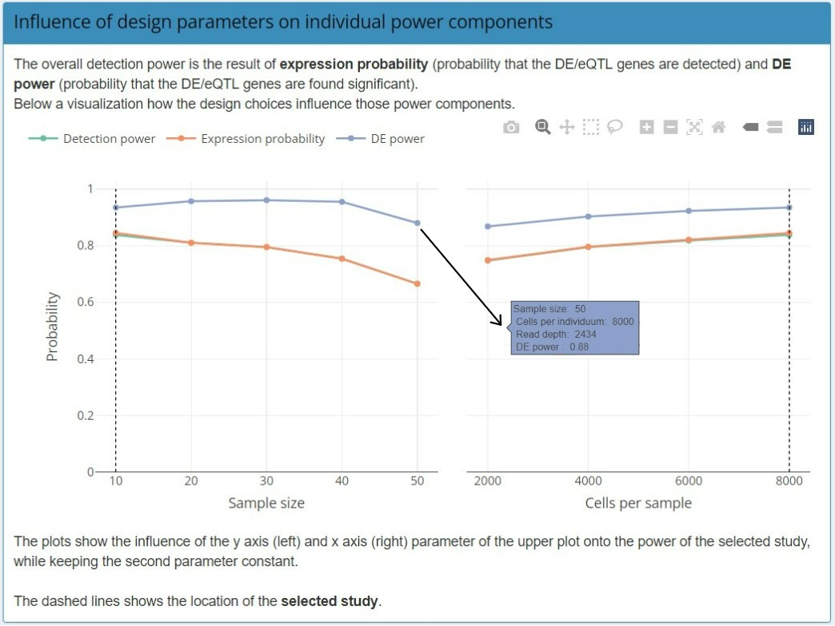
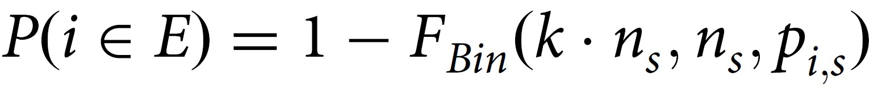
Enabling cell atlas guided optimal experimental design
Cem Güleç¹, Matthias Heinig^{1, 2, 3}
¹ Institute of Computational Biology (ICB), Helmholtz Center Munich, German Research Center for Environmental Health, Munich-Neuherberg, Germany
² Department of Computer Science, TUM School of Computation, Information and Technology, Technical University of Munich, Garching, Germany
³ German Centre for Cardiovascular Research (DZHK), Munich Heart Association, Partner Site Munich, Berlin, Germany
Instant access to our repository.
Let's collaborate - reach out anytime!
✉ cem.ggulecc@gmail.com
✉ matthias.heinig@googlemail.com
We have previously developed scPower - a statistical framework that allows user to optimize the power of their experimental design of multi-sample single cell transcriptomics with a user friendly interface.However it requires cell type specific prior information. Previously this information was available only for selected cell types and tissues. Now with the increasing availability of reference cell atlases available, we can scale our framework to allow experimental design an all known cells of an organism. We systematically apply scPower wrapped into a data processing and data management infrastructure to obtain the required prior information on cell type specific gene expression distributions. Based on these systematic priors, a unified experimental design online resource will be established. It will enable researchers to design the most powerful experiments for the identification of differential expression or eQTL in their respective application areas. In future work, this model will further be extended to allow for the optimal design of allele specific expression and perturbation experiments such as CROP-seq and Perturb-seq.
Panel A: Heatmap of cell counts across tissue and cell type representation, derived from the single-nucleus cross-tissue molecular reference maps in Eraslan et al.'s study (2022). Data were accessed via the cellxgene portal (which was generated by gtexportal.org) and illustrate cellular heterogeneity in the context of deciphering disease gene function.
Panel B: Heatmap depicting the distribution of cell counts across various tissues and cell types, as derived from the cross-tissue immune cell analysis conducted by Domínguez Conde et al. (2022) in Science. Data were sourced from the cellxgene portal, highlighting the cellular heterogeneity present in human tissues and its implications for understanding disease gene function.
Panel C: Heatmap of gene expression levels across tissue and cell type representation, derived from the single-nucleus cross-tissue molecular reference maps in Eraslan et al.'s study (2022). Data were accessed via the cellxgene portal (gtexportal.org) and showcase the diversity in gene expression patterns associated with different cell types and tissues, providing insights into disease gene function.
Panel D: Heatmap illustrating the variation in gene expression levels among different tissues and cell types, originating from Domínguez Conde et al.'s cross-tissue immune cell analysis, which reveals tissue-specific features in humans (2022) Science. Data were obtained through the cellxgene portal, emphasizing the diverse gene expression profiles linked to various cell types and tissues, and their implications for understanding disease gene function.
Figure 2: scPower provides data-driven priors for 25 different cell types across three tissues and three technologies as a pilot work. These priors are derived from single cell atlases and ensure accurate power estimation by quantifying the probability of detecting cell type-specific gene expression in scRNA-seq data. In addition to these pilot priors, scPower plans to further extend its dataset with the wealth of organism-wide data from the Human Cell Atlas project. This will enable researchers to optimize their experimental design and improve the accuracy of their power analysis in a wide range of organ systems.
Figure 1: Software and data management infrastructure around our modeling framework for indexing and querying model parameters for different cell types. It takes data from HCA and other individual projects and able to store the priors detected from it.
Figure 3: The overall detection power is defined as the mean gene level detection power P_{i} conditional on gene specific priors of gene i.
Figure 4: Conditioning the gene level detection power P_{i} on these priors and experimental design parameters, allows for decomposing P_{i} as the product of the expression probability and the DE/eQTL power.
Figure 5: To define a gene as expressed, we require that it can be found in a certain fraction of more than k percent in all n_{s} individuals. The expression probability of a gene i is obtained from a cumulative binomial distribution F_{Bin} as follows.
Figure 6: The probability that the sum of counts y is greater than n is

