Slide 1


Process-Focused Report
Autonomous Parallel Parking Using Soft Actor-Critic (SAC) Algorithm
An Iterative Approach to Reward Engineering & Problem Solving
Presenters
Cem Irer & Idil Balandı
Deep Reinforcement Learning Project
Spring 2026

Slide 2
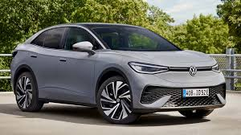








VW ID.4 Model
Problem Definition
Real-World Challenge & Vehicle Specifications
Vehicle Specs
The Urban Parking Challenge
Length
4.77 m
Autonomous parallel parking requires precise control in constrained urban environments. The vehicle must maneuver into a tight slot with minimal error, requiring multi-phase planning:
Width
2.04 m
Wheelbase
3.00 m
Approach phase with velocity control
Orientation alignment (Heading control)
Steering Limit
±35°
Final positioning (Lateral control)
Environment Specs
Constraints
Parking Slot Length
6.00 m Tight
Why Reinforcement Learning?
Parking Slot Width
2.50 m Tight
Handling Complexity
Longitudinal Margin
1.23 m (Total)
Learns complex non-linear dynamics difficult to model with PID
Lateral Margin
0.46 m (Total)
Generalization
Adapts to varied starting positions better than rule-based systems

Slide 3








Mathematical Formulation
Markov Decision Process (MDP)
13D State Space (s)
Bicycle Kinematic Model
s = [ x, y, θ, v, # Ego State (4D)
ẋ = v cos(θ)
Δx, Δy, Δθ, # Target Relative (3D)
X-Velocity
xmin, xmax, ymin, ymax, # Boundaries (4D)
Y-Velocity
ẏ = v sin(θ)
dobs1, dobs2 ] # Obstacles (2D)
Angular Vel
θ̇ = (v / L) tan(δ)
All inputs are normalized to [-1, 1] for neural network stability.
Acceleration
v̇ = a
2D Action Space (a)
Wheelbase (L): 3.0m
dt: 0.05s (50Hz)
Termination Conditions
a = [ δ, acc ]
Success
4 vehicle corners inside parking slot boundaries
Steering (δ)
Acceleration (acc)
Collision
Vehicle body intersects with obstacle or boundary
[-1, +1] → [-35°, +35°]
[-1, +1] → [-0.5, +0.5] m/s²
Timeout
Episode length > 500 steps (25 seconds)
Autonomous Parallel Parking Project
Mathematical Formulation • Slide 3

Slide 4
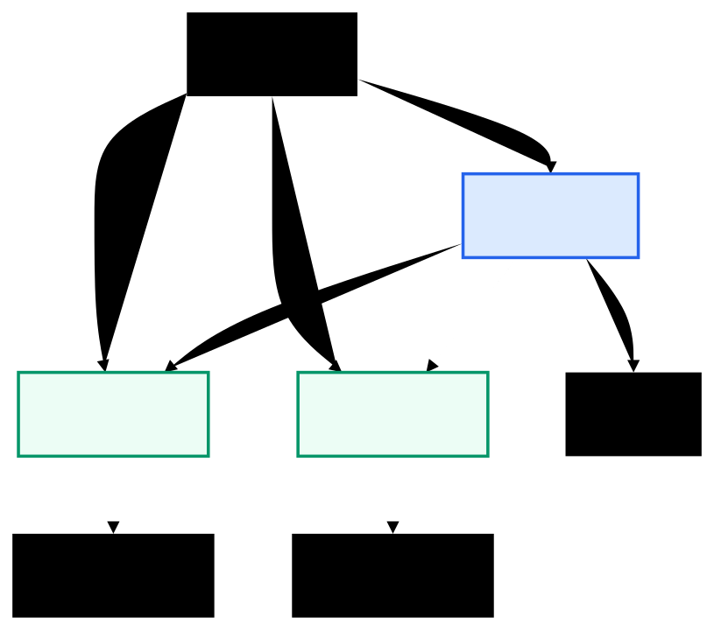




Why Soft Actor-Critic (SAC)?
Core Advantages for Parking Task
Architecture
Off-Policy Efficiency
State s
Reuses past experiences from a replay buffer, crucial for sample-efficient learning within limited compute budget.
Actor π
Maximum Entropy
a
Action a
a
Encourages exploration by maximizing entropy alongside reward. Prevents premature convergence to local optima.
Critic Q1
Critic Q2
Env
Continuous Control
Directly outputs smooth steering/acceleration values without discretization artifacts, essential for precise maneuvering.
Q Value 1
Q Value 2
Stability
Uses twin Q-networks (clipped double Q-learning) to reduce value overestimation bias.
4

Slide 5

Hyperparameters & First Steps of Environment
Hyperparameters
Learning Rate | 3e-4 (Adam)
Replay Buffer | 100,000 transitions
Batch Size | 256
Network Structure | MLP [256, 256] (ReLU)
Discount (γ) | 0.99
Total Timesteps | 300,000
Y
Obstacle 1
TARGET SLOT
6.0m x 2.5m
Obstacle 2
VW ID.4
15.0m
Parking Zone
X
Slot Size: 6.0m × 2.5mv
30.0m (Road Length)
Margin: Tight (0.6m fwd/back)
Config: Parallel (Street-side)
4

Slide 6












Environment Implementation
Gymnasium Architecture
Constraints & Safety
Custom Environment: Built on Gymnasium interface inheriting from gym.Env
Safety Barriers: Exponential penalty near boundaries
Observation Space: 13D continuous vector normalized to [-1, 1]
Collision Check: Oriented bounding box intersection (SAT)
Ego state, Relative target, Boundaries, Obstacles
Action Space: 2D continuous control
Speed Limits: Global max 1.0 m/s, parking zone max 0.5 m/s
Steering [-35°, +35°], Acceleration [-0.5, +0.5] m/s²
Reward System Design
Stage 0
Approach (>5.5m)
Stage 1
Y-Correction (3.0m - 5.5m)
Episode Settings
Stage 2
Entry & Alignment (<3.0m)
Time Step
Max Length
dt = 0.05s (20Hz)
500 steps (25s)
Initialization
Randomized spawn near parking zone
Position +/- 2m, Angle +/- 15°
Gymnasium Custom Env • Bicycle Kinematics • Staged Rewards
Slide 5

Slide 7










Initial Approach: Complex Reward System
Iteration 1 (0 - 50k Steps)
FAILED ATTEMPT
The Over-Engineered Reward Function
Rtotal = r_progress + r_safety + r_smoothness + r_effort + r_time
+ r_anti_stagnation + r_anti_oscillation + r_y_direction
+ TERMINAL_REWARDS
12+ components with separate weights attempting to control every aspect of motion
Problems Encountered
Attempt 1
Over-Parameterized: 20+ hyperparameters made tuning impossible (curse of dimensionality)
Hard to Debug: Couldn't identify which component was causing bad behavior
Unpredictable Behavior: Components canceled each other out (e.g., smoothness vs. progress)
OUTCOME: Agent stuck at 5-6m distance
Failed to approach parking area. Policy collapsed to "do nothing" to avoid penalties.
06

Slide 8









Iteration 2: Simplification & Progress
50k - 150k Steps
PARTIAL SUCCESS
What Worked
New Discovery
Simplified Reward Structure
The "False Attractor" Problem
Reduced 12+ components to 6 core terms to isolate behaviors:
Stalled Progress: Agent gets stuck at 1.8 - 2.0m distance
Deceptive Metrics: Perfect angle (~2°) but absolute failure to enter slot
R = -d - |Δθ| - y_dist
+ Δd + Δθ + terminal
Entry Failure: 0/4 corners inside parking slot
Observable Improvements
Agent successfully learned to approach the parking area
Key Insight
Reliable distance reduction from start (25m → 2m)
The agent found a local maximum: "Standing still with good angle is safer than trying to park."
Collision rate dropped significantly
07

Slide 9







Root Cause Analysis
The "False Attractor" Problem (215k Steps)
Situation at 215k Steps
Identified Root Causes
Agent State Breakdown
Fixed Bonuses Exploitation
No Standing Penalty
Current Position
(18.11, 6.70)
Reward `+30` given for ANY approach. Agent learned to make microscopic movements to farm rewards without risking entry.
Lack of penalty for zero velocity allowed the agent to "park" outside the slot indefinitely once angle was minimized.
Target Position
(17.50, 8.50)
Y-Axis Error
1.60m (Critical!)
Heading Error
~2.0° (Excellent)
Speed
~0.05 m/s (Stuck)
Weight Imbalance
Absolute State Reward
Angle penalty (50.0) dwarfed Y-penalty (5.0). Agent optimized the easier objective (heading) and ignored the harder one (position).
Rewarded `total_corners_inside` instead of `new_corners`. Standing with 0 corners was safer than risking collision to get 1.
TOP-DOWN VIEW RECONSTRUCTION
TARGET SLOT
AGENT
Key Insight: The agent found a local maximum where Risk(Entry) > Reward(Status Quo). We needed to invert this equation.
Risk(Entry) > Reward(Status Quo)
Agent aligns angle perfectly but fails to enter slot due to Y-axis gap
08

Slide 10




Solution: Staged Reward System
SOLVED FALSE ATTRACTOR
Matching Reward Complexity to Task Phase
Stage 0: APPROACH
> 5.5m
Stage 1: Y-DIRECTION
5.5m - 3.0m
Stage 2: ENTRY
< 3.0m
Goal
Goal
Goal
Learn to move towards parking area without rushing
Align vertical position (Y-axis) with parking slot
Fix angle, enter slot, prevent false attractor
- 20.0 · |y - y_tgt|
- 0.3 · d
Light distance penalty
- 0.5 · d
Moderate distance penalty
+ 250 · Δd
Delta-Proportional Progress
- 2.0 · |y - y_tgt|
Y-Distance Penalty
- 50.0 · |Δθ|
Angle Penalty
- 2 (if stuck)
Minimal stall penalty
+ 600 · Δcorners
NEW Corners Only
+ 300 · Δy_up
Bonus for moving UP
- 80 (if standing)
Anti-Stagnation
- 400 · |Δy_down|
Penalty for moving DOWN
- 500 · retreat
No Retreat Allowed
Safe Exploration: Reward floored at -50, weak safety barriers
Vertical Focus: Strong incentives to correct Y-offset before arrival
Precision Mode: Full constraints, massive penalties for errors
Iteration 3: Staged Reward System Implementation
Slide 9

Slide 11





Additional Fixes & Curriculum
Refining Learning Stability
Deadlock Detection
Curriculum Learning Strategy
Prevents agent from exploiting "safe spots" without making progress.
if |Δd| < 0.01 for 40 steps:
terminate = True
reward -= 300
1
Early Episodes (0-50k)
Spawn very close to parking slot (1-2m). Gentle constraints allow easy exploration of the target area.
Stuck
Detect
Terminate & Penalize
2
Mid Training (50k-150k)
Spawn distance increases to medium range (3-5m). Introduction of stricter Y-axis penalties.
False Attractor Killer
Specifically targets the local minimum at 2m distance.
if speed < 0.05 and angle_err > 10°:
reward -= 80 (Standing)
reward -= 300 (Wrong Pose)
3
Final Stage (150k+)
Full hard difficulty spawn (6m+). Full constraints enabled. Simulates real-world parallel parking scenario.
Goal: Guide agent from simple tasks to complex maneuvers progressively.
Adaptive Difficulty • Anti-Stagnation Logic
Slide 10

Slide 12








Code Structure & Organization
parking_rl/
Modular Architecture
envs/
Separation of concerns between environment logic, agent implementation, and configuration management allows for easier debugging and extension.
parking_env.py
806 lines
# Core logic, Kinematics, Rewards
antagonist_wrapper.py
# Curriculum interface
Production Standards
agents/
Comprehensive Type Hints and Docstrings across all modules ensuring code readability and maintainability.
antagonist.py
# Progressive difficulty agent
configs/
config.py
# Dataclasses, Hyperparameters
Config-Driven
models/
# Saved checkpoints (.zip)
All hyperparameters centralized in config.py using Dataclasses. No hardcoded magic numbers in logic files.
train.py
# Training loop, Logging
demo.py
# Visualization & Inference
Modular Reward System
evaluate.py
# Metric calculation
Reward components implemented as separate private methods for granular testing and weight tuning.
Production-Grade Python Implementation
Slide 11

Slide 13











What We Learned - Key Insights
The development process revealed critical lessons in reward engineering and RL system design that go beyond simple parameter tuning.
1
Simplicity > Complexity
2
Reward Progress, Not State
3
Explicitly Prevent Local Minima
Our initial 12+ component reward function was impossible to debug. Reducing to core components per stage made behavior predictable and identifiable.
Fixed bonuses for "being in a good state" led to exploitation. Using delta-proportional rewards (rewarding change) incentivized continuous improvement.
The agent found a "false attractor" by standing still at a safe distance. We had to add explicit penalties for stagnation and lack of progress to force movement.
Design for debuggability
Always use deltas (Δ)
Anticipate false attractors
4
Priorities via Weights
5
Exploration Needs Safety
6
Design for Observability
The agent ignored Y-positioning because the penalty (5.0) was weak compared to angle (50.0). Boosting critical dimensions to 20.0 forced learning.
Early training failed when penalties were too harsh. Implementing reward floors and weaker constraints in early stages allowed necessary exploration.
We couldn't fix what we couldn't see. Adding detailed logging, stage tracking, and reward component breakdowns was crucial for the final breakthrough.
Weight reflects priority
Don't crush exploration
Log everything
Project Retrospective • Key Lessons
Slide 12

Slide 14










Challenges & Limitations
What Worked Well
What Didn't Work
Current Constraints
Limited Compute
~300k Steps
Staged Reward System: Breaking the task into Approach → Y-Align → Entry phases simplified learning.
Over-Complex Rewards: Initial 12+ component function was undebuggable chaos.
Single Seed
Single Scenario
Due to time constraints, we couldn't perform extensive hyperparameter sweeps or multi-seed robustness testing.
Delta Bonuses: Rewarding improvement (Δ) instead of state prevented exploitation.
Fixed Bonuses: Providing constant reward for "being close" created false attractors.
Deadlock Detection: Automatically terminating stuck episodes saved training time.
Weak Y-Penalty: Initial weight (5.0) was ignored in favor of angle optimization (50.0).
If We Started Over...
"We would implement the staged reward system from Day 1 and prioritize logging detailed reward component breakdowns immediately. We spent 50% of our time fighting a complex reward function that was fundamentally flawed."
Curriculum: Progressive spawn difficulty helped early stabilization.
Honest Assessment • Project Constraints
Slide 13

Slide 15









Technical Contributions
Key Innovations & Engineering
01
02
03
Three-Stage Reward Engineering
Delta-Proportional Shaping
False Attractor Prevention
Designed a novel progressive system matching reward complexity to task phases (Approach → Position → Entry) with reward floors for safe exploration.
Shifted from rewarding absolute states to rewarding improvement (Δ) across all objectives, completely eliminating static state exploitation.
Identified and solved local minima via explicit penalties for stagnation (standing still), retreat, and deadlock detection mechanisms.
04
05
Integrated Curriculum Strategy
Production-Grade Codebase
Implemented an adaptive spawning system that increases task difficulty (distance and angle constraints) linearly with training progress, stabilizing early learning.
Delivered a robust 806-line custom Environment with comprehensive type hinting, modular reward components, and configuration management for reproducibility.
Novel Approaches & Implementation Quality
Slide 14

Slide 16














Experimental Results - Process Focus
Phase 1: Exploration
Phase 3: Stagnation
0 - 50k Steps
Phase 2: Approach
150k - 215k Steps
Phase 4: Correction
Random actions
50k - 150k Steps
Good angle (~2°)
215k - 300k Steps
High collision rate
Consistent pathing
False attractor found
Staged rewards active
No directional sense
Safety improved
Y-axis ignored
Y-correction focus
1
Stalls at ~5m dist
Training ongoing...
2
3
Qualitative Progress Indicators
Collision Rate
Target Approach
Angle Control
Y-Positioning
High Low
Random Consistent
Erratic Precise (~2°)
Ignored Learning...
Training Progression Timeline
Slide 15

Slide 17






Future Roadmap
Planned Extensions & Research Directions
With the core staged reward system validated, future work will focus on robustness, generalization, and transferability to physical systems.
Hyperparameter Optimization
Curriculum Extensions
Algorithm Comparisons
Systematic grid search over Y-penalty weights [10-30] and stage transition thresholds to find the optimal trade-off between position accuracy and training speed.
Expanding the curriculum to include variable parking slot sizes (5.5m - 7.0m) and varied spawn orientations to improve policy generalization.
Benchmarking SAC against PPO (on-policy stability) and TD3 (deterministic control) to empirically validate the choice of algorithm for parking tasks.
Sim-to-Real Preparation
Multi-Task Learning
Next Step
Introducing domain randomization, sensor noise (Gaussian ±0.1m), and actuator delays to bridge the gap between idealized simulation and physical hardware.
Training a single unified policy capable of handling angle parking, perpendicular parking, and garage scenarios using context-aware observation spaces.
Deploying current policy to
Hardware-in-Loop (HIL) testbench
Research Extensions • 2024-2025
Slide 17

Slide 18








Conclusion
Implemented production-grade Autonomous Parallel Parking with SAC in custom Gym environment
Designed novel Staged Reward System to solve complex multi-phase maneuver task
Identified and fixed critical "False Attractor" local minimum using root cause analysis
Demonstrated systematic, iterative engineering approach over simple parameter tuning
"RL reward engineering is iterative. We failed, learned, and redesigned. The journey of debugging and fixing IS the learning process."
Core Learning Outcomes:
Reward Engineering is Critical
Simplicity Facilitates Debugging
Prevent Local Minima
Staged Approaches Match Intuition
Final Project Submission
Slide 18

